Slide 1
Database Management Systems SE 3309a
Lecture #8
Logical Database Design
for the Relational Model
Dr. Miriam Capretz
The University of Western Ontario
10/01/2014
Dr. Miriam Capretz SE3309a DBMS
‹#›
Notes:
‹#›

Slide 2
Build and Validate Logical Data Model
How to derive a set of relations (relational schema) from a conceptual data model
10/01/2014
Dr. Miriam Capretz SE3309a DBMS
‹#›
Notes:
‹#›

Slide 3
Build and Validate Logical Data Model
Derive relations for logical data model
To create relations for the logical data model to represent the entities, relationships, and attributes that have been identified.
10/01/2014
Dr. Miriam Capretz SE3309a DBMS
‹#›
Notes:
‹#›

Slide 4
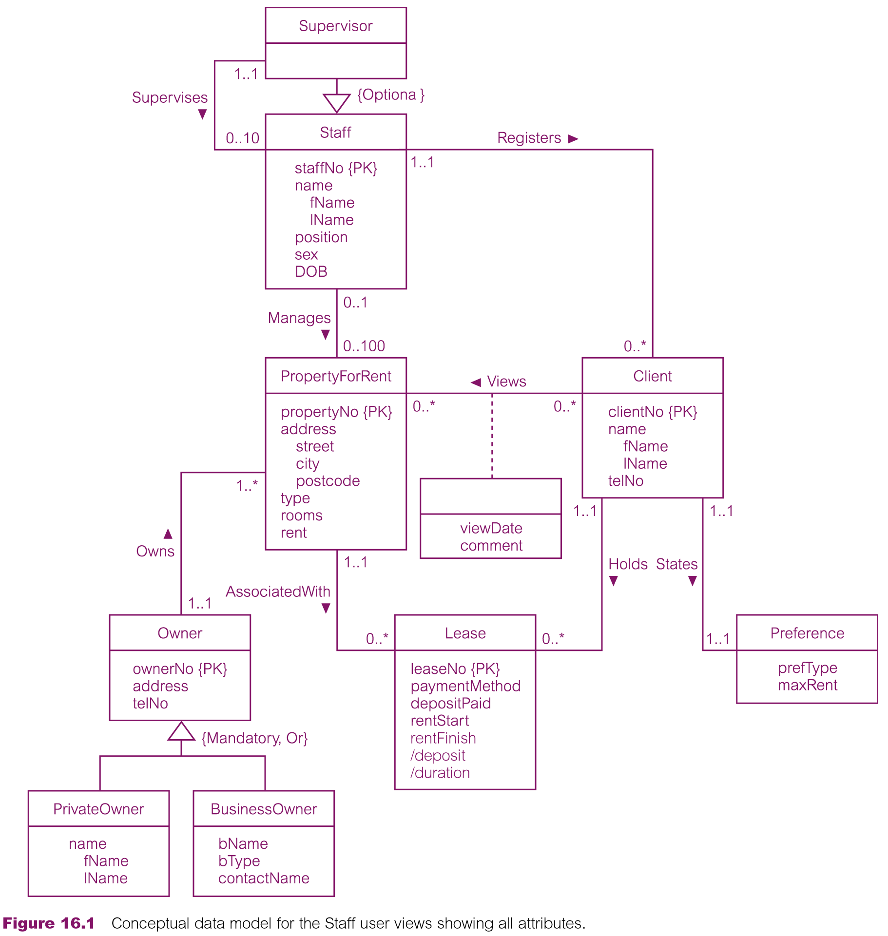
Conceptual Data Model for Staff View Showing all Attributes
10/01/2014
Dr. Miriam Capretz SE3309a DBMS
‹#›
Notes:
‹#›

Slide 5
Derive Relations for Logical Data Model
Strong entity types
Weak entity types
1:* binary relationship types
1:1 binary relationship types
1:1 recursive relationship types
Superclass/subclass relationship types
*:* binary relationship types
Complex relationship types
Multi-valued attributes
10/01/2014
Dr. Miriam Capretz SE3309a DBMS
‹#›
Notes:
‹#›

Slide 6
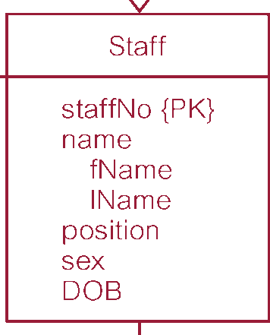
Derive Relations for Logical Data Model
(1) Strong entity types
Create a relation that includes all simple attributes of that entity. For composite attributes, include only constituent simple attributes.
10/01/2014
Dr. Miriam Capretz SE3309a DBMS
‹#›
Notes:
‹#›

Slide 7
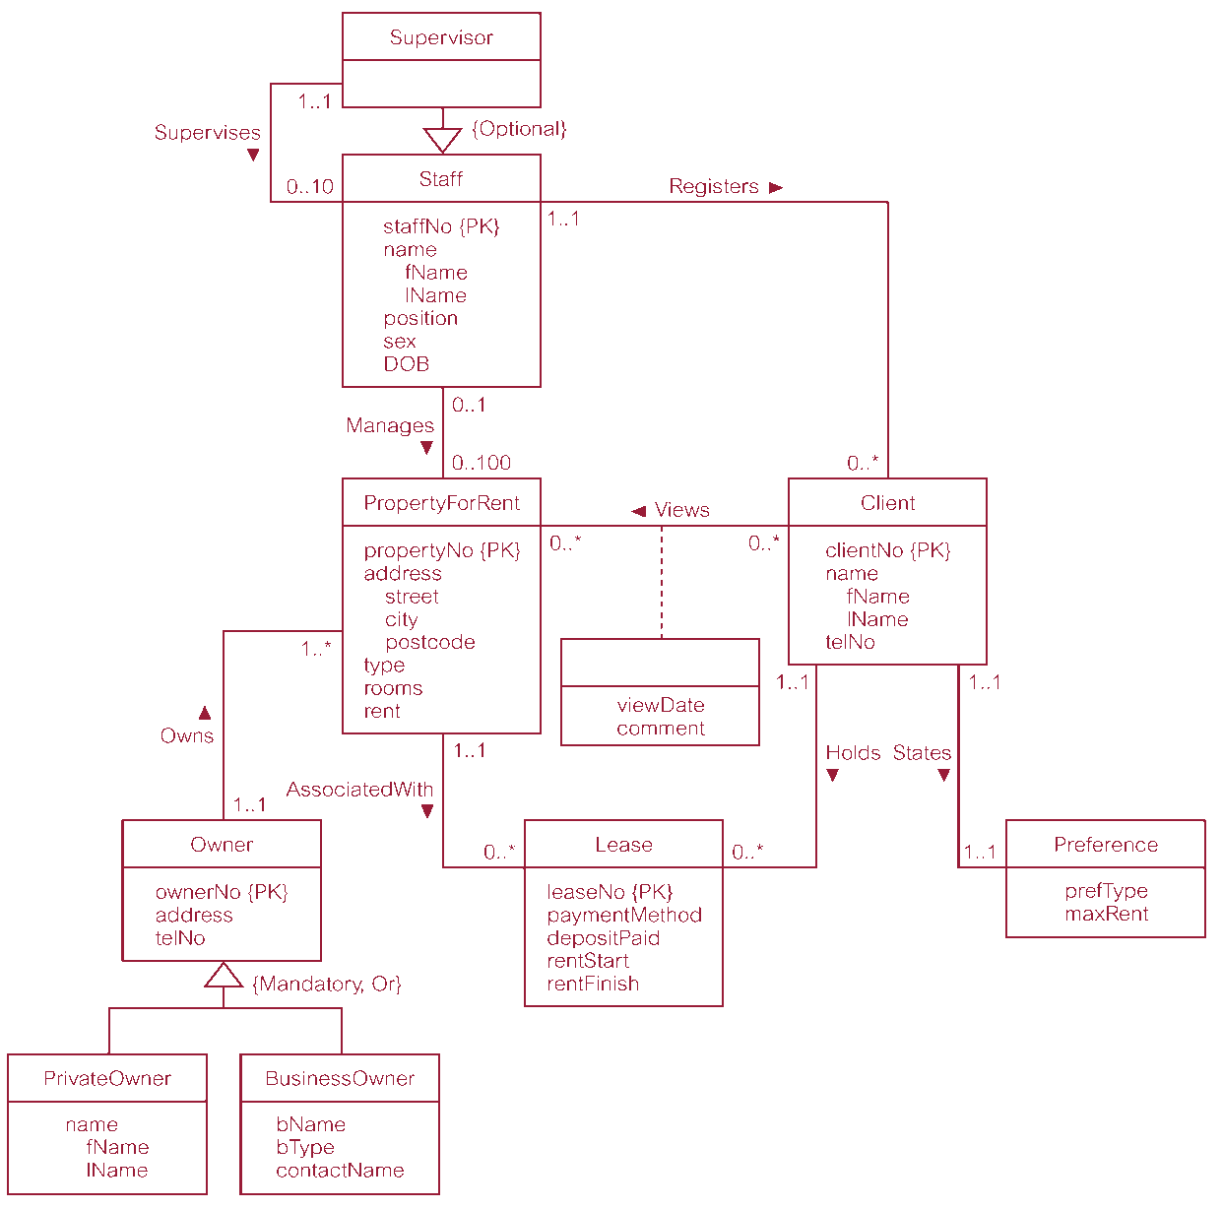
Derive Relations for Logical Data Model
(2) Weak entity types
Create a relation that includes all simple attributes of that entity.
Primary key is partially or fully derived from each owner entity.
10/01/2014
Dr. Miriam Capretz SE3309a DBMS
‹#›
Notes:
‹#›

Slide 8
Derive Relations for Logical Data Model
The relationship that an entity has with another entity is represented by the primary key/foreign key mechanism
Parent/child entities
10/01/2014
Dr. Miriam Capretz SE3309a DBMS
‹#›
Notes:
‹#›

Slide 9
Derive Relations for Logical Data Model
(3) 1:* binary relationship types
Entity on ‘one side’ is designated the parent entity and entity on ‘many side’ is the child entity.
Post copy of the primary key attribute(s) of parent entity into relation representing child entity, to act as a foreign key.
10/01/2014
Dr. Miriam Capretz SE3309a DBMS
‹#›
Notes:
‹#›

Slide 10
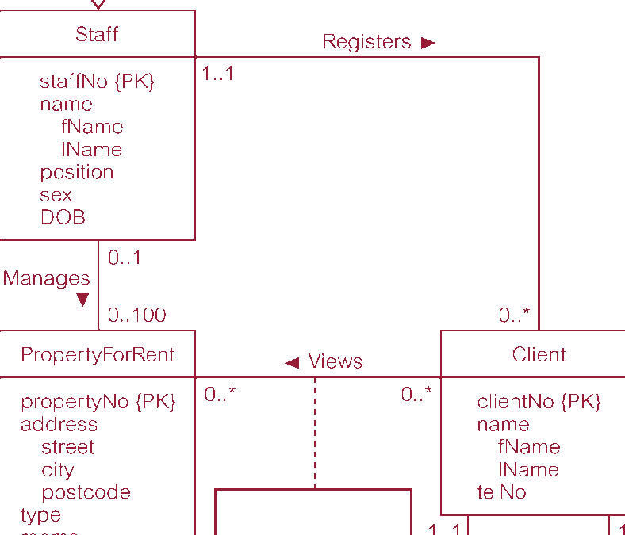
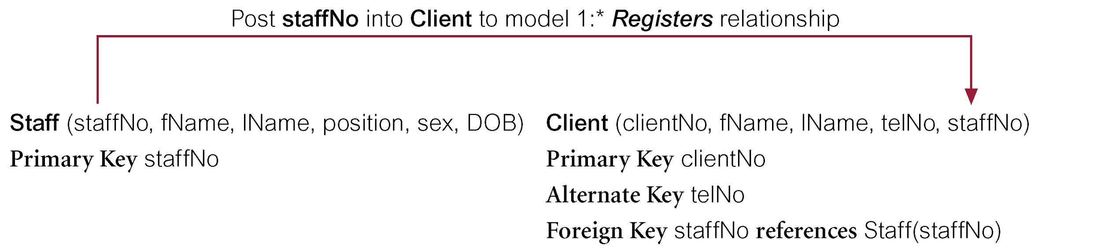
Derive Relations for Logical Data Model
10/01/2014
Dr. Miriam Capretz SE3309a DBMS
‹#›
Notes:
‹#›

Slide 11
Derive Relations for Logical Data Model
(4) 1:1 binary relationship types
More complex as cardinality cannot be used to identify parent and child entities in a relationship.
Instead, participation is used to decide whether to combine entities into one relation or to create two relations and post a copy of the primary key from one relation to the other.
10/01/2014
Dr. Miriam Capretz SE3309a DBMS
‹#›
Notes:
‹#›

Slide 12
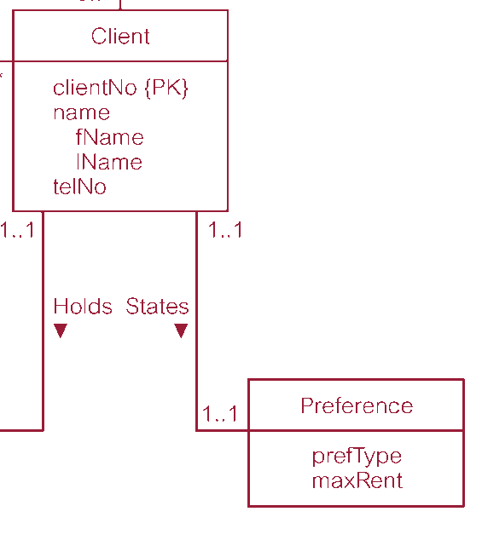
Derive Relations for Logical Data Model
(4) 1:1 binary relationship types
(a) mandatory participation on both sides of 1:1 relationship;
(b) mandatory participation on one side of 1:1 relationship;
(c) optional participation on both sides of 1:1 relationship.
10/01/2014
Dr. Miriam Capretz SE3309a DBMS
‹#›
Notes:
‹#›

Slide 13
Derive Relations for Logical Data Model
(a) Mandatory participation on both sides of 1:1 relationship
Combine entities involved into one relation and choose one of the primary keys of original entities to be primary key of new relation, while other (if one exists) is used as an alternate key.
10/01/2014
Dr. Miriam Capretz SE3309a DBMS
‹#›
Notes:
‹#›

Slide 14
Derive Relations for Logical Data Model
(b) Mandatory participation on one side of a 1:1 relationship
Identify parent and child entities using participation constraints.
Entity with optional participation is designated parent entity, and other entity designated child entity.
Copy of primary key of parent placed in relation representing child entity.
If relationship has one or more attributes, these attributes should follow the posting of the primary key to the child relation.
10/01/2014
Dr. Miriam Capretz SE3309a DBMS
‹#›
Notes:
‹#›

Slide 15
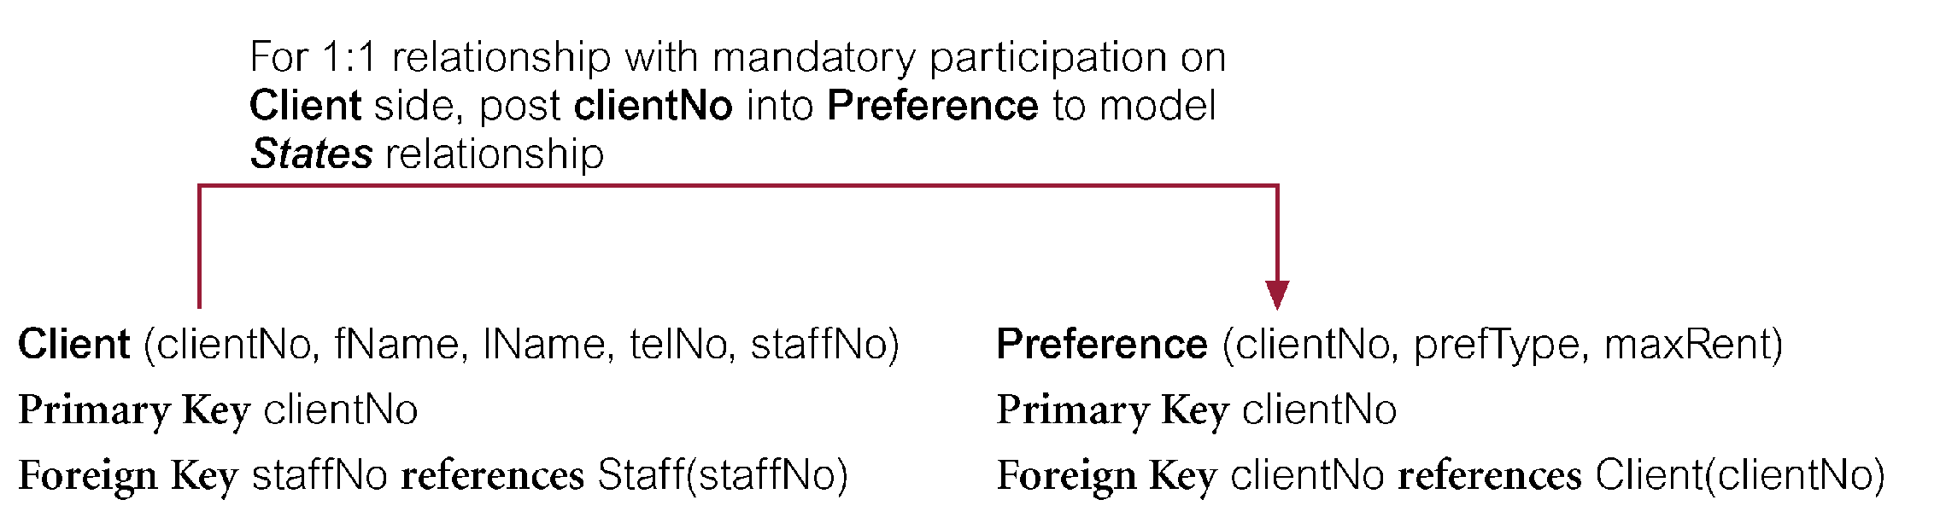
Derive Relations for Logical Data Model
(b) Mandatory participation on one side of a 1:1 relationship - Example
10/01/2014
Dr. Miriam Capretz SE3309a DBMS
‹#›
Notes:
‹#›

Slide 16
Derive Relations for Local Logical Data Model
(c) Optional participation on both sides of a 1:1 relationship
Designation of the parent and child entities is arbitrary unless can find out more about the relationship.
10/01/2014
Dr. Miriam Capretz SE3309a DBMS
‹#›
Notes:
‹#›

Slide 17
Derive Relations for Local Logical Data Model
(c) Optional participation on both sides of a 1:1 relationship
Consider 1:1 Staff Uses Car relationship with optional participation on both sides. Assume majority of cars, but not all, are used by staff and only minority of staff use cars.
Car entity, although optional, is closer to being mandatory than Staff entity. Therefore designate Staff as parent entity and Car as child entity.
10/01/2014
Dr. Miriam Capretz SE3309a DBMS
‹#›
Notes:
‹#›

Slide 18
Derive Relations for Logical Data Model
(5) 1:1 recursive relationships - follow rules for participation for a 1:1 relationship.
(a) mandatory participation on both sides
(b) mandatory participation on only one side
(c) optional participation on both sides
10/01/2014
Dr. Miriam Capretz SE3309a DBMS
‹#›
Notes:
‹#›

Slide 19
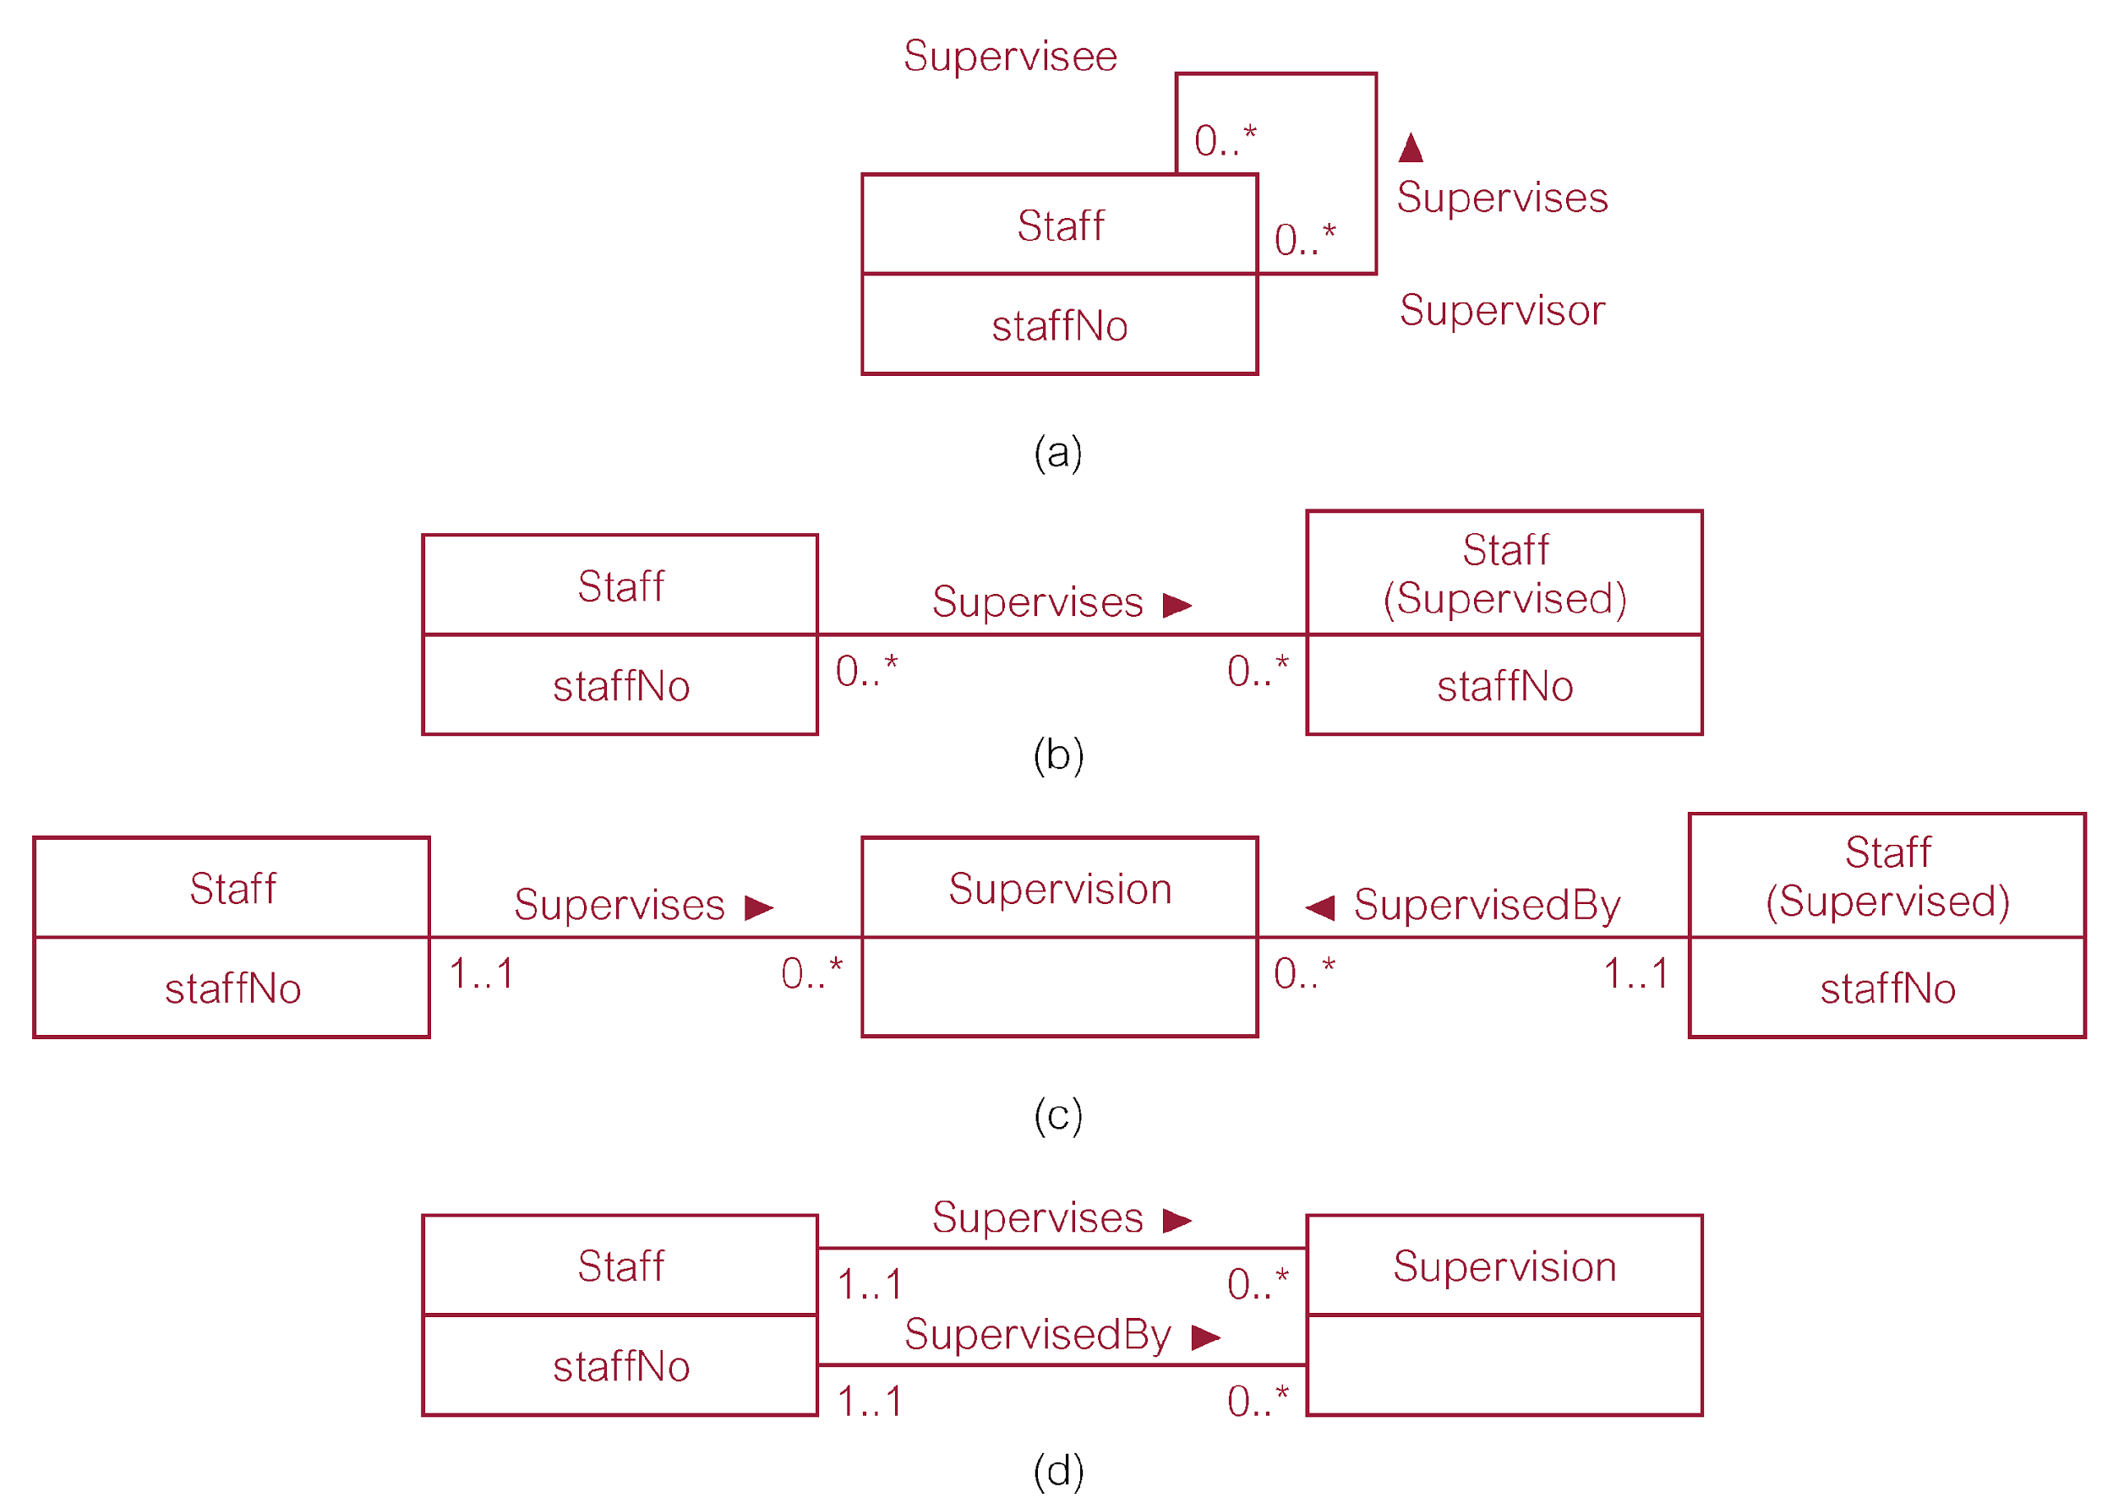
Derive Relations for Logical Data Model
(5) 1:1 recursive relationships
(a) mandatory participation on both sides: single relation with two copies of the primary key.
10/01/2014
Dr. Miriam Capretz SE3309a DBMS
‹#›
Notes:
‹#›

Slide 20
Derive Relations for Logical Data Model
(5) 1:1 recursive relationships
(b) mandatory participation on only one side: option to create a single relation with two copies of the primary key, or create a new relation to represent the relationship. The new relation would only have two attributes, both copies of the primary key.
10/01/2014
Dr. Miriam Capretz SE3309a DBMS
‹#›
Notes:
‹#›

Slide 21
Derive Relations for Logical Data Model
(5) 1:1 recursive relationships
(c) optional participation on both sides: create a new relation to represent the relationship.
10/01/2014
Dr. Miriam Capretz SE3309a DBMS
‹#›
Notes:
‹#›

Slide 22
Derive Relations for Logical Data Model
(6) Superclass/subclass relationship types
Identify superclass as parent entity and subclass entity as child entity.
There are various options on how to represent such a relationship as one or more relations.
Most appropriate option is dependent on a number of factors such as:
disjointness and participation constraints on the superclass/subclass relationship,
whether subclasses are involved in distinct relationships,
number of participants in superclass/subclass relationship.
10/01/2014
Dr. Miriam Capretz SE3309a DBMS
‹#›
Notes:
‹#›

Slide 23
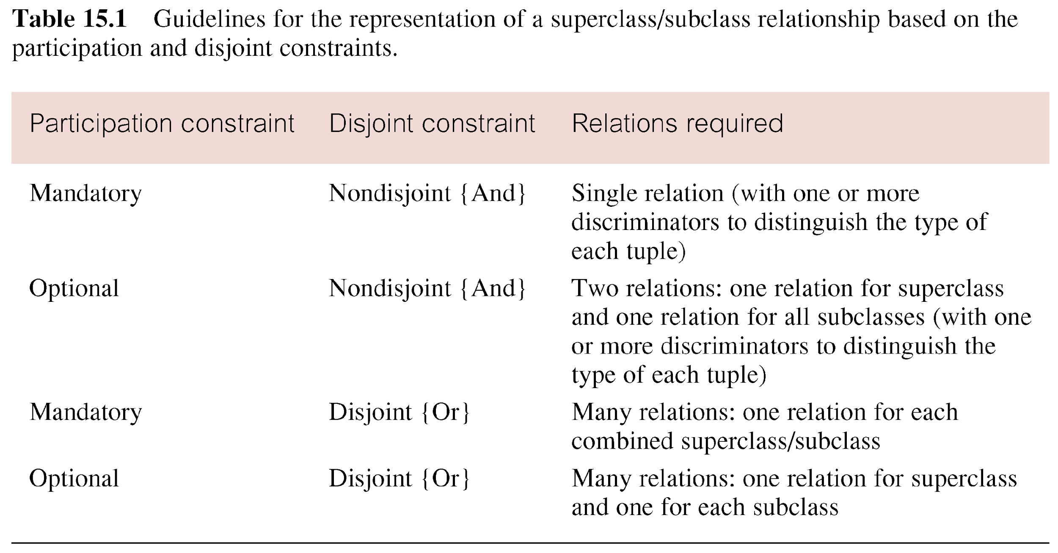
Guidelines for Representation of Superclass / Subclass Relationship
10/01/2014
Dr. Miriam Capretz SE3309a DBMS
‹#›
Notes:
‹#›

Slide 24
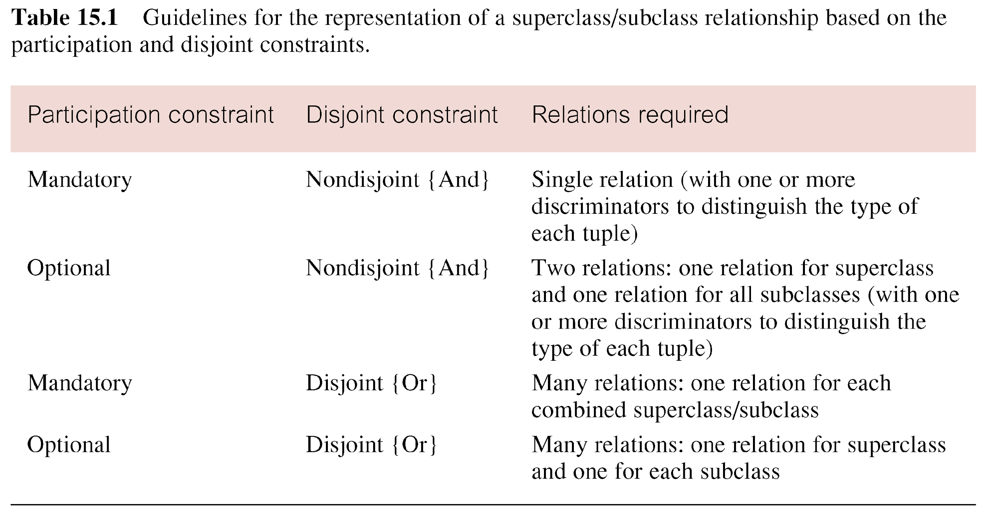
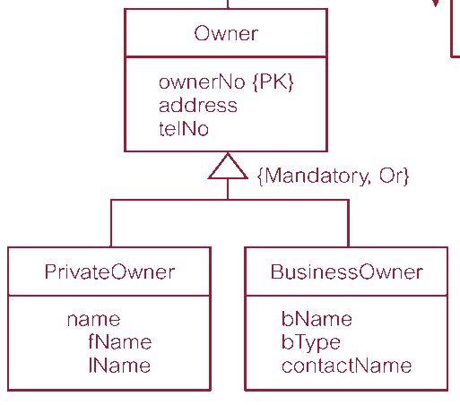
Superclass/Subclass Relationship
Mandatory Nondisjoint {And}
10/01/2014
Dr. Miriam Capretz SE3309a DBMS
‹#›
Notes:
‹#›

Slide 25
Superclass/Subclass Relationship
Optional Nondisjoint {And}
10/01/2014
Dr. Miriam Capretz SE3309a DBMS
‹#›
Notes:
‹#›

Slide 26
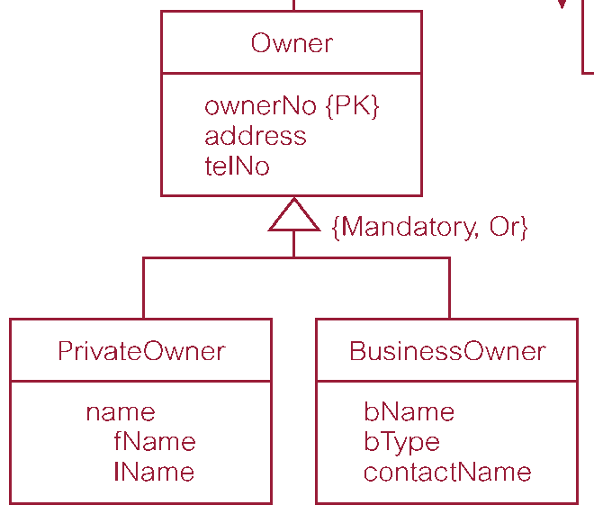
Superclass/Subclass Relationship
Mandatory Disjoint {Or}
10/01/2014
Dr. Miriam Capretz SE3309a DBMS
‹#›
Notes:
‹#›

Slide 27
Superclass/Subclass Relationship
Optional Disjoint {Or}
10/01/2014
Dr. Miriam Capretz SE3309a DBMS
‹#›
Notes:
‹#›

Slide 28
Derive Relations for Logical Data Model
(7) *:* binary relationship types
Create relation to represent relationship and include any attributes that are part of relationship.
Post a copy of the primary key attribute(s) of the entities that participate in relationship into new relation, to act as foreign keys.
These foreign keys will also form primary key of new relation, possibly in combination with some of the attributes of the relationship.
10/01/2014
Dr. Miriam Capretz SE3309a DBMS
‹#›
Notes:
‹#›

Slide 29
Derive Relations for Logical Data Model
(7) *:* binary relationship types - Example
10/01/2014
Dr. Miriam Capretz SE3309a DBMS
‹#›
Notes:
‹#›

Slide 30
Derive Relations for Local Logical Data Model
(8) Complex relationship types
Create a relation to represent the relationship and include any attributes that are part of the relationship.
Post copy of primary key attribute(s) of entities that participate in the complex relationship into new relation, to act as foreign keys.
Any foreign keys that represent a ‘many’ relationship (for example, 1..*, 0..*) generally will also form the primary key of new relation, possibly in combination with some of the attributes of the relationship.
10/01/2014
Dr. Miriam Capretz SE3309a DBMS
‹#›
Notes:
‹#›

Slide 31
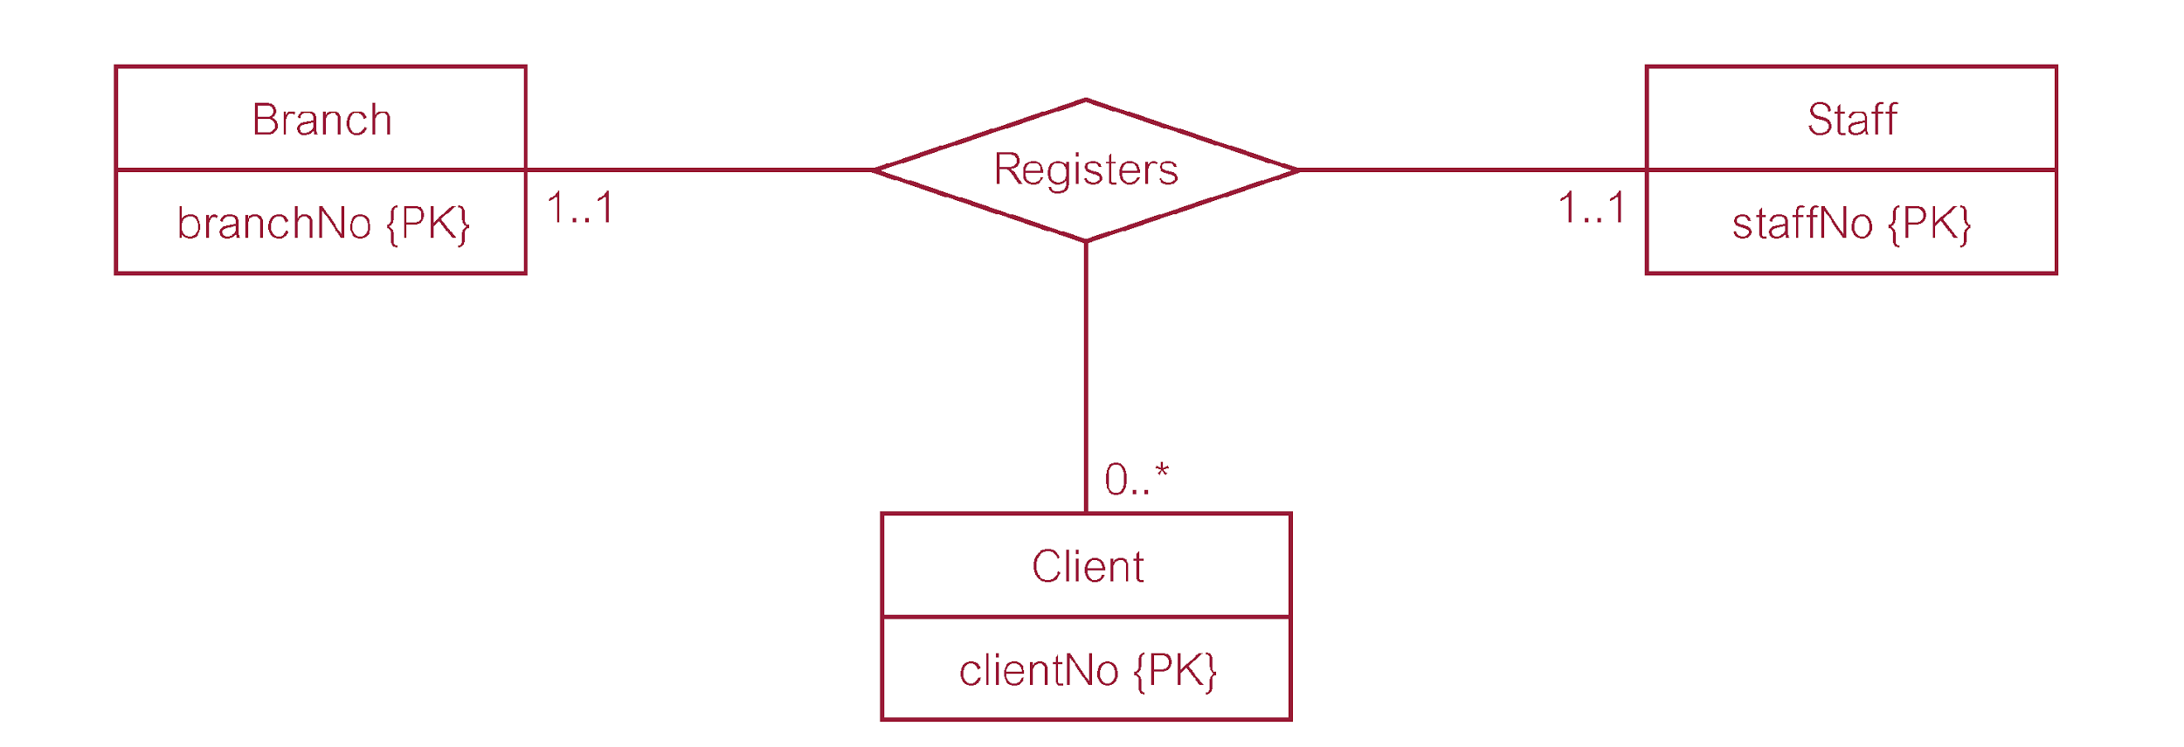
Derive Relations for Local Logical Data Model
(8) Complex relationship types - Example
10/01/2014
Dr. Miriam Capretz SE3309a DBMS
‹#›
Notes:
‹#›

Slide 32
Derive Relations for Logical Data Model
(9) Multi-valued attributes
Create new relation to represent multi-valued attribute and include primary key of entity in new relation, to act as a foreign key.
Unless the multi-valued attribute is itself an alternate key of the entity, the primary key of new relation is a combination of the multi-valued attribute and the primary key of the entity.
10/01/2014
Dr. Miriam Capretz SE3309a DBMS
‹#›
Notes:
‹#›

Slide 33
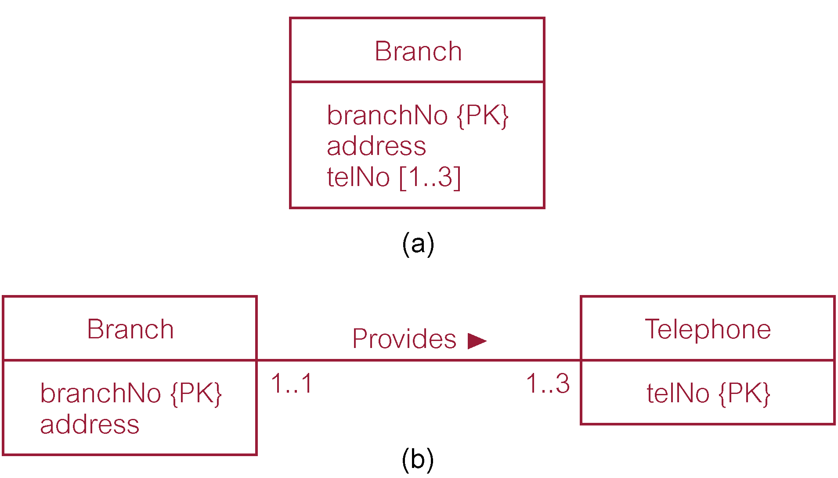
Derive Relations for Logical Data Model
(9) Multi-valued attributes - Example
10/01/2014
Dr. Miriam Capretz SE3309a DBMS
‹#›
Notes:
‹#›

Slide 34
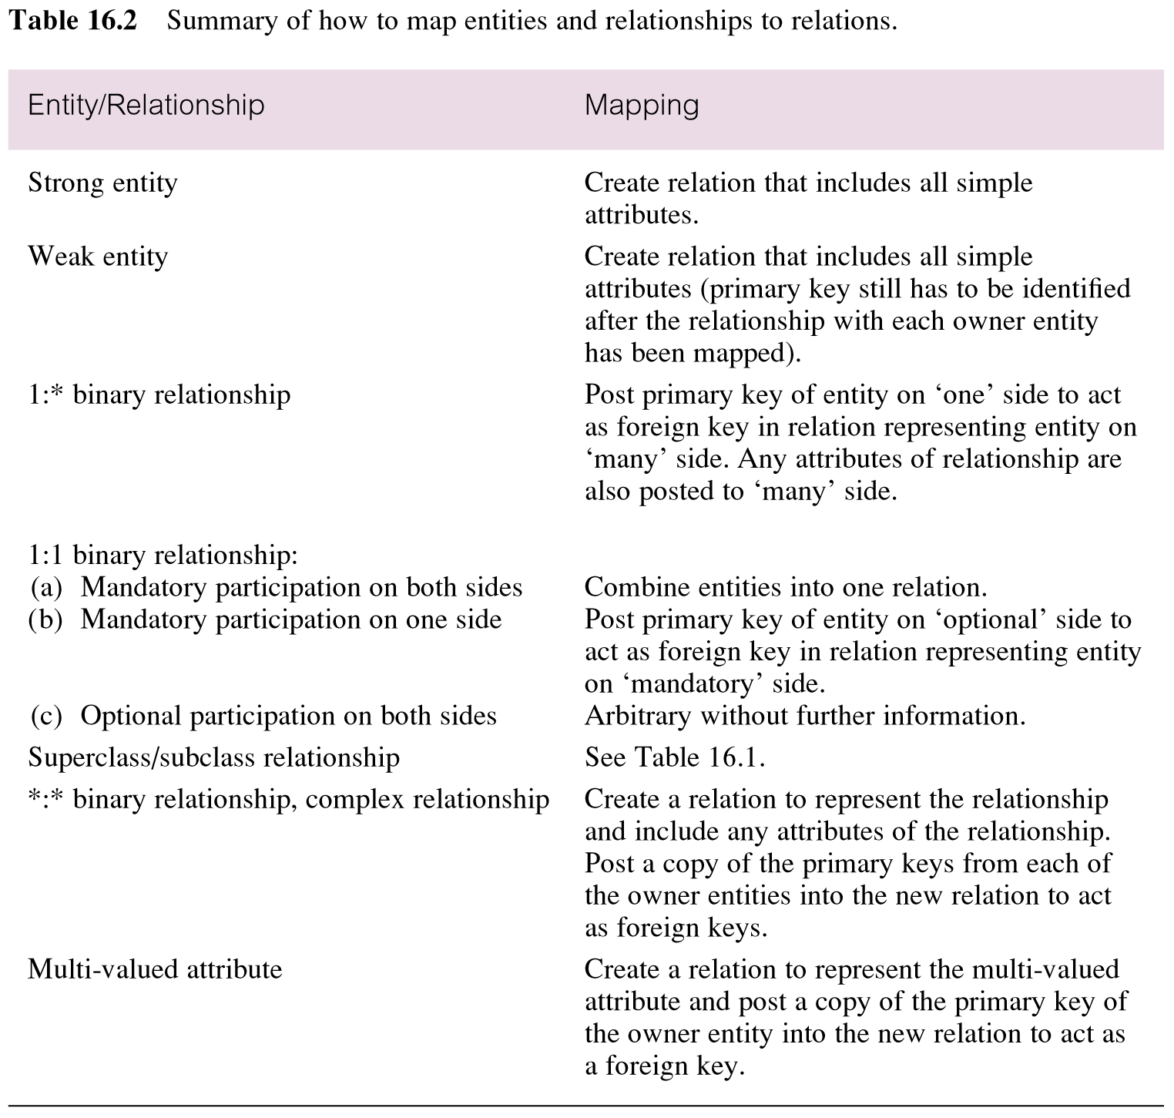
Summary of How to Map Entities and Relationships to Relations
10/01/2014
Dr. Miriam Capretz SE3309a DBMS
‹#›
Notes:
‹#›

Slide 35
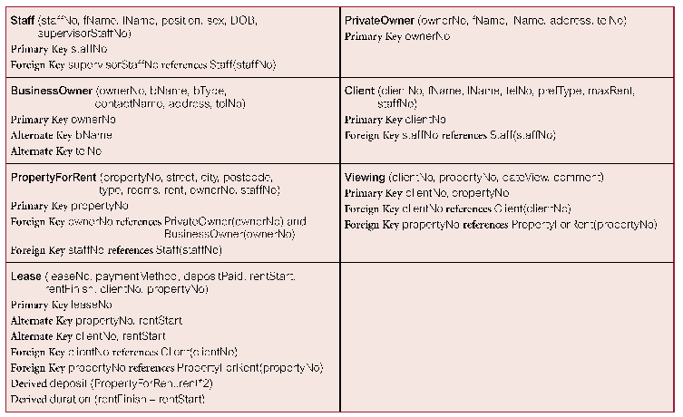
Relations for the Staff View of DreamHome
10/01/2014
Dr. Miriam Capretz SE3309a DBMS
‹#›
Notes:
‹#›

Slide 36
Build and Validate Logical Data Model
Next Step:
Validate relations using normalization
To validate the relations in the local logical data model using the technique of normalization.
10/01/2014
Dr. Miriam Capretz SE3309a DBMS
‹#›
Notes:
‹#›

