Slide 1
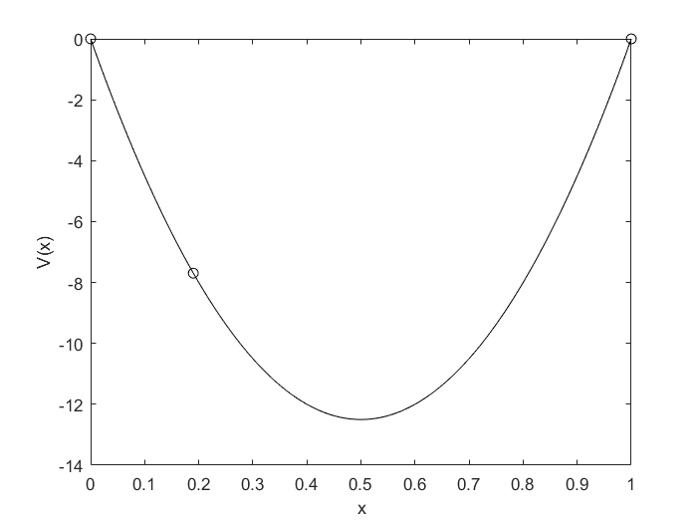




$$ψ_{L}\left(0\right)∼e^{−0.5}$$
$$ψ_{L}\left(0−h\right)∼e^{−0.5−h}$$
$$V\left(x\right)=c\left(x^{2}−x\right)$$
$$ψ_{R}\left(1\right)∼e^{−0.5}$$
$$ψ_{R}\left(1+h\right)∼e^{−0.5−h}$$
Find the b such that $V\left(b\right)=E⇔$ $$f\left(b\right)=\frac{ψ_{R}^{′}(b)}{ψ_{R}(b)}−\frac{ψ_{L}^{′}\left(b\right)}{ψ_{L}\left(b\right)}→0$$

