Slide 1
Physic 514 Term Project Single-particle physics -- Oscillator
12/13/2016
Chih-Chuen (Ian) Lin
Mechanical Engineering, University of Michigan
iancclin@umich.edu

Slide 2
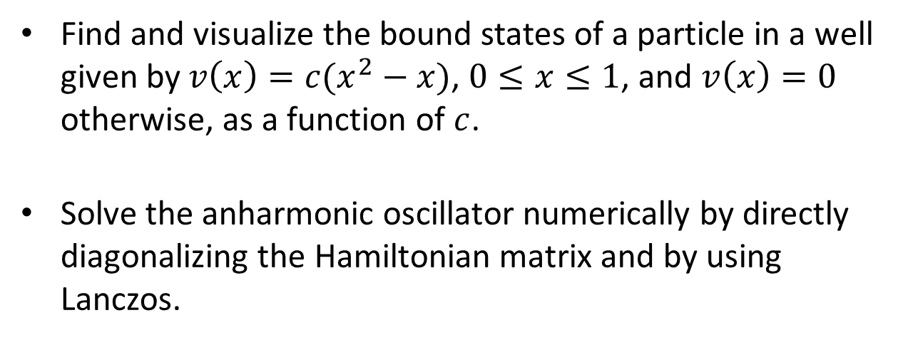
Problems
Find and visualize the bound states of a particle in a well given by $v\left(x\right)=c(x^{2}−x)$, $0≤x≤1$, and $v\left(x\right)=0$ otherwise, as a function of $c$.
Solve the anharmonic oscillator numerically by directly diagonalizing the Hamiltonian matrix and by using Lanczos.

Slide 3
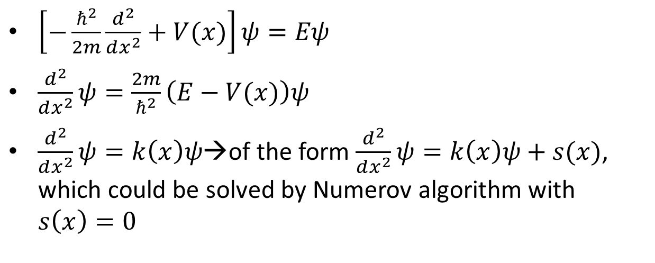
Harmonic Oscillator
$\left[−\frac{ℏ^{2}}{2m}\frac{d^{2}}{dx^{2}}+V(x)\right]ψ=Eψ$
$\frac{d^{2}}{dx^{2}}ψ=\frac{2m}{ℏ^{2}}\left(E−V(x)\right)ψ$
$\frac{d^{2}}{dx^{2}}ψ=k\left(x\right)ψ$→of the form $\frac{d^{2}}{dx^{2}}ψ=k\left(x\right)ψ+s(x)$, which could be solved by Numerov algorithm with $s\left(x\right)=0$

Slide 4
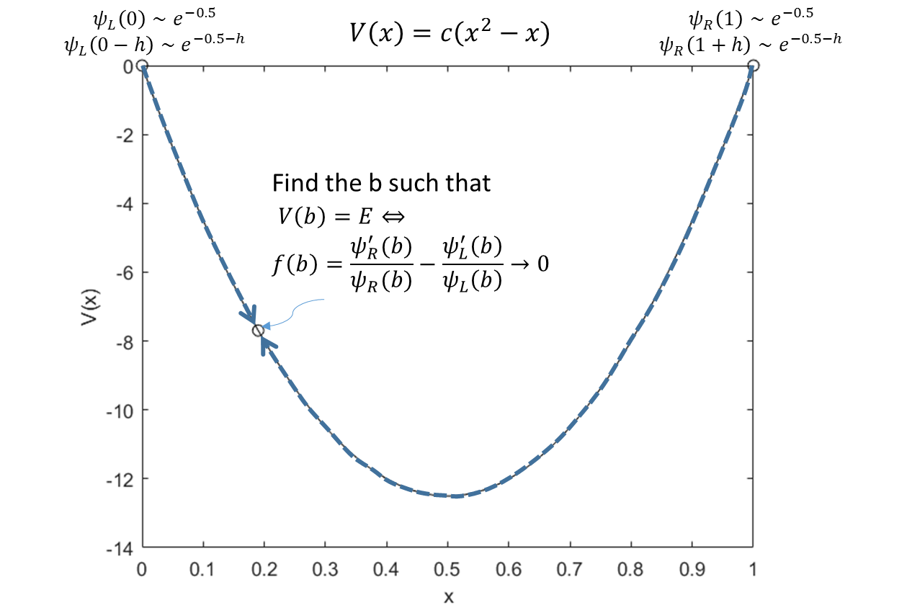
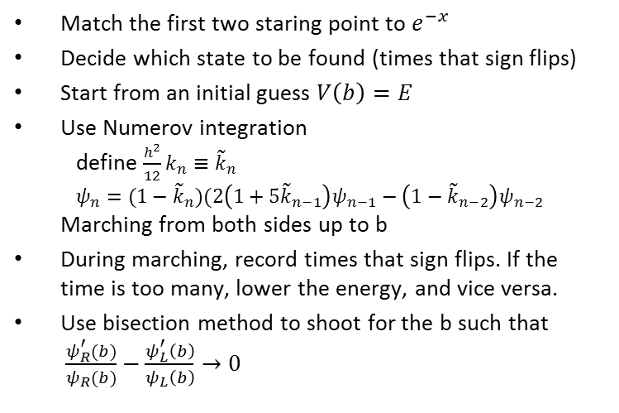
Numerov Algorithm
Match the first two staring point to $e^{−x}$
Decide which state to be found (times that sign flips)
Start from an initial guess $V\left(b\right)=E$
Use Numerov integration define $\frac{h^{2}}{12}k_{n}≡{\tilde{k}}_{n}$ $ψ_{n}=(1−{\tilde{k}}_{n})(2\left(1+5{\tilde{k}}_{n−1}\right)ψ_{n−1}−\left(1−{\tilde{k}}_{n−2}\right)ψ_{n−2}$ Marching from both sides up to b
During marching, record times that sign flips. If the time is too many, lower the energy, and vice versa.
Use bisection method to shoot for the b such that $\frac{ψ_{R}^{′}(b)}{ψ_{R}(b)}−\frac{ψ_{L}^{′}\left(b\right)}{ψ_{L}\left(b\right)}→0$

Slide 5
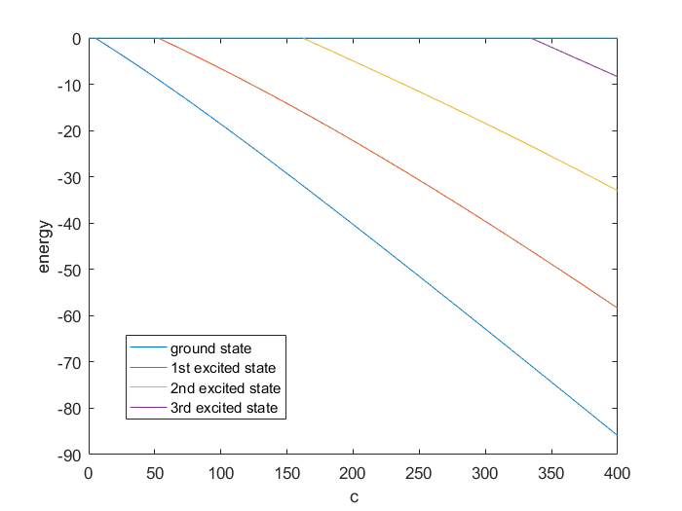
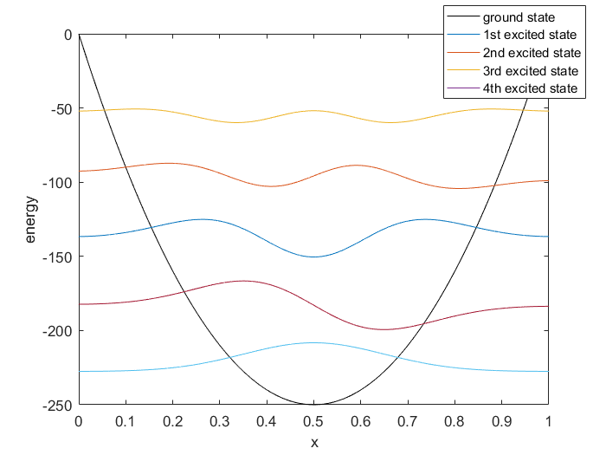

Results
Parameter c vs. energy
wavefunctions of bound states
$$ψ(x)$$

Slide 6
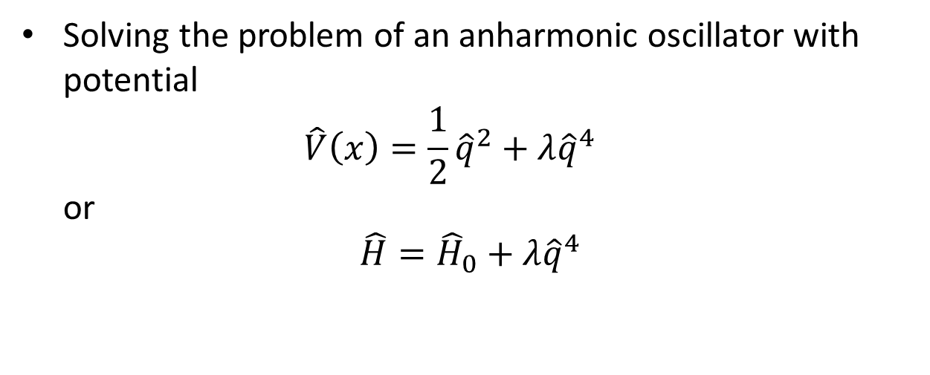
Anharmonic Oscillator
Solving the problem of an anharmonic oscillator with potential $\hat{V}\left(x\right)=\frac{1}{2}{\hat{q}}^{2}+λ{\hat{q}}^{4}$ or
$$\hat{H}={\hat{H}}_{0}+λ{\hat{q}}^{4}$$

Slide 7
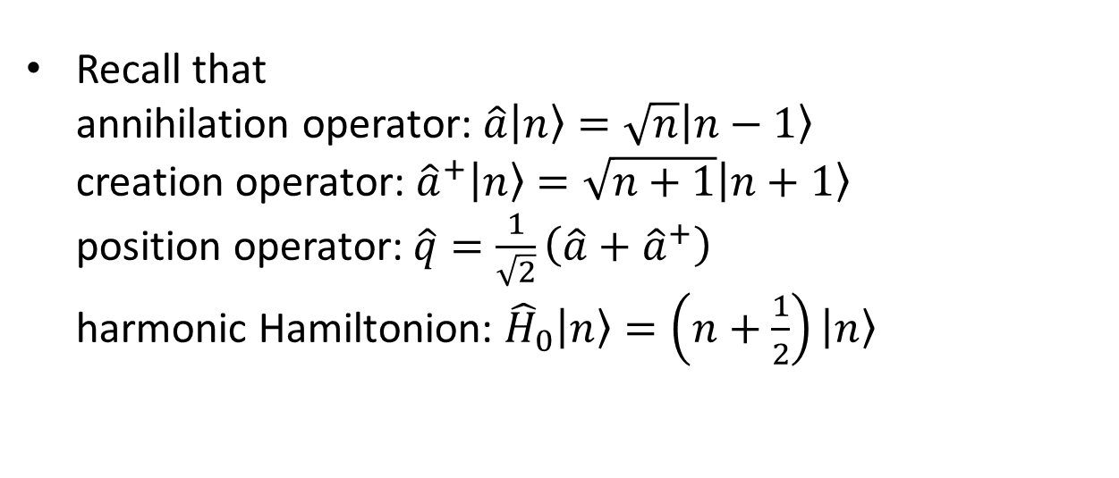
Annihilation & creation operator
Recall that annihilation operator: $\hat{a}\left|\left.n\right\rangle \right.=\sqrt{n}\left|\left.n−1\right\rangle \right.$ creation operator: ${\hat{a}}^{+}\left|\left.n\right\rangle \right.=\sqrt{n+1}\left|\left.n+1\right\rangle \right.$ position operator: $\hat{q}=\frac{1}{\sqrt{2}}\left(\hat{a}+{\hat{a}}^{+}\right)$ harmonic Hamiltonion: ${\hat{H}}_{0}\left|\left.n\right\rangle \right.=\left(n+\frac{1}{2}\right)\left|\left.n\right\rangle \right.$

Slide 8
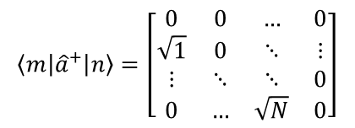
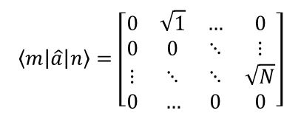
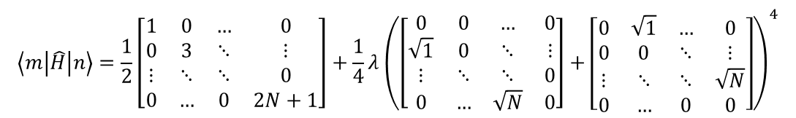
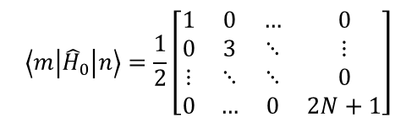
Matrix form
$$\left\langle m | {\hat{a}}^{+} | n\right\rangle =\left[\begin{matrix}0 & 0 & … & 0 \\ \sqrt{1} & 0 & ⋱ & ⋮ \\ ⋮ & ⋱ & ⋱ & 0 \\ 0 & … & \sqrt{N} & 0\end{matrix}\right]$$
$$\left\langle m | \hat{a} | n\right\rangle =\left[\begin{matrix}0 & \sqrt{1} & … & 0 \\ 0 & 0 & ⋱ & ⋮ \\ ⋮ & ⋱ & ⋱ & \sqrt{N} \\ 0 & … & 0 & 0\end{matrix}\right]$$
$$\left\langle m | {\hat{H}}_{0} | n\right\rangle =\frac{1}{2}\left[\begin{matrix}1 & 0 & … & 0 \\ 0 & 3 & ⋱ & ⋮ \\ ⋮ & ⋱ & ⋱ & 0 \\ 0 & … & 0 & 2N+1\end{matrix}\right]$$
$$\left\langle m | \hat{H} | n\right\rangle =\frac{1}{2}\left[\begin{matrix}1 & 0 & … & 0 \\ 0 & 3 & ⋱ & ⋮ \\ ⋮ & ⋱ & ⋱ & 0 \\ 0 & … & 0 & 2N+1\end{matrix}\right]+\frac{1}{4}λ{\left(\left[\begin{matrix}0 & 0 & … & 0 \\ \sqrt{1} & 0 & ⋱ & ⋮ \\ ⋮ & ⋱ & ⋱ & 0 \\ 0 & … & \sqrt{N} & 0\end{matrix}\right]+\left[\begin{matrix}0 & \sqrt{1} & … & 0 \\ 0 & 0 & ⋱ & ⋮ \\ ⋮ & ⋱ & ⋱ & \sqrt{N} \\ 0 & … & 0 & 0\end{matrix}\right]\right)}^{4}$$
→A sparse banded Hermitian matrix with band-width 5

Slide 9
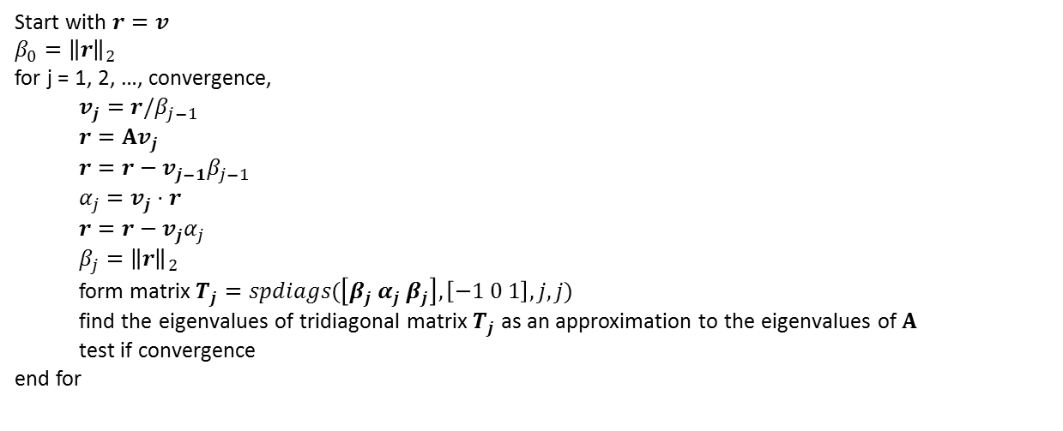
Lanczos algorithm
Start with $r=v$
$β_{0}={\left\|r\right\|}_{2}$
for j = 1, 2, …, convergence,
$v_{j}=r/β_{j−1}$
$r=Av_{j}$
$r=r−v_{j−1}β_{j−1}$
$α_{j}=v_{j}⋅r$
$r=r−v_{j}α_{j}$
$β_{j}={\left\|r\right\|}_{2}$
form matrix $T_{j}=spdiags(\left[β_{j} α_{j} β_{j}\right], \left[−1 0 1\right], j, j)$
find the eigenvalues of tridiagonal matrix $T_{j}$ as an approximation to the eigenvalues of $A$
test if convergence
end for
Bai, Zhaojun, et al., eds. Templates for the solution of algebraic eigenvalue problems: a practical guide. Vol. 11. Siam, 2000.

Slide 10
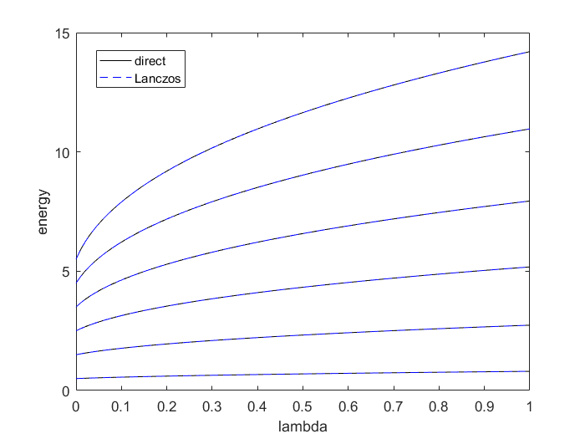
Results
Comparison between direct diagonalization and Lanczos algorithm

Slide 11
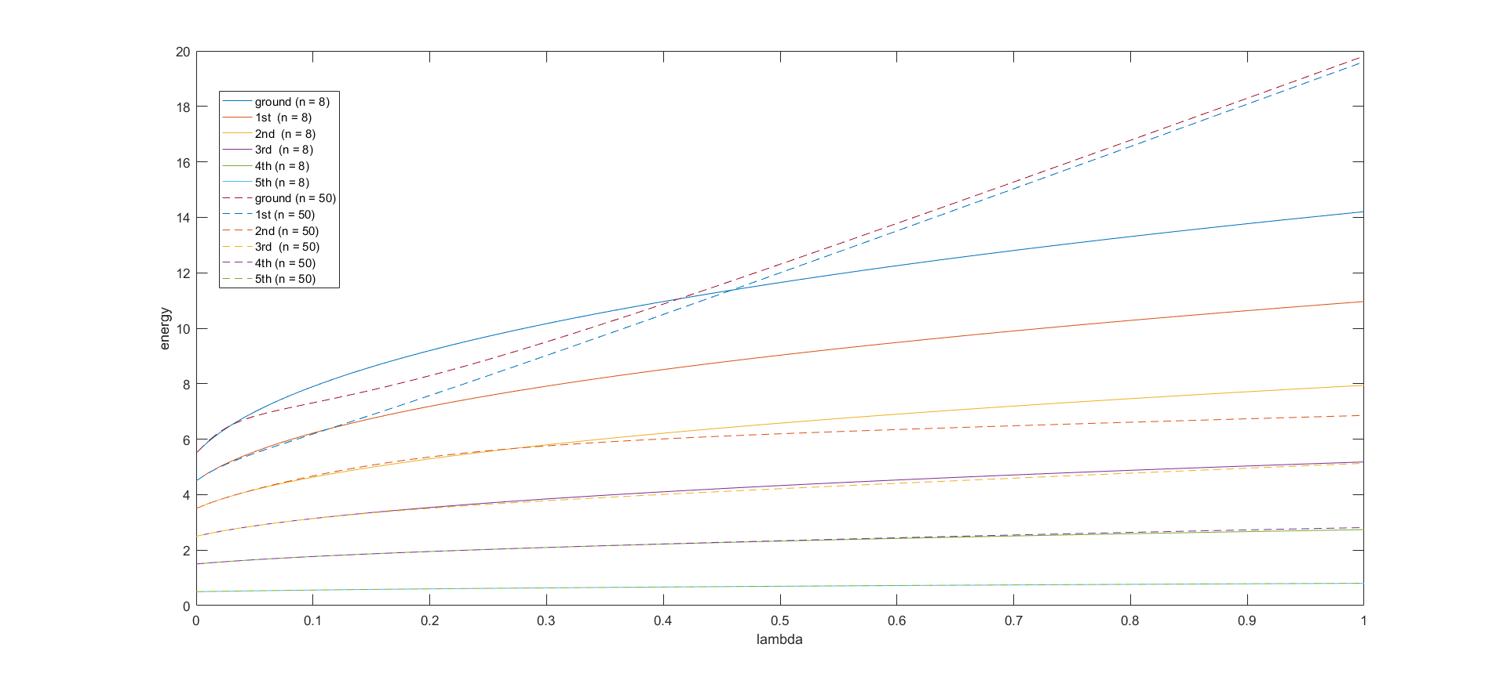
Results
Comparison between the first 6 states with different system size
Finite dimension error

Slide 12
Happy Holiday ☺
https://github.com/iancclin/Physics514Proj.git

