Slide 1
0816 EEG Meeting
Presenter: 陳奕安(Ian Chen)

Slide 2
Progress from the last 2 week:
1. Review FastICA and t-SNE paper line by line (Go through the mathematical derivation from the paper)
2. Work on IC clustering from the ICA encoder pipeline (Check the ICA alignment on regression performance)
3. Replacing the encoder with a full MLP architecture shows competitive results.
4. Try using EEGNet to encode components × time EEG data.
5. Investigate the memorization problem of the encoder

Slide 3
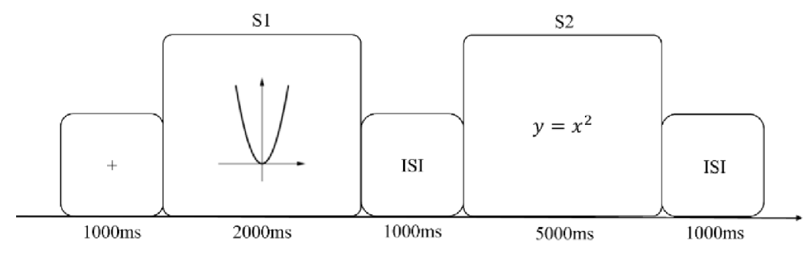
Experimental Protocol
Fixed 2s EEG length
Trigger 11(Correct Equation)
Trigger 10(Incorrect Equation)
Trigger 201(Answer correctly)
Trigger 200(Answer incorrectly)
Trigger 61~120(Questions)

Slide 4
Preprocessing:
1. Notch filter at 60 Hz (line noise)
2. Bandpass 0.1–40 Hz
3. Average reference
4. ICA ocular artifact removal
5. Extracts −0.2 to 2.0 s epochs with a −0.2–0 s baseline correction
6. A rejection threshold of 150 µV peak-to-peak — auto-drops any epoch exceeding this. >> The number of epochs varies across subjects.
7. Each surviving epoch is tagged 1 (correct/201) or 0 (incorrect/200)
Resampled to 128 Hz post-epoching.
Validation: GroupKFold-by-subject
With ~256 subjects and N_SPLITS=5, each fold holds out roughly 1/5 of subjects (~51) as test, trains on the rest.

Slide 5
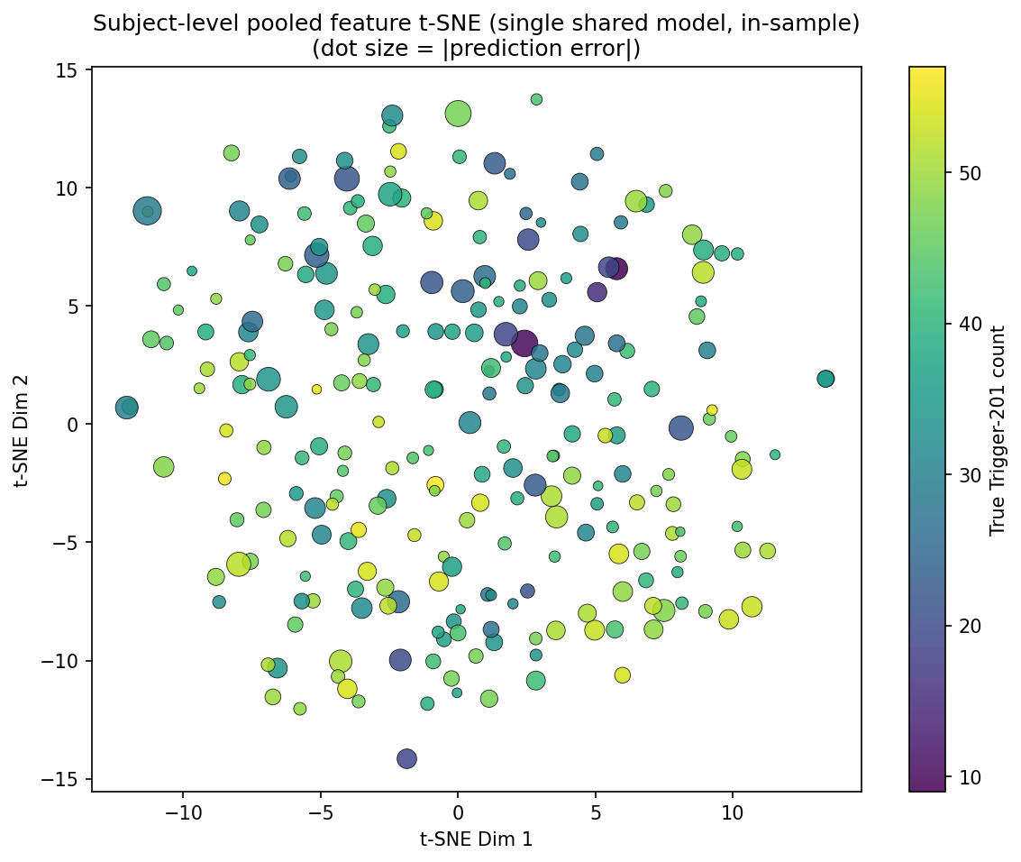
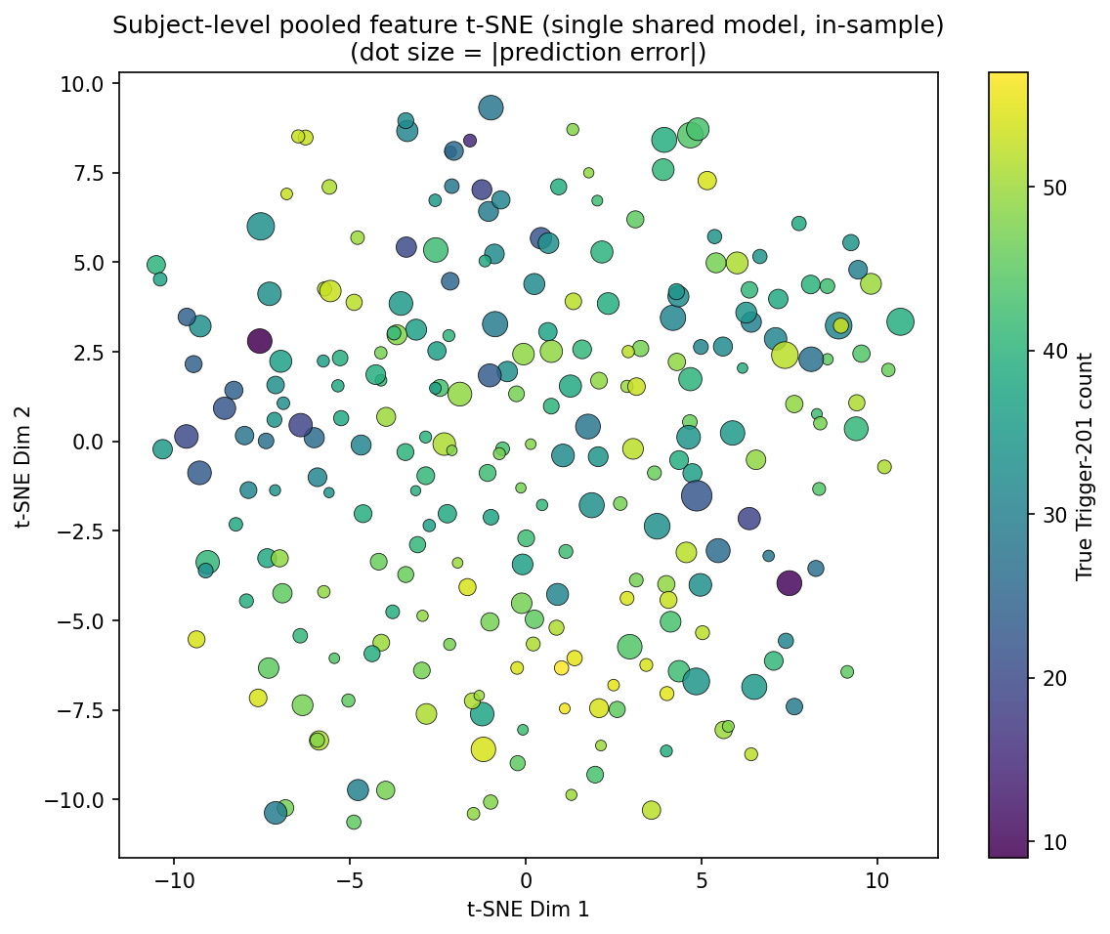
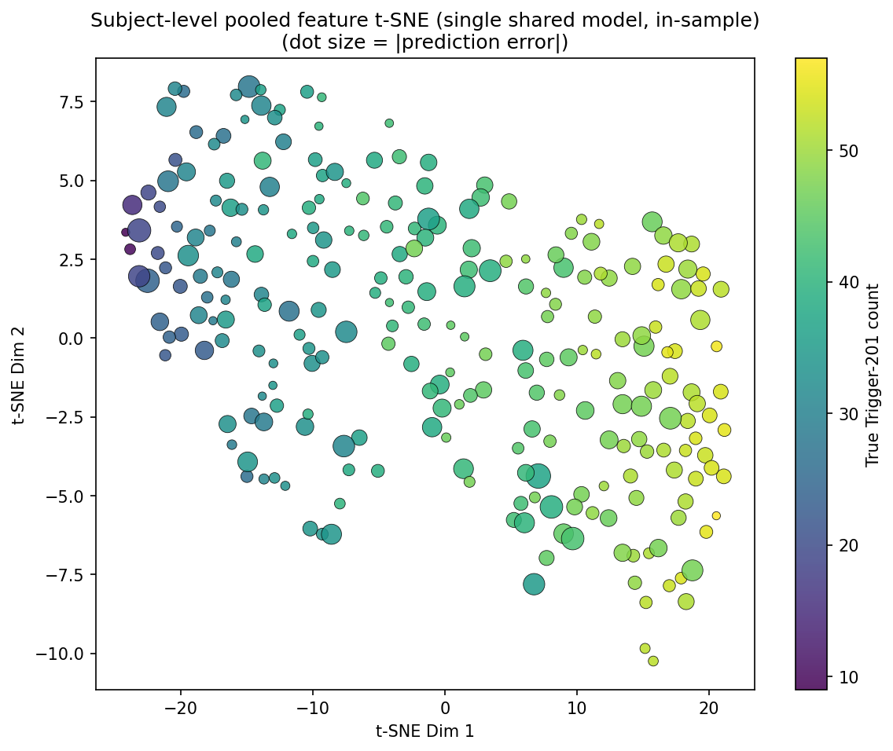
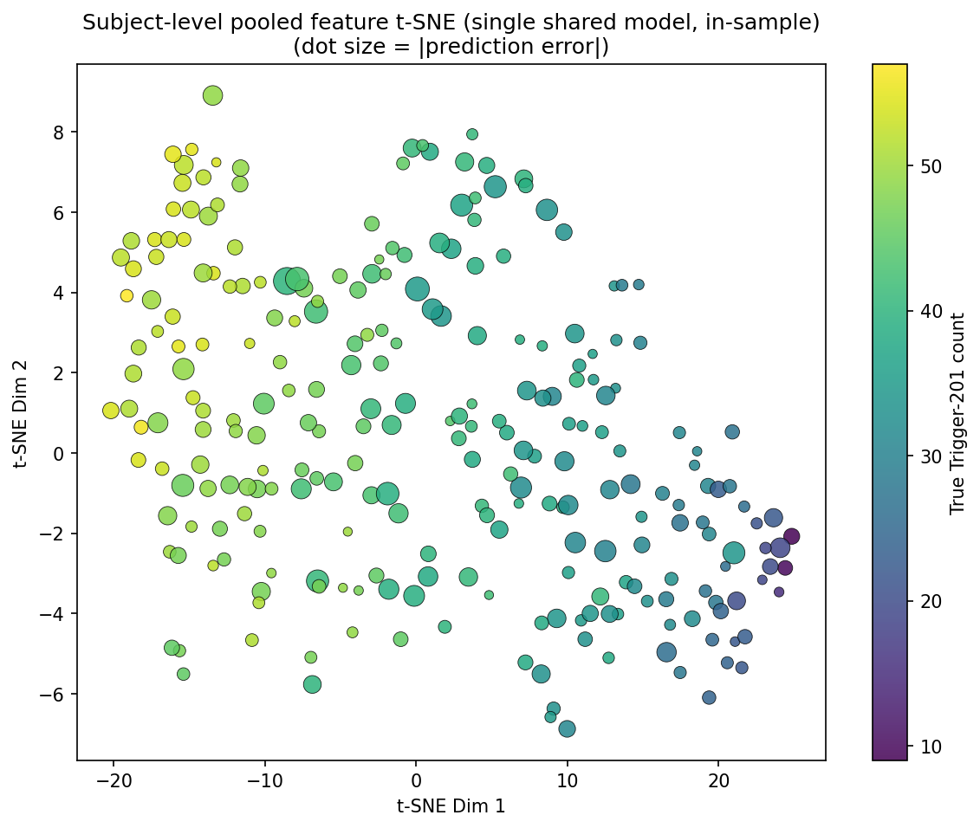
EEG data dimension
Channel x Time
Component x Time
EEGNet
Encoder Architecture
MLP

