Slide 1
Quick Start RabbitMQ (RMQ)
A Hitchhiker’s Guide to AMQP 0-9-1

Slide 2
Protocol
RMQ uses the AMQP protocol to transport messages
RMQ uses AMQP 0-9-1
This is a significantly different protocol to AMQP 1–0
AMQP 1-0 implementations include Azure Service Bus and Azure Event Hubs
Further reading:
AMQP 0-9-1
RMQ and AMQP 0-9-1
Notes:
# Protocol #
Rabbit MQ (RMQ) uses the open-standard Advanced Message Queuing Protocol (AMQP).
AMQP 0-9-1 consists of both the AMQ model, which defines a server model of exchanges, queues, and bindings and the AMQ wire-protocol which defines how frames are sent between client and server.
AMQP 1-0 does not use the AMQ model, and is a major change from AMQP 0-9-1.
RMQ is unlikely to move to the 1-0 version as it is highly dependent on the AMQ model

Slide 3
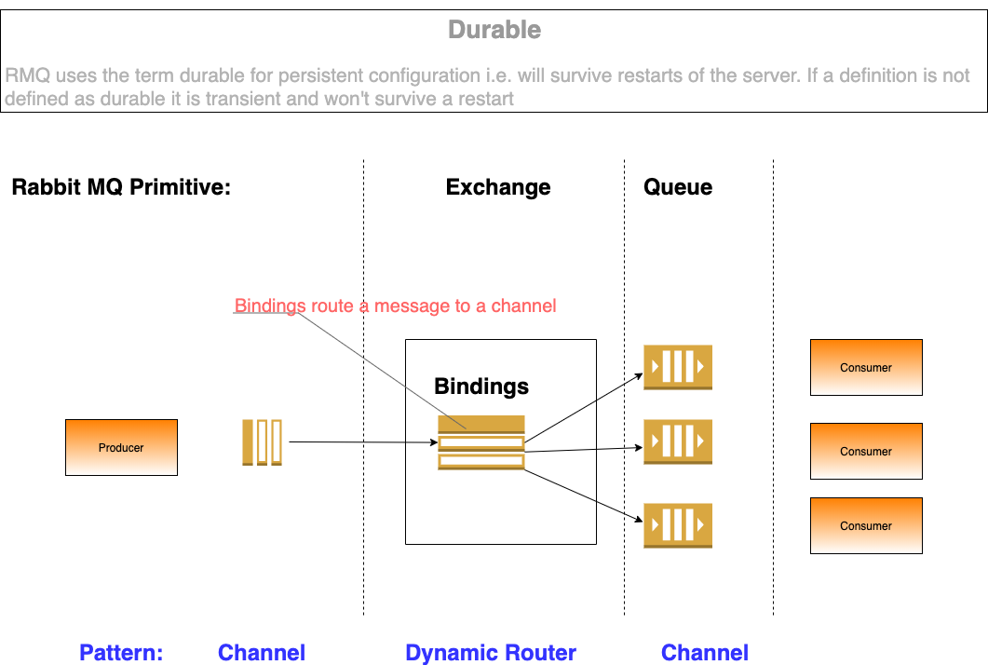
Notes:
# Primitives #
The AMQ model defines a number of primitives.
* Exchanges are routers, that forward messages from Producers to Queues
* Message Queues hold messages and forward them to consuming applications
* Bindings are the relationship between an Exchange and a Message Queue that tells the Exchange how to route messages to Queues
Resources that are defined as Durable in AMQP survive a server restart. (Resources that don't survive a restart are Transient). Note that a message on a queue only survives a restart if it is sent as Persistent, not if the Queue itself is Durable, which simply means that the forwarding destination survives a restart.

Slide 4
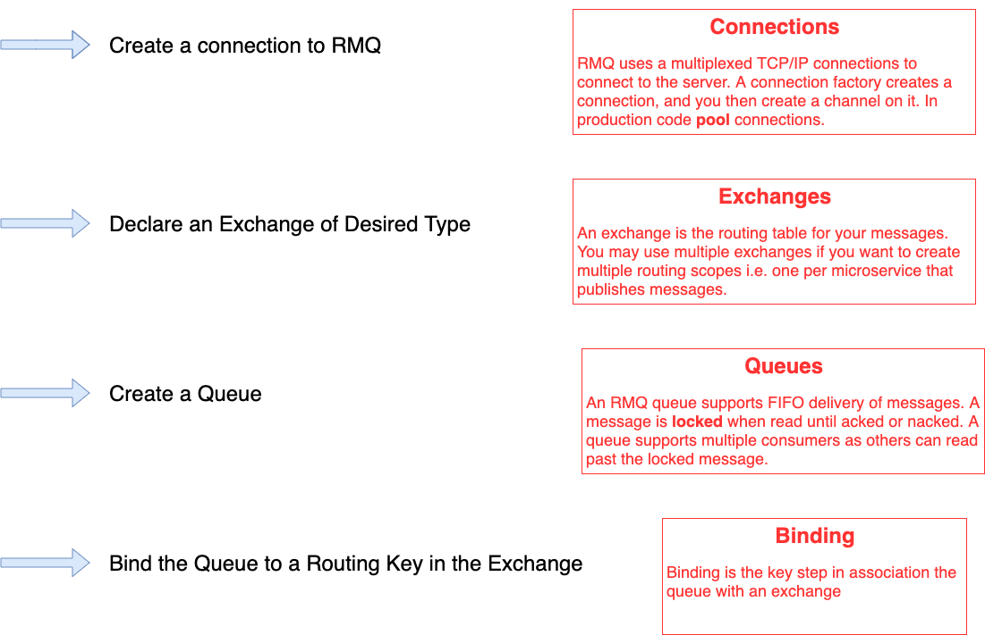
Notes:
# Flow #
AMQP allows the AMQ model to be programmable by the protocol - clients can programmatically declare the infrastructure they need, instead of relying on administrators to do so.
The flow for configuring the server can be run either by the client or the server, or both. Components that have already been declared can be re-declared, provided that the the parameters of the configuration are the same. For example a Message Queue named Foo can be declared by both Producer and Consumer. Provided both declarations agree on parameters such as, is the queue durable, there will not be an error on the re-declaration.
* Create a Connection to RMQ. RMQ uses a multiplexed TCP/IP connection consisting of one or more channels. Connections are expensive and should be pooled, channels are cheap. All subsequent commands are sent on the channel.
Declare an Exchange. An application needs one or more exchanges, which route messages to queues according to their type.
* Declare a Queue. A consumer needs to declare the queue for the exchange to forward messages to.
* Bind the Queue. A queue is bound to the exchange, using a routing key to identify what traffic should be routed to the queue.

Slide 5
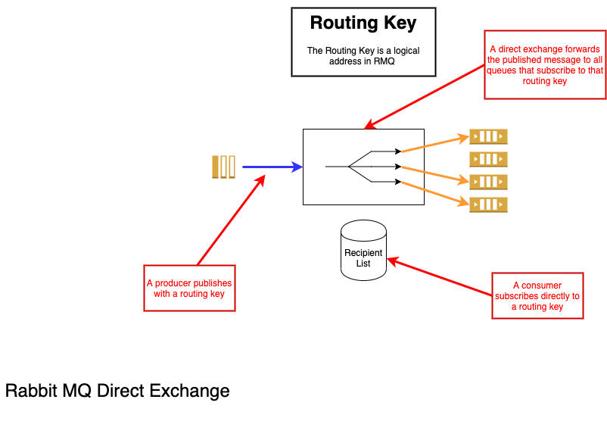
Notes:
# Direct Exchange #
In a direct exchange, a publisher specifies a routing key for a message, and a binding specifies queues that want messages with that routing key. Typically, in a direct exchange, the routing key is the name of the queue that the publisher wishes to publish to, and there is one queue. But a direct exchange may dispatch the message to a list of recipients if more than one is bound.

Slide 6
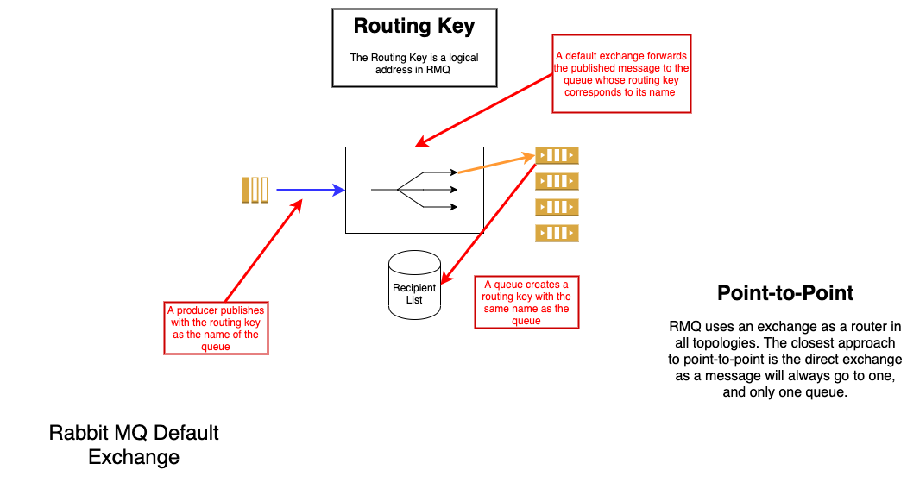
Notes:
# Default Exchange #
A default exchange simplifies the typical direct exchange scenario. A queue that does not supply a routing key when binding to a default exchange binds with the queue name as the routing key. The producer then sends to the queue name and the default exchange routes to the queue.
All messaging in RMQ uses an intermediary exchange, but the behavior of the Point-to-Point channel, which we will discuss later, pattern can be emulated using a direct exchange with the routing key of the queue name, or more simply by using the default exchange.

Slide 7
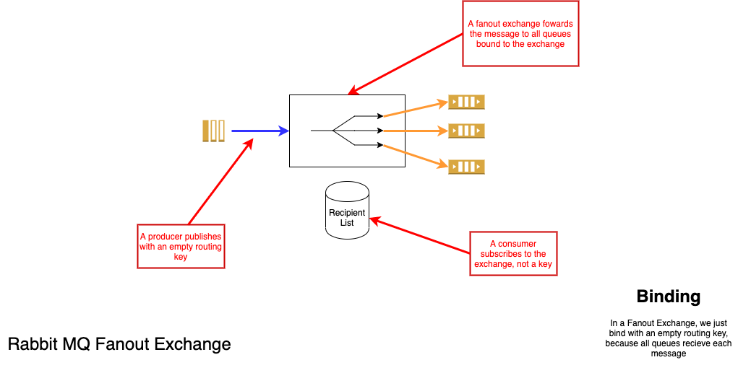
Notes:
# Fanout #
In a fanout exchange the routing key is ignored. Any queue bound to the exchange will receive any message published to the exchange. This emulates a publish-subscribe channel, which we will discuss later.

Slide 8
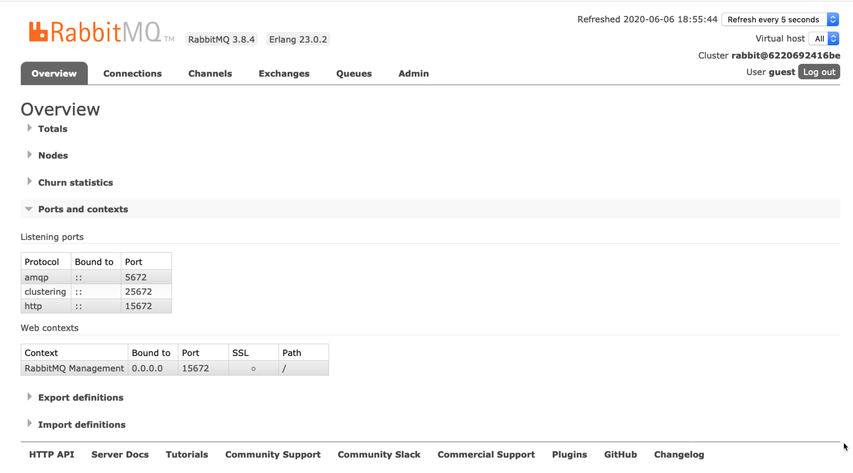
Notes:
# Management #
RMQ runs as a server, with a default port of 5672. If the management interface is installed, that runs on a default port of 15672.
Accessing the management port via HTTP brings up a web interface for managing RMQ.
The username:password "out-of-the-box" is guest:guest

Slide 9
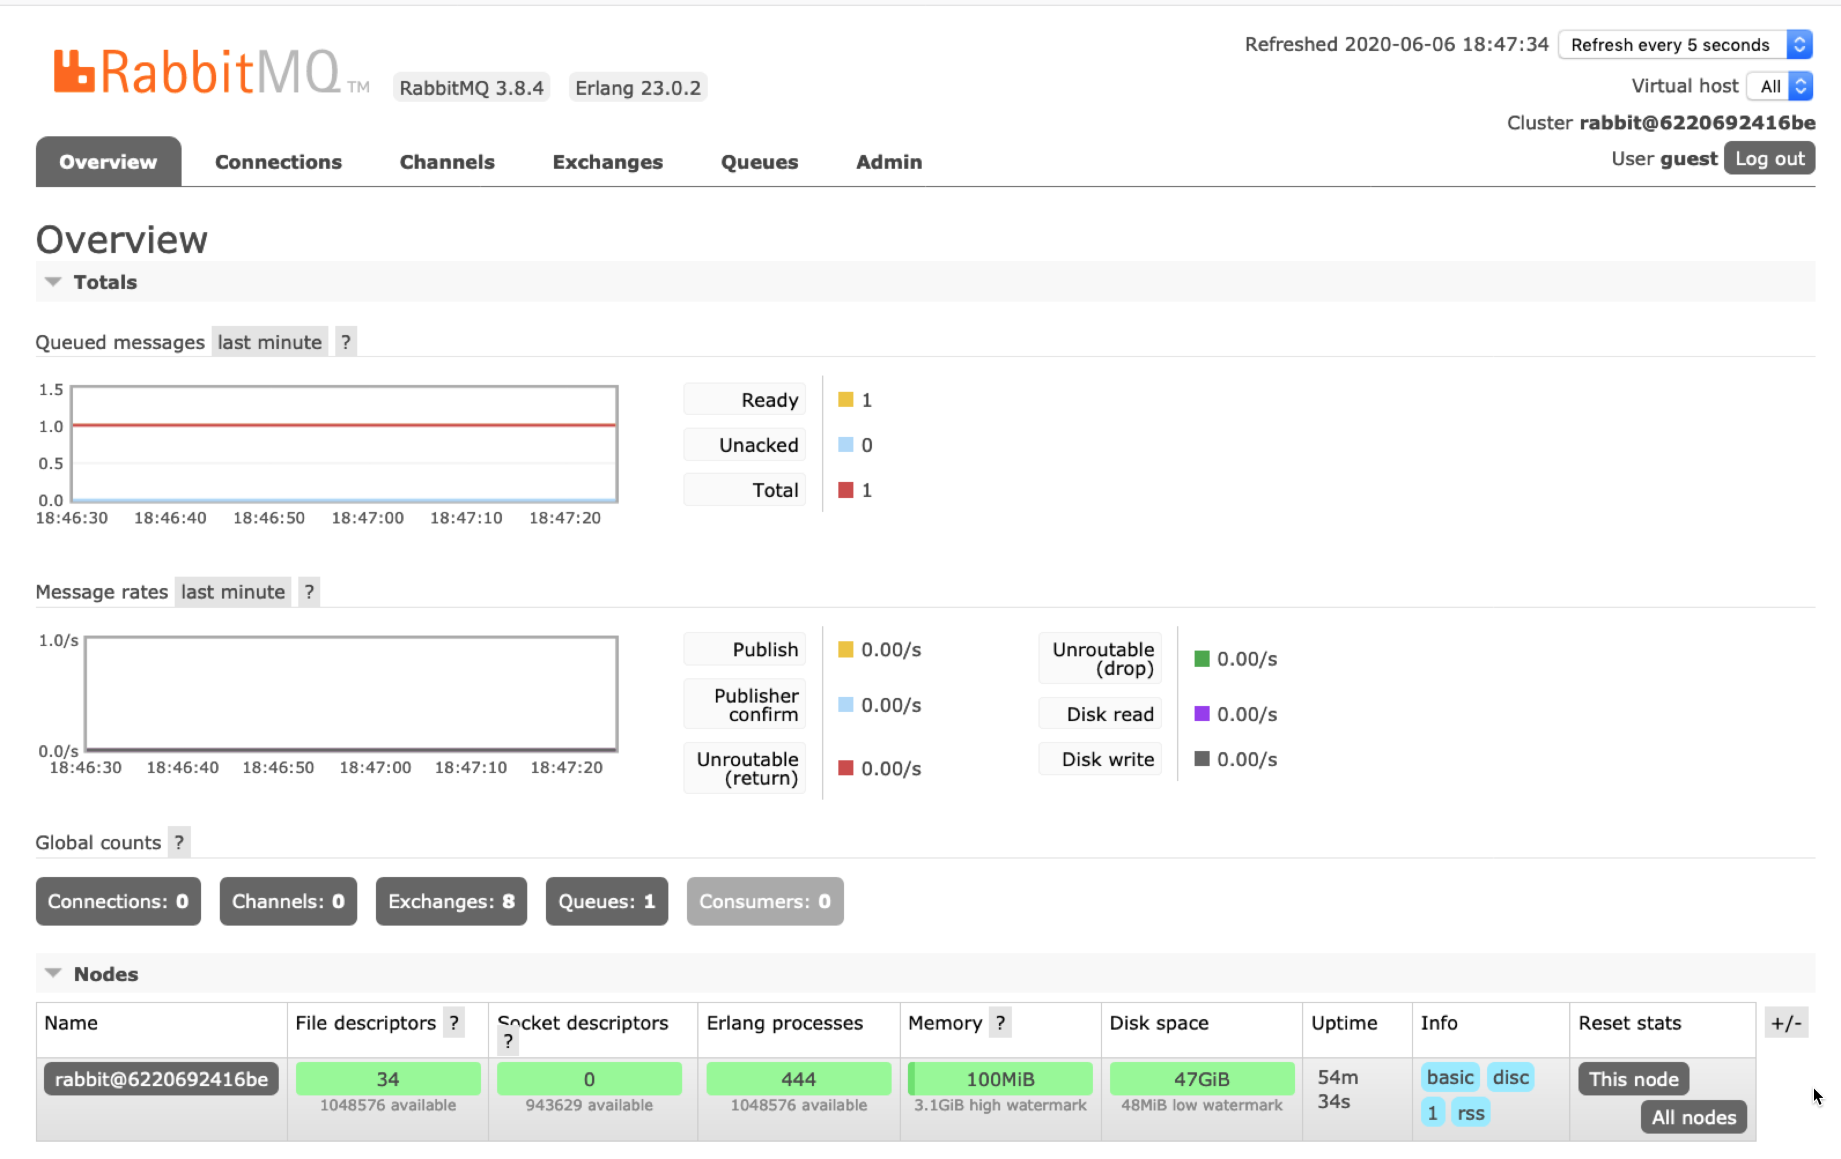
Notes:
# Overview #
The management console is divided into a series of tabs, which list instances of the AMQP primitives: Connections, Channels, Exchanges and Queues as well as providing an Administration page.
The overview page also provides diagnostics on the server itself.
Individual pages allow you to see the state of those primitives as well as define their properties. For example, highlighting an Exchange on the Exchanges tab allows you to see the bindings on that Exchange, add new bindings and publish messages to the Exchange.

Slide 10
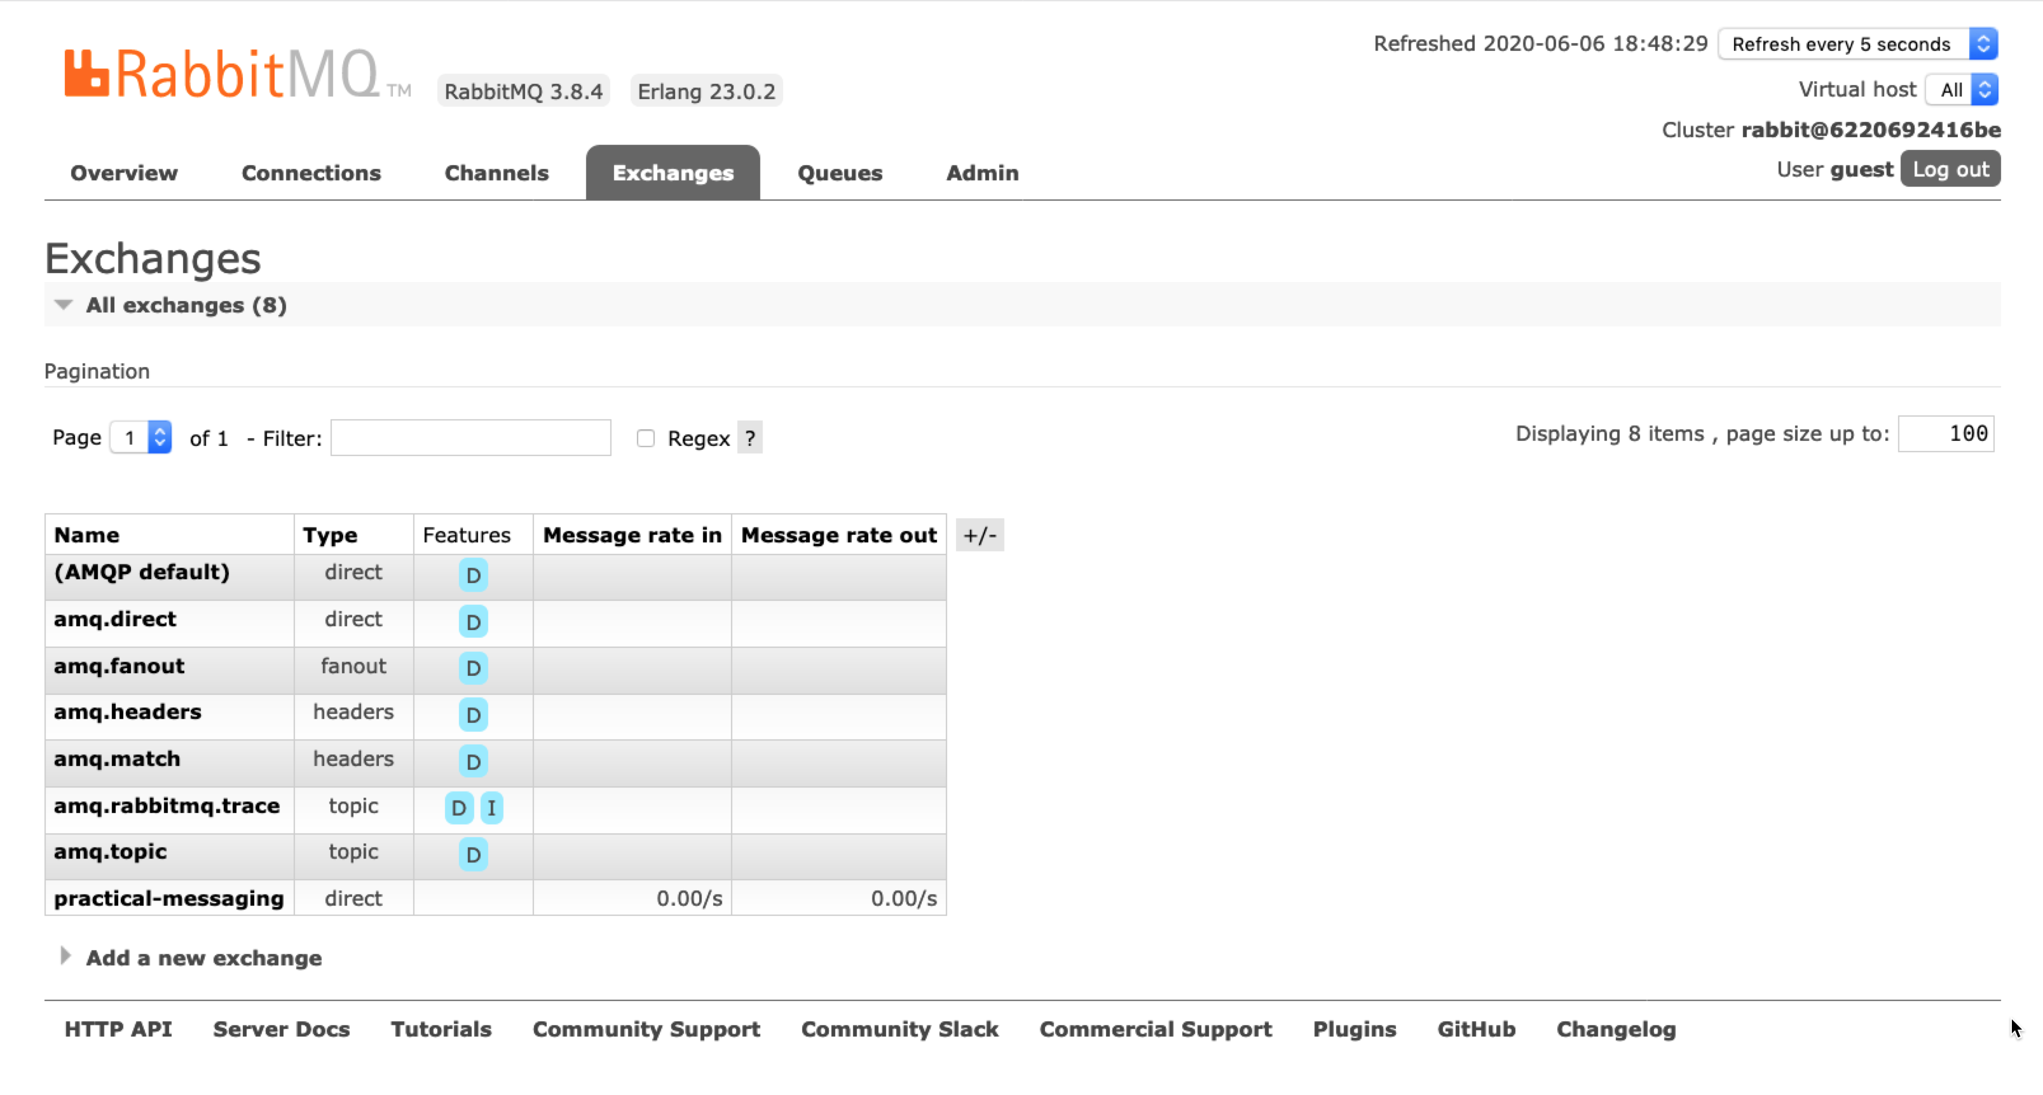
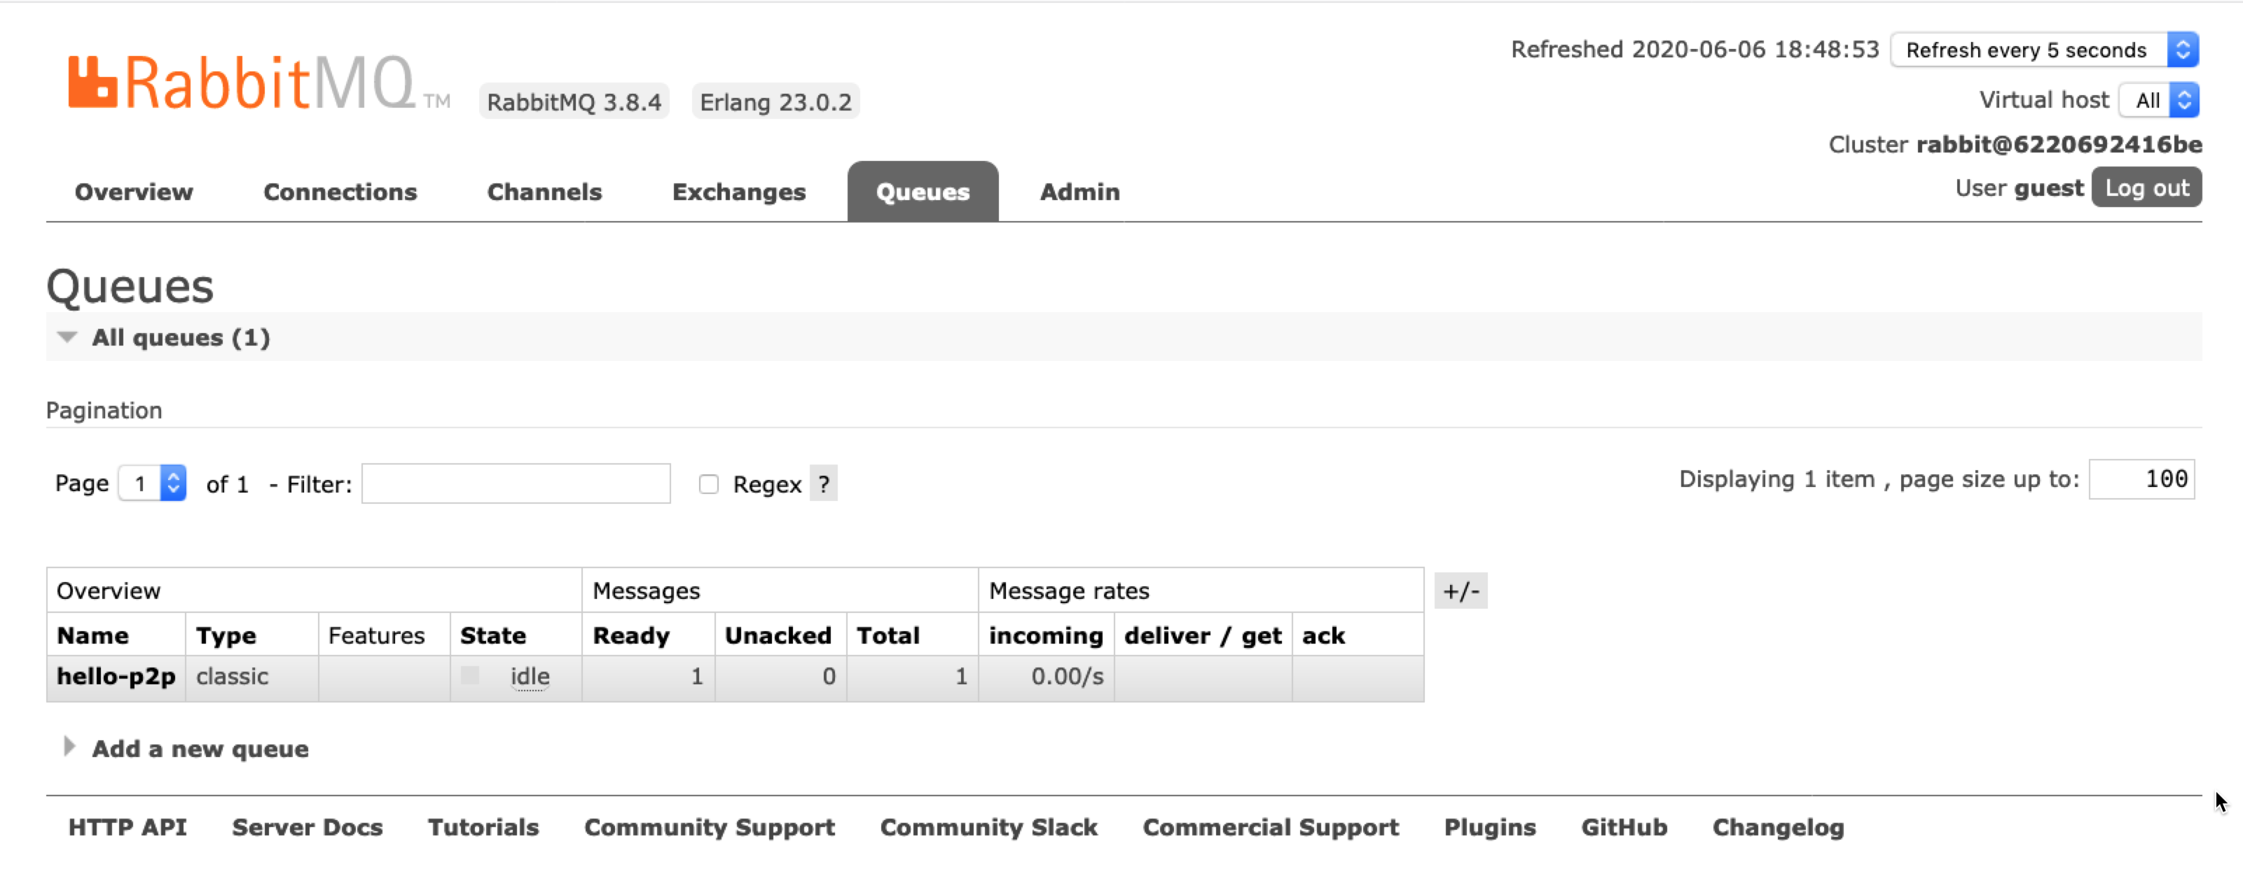
Notes:
# Queues #
The queues tab lists the queues, which can be filtered by exchange. New queues can be defined.
In addition to showing the queue it will also show messages in the queue etc.
Selecting a queue allows inspection of its consumers, bindings, and CRUD operations on its messages.

