Slide 1

Albert Guo
junyuo@gmail.com

Slide 2

What is Java Persistence API
Primary Features
Five Steps to Implement JPA
  Download Hibernate Components
  Prepare Database, and Download JDBC Driver
  Implemented POJO entities and add annotations
  Persistence.xml
  Implemented client side code via EntityManager

Slide 3

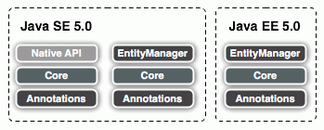
The Java Persistence API is the standard object/relational mapping and persistence management interface of the Java EE 5.0 platform. As part of the EJB 3.0 specification effort, it is supported by all major vendors of the Java industry.

Slide 4

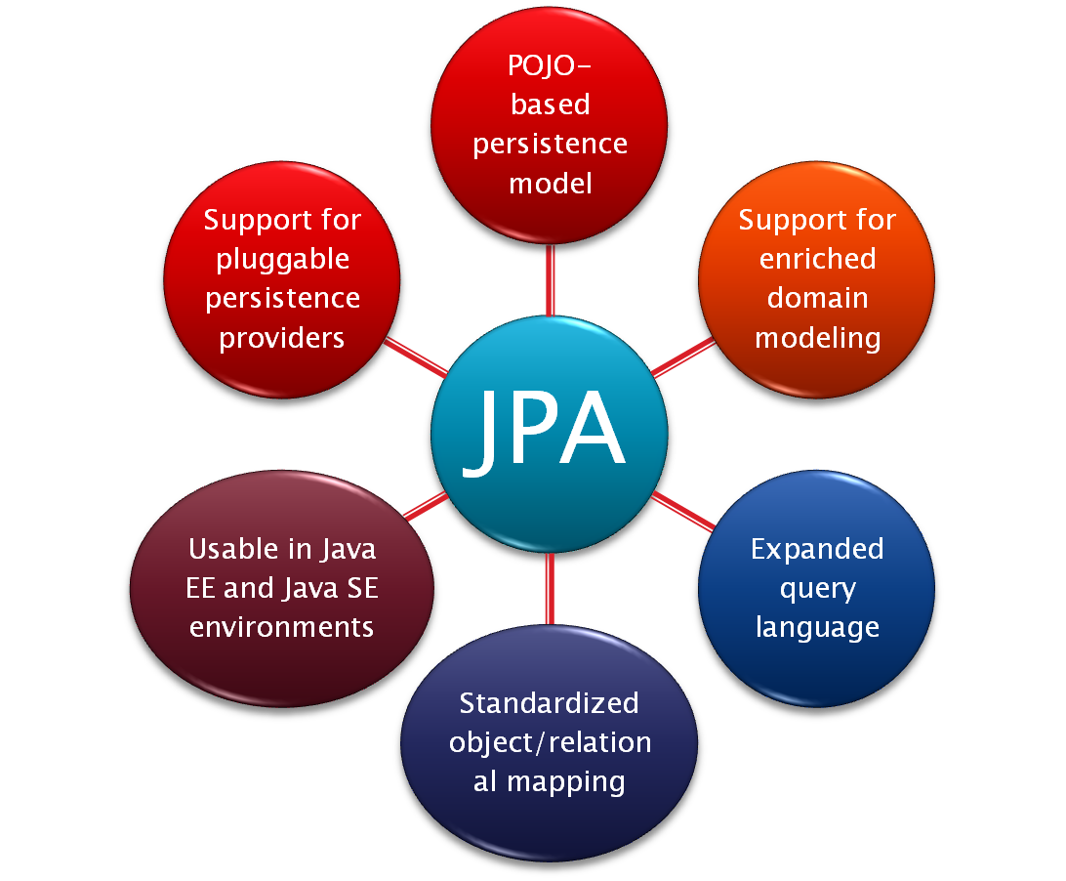
Inheritance, polymorphism, etc.
Using annotations and/or XML

Slide 5







Java Application
Java Persistence API
Hibernate
TopLink
Kodo (OpenJPA)
Everyone can use their own favorite persistence technology

Slide 6

Java Persistence API
Hibernate API
Hibernate Annotation (JPA)
Hibernate EntityManager
Hibernate Annotation (Hibernate)
Hibernate XML Mapping File
Hibernate Core

Slide 7


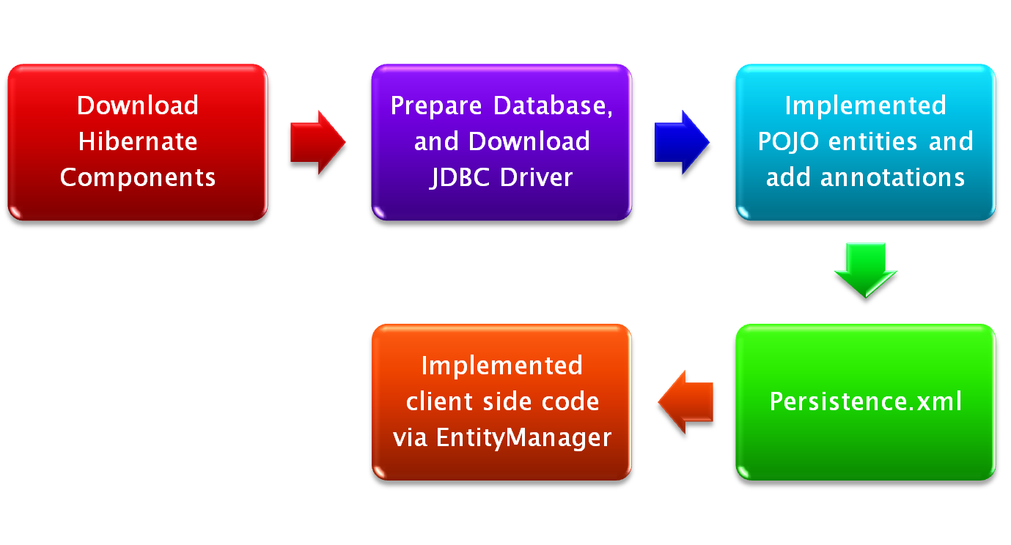


1. Hibernate Core
2. Hibernate EntityManager
3. Hibernate Annotations
http://www.hibernate.org/
MySQL JDBC Driver
http://tinyurl.com/ymt6rb

Slide 8


1. Hibernate Core
2. Hibernate EntityManager
3. Hibernate Annotations
http://www.hibernate.org/
MySQL JDBC Driver
http://tinyurl.com/ymt6rb

Slide 9

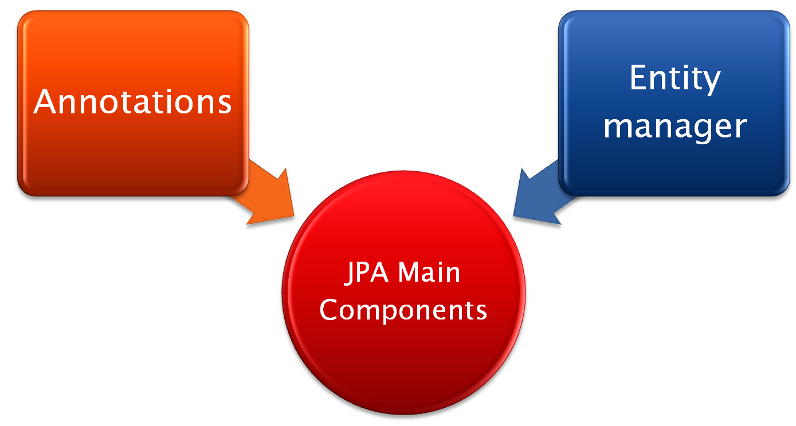
To label artifacts
(classes, methods etc.) for
persistence or persistence
related operations
A “gateway” to the
persistence classes
Allow access to persistent
objects, transaction context,
query language etc.

Slide 10

Hibernate Annotations includes
  Standardized Java Persistence and EJB 3.0 (JSR 220) object/relational mapping annotations
  Hibernate-specific extension annotations for performance optimization and special mappings
Hibernate EntityManager includes
  The standard Java Persistence management API
  The standard Java Persistence Query Language
  The standard Java Persistence object lifecycle rules
  The standard Java Persistence configuration and packaging

Slide 11
1. Hibernate Core
2. Hibernate EntityManager
3. Hibernate Annotations
http://www.hibernate.org/
MySQL JDBC Driver
http://tinyurl.com/ymt6rb

Slide 12

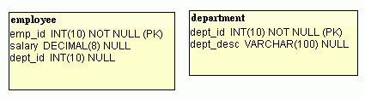
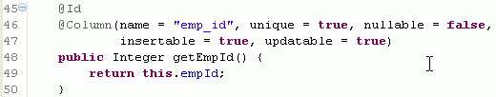

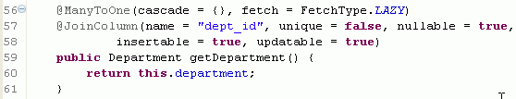

Slide 13
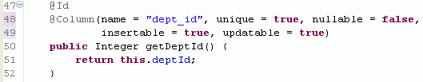



Slide 14


Attached to a class
Signify that a class is persistent
Example:
An entity must follow the Java Bean convention for its attributes to be persistent
  Having getters and setters

Slide 15

Each entity must have an identity
An identity of an entity could simply be a class variable annotated with @Id
Example

Slide 16
Id can be auto generated
  @Id(generate=GeneratorType.AUTO)
There are other strategies such as
  GeneratorType.SEQUENCE
  GeneratorType.IDENTITY
AUTO is best for portability between database vendors

Slide 17

@Column, is put on getter of a class variable
Has several functionalities
  Updatable (boolean)
  Nullable (updatable)
  Length (int)
  Example:

Slide 18

There are 4 types of links
  @OneToOne
  @OneToMany
  @ManyToOne
  @ManyToMany
In most cases, putting the annotation on a getter of a class variable would be enough
In some cases, we need to identify a few parameters to the annotations

Slide 19

Two cases
  Two entities share the same primary key value

Slide 20

Entity objects have two distinct modes
  Attached
    The object is in the database
  Detached
    The object is in memory acting as a DTO
    Modification on detached object would not be persisted automatically
    Developers need to persist detached objects using a primitive

Slide 21

Entity manager:
  Gateway to persistent classes
  Enable queries
  Outside of session beans, provides transaction facility

Slide 22

1. Hibernate Core
2. Hibernate EntityManager
3. Hibernate Annotations
http://www.hibernate.org/
MySQL JDBC Driver
http://tinyurl.com/ymt6rb

Slide 23


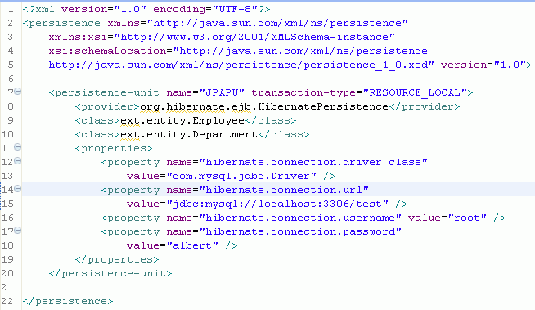
EntityManagerFactory Name
Entity classes
JDBC Driver
JDBC URL
User name
password

Slide 24

1. Hibernate Core
2. Hibernate EntityManager
3. Hibernate Annotations
http://www.hibernate.org/
MySQL JDBC Driver
http://tinyurl.com/ymt6rb

Slide 25

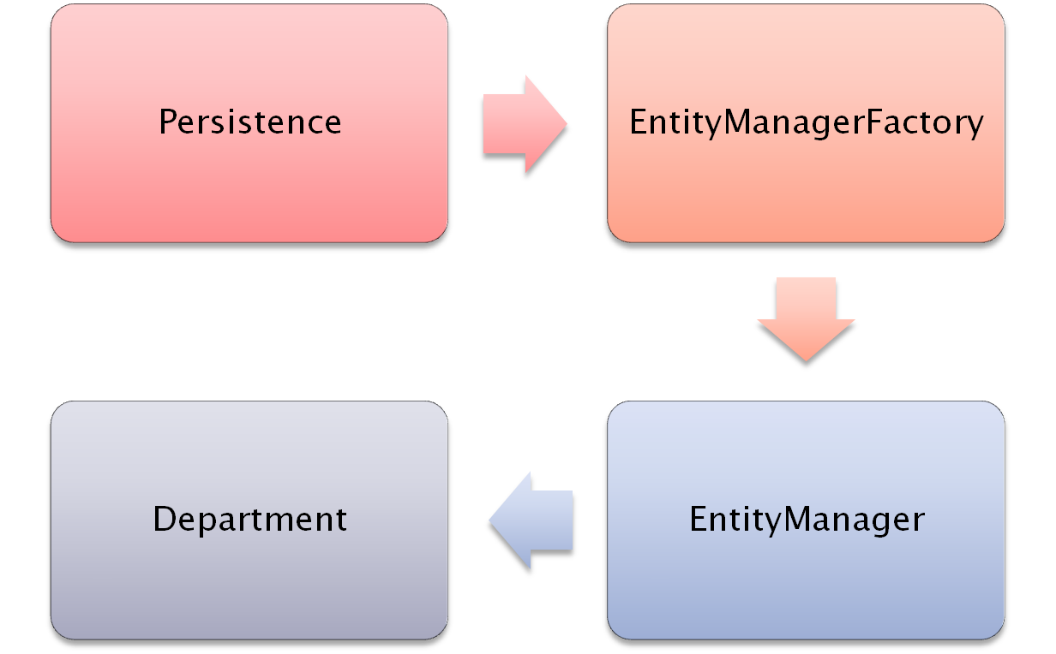
Create
Persistence.xml
Create
Operates

Slide 26

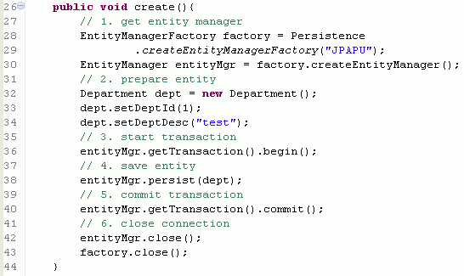

Slide 27

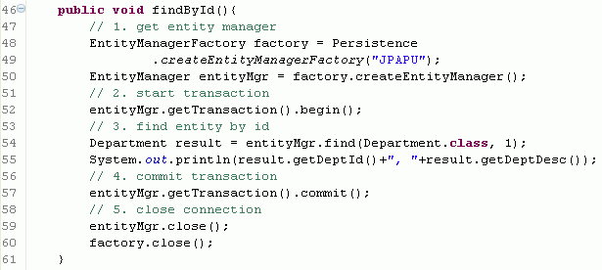

Slide 28

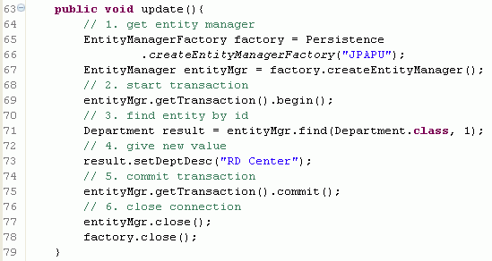

Slide 29

