Slide 1
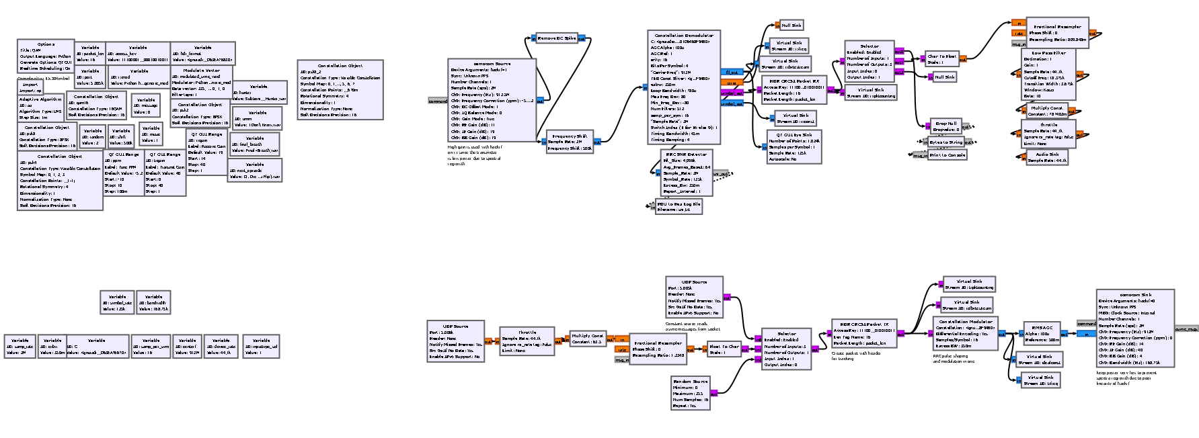
SNR-to-Error Evaluation of M-Ary PSK/QAM
Applied to Affordable Consumer SDRs
Ian Dwyer and Esraa Aldhufairi

Slide 2
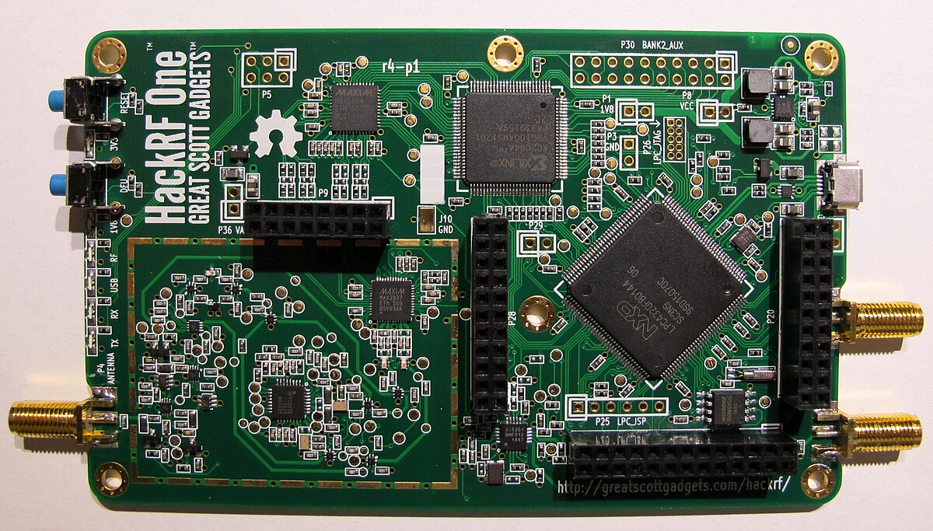
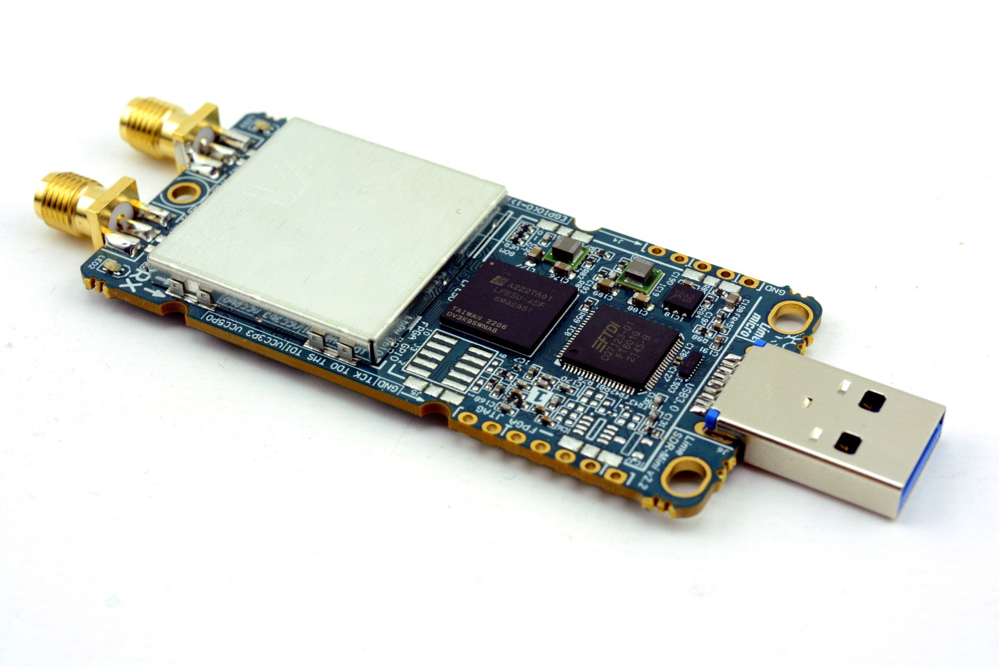
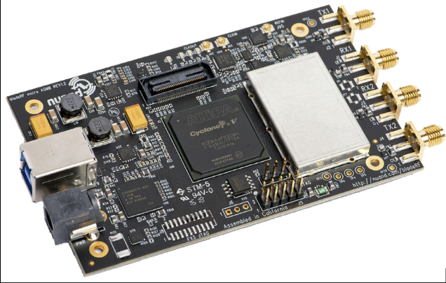
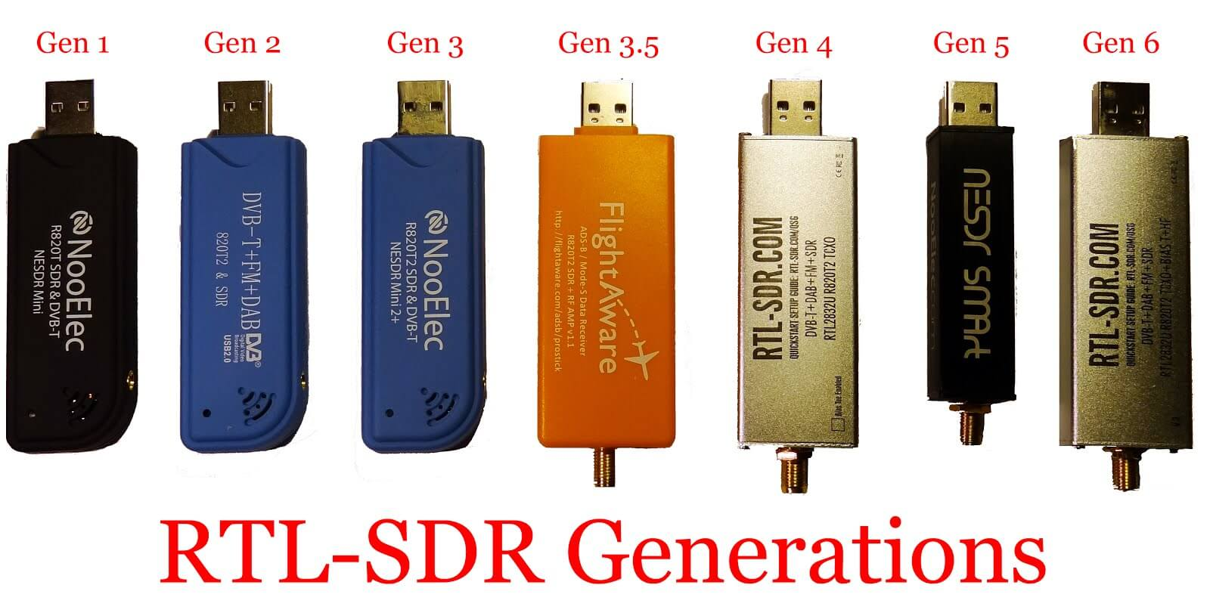
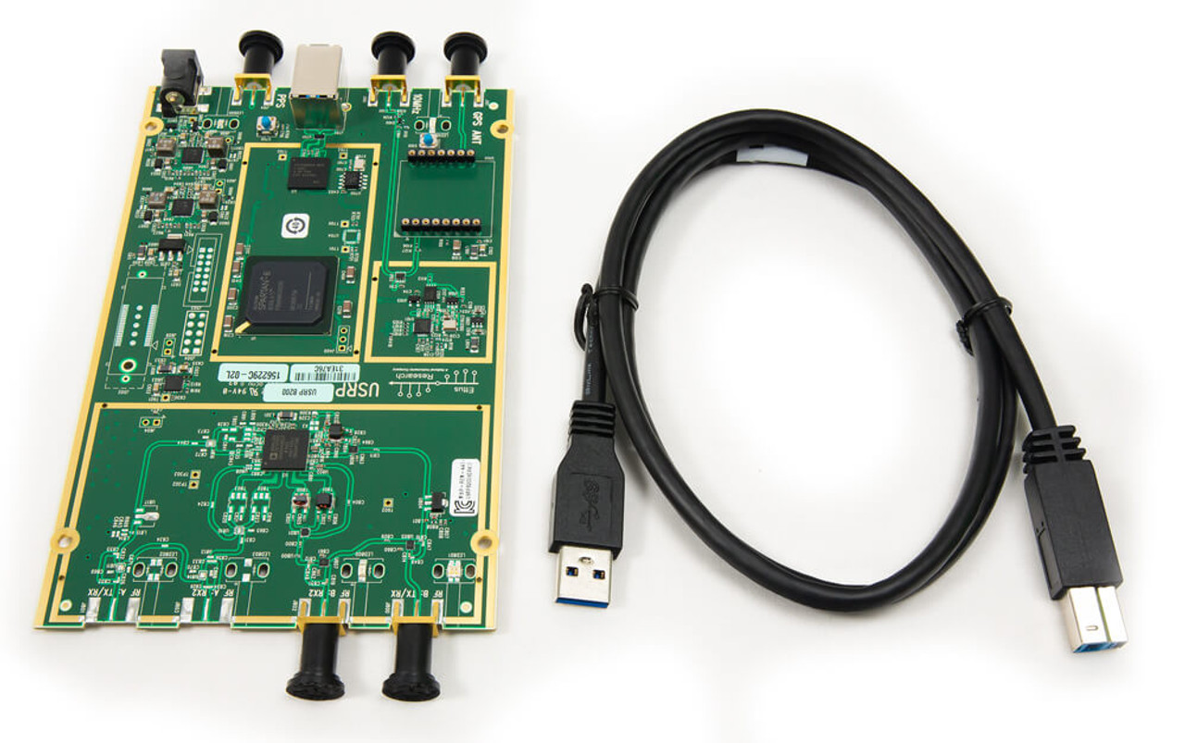
Motivation for Quantifying SNR on Consumer SDRs
Software defined radio (SDR) devices have become more popular and despite massive price hikes, up to 200% MSRP, due to availability such as the receiver devices like the RTL-SDR, half-duplex transceivers like the HackRF One and full-duplex high-quality systems like USRP B200 are readily available to hobbyists and developers alike.
Unfortunately, dynamic functionality comes at a price and without deep pockets quality takes a backseat [5], so how well transceivers transmit and detect signals is a considerably practical application that should likely be done to characterize the functionality of any new device used in development.

Slide 3
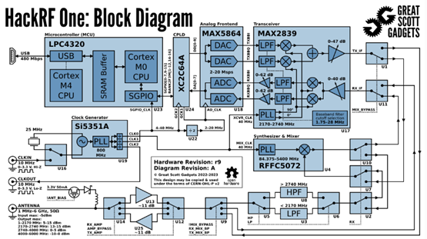
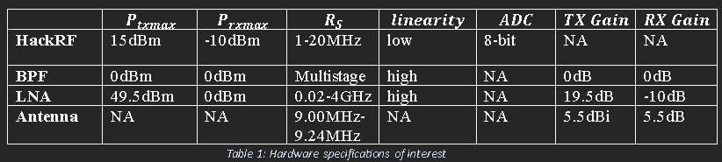
Overview of HackRF
The most affordable platform for developers and hobbyists is GNURadio with HackRF One or the PlutoSDR. The HackRF has no filtering to ensure that the signal only operates in the intended band, so an essential expense is the bandpass filter to remove upper harmonics.
The HackRF One, by Michael Ossmann, is open-source software and hardware, so modifications are welcome and there is plenty of documentation available.
Michael Ossmann hosts his own tutorials at Great Scotts Gadgets homepage for HackRF on GNU Radio.

Slide 4
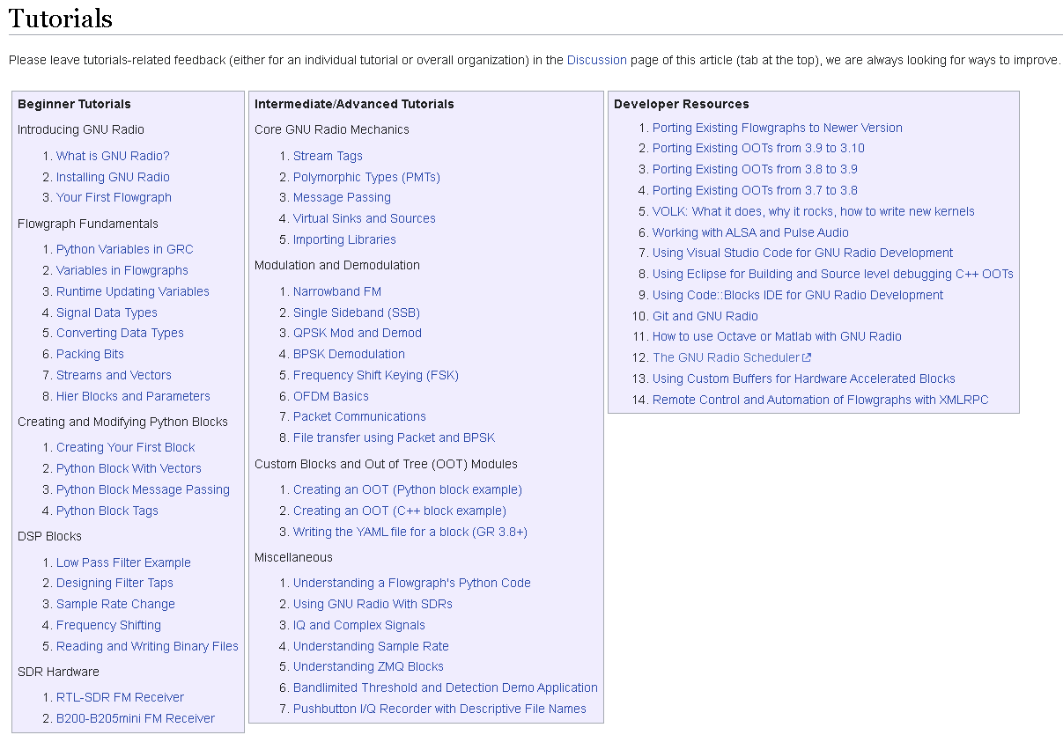
Overview of GNU Radio
Free, open-source toolkit for building software-defined radios (SDRs)
GUI-based design with GNU Radio Companion (GRC)
Modular signal processing blocks in C++ and Python
Supports PSK, QAM, FSK, OFDM, and custom modulation schemes
Interfaces with SDR hardware: HackRF, USRP, RTL-SDR, PlutoSDR
Widely used in research, prototyping, and academic labs
Tutorials on using GNU Radio are available through Wikipedia [4]

Slide 5
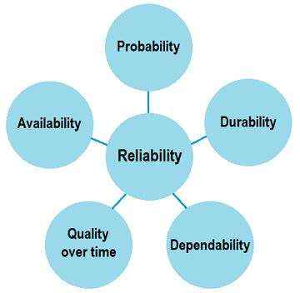
Reliability of GNU Radio and HackRF
HACKRF ONE'S HAVE MOSTLY NONLINEAR FRONT-END CIRCUITRY, ESPECIALLY THE AMPLIFIER. IT ALSO DOES NOT APPEAR TO HAVE THE MOST STABLE INTERNAL HARDWARE PLL AND IS MORE STABLE WITHOUT IT ENABLED.
HACKRFS ARE SENSITIVE BUT APPEAR TO HAVE STABLE RESULTS.
GNU RADIO IS ACTIVELY SUPPORTED BUT UPDATES AND SUPPORT ARE NOT SIGNIFICANT SO THERE IS A MIX AND LACK OF RESOURCES THAT PRODUCES INCONSISTENCIES.
GNU RADIO IS CONSIDERED FAST AND HIGHLY RELIABLE WHEN THE BLOCKS USED ARE SUPPORTED AND THE FLOWGRAPH DESIGN IS WELL CONSTRUCTED, BUT IS NOT GOOD FOR DEBUGGING WHEN THIS FAILS.
NO FAILSAFES BUILT INTO GNURADIO SO IT COMMONLY CRASHES WITH THE WRONG SETTINGS.

Slide 6
System Architecture
RECEIVER:
MIRRORS TRANSMITTER, WITH ADDITIONAL RECOVERY BLOCKS.
RMS AGC LOCKS GAIN; SNR IS MEASURED HERE.
TIMING RECOVERY VIA ZERO-CROSSING AND POLYPHASE FILTER USING MATCHED RRC.
FOLLOWED BY PHASE RECOVERY AND SYMBOL DETECTION.
FINAL PROCESSING INCLUDES PACKET HEADER CHECK, BYTE ALIGNMENT, AND OUTPUT TO CONSOLE OR AUDIO.
TUNED FOR CONNECTIVITY: TIGHT PHASE BANDWIDTH (0.001), WIDE TIMING BANDWIDTH.
Transmitter:
Sources: audio or UDP (local socket) feed Python-generated byte messages.
Data is packed into packets with checksum and access headers.
Modulation: constellation mapper → zero-filled interpolation → RRC pulse shaping.
An RMS AGC block soft clips to reduce PAPR before sending to the radio.
Max reliable output: ~38 dB SNR (theoretical max ~49 dB), constrained by 8-bit DAC and AGC tuning.
CHANNEL:
INDOOR, LINE-OF-SIGHT SETUP (12×12×7 FT ROOM), ~6 FT DISTANCE.
MINIMAL FADING, SOME MULTIPATH EXPECTED DUE TO WALLS AND WINDOW.
NO EXTERNAL AMPLIFIER USED; TRANSMIT GAIN AT MAXIMUM.

Slide 7
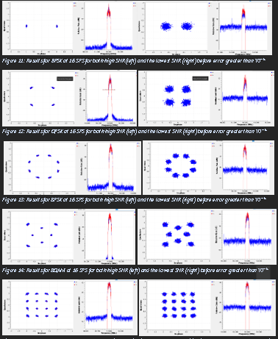
Modulation Schemes Used
There are two fundamental modulation schemes used as PSK, specifically BPSK, QPSK, 8-PSK, 8QAM, and 16-QAM to obtain 3 of each with 1 crossover, QPSK.
The value of testing two different modulation schemes is due to the effect on minimum distance when packing more symbols either in amplitude and phase.
All constellations except the 8QAM are available in-tree but a model that allowed for stepping constellation density by 2 was valuable for testing

Slide 8
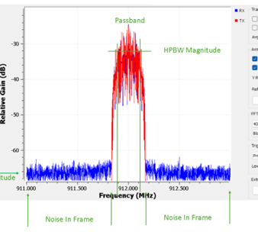
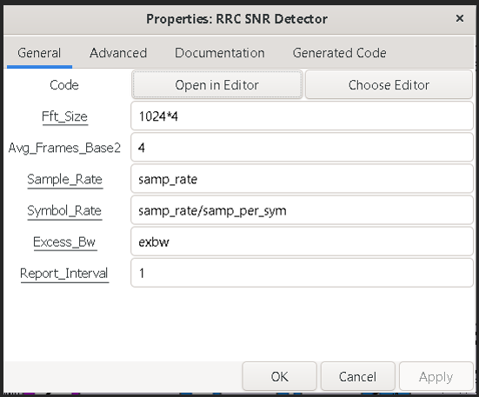
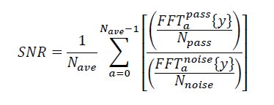
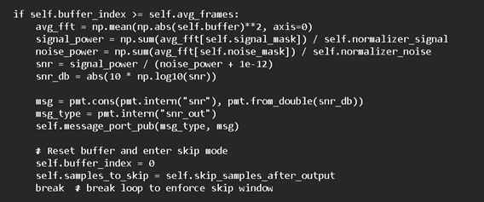
How SNR Measured SNR
The SNR is not obtained using a conventional numerical method but instead uses a more rudimentary design using embedded python block uses the RRC modulation parameters:
excess bandwidth (aka roll-off factor)
sample rate
symbol rate
moving average
FFT size
number of frames to average with an
output duration to limit the writes
Results of the custom detector were very accurate but very resource intensive and unreasonable for practical designs.
Results are saved to a text file or output to the console.

Slide 9
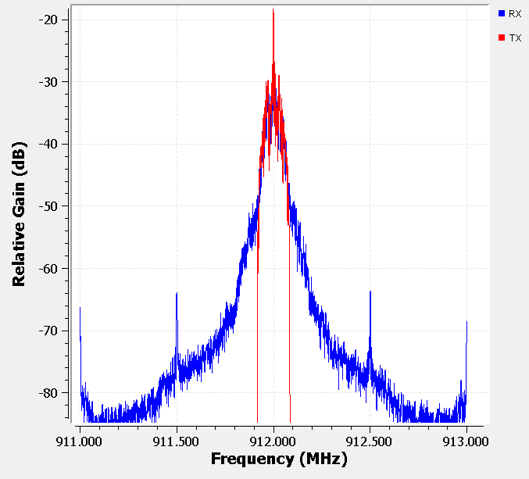
Challenges Encountered
Spectral regrowth due to ADC/DAC and nonlinear amplifier on HackRF was mitigated with a soft clip to minimize PAPR. Could have done with less filters if not using the Constellation Modulator.
Ensuring that sample rates were correct at each block and that none were over or under-running due to buffer/computational limitations was an ongoing hurdle.
Obtaining BER due to synchronization timing. A better but processes intensive method would be to compare each packet received, truncate startup and compare unique payloads.
The most difficult challenge was getting a lock on phase-ambiguous constellations, with the 8-psk being the most difficult to stabilize.

Slide 10
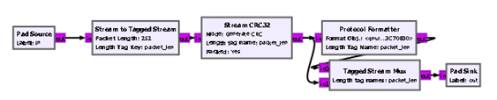

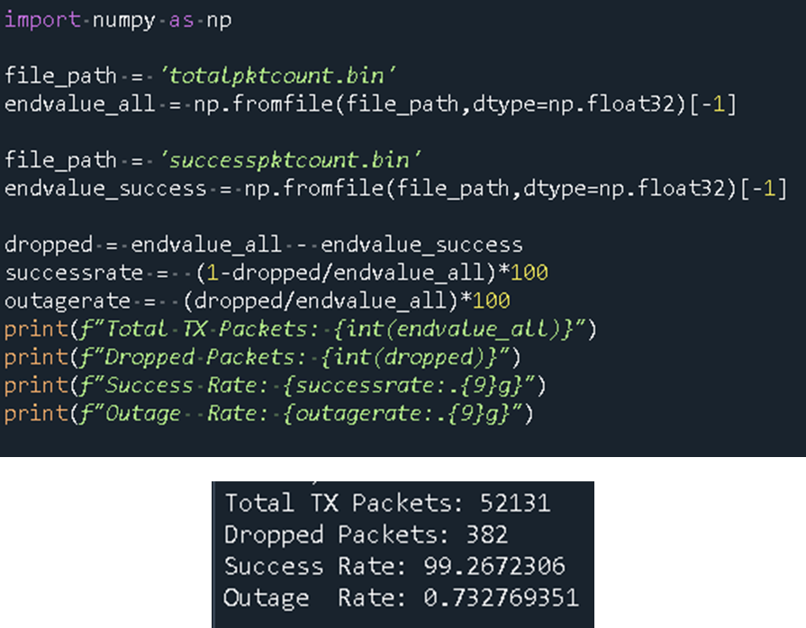
PER/BER Calculations
Each packet was 264 bytes, including a 252-byte payload and CRC32 checksum.
An additional excess bandwidth of 0.35 helped lock higher-order constellations (order > 4).
No redundancy was applied, so no coding gain aided in error rate
Packet Error Rate (PER) was the primary performance metric, determined with zero tolerance via CRC32 checksums, ensuring strict validation where any bit error results in a failed packet.

Slide 11
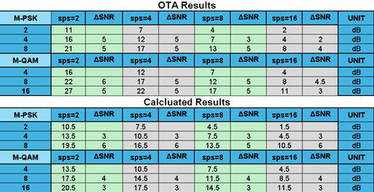
Minimum SNR for BER=10^-6 Results and Comparison
Results between calculated and tested OTA results were similar but still had significant discrepancies
One major discrepancy is only 3dB required increase in SNR per halving of SPS was calculated on average but obtained 5dB for lower SPS.
This table, despite the inaccuracies, still provides the value of oversample/process gain for SDRs as TI highlights as "cheating physics"

Slide 12


Summary of Findings
IT WAS ALSO FOUND THAT THERE IS LIKELY LARGER SNR REQUIREMENTS THAN PREDICTED FOR LOW SPS DUE TO THE CHANNEL AND PULSE SHAPING FILTERS BUT APPEARS TO CONVERGE AT HIGH SPS PROVIDING DETECTION LIKE HIGHER QUALITY RADIOS AT THE COST OF COMPUTATIONAL OVERHEAD.
IF TESTING MATCHED IDEAL RESULTS OVERSAMPLING GAIN WOULD PERFECTLY OFFSET CONSTELLATION PACKING LOSSES
$\frac{Δ\text{SNR}}{ΔM}\text{≈}\frac{\text{5}\text{dB}}{2M}$ in packing loss
$\frac{Δ\text{SNR}}{ΔSPS}\text{≈}\frac{\text{3}\text{dB}}{2SPS}$ in oversampling gain

Slide 13
Reported Challenges in Similar Work
Many SNR detector models ignore inter-symbol interference (ISI) which can be fixed based on a well-designed pilot.
High computation overhead in SNR estimation techniques (e.g., pilot-based time domain detectors commonly fix this)
Lack of real-world, over-the-air testing in most studies begs the question of practicality
This study fills the gap by evaluating SNR-to-error performance using real OTA tests with consumer-grade SDR (HackRF One) but in impractically uses an inefficient algorithm that ensures accuracy.

Slide 14
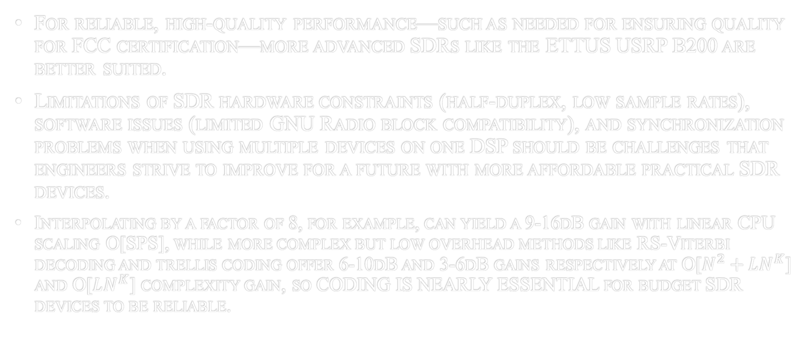
Implications for Practical System Using SDR
For reliable, high-quality performance—such as needed for ensuring quality for FCC certification—more advanced SDRs like the ETTUS USRP B200 are better suited.
Limitations of SDR hardware constraints (half-duplex, low sample rates), software issues (limited GNU Radio block compatibility), and synchronization problems when using multiple devices on one DSP should be challenges that engineers strive to improve for a future with more affordable practical SDR devices.
Interpolating by a factor of 8, for example, can yield a 9-16dB gain with linear CPU scaling O[SPS], while more complex but low overhead methods like RS-Viterbi decoding and trellis coding offer 6-10dB and 3-6dB gains respectively at O[$N^{2}+LN^{K}$] and O[$LN^{K}$] complexity gain, so CODING IS NEARLY ESSENTIAL for budget SDR devices to be reliable.

Slide 15
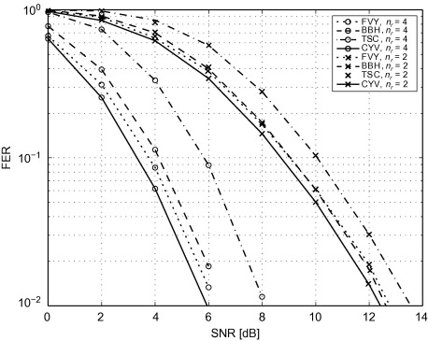
Suggestions for Future Work
FUTURE TESTING SHOULD CONSIDER MORE REALISTIC CHANNEL MODELS SUCH AS RICIAN AND RAYLEIGH FADING, AS WELL AS COMMON MULTIPLE ACCESS SCHEMES WHICH CAN DEGRADE SNR
FUTURE RESEARCH SHOULD EXPLORE OVER-THE-AIR (OTA) SNR DETECTORS, ADVANCED CODING TECHNIQUES, MIMO, EFFICIENT MODULATIONS LIKE MSK/GMSK, EQUALIZATION STRATEGIES (E.G., ZERO-FORCING, MMSE), AND OPTIMIZATION OF CONSTELLATION DESIGN TO FURTHER ENHANCE DETECTION GAIN AND SYSTEM PERFORMANCE.
CODING TECHNIQUES LIKE CONVOLUTIONAL, TURBO, REED-SOLOMON, AND VITERBI DECODING OFFER VARIOUS TRADE-OFFS BETWEEN CODING GAIN AND COMPUTATIONAL COMPLEXITY.

Slide 16
Concluding THOUGHTS
THIS STUDY HIGHLIGHTS HOW ANALYZING SNR REQUIREMENTS FOR PSK AND QAM OFFERS VALUABLE INSIGHT INTO THE CAPABILITIES AND LIMITATIONS OF CONSUMER-GRADE SDRS.
IT EMPHASIZES THE IMPORTANCE OF SELECTING THE RIGHT SDR BASED ON APPLICATION NEEDS, WHETHER FOR RESEARCH OR HOBBY USE.
THE FINDINGS SUPPORT USING SDRS FOR FLEXIBLE SIGNAL QUALITY MANAGEMENT, EVEN THOUGH SPECIALIZED RADIOS OFTEN PERFORM BETTER IN FIXED ROLES.
HOPEFULLY MORE FOCUS IS GIVEN TO SDR DEVELOPMENT TO REDUCE COSTS, IMPROVE PERFOMANCE AND EXPLORE DYNAMIC SYSTEM THAT TRULY HARNESS THE POWER OF SDR RADIO.

Slide 17
QUESTIONS?

