Slide 1
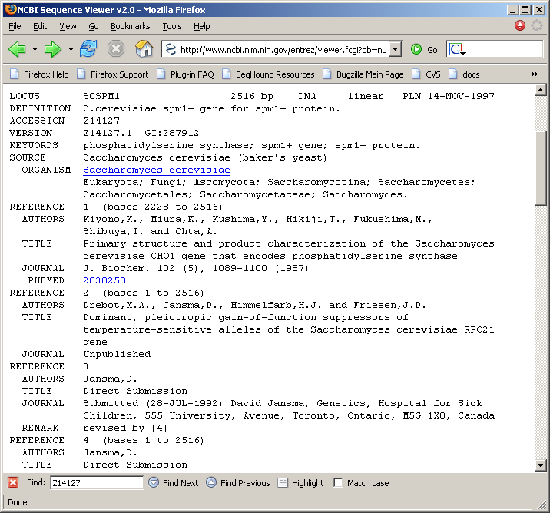
GENBANK ID CONVERSIONS
The sequence encoding spm1+ protein.
What is the identifier for this record?

Slide 2
GENBANK ID CONVERSIONS
seq {
id {
embl {
name "SCSPM1" ,
accession "Z14127" ,
version 1 } ,
gi 287912 } ,
descr
{ title "S.cerevisiae spm1+ gene for spm1+ protein" ,
The sequence encoding spm1+ protein has three identifiers
In the ASN.1 that underlies the GenBank flat-file.

Slide 3
GENBANK ID CONVERSIONS
SHoundGBAccFromGi
SHoundDbNameAndIdFromGi
GI
(Gene Info identifier)
e.g. 287912
SHoundGiFromGBAcc
SHoundGiFromDbNameAndId
SHoundGBAccFromDbNameAndId
GenBank accession
e.g. Z14127
Dbname and id
e.g. embl + SCSPM1
SHoundDbNameAndIdFromGBAcc
The sequence encoding spm1+ protein has three identifiers.
The GenBank ID Conversion functions convert between these identifiers.

