Slide 1
Design Patterns for working with Fast Data
Portland Java User Group
October 18, 2016
Notes:
I work for a company called MapR.
How many people here use message busses?
Streaming
-message busses are often overlooked in APM
-fast data streams are usually pretty cool
-working with fast data encourages efficient code
Microservices (because I already embrace OOP, and it’s ”hot”)

Slide 2
Abstract
Apache Kafka is an open-source message broker project that provides a platform for storing and processing real-time data feeds. In this presentation Ian Downard will describe the concepts that are important to understand in order to effectively use the Kafka API. You will see how to prepare a development environment from scratch, how to write a basic publish/subscribe application, and how to run it on a variety of different cluster types, starting with a single-node cluster on Virtual Box, then on multi-node cluster using Heroku’s “Kafka as a Service”, and finally on an enterprise-grade multi-node cluster using MapR’s Converged Data Platform.
Ian will also discuss strategies for working with "fast data" and how to maximize the throughput of your Kafka pipeline. He'll describe which Kafka configurations and data types have the largest impact on performance and provide some useful JUnit tests, combined with statistical analysis in R, that can help quantify how various configurations effect throughput.
The code and presentation for this talk will be available at https://github.com/iandow/design-patterns-for-fast-data

Slide 3

Author
Ian Downard is a technical evangelist for MapR where he is focused on creating developer-friendly ways to use the MapR Converged Data Platform.
Personal Blog: http://www.bigendiandata.com
Twitter: https://twitter.com/iandownard
GitHub: https://github.com/iandow
LinkedIn: https://www.linkedin.com/in/iandownard

Slide 4
What is Kafka?
A cluster based platform for storing and processing data.
A distributed publish-subscribe messaging system.
Persists on disk (not “in-memory”).
Supports true streaming (not just fast batching).
Can be used for data storage AND data processing (not just storage)
Oriented around small messages and dynamic data sets (i.e. “streams”).
Notes:
Have we heard this before at PJUG?
In memory data grids: Hazelcast and Gemfire
Similarities
Easy to scale up. Really fast (in memory). Resilience thru clustering.
Both support Object-oriented and schemaless data
major differences:
Kafka is not in memory.
Kafka supports true streaming (not just fast batching).
Kafka can be used for data storage AND data processing (not just storage)
Oriented more around highly dynamic data sets.

Slide 5
Why Kafka?
Decoupling is one of the most important things that make services scalable.
Kafka is elastic, resilient to failure, and low latency.
Kafka fits well in microservice architectures.
Kafka is becoming the default for inter-service communication.
It’s open source and doesn’t require big hardware.
Notes:
Good messaging systems are key to microservices.
Message busses are often overlooked by APM.
Why fast data?
Because fast data streams are usually pretty cool
And working with fast data encourages efficient code

Slide 6
What is Streaming Data?
Retail: orders, sales, shipments, price adjustments
Finance: stock prices, other time series data
Web sites: clicks, impressions, searches
Operating Systems: machine metrics, and logs

Slide 7
Some examples of streaming datasets
Social Media
  https://dev.twitter.com/streaming/overview
IoT
  Lots of examples at https://data.sparkfun.com/streams/
  http://dweet.io is pretty cool
Servers:
  /var/log/syslog
  tcpdump
Banking
  Yahoo Finance API: https://github.com/cjmatta/TwitterStream, http://meumobi.github.io/stocks%20apis/2016/03/13/get-realtime-stock-quotes-yahoo-finance-api.html
  NYSE markets: http://www.nyxdata.com/Data-Products/Daily-TAQ
Other
  screen scrape anything
Notes:
We kinds of things can you do with streaming data?
Machine Learning
-credit card fraud
-web click fraud
-detect mechanical part failures, samsung phone example
Text Mining
Business Intelligence

Slide 8
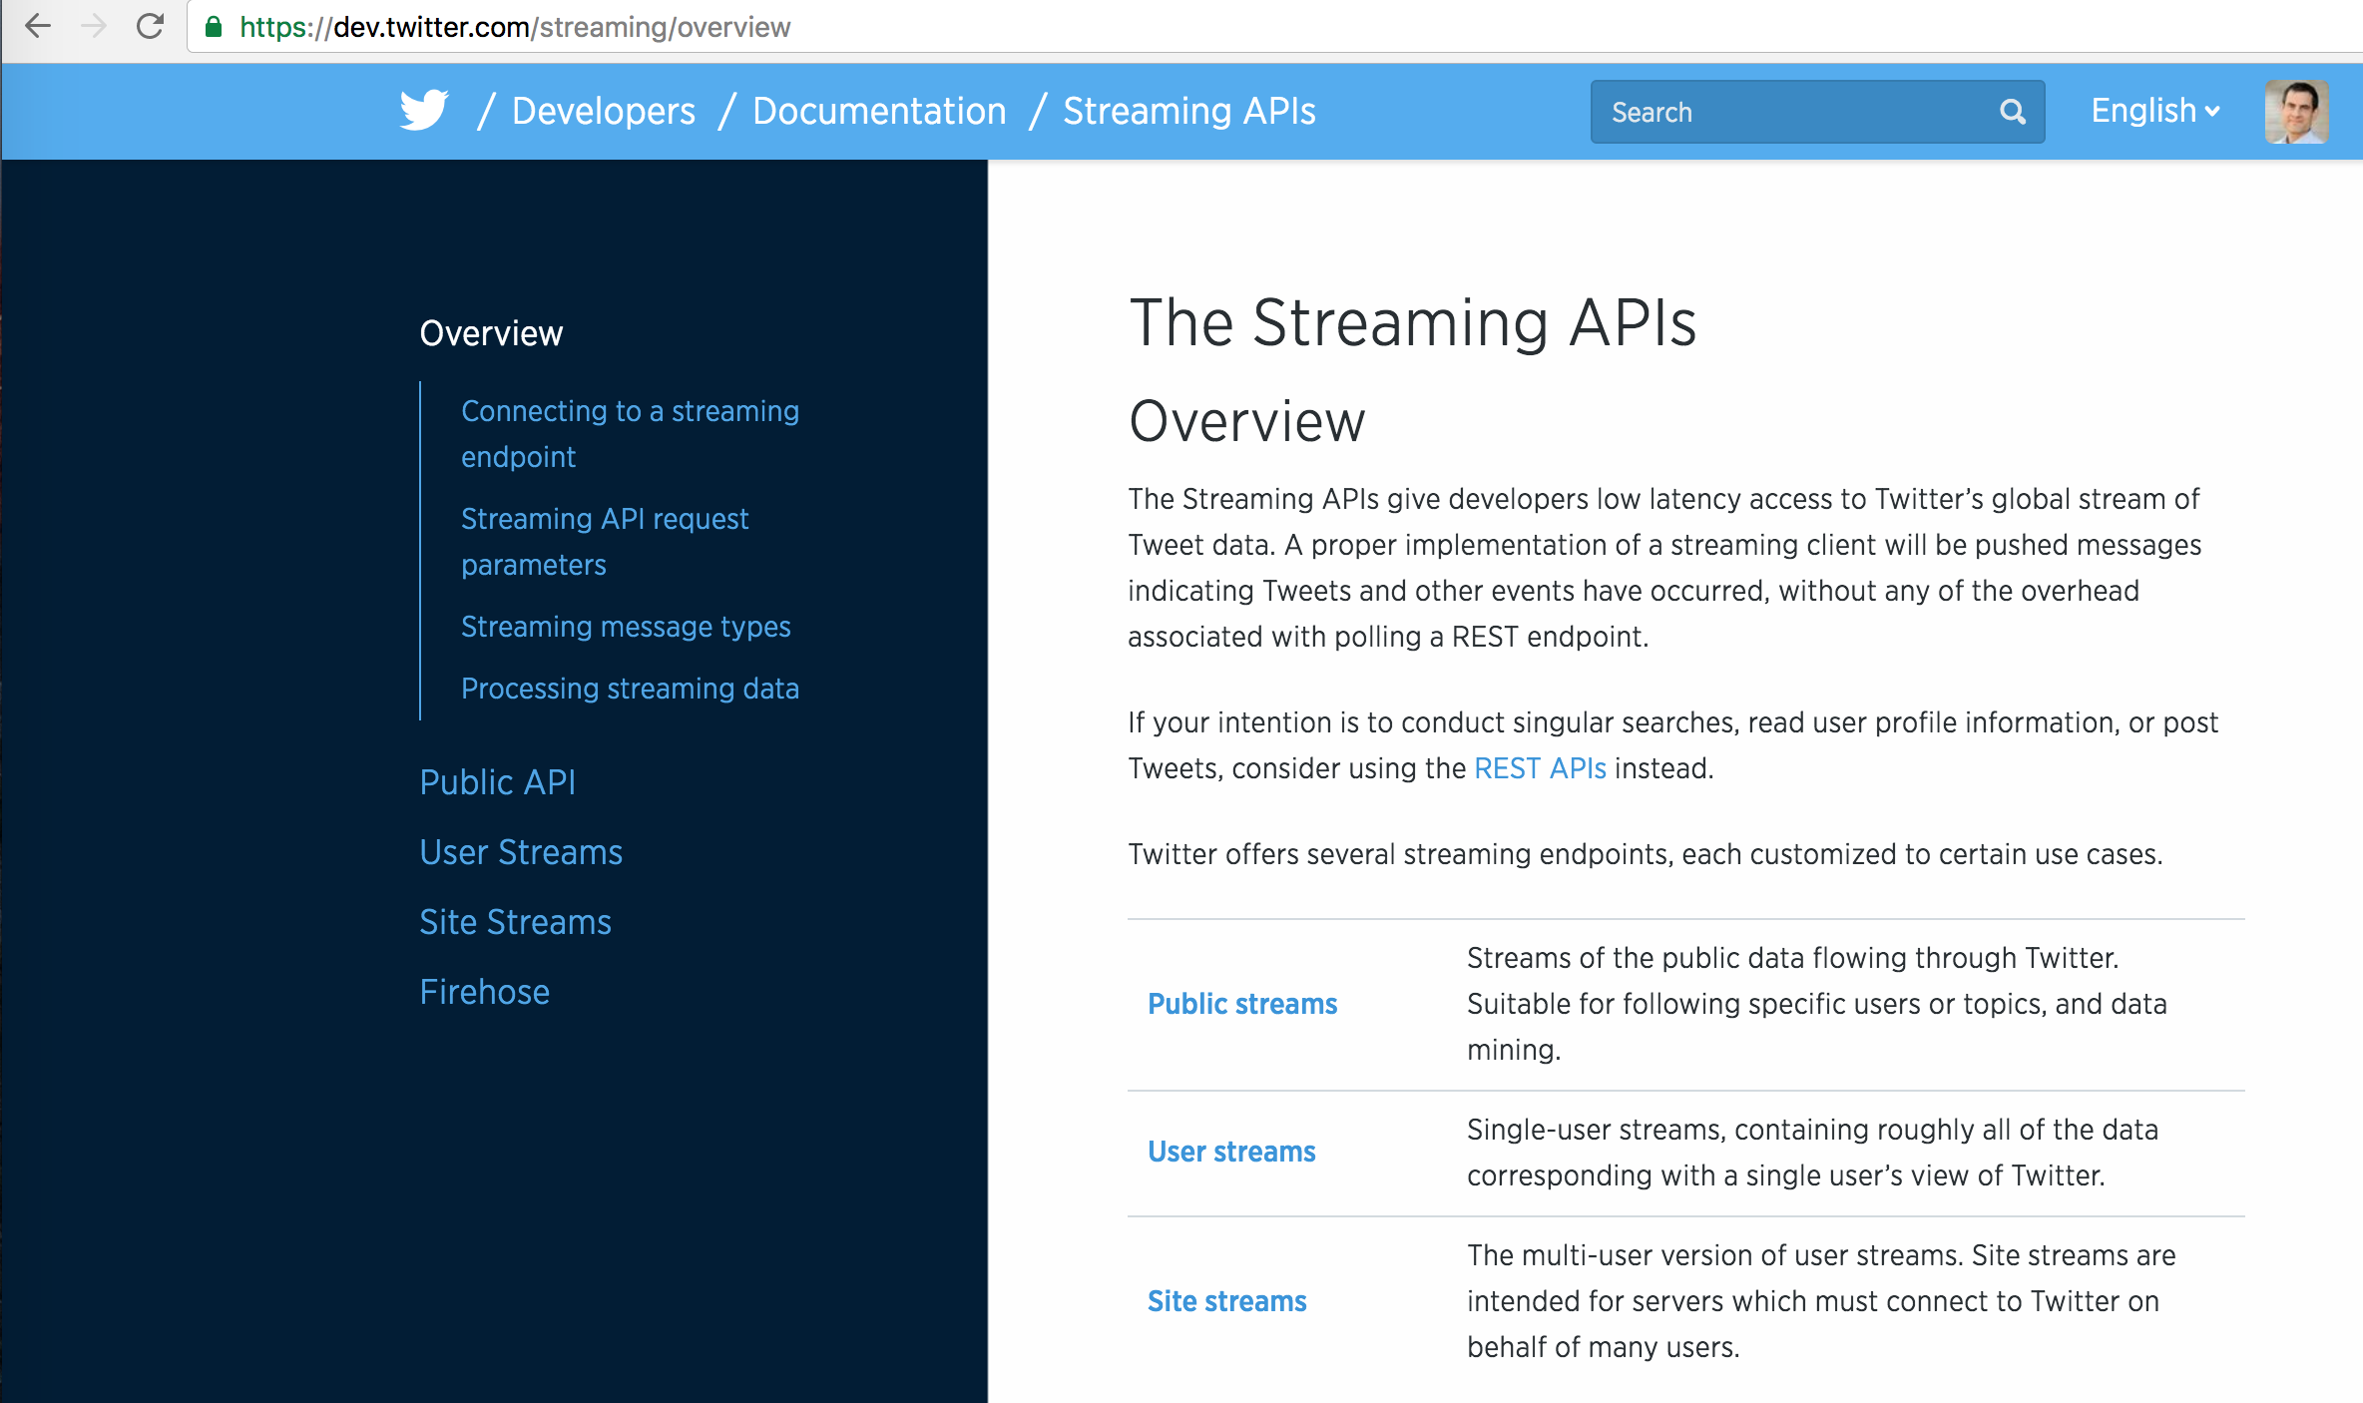

Slide 9
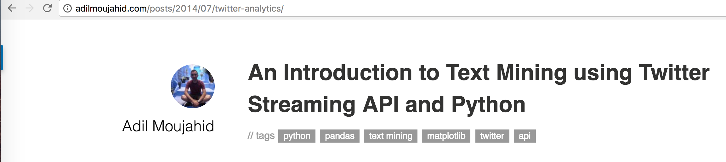
http://adilmoujahid.com/posts/2014/07/twitter-analytics/
“Text mining is the application of natural language processing techniques and analytical methods to text data in order to derive relevant information.”

Slide 10
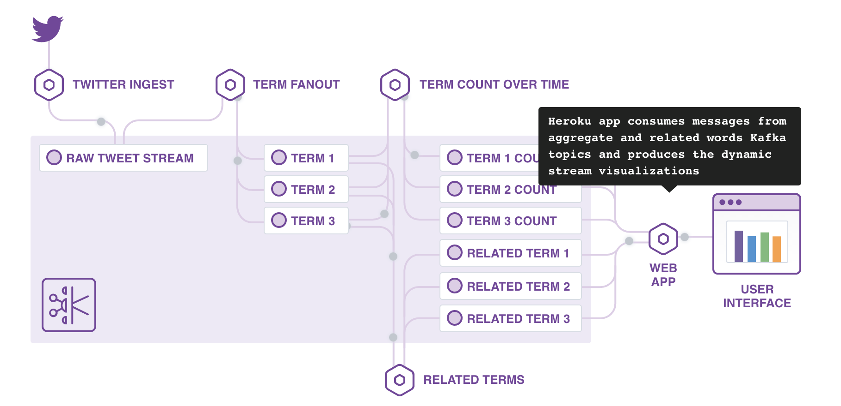
https://heroku.github.io/kafka-demo/

Slide 11
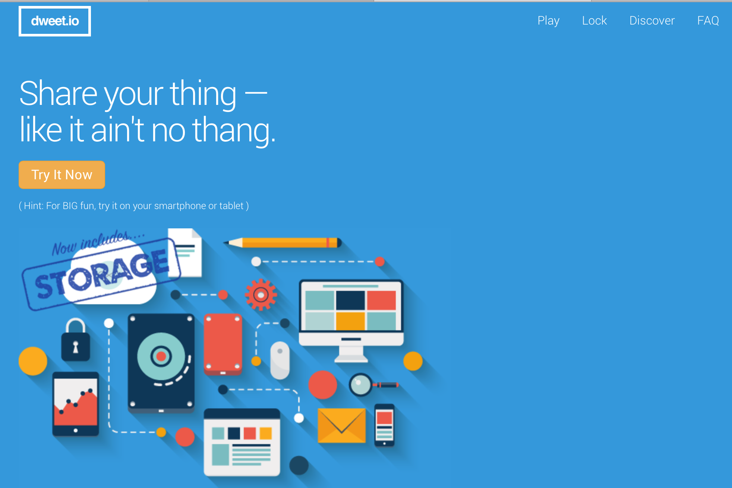

Slide 12
Citation:
http://www.confluent.io/blog/stream-data-platform-1
Notes:
It was originally developed at LinkedIn and became an Apache project in July, 2011.
Data pipelines were built ad-hoc between systems.
…became really hard to scale and manage as the systems that used them also scaled.
…data was unreliable. “I remember an incident where we checked two systems that had similar data and found a discrepancy; we checked a third to try to determine which of these was correct and found that it matched neither.”
Linked In built Kafka for two reasons:
Transport data between systems
Analyze data with feature-rich streaming APIs

Slide 13
Citation:
http://www.confluent.io/blog/stream-data-platform-1
Notes:
Kafka became a universal pipeline for all their services.
Each system can feed into this central pipeline or be fed by it;
Applications create new, derived streams, which in turn can be fed back into various apps.

Slide 14
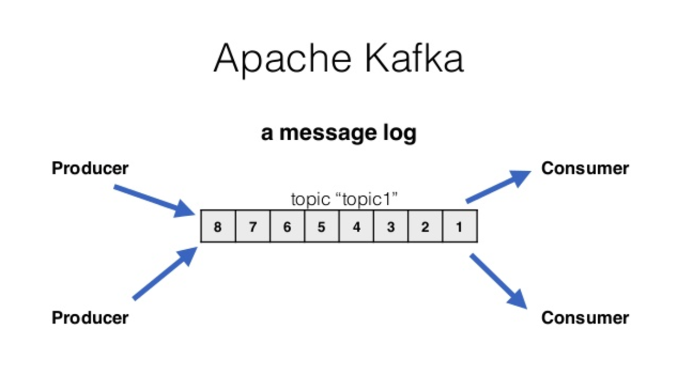
Messages contain <Key, Value>
delivered in order
transferred as bytes (you specify serializer / deserializer)
remain available for TTL
with at least once semantics
Citation: http://www.slideshare.net/kpciesielski/reactive-kafka-with-akka-streams
Notes:
They call a topic a “log” (basically a distributed message bus).
Default retention period = 7 days.

Slide 15
Producers send messages one at a time
Consumers subscribe to topics, poll for messages,
and receive records many at a time
Citation: http://www.slideshare.net/kpciesielski/reactive-kafka-with-akka-streams

Slide 16
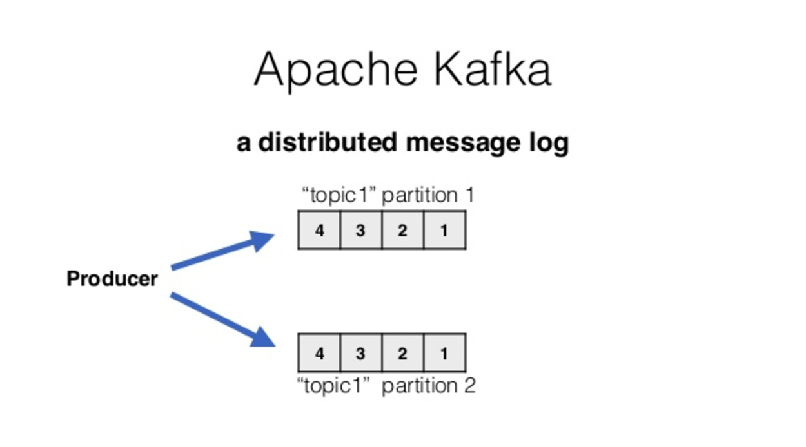
Producer sees a topic as one logic object.
The order of messages within a single partition is guaranteed
Citation: http://www.slideshare.net/kpciesielski/reactive-kafka-with-akka-streams

Slide 17
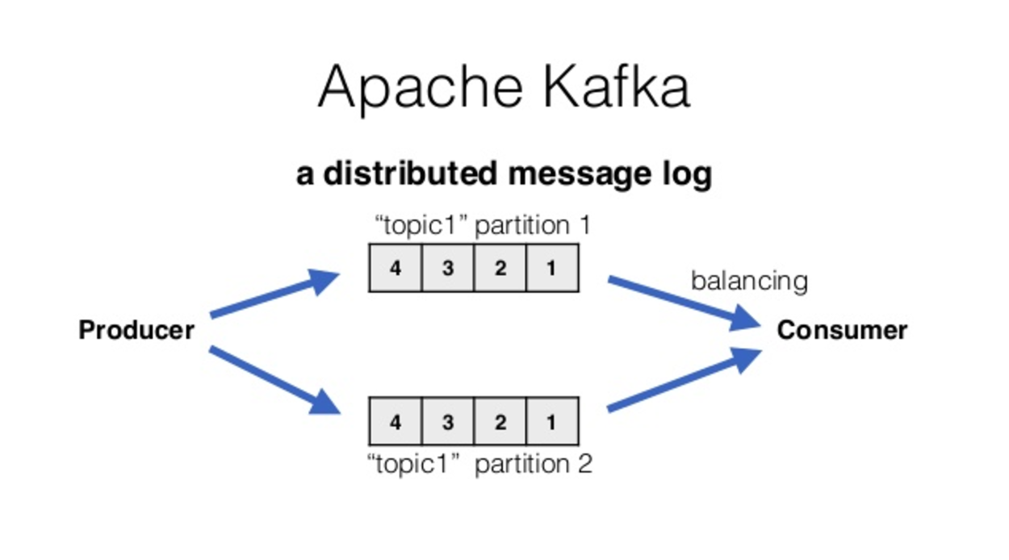
Partitioning facilitates concurrent consumers because a single partition can only be read by one consumer.
Broker will deal with balancing with multiple consumers.
Citation: http://www.slideshare.net/kpciesielski/reactive-kafka-with-akka-streams

Slide 18
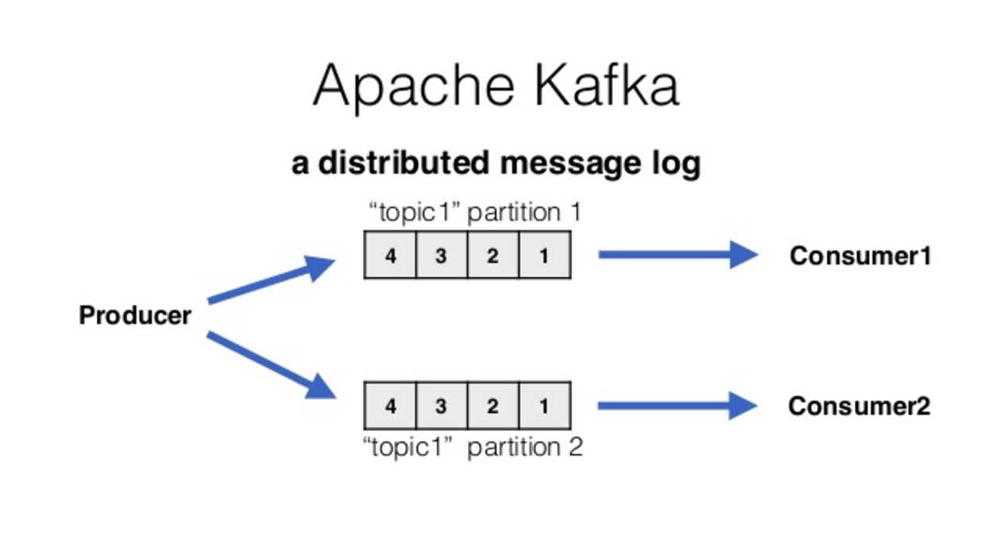
But if another consumer joins, a rebalancing will occur and some partitions will be assigned to one consumer and some to another.
The server will also automatically assign partitions to a consumer, and rebalance as new consumers subscribe
Citation: http://www.slideshare.net/kpciesielski/reactive-kafka-with-akka-streams

Slide 19
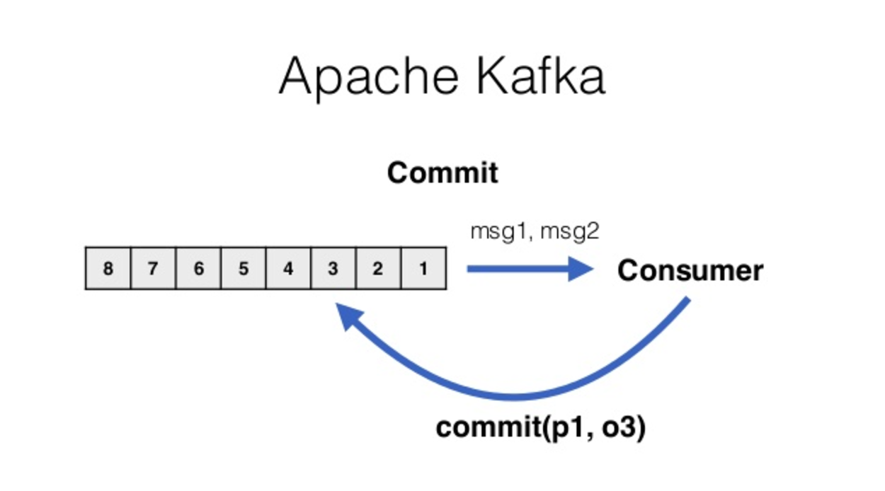
Calling commit marks where a consumer has finished processing.
Citation: http://www.slideshare.net/kpciesielski/reactive-kafka-with-akka-streams

Slide 20
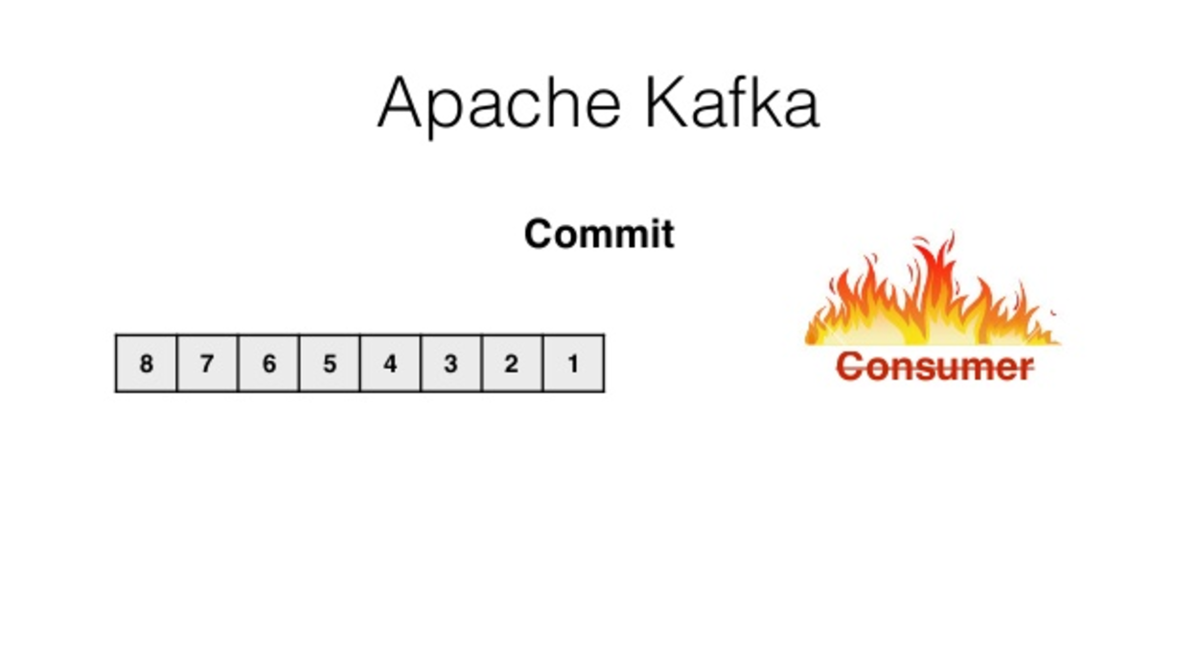
Thanks to commit, when a consumer goes down we let it crash.
Citation: http://www.slideshare.net/kpciesielski/reactive-kafka-with-akka-streams

Slide 21
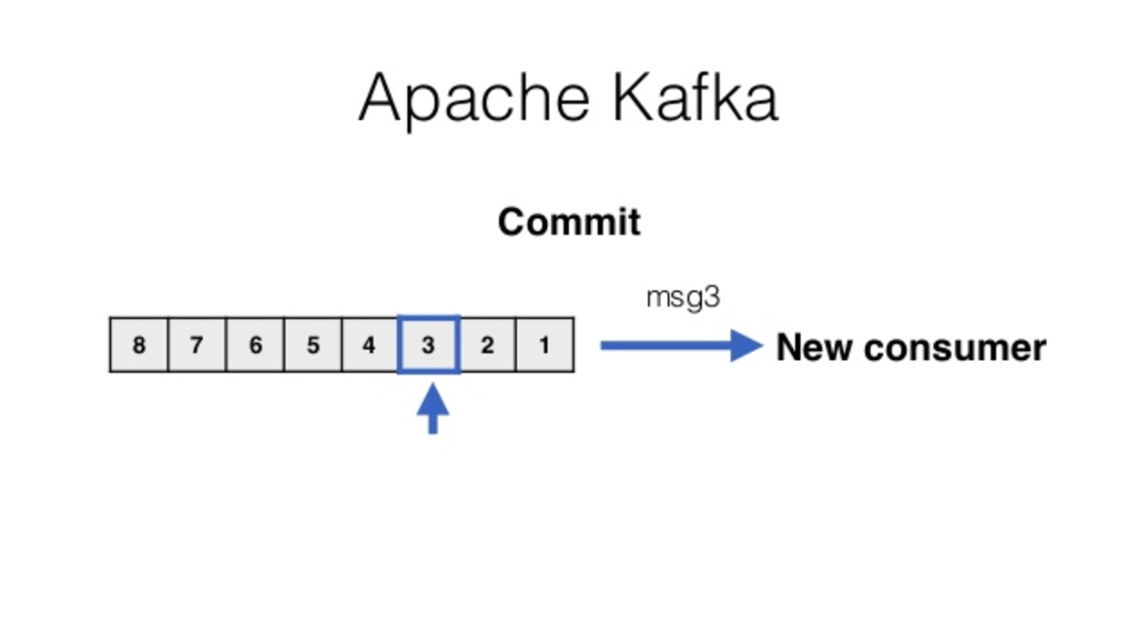
When another consumer takes its place, it continuous where the old consumer left off.
Citation: http://www.slideshare.net/kpciesielski/reactive-kafka-with-akka-streams

Slide 22
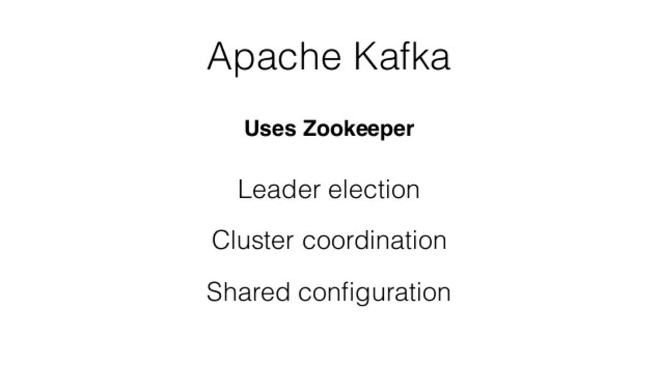
Notes:
Kafka uses Zookeeper which is good at managing cluster related stuff, like
who’s the leader for each topic?
which brokers are alive (and when have they failed)?
which topics exist, and how are they configured (partitions, ttl, replica, etc)
No need for Kafka to reinvent it.
Leader election. The leader is one of the brokers and is responsible for maintaining the leader/follower relationship for all the partitions. When a node shuts down, it is the controller that tells other replicas to become partition leaders to replace the partition leaders on the node that is going away. Zookeeper is used to elect a controller, make sure there is only one and elect a new one it if it crashes.
Cluster membership - which brokers are alive and part of the cluster? this is also managed through ZooKeeper.
Topic configuration - which topics exist, how many partitions each has, where are the replicas, who is the preferred leader, what configuration overrides are set for each topic
This is why we can’t just remove the kafka log dir to purge data

Slide 23
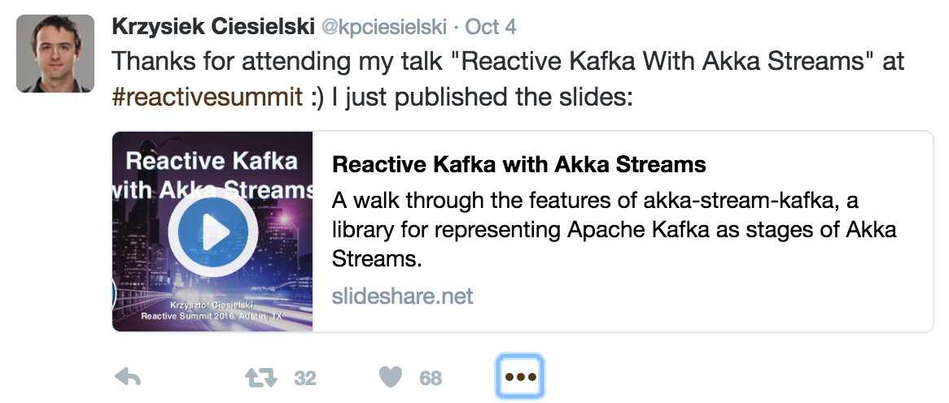
(I copied his Kafka intro slides.)
https://twitter.com/kpciesielski/status/783417291568402432
https://www.youtube.com/watch?v=mgVH3NMGMUg

Slide 24
DEMO: Kafka CLI
Create, alter, pub/sub, and delete topic.
See where topics are saved.
Notes:
DEMO WORKFLOW:
cd ~/development/kafka_2.11-0.10.0.1/
bin/kafka-topics.sh --zookeeper ubuntu:2181 --list
bin/kafka-topics.sh --create --zookeeper ubuntu:2181 --replication-factor 1 --partitions 1 --topic test --config retention.ms=10000
bin/kafka-topics.sh --describe --zookeeper ubuntu:2181 --topic test
bin/kafka-topics.sh --zookeeper ubuntu:2181 --alter --topic test --config retention.ms=600000
What’s the default TTL?
What’s the default log.dir?
bin/kafka-console-producer.sh --broker-list ubuntu:9092 --topic test
bin/kafka-console-consumer.sh --zookeeper ubuntu:2181 --topic test --from-beginning
Pipe tcpdump to the producer.
bin/kafka-topics.sh --delete --zookeeper ubuntu:2181 --topic test

Slide 25
DEMO: Java API
Basic producer/consumer example
Notes:
DEMO WORKFLOW:
Open kafka_intro project in Intellij
Open terminal in Intellij
Git checkout initial
Go thru BasicConsumer, then BasicProducer

Slide 26
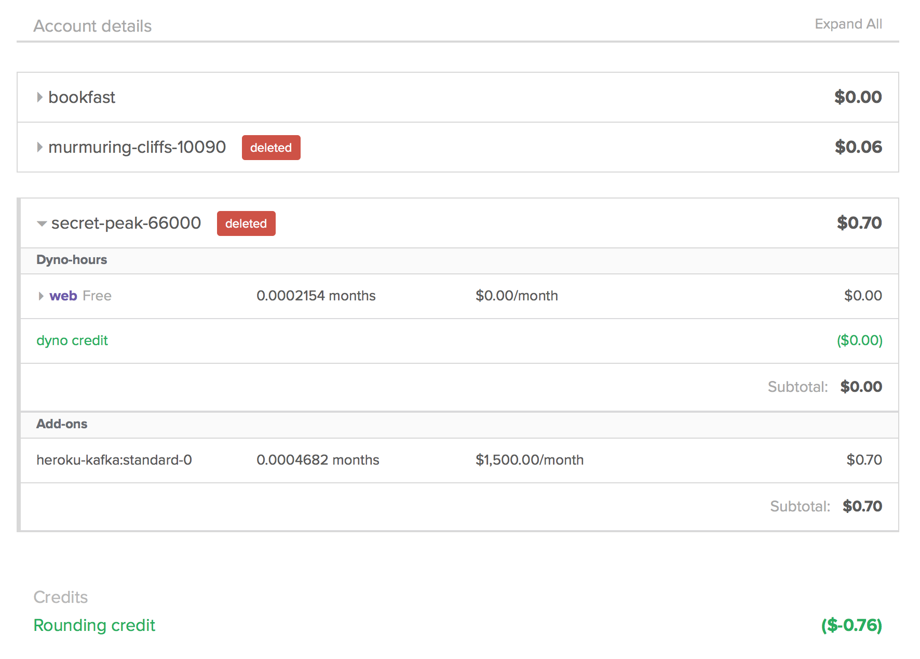
DEMO: Heroku Kafka-as-a-Service
Demo app:
  https://github.com/iandow/heroku-kafka-demo-java
Docs and Pricing:
  https://devcenter.heroku.com/articles/kafka-on-heroku
  $1,500/month !!!
  Oh, but rounding credits.
Notes:
DEMO WORKFLOW
Open ~/development/heroku-kafka-demo-java/ in IntelliJ
Double check the KAFKA_URL env variable in the Run config. Then run, or type this:
java $JAVA_OPTS -cp target/classes:target/dependency/* com.heroku.kafka.demo.DemoApplication server config.yml
Then open http://localhost:8081
Then on the ubuntu kafka server, run this:
while true; do fortune | bin/kafka-console-producer.sh --broker-list localhost:9092 --topic mytest; done
index.js calls http://localhost:8081/api/messages
DemoResource.java is the controller for those GETs
Note, this example sets consumer/producer properties differently than other examples.

Slide 27
DEMO: Kafka in a web app
How to send a message
  How to ensure delivery guarantee
  How to handle failure
    Demonstrate it:
      Change 20 second timeout in DemoResources.java
      Observe the java.util.concurrent.Timeout in the user specified callback
      Also observe that the message may ultimately get there, (if its in transit)
    To get rid of Dropwizard metrics, change timeout in DemoApplication.java
      reporter.start(1, TimeUnit.MINUTES);

Slide 28
Consumer Groups, Cursors, and Partitions

Slide 29
ProducerRecord vs ConsumerRecord
Producers send messages one at a time as ProducerRecord
Consumers subscribe to topics and poll for messages and receive them many-at-a-time as ConsumerRecords

Slide 30
Consumer Groups, Cursors, and Partitions
Consumer Groups – groups of consumers working together
Cursors – track positions of consumers
Partitions – subdivide a topic for scale
Replication Factor – replicate partitions across nodes for fault tolerance

Slide 31
Partition Balancing
Available partitions are balanced among consumers for a given group
  Single partition can be read by only one consumer
  A single consumer can read multiple partitions
  Examples:
    3 partitions, 2 consumers: 2 & 1
    5 partitions, 1 consumer: 5
    3 partitions, 4 consumers: 1, 1, 1, 0 (4th consumer gets no messages)
When new consumers join or new partitions added, rebalance occurs
  Some consumers will gain or lose partitions and there may be a slight pause in message delivery while this happens
  Can cause duplicates if consumers don’t properly commit cursors

Slide 32
Consumer Groups
Only one consumer IN A GROUP can consume one topic/partition simultaneously
Consumers in different groups will see the same messages if they read the same topic/partition
http://kafka.apache.org/documentation.html

Slide 33
Cursor Persistence
Consumer Group A
Cursor A
topic “topic1”
8 | 7 | 6 | 5 | 4 | 3 | 2 | 1
Consumer Group B
Cursor B
Ensure consumers pick up from where they left off after a stop
Tracks last known commit point for message reads
By default, auto commit after 5s (auto.commit.interval.ms)
  If slow consumer code, auto commit() might go out before processed
  You can explicitly commit with consumer.commit()
If you need to concurrent consumers, would you use consumer groups or topic partitions?

Slide 34
At Least Once semantics
Messages may be seen multiple times
  Producer side
    Retransmit on network
    Producer might fail and resend previously sent messages on restart
  Consumer side
    Client might crash after get but before cursor.commit()
Applications must be idempotent message processors
Notes:
Kafka producer property to disable retries is simply ‘retries’
retries - # of retries before giving up. Setting to 0 prevent duplicate sends consumer side at the risk of possible message loss. Can we control?

Slide 35
Batching Behavior
Producer.send() places messages in client-side memory buffer
That buffer is not flushed until one of three criteria met:
  Timeout (linger.ms)
  Max memory (buffer.memory)
  Producer.flush() called
Notes:
linger.ms – how long messages are buffered once the last send was acknowledged by the server. 0 is default (no wait).
block.on.buffer.full - default is true but if false kafka will raise an exception warning the client that messages aren’t being sent fast enough:
acks - number of servers required to ack of the current in sync set.

Slide 36
Serialization
Each Kafka message is a byte array.
You must convert <K,V> to/from bytes with a serializer
Two provided out of the box
  ByteArraySerializer/ByteArrayDeserializer
  StringSerializer/StringDeserializer
You can write your own serializer.

Slide 37
Key Concept - Serialization
If you’re streaming data that is a byte array, use the byte array serializer.
If you’re streaming data that is a String, use the String serializer.
If you’re streaming data that is a POJO, use ???

Slide 38
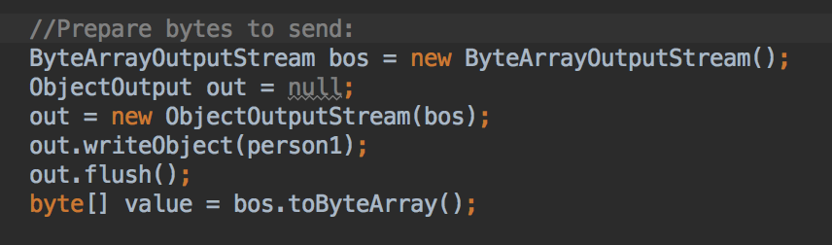
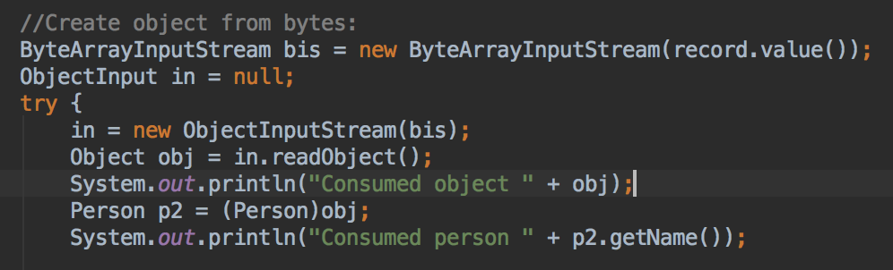
How to stream a POJO
Make it serializable
  Otherwise you’ll get a java.io.NotSerializableException later when we write the object to a byte array
Write the object to a byte array
Send that byte array
  Why can’t we just send the Person
  object?
In the consumer, poll the topic, then convert record.value() to your POJO.
Notes:
If you skip converting Person to bytes, you’ll get a SerializationException when Kafka tries to convert it to bytes using whatever serializer you specified (unless you wrote a custom serializer).
DEMO WORKFLOW:
Open kafka-study project.
1. compile:
mvn package
2. Right click on the consumer class and say run
java -cp target/:target/kafka-study-1.0-jar-with-dependencies.jar com.mapr.demo.finserv.PersonConsumer
3. run a CLI producer to see the streamed bytes
~/development/kafka_2.11-0.10.0.1/bin/kafka-console-consumer.sh --zookeeper ubuntu:2181 --topic persons --from-beginning
4. Right click on the producer class and say run
java -cp target/:target/kafka-study-1.0-jar-with-dependencies.jar com.mapr.demo.finserv.PersonProducer

Slide 39
Problems with streaming POJOs
What if your raw data is dirty, and casting fails because you streamed a record with missing POJO fields?
The overhead of encoding/decoding a POJO to/from bytes is redundant, especially if this is done at multiple stages in the Kafka pipeline.
It’s better to postpone parsing/casting downstream.

Slide 40
How would you stream this?
080449201DAA T 00000195700000103000N0000000000000004CT1000100710071007
080449201DAA T 00000131000000107000N0000000000000005CT10031007
080449201DAA T 00000066600000089600N0000000000000006CT10041005
080449201DAA T 00000180200000105100N0000000000000007CT100310051009
080449201DAA T 00000132200000089700N0000000000000008CT100410051005
080449201DAA T 00000093500000089400N0000000000000009CT10031007
080449201DAA T 00000075100000105400N0000000000000010CT100410081006
080449201DAA T 00000031300000088700N0000000000000011CT1004100810081007
080449201DAA T 00000021800000105100N0000000000000012CT100410091005
080449201DAA T 00000191300000104500N0000000000000013CT10041006
080449201DAA T 00000124500000105100N0000000000000014CT1001100610071008
Notes:
Knowing that one of your consumers will want to access various fields.

Slide 41
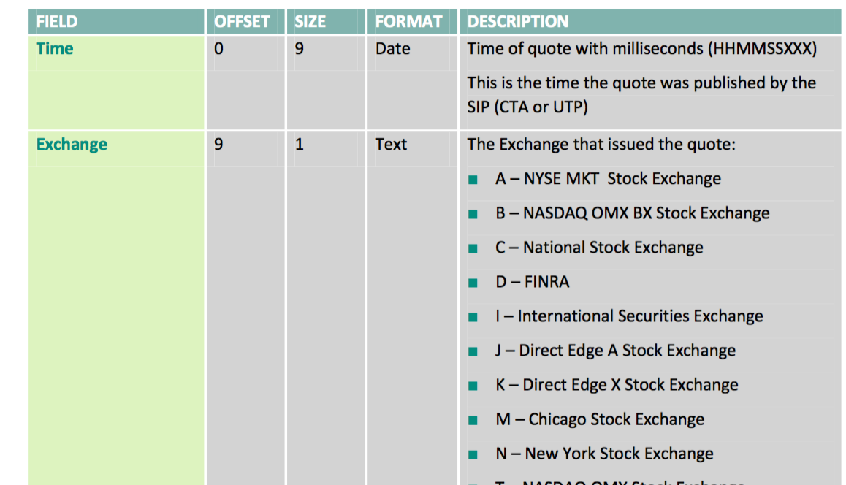
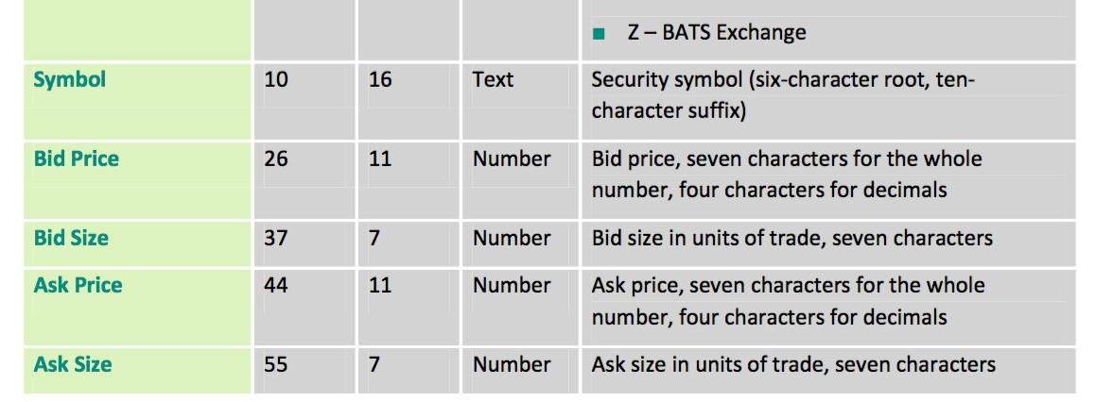
Schema excerpt

Slide 42
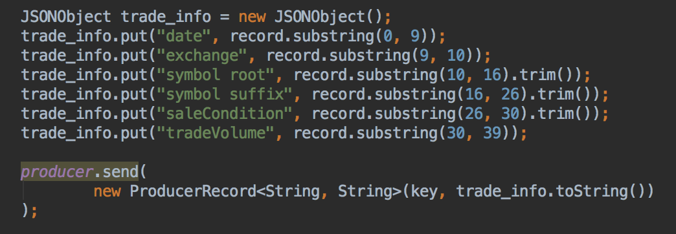
Option A?
Parse each record into a JSON object,
Publish json_object.toString()
Stream with with String serializer
Notes:
Easy field access downstream (easy for the developer).
But, creates lots of objects, and objects are most costly than native types.
Calls substring A LOT!
Calls json.toString A LOT!

Slide 43
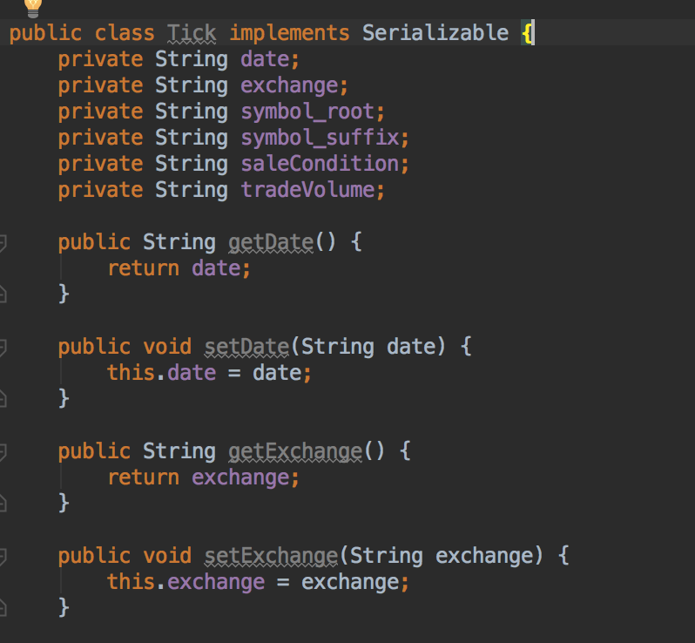
Option B?
Create a POJO (“Tick”) with attributes for each field
Parse each record and create a Tick object
Stream Tick objects using a custom serializer
Notes:
Parsing is expensive.
Creates lots of objects, and objects are most costly than native types
Creates lots of strings with potentially inefficient memory locations

Slide 44
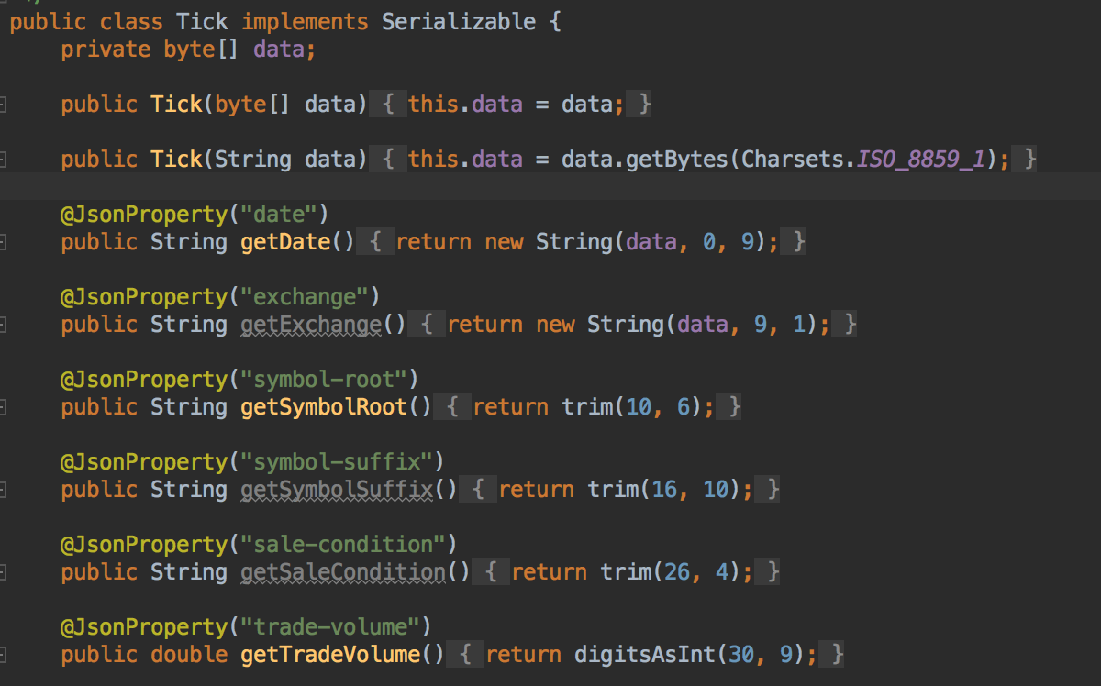
Option C?
Create a POJO “Tick” with a single byte[] attribute, and getters that return fields by directly indexing the byte[]
Annotate getters with @JsonProperty
Notes:
Gives us the convenience of easy field access, easy JSON object creation, and fast lookup into a byte[], and we can push parsing way downstream.
Keeping our data in one large array has the best possible locality,
all the data is on one area of memory,
cache-thrashing will be kept to a minimum.

Slide 45
A
C
B

Slide 46
Major Performance Factors
Replication turned on?
Streaming large messages?
Producers sending synchronously or async.?
Send buffer flushed until one of three criteria met:
  Timeout (linger.ms)
  Max memory (buffer.memory)
  Producer.flush() called
Topics / Producer affinity

Slide 47
Major Performance Factors
What affects producer latency?
  Using send futures? (i.e. synchronous sends)
  acks=all,1,or 0 (ack after leader logs / after all replicas log / or not at all)
  ”Nagle’s algorithm” and the linger.ms config
What affects producer throughput?
  Producer batch.size
  Concurrent producer.send()
  Number of topics
  Message size
What affects consumer throughput?
  Partitions

Slide 48
Major Performance Factors
What affects Kafka server stability?
  Garbage Collection: Long GCs from sending large messages can break the kafka/zookeeper connection.
  Topics can easily consume disk space
  May need to increase file handles
    Topic data and index files are in log.dir (e.g. /tmp/kafka-logs)
    Kafka keeps an open file for each topic.
      Reference:
      http://www.michael-noll.com/blog/2013/03/13/running-a-multi-broker-apache-kafka-cluster-on-a-single-node/

Slide 49
Read vs Processing Parallelism
Consumer read parallelism
  Concurrent reads can be achieved via topic partitioning and consumer groups
  If your consumer logic is CPU-bound, use partitions or consumer groups
Downstream Processing Parallelism
  If you need more processing threads than read threads, then “fan-out” the data to more topics.

Slide 50
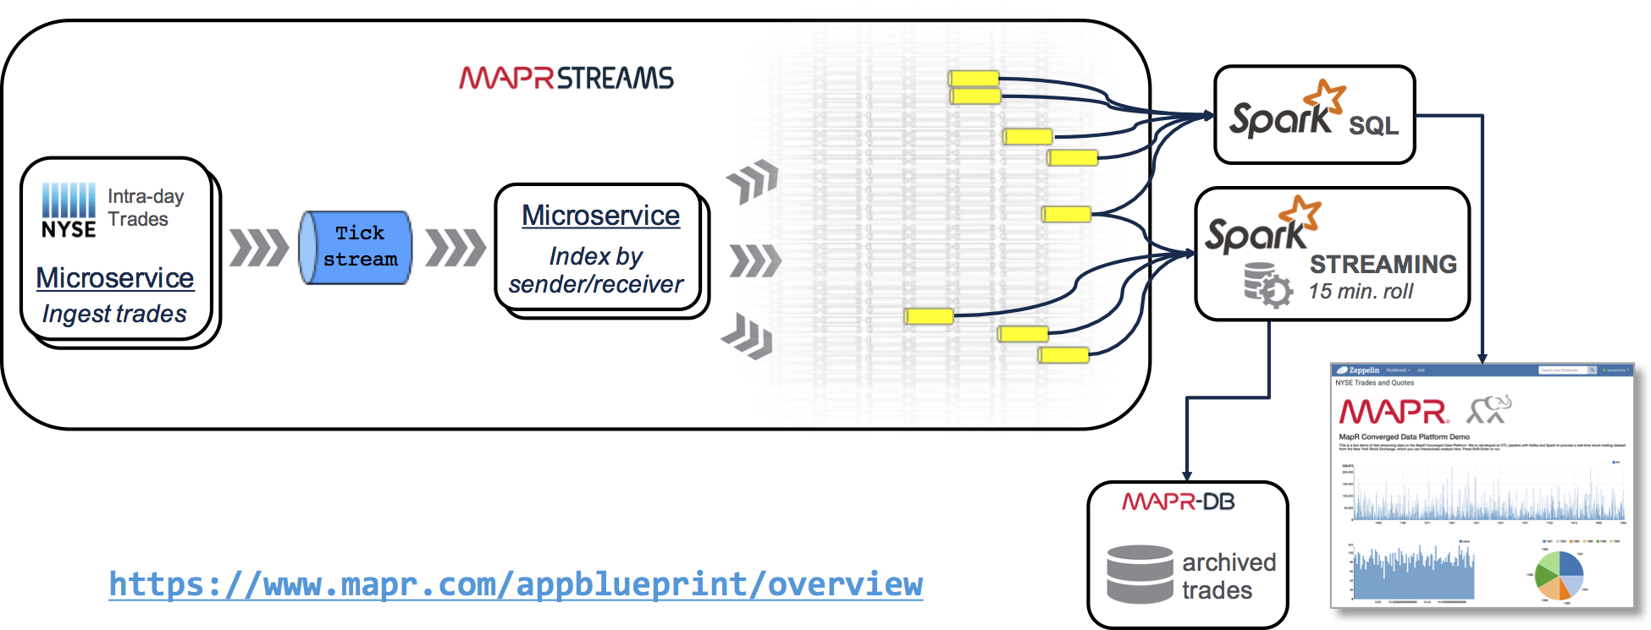

What I mean by, “Fan-out”:
Kafka API
Notes:
This is a fanout example.
Another good example:
https://heroku.github.io/kafka-demo/images/kafka-diagram.html

Slide 51
Performance Anti-Pattern
Problem: I want to count all the messages read in each consumer thread.
Anti-pattern: I’ll just increment a counter in a synchronized block.

Slide 52
Performance Anti-Pattern
I want to count all the messages read in each consumer thread.
Fine, I’ll just increment a counter in a synchronized block.
  Lesson learned: synchronization really hurts throughput.
  Solution: I decreased the cost of metric collection to near zero by giving each thread its own metrics structure, and every second or so, updating a shared metric structure with locks.

Slide 53
Performance Anti-Pattern
I want to be sure never to read a duplicate message.
Fine, I’ll just commit the read point for every message I consume.

Slide 54
Performance Anti-Pattern
I want to be sure never to read a duplicate message.
Fine, I’ll just commit the read point for every message I consume.
  Lesson learned, you’re still not guaranteed not to get a duplicate message. Kafka consumers must be idempotent.
  Solution: Postpone deduplication downstream. (i.e. Give up till’ later.)

Slide 55
Performance Anti-Pattern
I want to stream JSON strings to simplify DB persistence and columnar selections in Spark.
Fine, I’ll just convert every message to a JSON object at the first step of my pipeline and use a JSON serializer.

Slide 56
Performance Anti-Pattern
I want to stream JSON strings to simplify DB persistence and columnar selections in Spark.
Fine, I’ll just convert every message to a JSON object at the first step of my pipeline and use a JSON serializer.
  Lesson learned: parsing is expensive! Handling parsing errors is expensive. Custom serializers are not as easy I as thought.
  This anti-pattern is illustrated here: https://github.com/mapr-demos/finserv-ticks-demo/commit/35a0ddaad411bf7cec34919a4817482df2bf6462
  Solution: Stream a data structure containing a byte[] to hold raw data, and annotate it with com.fasterxml.jackson.annotation.JsonProperty.
  Example: https://github.com/mapr-demos/finserv-ticks-demo/blob/35a0ddaad411bf7cec34919a4817482df2bf6462/src/main/java/com/mapr/demo/finserv/Tick2.java
Notes:
It was much faster for us to ingest raw data into a byte array primitive type, and stream that using the ByteArray serializers, and only parse it to JSON as the last step in our pipeline.

Slide 57
Good Practices
Design your data structures to prefer arrays of objects, and primitive types, instead of the standard Java or Scala collection classes (e.g. HashMap).
Maintain affinity between topic and producer thread.
  Kafka will batch multiple sends together. If a send hits only one topic, it will benefit from writes to sequential memory locations.
  Reference code:
  https://github.com/mapr-demos/finserv-application-blueprint/blob/master/src/test/java/com/mapr/demo/finserv/ThreadCountSpeedIT.java
Consider using numeric IDs or enumeration objects instead of strings for keys.

Slide 58
Three Performance Takeaways
Process as little as possible in the pipeline.
  Transfer byte arrays. It’s faster than serializers based on strings, POJOs, or custom serialization.
Use JSON annotation. It makes persistence easier in the final stages. It also makes data analysis easier because it gives you an easy schema.
Categorize raw data into multiple topics (aka “fan-out”). It makes real-time analysis easier.
Use parameterized tests in Junit to tune Kafka.

Slide 59
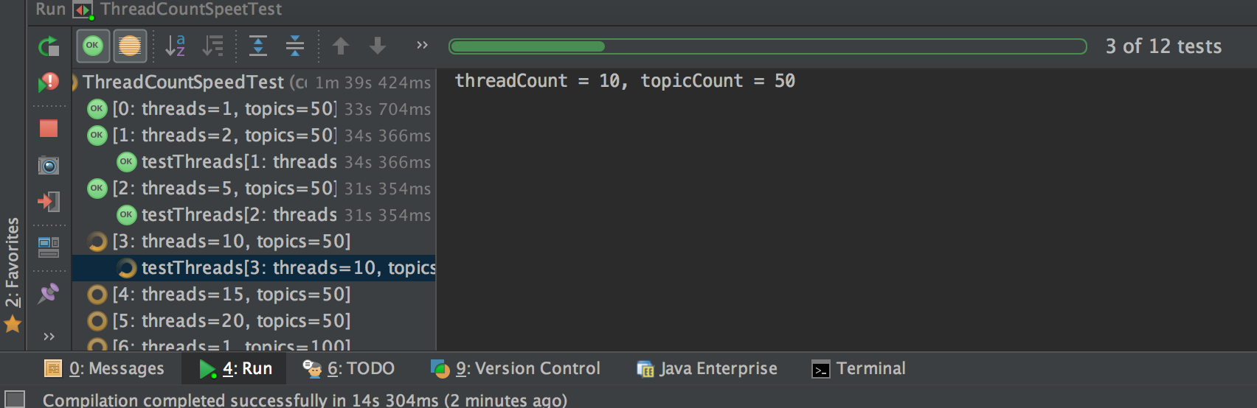
Junit tests
https://github.com/iandow/kafka_junit_tests
Notes:
DEMO WORKFLOW:

Slide 60
How to create Junit parameterized tests
Annotate test class with @RunWith(Parameterized.class).
Create a public static method annotated with @Parameters that returns a Collection of Objects (as Array) as test data set.
Create a public constructor that takes in one "row" of test data.
Notes:
https://github.com/junit-team/junit4/wiki/parameterized-tests

Slide 61
Benchmarks
Lazy benchmark, by Jay Kreps at LinkedIn (2014):
  https://engineering.linkedin.com/kafka/benchmarking-apache-kafka-2-million-writes-second-three-cheap-machines
Answers questions like these:
  Will Kafka slow down if I never consumer messages?
  Should I stream small messages or large messages
  (in order to maximize Throughput)?
  Should I stream small messages or large messages?

Slide 62
MapR Streams → (more scalable Kafka)
MapR Streams load balances topics more effectively
  Kafka assumes all partitions are equal in terms of size and throughput
MapR Streams stores stream data in a distributed file system (MapR-FS), allowing topics to save much more data and replicate much faster.
  Kafka partitions are pinned to a single node, meaning they can’t outgrow the storage capacity of that node.
MapR Streams can span across clusters in multi-datacenters
  Kafka, “More Clusters, More Problems”
https://www.mapr.com/blog/scaling-kafka-common-challenges-solved
Notes:
“More Clusters More Problems”:
-no global namespace
-unsynchronized offsets across clusters)

Slide 63
Blueprint of a Converged Application
for real-time tick streaming
Kafka API

Slide 64






MapR Converged Data Platform
Open Source Engines & Tools
Commercial Engines & Applications
Search and Others
Cloud and Managed Services
Custom Apps
Search and
Others
Processing
Search and
Others
HDFS API
POSIX, NFS
HBase API
JSON API
Unified Management and Monitoring
Kafka API
Web-Scale Storage
Database
Event Streaming
Data
MapR-FS
MapR-DB
MapR Streams
High Availability
Real Time
Unified Security
Multi-tenancy
Disaster Recovery
Global Namespace
Enterprise-Grade Platform Services
Notes:
MCDP combines Hadoop, Kafka, Spark, nosql data stores, DFS in one cluster, whereas with competitors you need a separate cluster for each. You can install them manually, but they do not share resources and are managed separately... it is like they are on separate clusters.
The MCDP is much preferred over creating different silos for each app. Adhoc clusters are much harder to secure, much harder to move data between, much harder to admin.
Most of our customers run more than 50 applications on a single MapR cluster.

Slide 65
Resources
MapR Streams
https://www.mapr.com/blog/how-apache-kafka-and-mapr-streams-handle-topic-partitions
Heroku kafka
  https://github.com/heroku/heroku-kafka-demo-java
    heroku plugins:install heroku-kafka
    heroku addons:create heroku-kafka:beta-dev
  https://heroku.github.io/kafka-demo/#architecture
https://twitter.com/kpciesielski/status/783417291568402432
  (I copied his Kafka intro slides)
Basic Kafka operations:
  https://kafka.apache.org/090/ops.html

Slide 66
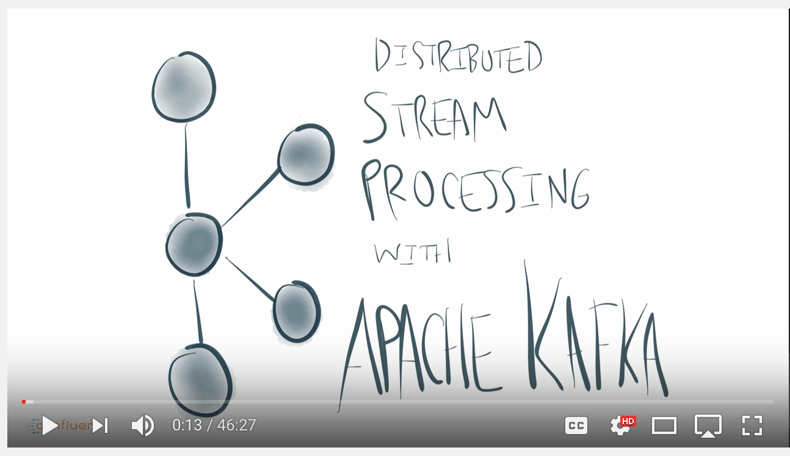
References
Jay Kreps, @jaykreps
  A Practical Guide to using Kafka:
    http://www.confluent.io/blog/stream-data-platform-1/
  The canonical post on Kafka design: ”The Log”
    https://engineering.linkedin.com/distributed-systems/log-what-every-software-engineer-should-know-about-real-time-datas-unifying
  Kafka intro and why it’s the defacto standard for streaming (Oct. 2016)
  https://youtu.be/rXzuZb3fHHM?list=PLKKQHTLcxDVZDAHuclOhAxMaaPtZ8ZDAi

