Slide 1
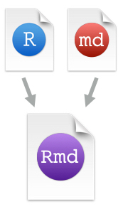






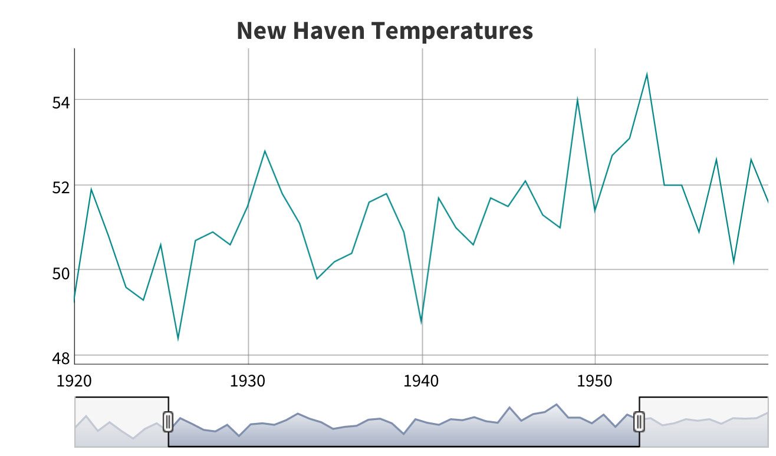

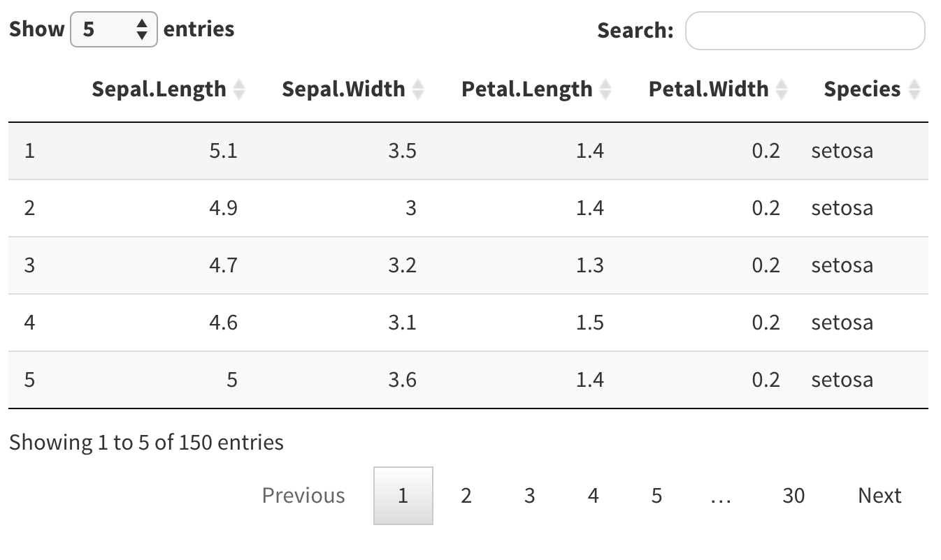

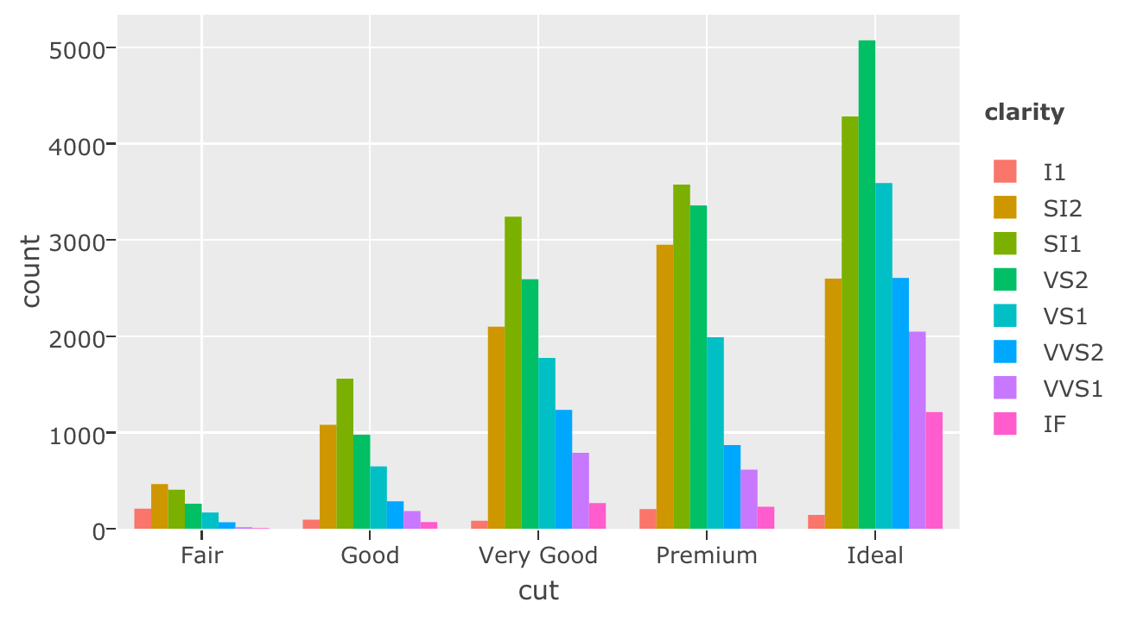

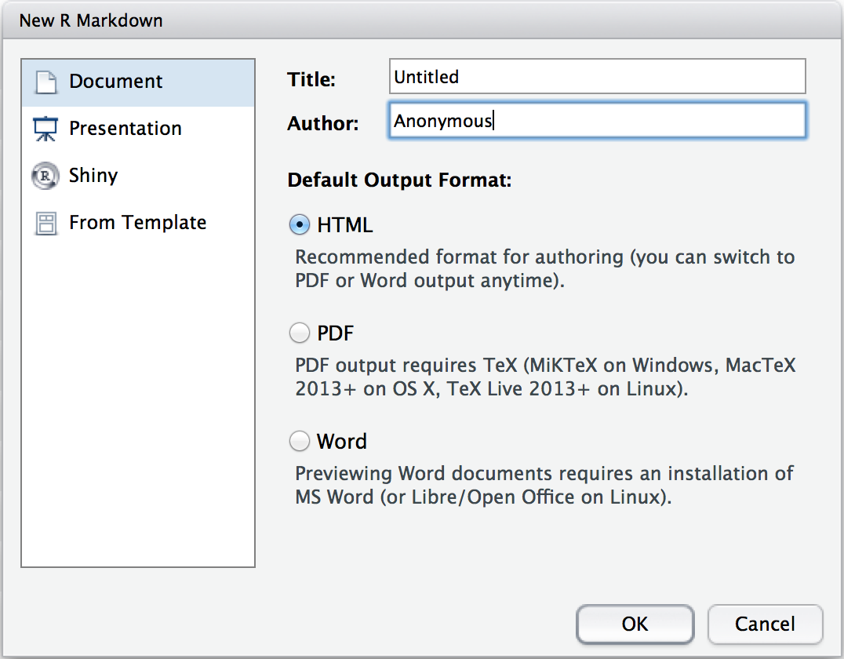
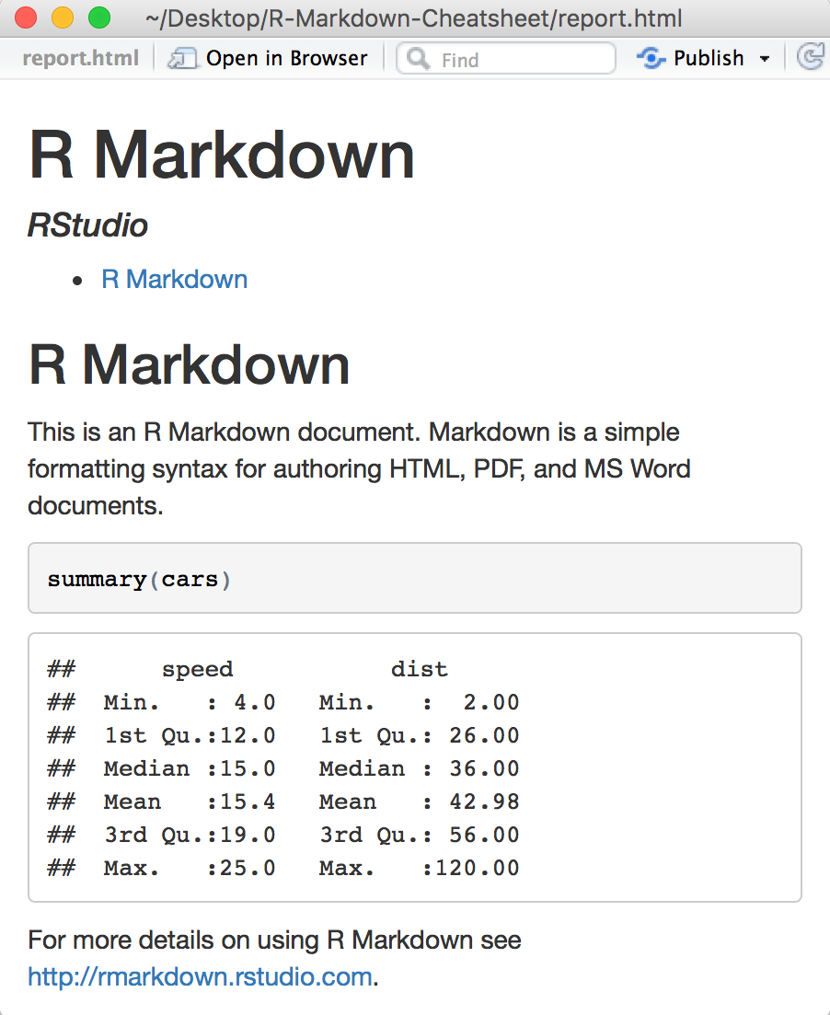
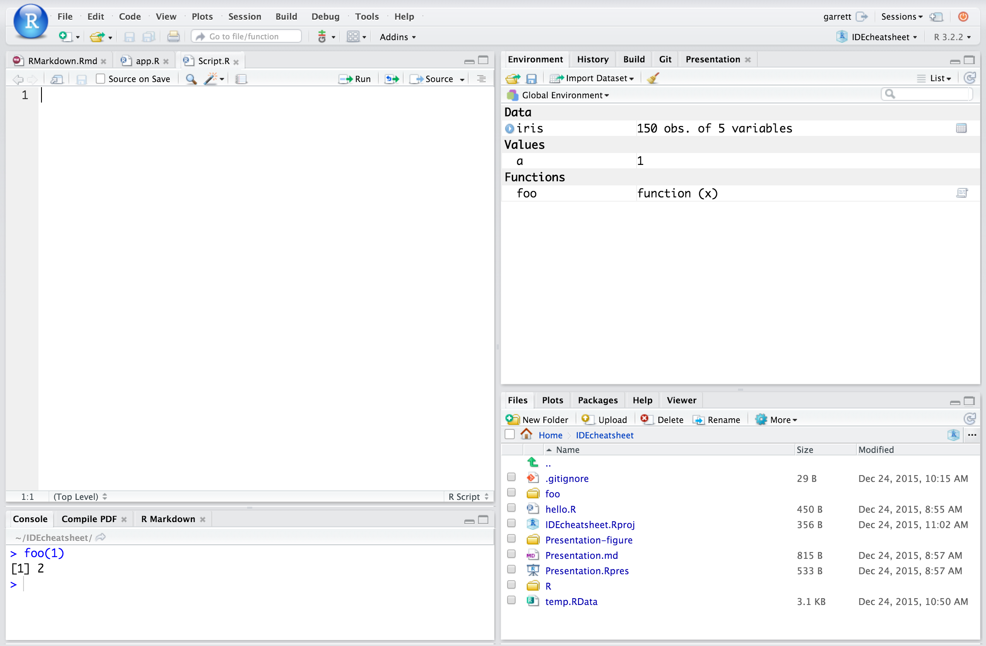
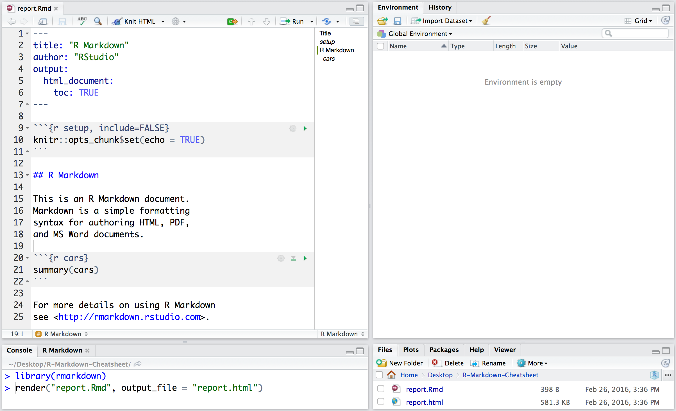
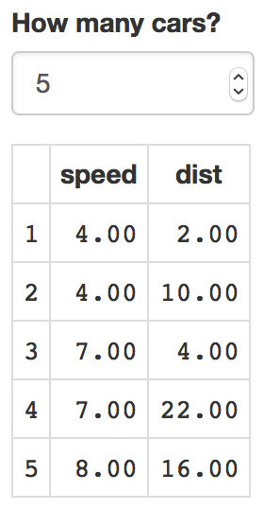
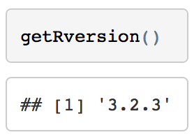


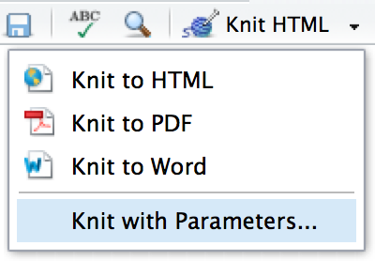
R Markdown Cheat Sheet
.Rmd files
An R Markdown (.Rmd) file is a record of your research. It contains the code that a scientist needs to reproduce your work along with the narration that a reader needs to understand your work.
Rmd
Reproducible Research
At the click of a button, or the type of a command, you can rerun the code in an R Markdown file to reproduce your work and export the results as a finished report.
Dynamic Documents
You can choose to export the finished report as a html, pdf, MS Word, ODT, RTF, or markdown document; or as a html or pdf based slide show.
learn more at rmarkdown.rstudio.com
Rmd
RStudio Pro Features
Workflow
Interactive Documents
Open a new .Rmd file at File ▶︎ New File ▶︎ R Markdown. Use the wizard that opens to pre-populate the file with a template
2
Write document by editing template
3
Knit document to create report
Use knit button or render() to knit
4
Preview Output
in IDE window
Publish (optional) to web or server
Debug Mode
1
5
Turn your report into an interactive Shiny document in 4 steps
Open in window
Save
Spell Check
Find and replace
Publish
Show outline
Synch publish button to accounts at
rpubs.com,
shinyapps.io
RStudio Connect
1
Add runtime: shiny to the
YAML header.
2
Call Shiny input functions to embed input objects.
Reload document
3
Find in document
Call Shiny render functions to embed reactive output.
File path to output document
.Rmd structure
Set preview location
Insert code chunk
Go to code chunk
Run code chunk(s)
6
Examine build log
in R Markdown console
4
Render with rmarkdown::run or click Run Document in RStudio IDE
YAML Header
Optional section of render (e.g. pandoc) options written as key:value pairs (YAML).
At start of file
Between lines of - - -
7
Use output file that is saved alongside .Rmd
---
output: html_document
runtime: shiny
---
```{r, echo = FALSE}
numericInput("n",
"How many cars?", 5)
renderTable({
head(cars, input$n)
})
```
Modify chunk options
Run all previous chunks
Run current chunk
render()
Text
Use rmarkdown::render() to render/knit at cmd line. Important args:
input - file to render
output_format
output_options - List of render options (as in YAML)
output_file
output_dir
params - list of params to use
envir - environment to evaluate code chunks in
encoding - of input file
Narration formatted with markdown, interspersed with:
Code chunks
Chunks of embedded code. Each chunk:
Begins with ```{r}
ends with ```
R Markdown will run the code and append the results to the doc.
Embed a complete app into your document with shiny::shinyAppDir()
* Your report will rendered as a Shiny app, which means you must choose an html output format, like html_document, and serve it with an active R Session.
Debug Mode
Embed code with knitr syntax
Parameters
Debug Mode
Inline code
Code chunks
Global options
Parameterize your documents to reuse with different inputs (e.g., data sets, values, etc.)
Insert with `r <code>`. Results will appear as text without code.
One or more lines surrounded with ```{r} and ```. Place chunk options within curly braces, after r. Insert with
Set with knitr::opts_chunk$set(), e.g.
1
```{r include=FALSE}
knitr::opts_chunk$set(echo = TRUE)
```
Add parameters
---
params:
n: 100
d: !r Sys.Date()
---
Built with
`r getRversion()`
```{r echo=TRUE}
getRversion()
```
Create and set parameters in the header as sub-values of params
Indent 2 spaces
Important chunk options
2
cache = FALSE
cache results for future knits
cache.path = "cache/"
directory to save cached results in
child = NULL
file(s) to knit and then include
collapse = FALSE
collapse all output into single block
comment = '##'
prefix for each line of results
dependson = NULL
chunk dependencies for caching
echo = TRUE
Display code in output document
engine = 'R'
code language used in chunk
error = TRUE
stop render when error occurs
eval = TRUE
Run code in chunk
fig.align = 'default'
'left', 'right', or 'center'
fig.cap = NULL
figure caption as character string
fig.height, fig.width
Dimensions of plots in inches
highlight = TRUE
highlight source code
include = TRUE
Include chunk after running
message = TRUE
display code messages in document
results = 'markup'
'asis' - passthrough results
'hide' - do not display results
'hold' - put all results below all code
tidy = FALSE
tidy code for display
warning = TRUE
display code warnings in document
Call parameters
Today’s date
is `r params$d`
Call parameter values in code as params$<name>
3
Set parameters
Set values wth Knit with parameters or the params argument of render():
render("doc.Rmd",
params = list(n = 1, d = as.Date("2015-01-01"))
RStudio® is a trademark of RStudio, Inc. • CC BY RStudio • info@rstudio.com • 844-448-1212 • rstudio.com
More cheat sheets at http://www.rstudio.com/resources/cheatsheets/
Learn more at support.rstudio.com • RStudio IDE 0.99.879 • Updated: 02/16

Slide 2
Setting up data for analysis with secr
Gather SCR data
SCR surveys use detectors at fixed locations to record the presence of individually identifiable animals at those locations. Detectors can be camera-traps, hair snares and dung surveys, live-captures, or acoustic detectors.
Set up data
The R package secr provides methods for estimating animal density from SCR data under many different conditions. This sheet summarizes getting your data into the format secr wants.
Analyze data
Once the data has been set up, use it to build SCR models and extract results on animal density and abundance, detectability, and important covariates.
(1) Make the detector/trap file
(2) Make the capture history file
(3) Read it all in
Debug Mode
Each line of trapfile contains the location of each detector (e.g. camera), plus any extra information about that detector.
Each line of capthist contains one detection, with ID variables recordings information about that detection.
Load both your trapfile and capthist files with read.capthist.
TrapID | X | Y | Effort | / | tri | temp
A1 | 0 | 0 | 10 20 | / | 0.6 | 25
A2 | 5 | 0 | 10 19 | / | 0.9 | 23
A3 | 0 | 5 | 0 20 | / | 0.8 | 31
Session | Animal | Occasion | TrapID
1 | z001 | 1 | A2
1 | z174 | 2 | A1
1 | z024 | 1 | A1
ch <- read.capthist(captfile = “ch.csv”, trapfile = “tf.csv”, detector = "count", fmt = "trapID", trapcovnames = c(“tri”, “temp), binary.usage = FALSE)
Important options
1
1
captfile, trapfile - the CSV files made in the previous steps.
detector - specifies the type of detector you have. Most camera trap surveys will use “multi”, “proximity” or “count”.
fmt - if trapID used as detector identifier in capthist then fmt = “trapID”. If X and Y used then fmt = “XY”.
trapcovnames - names of covariates in trapfile
binary.usage - indicates continuous effort variable present.
TrapID, X, and Y must be specified in the order given. X and Y must be in UTM coordinates.
Each detection is recorded as a session identifier, animal identifier, occasion identifier.
2
Effort records number of days each detector recorded for (optional). One value per occasion, separated by white space
2
Each detection includes a detector identifier, either as trapID (as above) or as X- and Y-coordinates (replace trapID with two columns X, and Y)
3
A column of “/“ indicates everything all columns the right of this column contain covariates (optional, only use if covariates used).
(4) Make the habitat mask
If you only use one session or occasion, include a column of 1’s (the columns must appear in capthist).
Save as a .csv or .txt file to read into R later.
A mask is a set of square grid cells representing habitat in the vicinity of detectors that is potentially occupied.
4
Other variables record values of any covariates at the traps (optional).
A mask object is a 2-column dataframe, each row gives the x- and y-coordinates of the centre of one cell.
Trap-specific variables only needed if detection function parameters vary across traps (g0, lambda0, sigma).
If using multiple sessions (see below), need one file per session.
Save as a .csv or .txt file to read into R later.
(5) Add mask covariates
Buffers
Constructing masks from detectors with make.mask
Mask covariates are used to model density (D), not detection parameters (g0, lambda0, sigma).
Choose buffer width large enough that animals beyond the buffer have negligible chance of being detected.
Rule of thumb is buffer = 4*sigma. Can get a rough estimate of sigma with RPSV(ch,CC=TRUE).
my_traps <- traps(ch)
my_mask <- make.mask(my_traps, buffer = 24000, spacing = 1000, type = "trapbuffer")
Adding covariates from a dataframe
Makes a grid extending 24km N, S, E and W of any detectors
Puts mask points down at 1km intervals within the grid
Sessions
Detector types
covariates(my_mask) <- data.frame(elevation = c(0,110,80,30), temp = c(25,26,36,37)
A session is a sampling block that is treated as independent.
Can be spatial (arrays far apart enough that no animals are detected on both) or temporal.
“multi” - animals can be detected at most once across all detectors in each occasion.
“proximity” - animals can be detected at most once at each detector in each occasion.
“count” - animals can be detected any number of times at each detector in each occasion.
See ?detector for others.
Just 4 mask points for illustration
Make your own mask and read.mask
can also add covariates before read.mask as in the bottom box in (4)
my_mask_df <- data.frame(X = c(0,1,0,1), Y = c(0,0,1,1), elevation = c(0,110,80,30))
my_mask <- read.mask(data = my_mask_df, spacing = 1)
ch <- read.capthist( captfile=“ch.csv”, trapfile = c(“sess1.csv”, “sess2.csv”)
my_mask <- make.mask(traps(ch))
Adding covariates from a spatial data source
Spacing
Assumes you have covariates stored in a spatial data source, which can be e.g. an ESRI polygon shapefile, SpatialPolygonsDataFrame, SpatialGridDataFrame (called spdata below)
Too few grid points means a poor approximation of continuous surfaces, too many points slows down model fitting.
Rule of thumb is spacing < 1*sigma, and try for 1000-3000 grid points.
Remember that my_mask_df must include the buffer region.
X | Y | elevation
0 | 0 | 0
1 | 0 | 110
0 | 1 | 80
1 | 1 | 30
Optional covariates - can be same or different to trap covariates
addCovariates(object = ch, spatialdata = spdata, columns = c(“elevation”, “temp”))
Session ID is in captfile, one trap file per session, and make.mask works as before (traps object is now a list).
Learn more about the material shown here with the secr vignettes: secr-overview, secr-datainput, secr-tutorial, secr-habitatmasks (available at https://www.otago.ac.nz/density/SECRinR.html)
CC BY SLT

Slide 3
Analyzing data with secr
Gather SCR data
SCR surveys use detectors at fixed locations to record the presence of individually identifiable animals at those locations. Detectors can be camera-traps, hair snares and dung surveys, live-captures, or acoustic detectors.
Set up data
The R package secr provides methods for estimating animal density from SCR data under many different conditions. First, you need to get your data into the format secr wants.
Analyze data
This sheet shows you how to build SCR models and extract results on animal density and abundance, detectability, and important covariates.
(1) Read in SCR inputs
(2) Fit a model
(3) Inspect model output
To build models in secr you need to have already loaded:
SCR models jointly estimate two spatial models, one for animal density and one for the detection process.
To view model output use print(m0)
1
A “capthist” object, which contains the capture histories and the trap locations
Run SCR models with secr.fit, starting with the simplest possible model.
N animals : 14
N detections : 99
N occasions : 1
Count model : Poisson
Mask area : 211725 ha
Model : D~1 lambda0~1 sigma~1
Fixed (real) : none
Detection fn : hazard halfnormal
Distribution : poisson
N parameters : 3
Log likelihood : -210.31
AIC : 426.6199
AICc : 429.0199
Beta parameters (coefficients)
beta SE.beta lcl ucl
D -9.510329 0.26789360 -10.035391 -8.985267
lambda0 -4.387800 0.16494892 -4.711094 -4.064506
sigma 8.852195 0.08157649 8.692308 9.012082
Variance-covariance matrix of beta parameters
D lambda0 sigma
D 0.0717669818 -0.0006783997 -0.0008909627
lambda0 -0.0006783997 0.0272081446 -0.0088657027
sigma -0.0008909627 -0.0088657027 0.0066547240
Fitted (real) parameters evaluated at base levels of covariates
link estimate SE.estimate lcl ucl
D log 7.408266e-05 2.020773e-05 4.382129e-05 1.252414e-04
lambda0 log 1.242805e-02 2.064016e-03 8.994936e-03 1.717147e-02
sigma log 6.989717e+03 5.711466e+02 5.956917e+03 8.201582e+03
2
A “mask” object, a set of grid cells that defines the area that is potentially occupied and not so far from any trap locations that observations are extremely unlikely.
m0 <- secr.fit(ch, detectfn = "HHN", mask = my_mask, model = list(D ~ 1, lambda0 ~ 1, sigma ~ 1))
Detection function parameters, lambda0 control encounter rate, sigma controls range of animal movement
density, ~ 1 for constant density
ch <- read.capthist(captfile = “ch.csv”, trapfile = “tf.csv”, detector = "count", fmt = "trapID")
my_traps <- traps(ch)
my_mask <- make.mask(my_traps, buffer = 24000, spacing = 1000, type = "trapbuffer")
!
coef(m0)
A “~ 1” means no covariate effects, and a single parameter is estimated for each of D, lambda0, and sigma
vcov(m0)
See the guide on “Setting up data” for more details
Including covariates
Detection models
Any of D, lambda0, and sigma can depend on covariates and passed to secr.fit
predict(m0)
A core SCR assumption is that detection probability (or frequency) decreases with distance to activity centre.
m1 <- secr.fit(ch, detectfn = "HHN", mask = my_mask, model = list(D ~ elev, lambda0 ~ water, sigma ~ 1))
Shape is given by the detection function (detectfn in secr.fit), with a small number of parameters to be estimated.
Main results are in this last table. Density is in animals per hectare.
Encounter hazard lambda0 depends on whether trap is close to water
Density depends on elevation
Model selection
g0 detection models
Very flexible e.g. can do regression splines with D ~ s(elev)
Model selection is by AIC or AICc (small sample size)
These model the probability of detection. The most common option is “half-normal” (HN), with parameters g0 and sigma, see ?detectfn for others.
AIC(m0,m0a,m0b,m1)
HR function, another option
!
Covariates on density (D) must be attached to the mask object, covariates on detection parameters (g0, lambda0, sigma) must be attached to the trap object.
Goodness-of-fit tests for SCR are not developed yet.
m0a <- secr.fit(ch, detectfn = "HR", mask = my_mask, model = list(D ~ 1, g0 ~ 1, sigma ~ 1, z ~ 1))
Multi-session models
HR has an extra parameter z
ch <- read.capthist(captfile=“ch.csv”, trapfile = c(“sess1.csv”, “sess2.csv”)
my_mask <- make.mask(traps(ch))
lambda0 detection models
coef(m1)
These model the hazard of detection. They are useful for quicker computation (especially for “count” detectors).
The most common option is “hazard half-normal” (HHN), with parameters lambda0 and sigma, see ?detectfn for others.
Beta parameters (coefficients)
beta SE.beta lcl ucl
D -9.5184241 0.27550956 -10.0584129 -8.9784353
D.elev 0.2443394 0.39160813 -0.5231985 1.0118772
lambda0 -4.4403272 0.17332682 -4.7800415 -4.1006128
lambda0.WaterYes 0.2277942 0.27803197 -0.3171385 0.7727268
sigma 8.8583684 0.08326936 8.6951634 9.0215733
Can run secr.fit as in (2). Parameters are shared between sessions by default but any of D, lambda0, and sigma can be session-specific.
m0b <- secr.fit(ch, detectfn = "HHN", mask = my_mask, model = list(D ~ 1, lambda0 ~ 1, sigma ~ 1))
Plot detection functions
m2 <- secr.fit(ch, detectfn = “HHN", mask = my_mask, model = list(D ~ 1, lambda0 ~ 1, sigma ~ session))
plot(m0a)
m0a (HR)
secr has a number of automatically generated covariates. These can be referred to directly in formulae without needing to be constructed. These include b (learned animal responses to detectors), k (site learned response), bk (animal x site learned response), session, t (time factor, one per occasion), T (time trend, linear over occasions)
Covariate effects can vary by session.
m3 <- secr.fit(ch, detectfn = “HHN", mask = my_mask, model=list(D ~ elev*session, lambda0 ~ 1, sigma ~ session))
lambda0 and g0 are mathematically equivalent and the choice between them is not crucial. Half-normal (HN or HHN) are good default options.
m0b (HHN)
Learn more about the material shown here with the secr vignettes: secr-overview, secr-densitysurfaces, secr-multisession, secr-varyingeffort (available at https://www.otago.ac.nz/density/SECRinR.html)
CC BY SLT

