Slide 1
A practical introduction to neural networks
Part 1: Feedforward neural networks
Ian Durbach
University of St Andrews / University of Cape Town
indurbach@gmail.com

Slide 2
Neural networks…
have proved enormously successful across a range of tasks
try to learn a mapping from inputs to a response of interest
Say we have two input variables (i1, i2) and two outcomes (t1, t2), and we want to predict (t1, t2) from (i1, i2)
INPUTS |  | RESPONSES
i1 | i2 | t1 | t2
8 | 2 | 3 | 6
3 | 6 | 2 | 1
4 | 6 | 6 | 2
6 | 8 | 5 | 9
6 | 9 | 5 | 1

Slide 3
Outline for today
Feedforward neural networks - NNs for tabular data
Practical example / implementation in code
Convolutional neural networks – NNs for image data (or other kinds of sequential data)
Practical example / implementation in code

Slide 4
Neural networks…
parameter estimation done by a sequence of “forward” and “backward” passes through the network
iteratively decrease some measure of prediction error
forward pass: weighted sums + non-linear transformations
backward pass: chain rule of differentiation

Slide 5
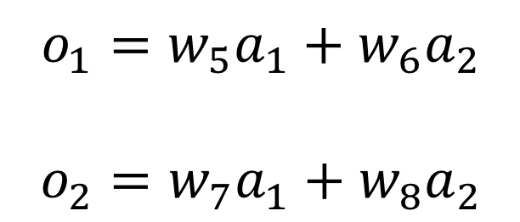
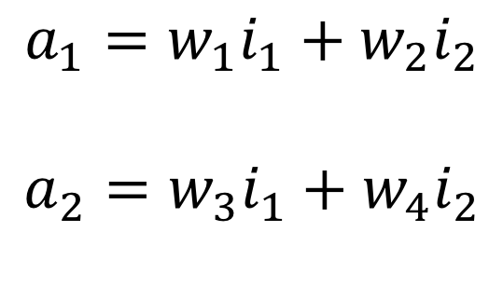
Forward Pass (linear)
w1 w5
$$a_{1}=w_{1}i_{1}+w_{2}i_{2}$$
$$a_{2}=w_{3}i_{1}+w_{4}i_{2}$$
i1
a1
o1
w3 w7
w2 w6
$$o_{1}=w_{5}a_{1}+w_{6}a_{2}$$
$$o_{2}=w_{7}a_{1}+w_{8}a_{2}$$
i2
a2
o2
w4 w8
Hidden layer
Input layer
Output layer

Slide 6
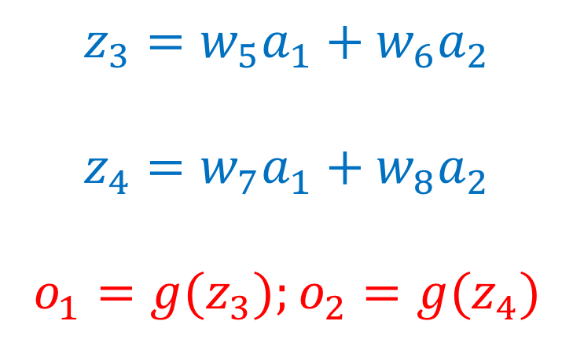

Forward Pass (non-linear)
$$z_{1}=w_{1}i_{1}+w_{2}i_{2}$$
$$z_{2}=w_{3}i_{1}+w_{4}i_{2}$$
$$a_{1}={g(z}_{1});a_{2}={g(z}_{2})$$
w1 w5
i1
z1 a1
z3 o1
w3 w7
w2 w6
$$z_{3}=w_{5}a_{1}+w_{6}a_{2}$$
$$z_{4}=w_{7}a_{1}+w_{8}a_{2}$$
$$o_{1}={g(z}_{3});o_{2}={g(z}_{4})$$
i2
z2 a2
z4 o2
w4 w8
Weighted sum
Non-linear transformation

Slide 7
Recap
Nodes, layers,
Weights, bias
Activation functions
Loss

Slide 8
Backward Pass
We want to adjust the weights so that the output of the network is closer to the observed responses.
We use backpropagation for this.
w1 w5
i1
z1 a1
z3 o1
w2 w6
w3 w7
i2
z2 a2
z4 o2
w4 w8

Slide 9
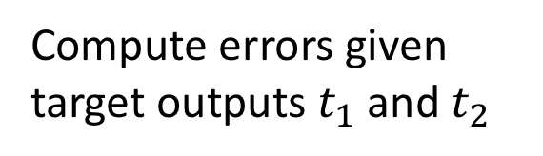
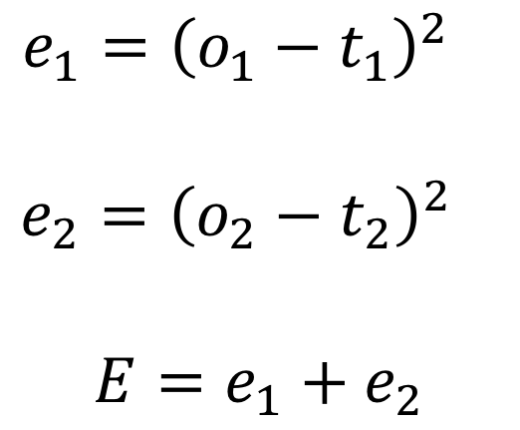
Backward Pass
Compute errors given target outputs $t_{1}$ and $t_{2}$
w1 w5
i1
z1 a1
z3 o1
$$e_{1}={{\left(o_{1}−t_{1}\right)}^{2}}_{}$$
$$e_{2}={{\left(o_{2}−t_{2}\right)}^{2}}_{}$$
$$E=e_{1}+e_{2}$$
w2 w6
w3 w7
i2
z2 a2
z4 o2
w4 w8

Slide 10
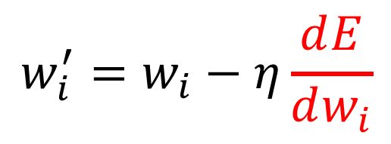
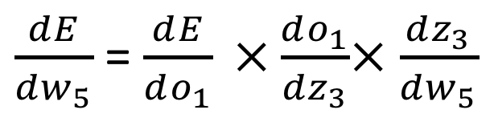
Backward Pass
Find out what computations are affected if we change w_{i}
e.g. w5 -> z3 -> o1 -> E
w1 w5
i1
z1 a1
z3 o1
w2 w6
$\frac{ⅆE}{dw_{5}}$ = $\frac{ⅆE}{do_{1}} ×\frac{ⅆo_{1}}{dz_{3}}$× $\frac{ⅆz_{3}}{dw_{5}}$
w3 w7
i2
z2 a2
z4 o2
$$w_{i}^{′}=w_{i}−η\frac{ⅆE}{dw_{i}}$$
w4 w8
Learning rate

Slide 11
Recap
Nodes, layers,
Weights, bias
Activation functions
Loss
Backpropagation
Learning rate
Optimizers e.g. stochastic gradient descent
Batch size

Slide 12
Case study: predicting species presence
15,000km visual survey
Extracted dataset with 1126 presences and 1935 absences (response var)
20 environmental covariates (predictors)
Can we predict species presence from covariates?
Jack, S. L., Hoffman, M. T., Rohde, R. F., & Durbach, I. (2016). Climate change sentinel or false prophet? The case of Aloe dichotoma. Diversity and Distributions, 22(7), 745-757.

