Slide 1
IMAGE PLACEHOLDER (anime-style, to be swapped in)
Anime-style, almost no text. A lone figure stands at the edge where smooth, glossy glass meets rough, textured ground. Dusk light, sky blue and gold. Wide, quiet, minimal composition.
Friction
1
Notes:
Open live, not scripted. "I don't do well just sitting and listening, and I'm guessing some of you don't either. So we're doing two things at once today. I'll talk, and we'll all build something with our hands. By the end you'll use what you made."
FOLD: Step 1.
(Reminder: paper and pencil handed out BEFORE students enter. Ian in student uniform, seated among them.)

Slide 2
IMAGE PLACEHOLDER (anime-style, to be swapped in)
Anime-style, striking, minimal. A face lit only by a phone screen in a dark party crowd. Everyone around is a soft silhouette; the phone is used instead of saying hello.
When have you chosen frictionless?
2
Notes:
Scene: a phone-lit face in a dark party crowd (phone instead of saying hi).
Name the scene plainly, without judgment. Then ask, don't answer: "Does that actually feel good? Does it actually satisfy?" Let the silence sit. Don't resolve it.
TONE: Not "it's a lie, it's a drug." Open question only. If the answer is "illusion," they say it, not you.
FOLD: Step 2.

Slide 3
IMAGE PLACEHOLDER (anime-style, to be swapped in)
Anime-style, striking, minimal. Close on a thumb mid-scroll, hovering over an Instagram-style post (generic, no real logos) instead of engaging or commenting.
When have you chosen frictionless?
3
Notes:
Scene: a thumb mid-scroll, hovering over an Instagram post instead of engaging or commenting.
Name the scene plainly, without judgment. Then ask, don't answer: "Does that actually feel good? Does it actually satisfy?" Let the silence sit. Don't resolve it.
TONE: Not "it's a lie, it's a drug." Open question only. If the answer is "illusion," they say it, not you.
FOLD: Step 3.

Slide 4
IMAGE PLACEHOLDER (anime-style, to be swapped in)
Anime-style, striking, minimal. A closed front door at night, a cool phone-glow spilling from the room behind it: staying in instead of going out and risking awkward or burned.
When have you chosen frictionless?
4
Notes:
Scene: a closed front door at night, phone-glow behind it (staying in instead of going out and risking awkward or burned).
Name the scene plainly, without judgment. Then ask, don't answer: "Does that actually feel good? Does it actually satisfy?" Let the silence sit. Don't resolve it.
TONE: Not "it's a lie, it's a drug." Open question only. If the answer is "illusion," they say it, not you.
FOLD: Step 4.

Slide 5
IMAGE PLACEHOLDER (anime-style, to be swapped in)
Anime-style, striking, minimal, TASTEFUL and NON-EXPLICIT. A screen-lit room with one person alone, seen from behind or in silhouette. Reads as 'alone with a screen' instead of risking a real relationship.
When have you chosen frictionless?
5
Notes:
Scene: a screen-lit room, a person alone (watching something, or pornography, instead of risking a real relationship). Image must be tasteful and non-explicit.
OPEN ITEM: Ian to confirm wording and whether to name this directly here or hold it for his story (Slide 6). Confirm image with administration.
Name the scene plainly, without judgment. Then ask, don't answer: "Does that actually feel good? Does it actually satisfy?" Let the silence sit. Don't resolve it.
TONE: Not "it's a lie, it's a drug." Open question only. If the answer is "illusion," they say it, not you.
FOLD: Step 5.

Slide 6
IMAGE PLACEHOLDER (anime-style, to be swapped in)
Warm, intimate anime-style image: an open door with warm gold light spilling out, or an open hand held out. Gentle, inviting, human scale. Gold and cream tones.
6
Notes:
Tell the story: asked to leave Principia in college for having sex, and using pornography to avoid real relationship. Say exactly why: "I'm not telling you this to shock you. Silence about hard things is its own kind of frictionless, and I think that's part of why the world feels like it's falling apart. We stopped saying the hard stuff out loud."
Keep it brief, honest, and free of detail. Disclosure serves them, not him.
OPEN ITEM: Ian to draft final wording and clear it with administration.
FOLD: Step 6. Ian: "I need something to do with my hands too."

Slide 7
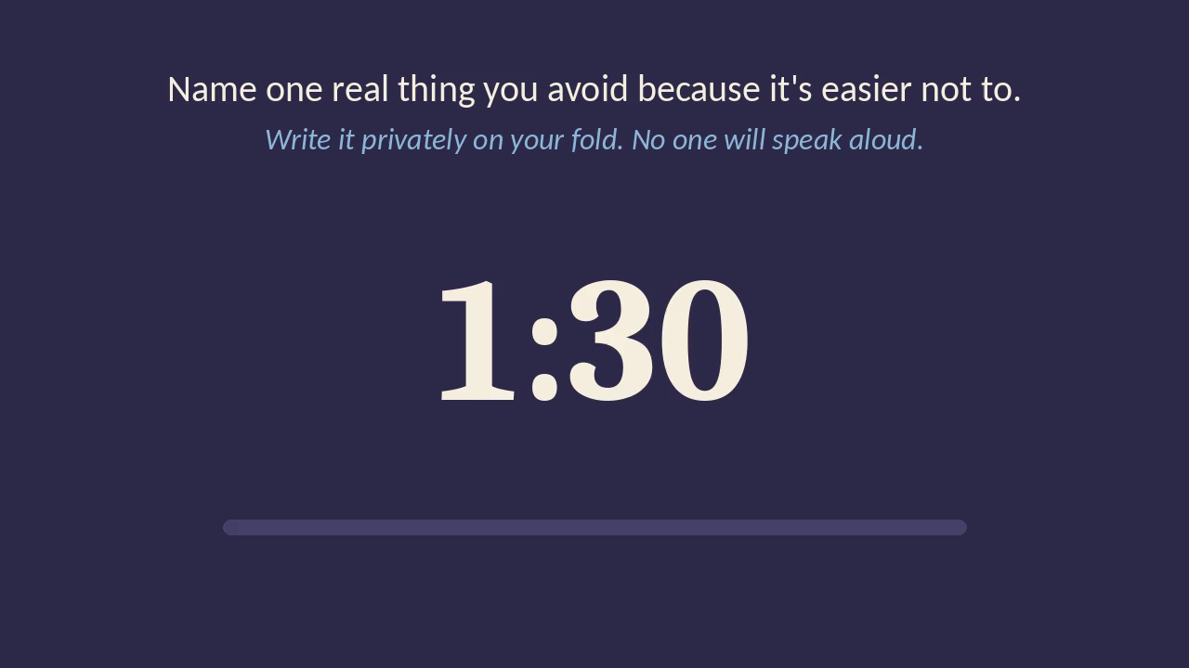
Embedded video: slide7-countdown-90s.mp4 (90-second countdown baked in, no live timer).
7
Notes:
Say the prompt once, then let the video run: "Name one real thing you avoid because it's easier not to." (Optional second line: "What's one wall you've built that you wish were a bridge?")
They write privately on their fold. Nobody speaks aloud. Walk the aisle. Afterward, read two or three unsigned responses back to the room. The room hears its own honesty, not yours.
Build-time budget: this beat costs about five minutes total including transition. Plan for it.
TECH: The countdown is a pre-rendered MP4 (slide7-countdown-90s.mp4, delivered alongside this deck). It is embedded on this slide; if PowerPoint on the presenting machine can't play it, insert it via Insert > Video, or play it from the same folder. Test on the school projector beforehand. The video should start only when you click.
FOLD: Step 7. They write on the fold.

Slide 8
IMAGE PLACEHOLDER (anime-style, to be swapped in)
Wide, open anime-style horizon: a vast soft sky at dawn over a calm plain, one level 'floor' stretching to the edge of the world. Sky blue, sage, gold. No figures, or a single tiny one. Echoes 'the floor we all stand on.'
8
Notes:
Ground this in what the room just wrote. "Nothing you just named makes you broken. None of it is something to fix before you're worth loving."
Share your story across faiths: Christian Scientist, married to a Muslim, worked around the world. Underneath every tradition you've touched is the same floor: everyone here is already whole and complete.
Name this generation: brilliant, often misunderstood, not broken. Hope and faith have gotten buried under dogma and a lot of human baggage, and that makes them hard to grab onto.
Eddy citation: Mary Baker Eddy dedicated Science and Health to "honest seekers for Truth." (Preface, p. xii:27.)
OPEN ITEM: Verify the dedication page and line in Ian's paginated edition before use.
"That's what this school is about. Not a box. Not conversion. It's putting reason and logic to the idea of love from a power greater than ourselves, and coming to it on your own terms, and letting that love comfort you and lead you."
Then: the real choice in front of them is walls or bridges. It's a waste to keep the walls up.
(Slides 8-9 share these notes; split the talk across the two slides as it flows.)
FOLD: Step 8.

Slide 9
IMAGE PLACEHOLDER (anime-style, to be swapped in)
Same wide, open horizon, now with a bridge of light or a simple footbridge crossing a gentle gap toward the sunrise. Sky blue, sage and gold. Hopeful, spacious, minimal.
9
Notes:
Ground this in what the room just wrote. "Nothing you just named makes you broken. None of it is something to fix before you're worth loving."
Share your story across faiths: Christian Scientist, married to a Muslim, worked around the world. Underneath every tradition you've touched is the same floor: everyone here is already whole and complete.
Name this generation: brilliant, often misunderstood, not broken. Hope and faith have gotten buried under dogma and a lot of human baggage, and that makes them hard to grab onto.
Eddy citation: Mary Baker Eddy dedicated Science and Health to "honest seekers for Truth." (Preface, p. xii:27.)
OPEN ITEM: Verify the dedication page and line in Ian's paginated edition before use.
"That's what this school is about. Not a box. Not conversion. It's putting reason and logic to the idea of love from a power greater than ourselves, and coming to it on your own terms, and letting that love comfort you and lead you."
Then: the real choice in front of them is walls or bridges. It's a waste to keep the walls up.
(Slides 8-9 share these notes; split the talk across the two slides as it flows.)
FOLD: Step 9.

Slide 10
Friction isn't shameful.
It's the process.
You are loved inside the discomfort,
not despite it.
10
Notes:
Say slowly:
- "Friction isn't shameful. It's the process."
- "You are loved inside the discomfort, not despite it."
If possible, weave in one or two phrases from the anonymous responses read back earlier so the takeaways are partly theirs.
FOLD: Step 10.

Slide 11
[Finished fold, large. Swap in an anime-style illustration of the completed fold. Shape to be confirmed.]
Notes:
Students finish the fold and write one commitment on it. They stand, turn to the people beside or behind them, and read it aloud. The listener witnesses it. Pairs join pairs (2 to 4), then fours join fours (4 to 8). Let it take the time it takes. Auditorium seating works because they can simply stand and turn around.
Close small and human: one plain, quiet sentence.
FOLD: Complete.

