Slide 1
Excel to R
An introduction

Slide 2

Visualise
Import
Tidy
Transform
Communicate
Model

Slide 3
“An article about computational science in a scientific publication is not the scholarship itself it is merely advertising of the scholarship”
–From Claerbout and Karrenbach (1992)

Slide 4
Why reproducible research?
To demonstrate correctness / audit
To allow others to follow methods
To remember what happened…
Students graduate
Future you!

Slide 5
What is R?
Programming language / system for data science
Open source and free
Extended by > 10,000 packages…

Slide 6
“This huge variety of packages is one of the reasons that R is so successful: the chances are that someone has already solved a problem that you're working on, and you can benefit from their work by downloading their package.”
–Hadley Wickham, Chief Scientist RStudio

Slide 7
The Tidyverse
Import
Tidy
Manipulate/Transform
Visualise
Model
Report

Slide 8
Example - experiment
Treatment A
Treatment B
Glucose measured weekly (3 times) for 4 weeks

Slide 9
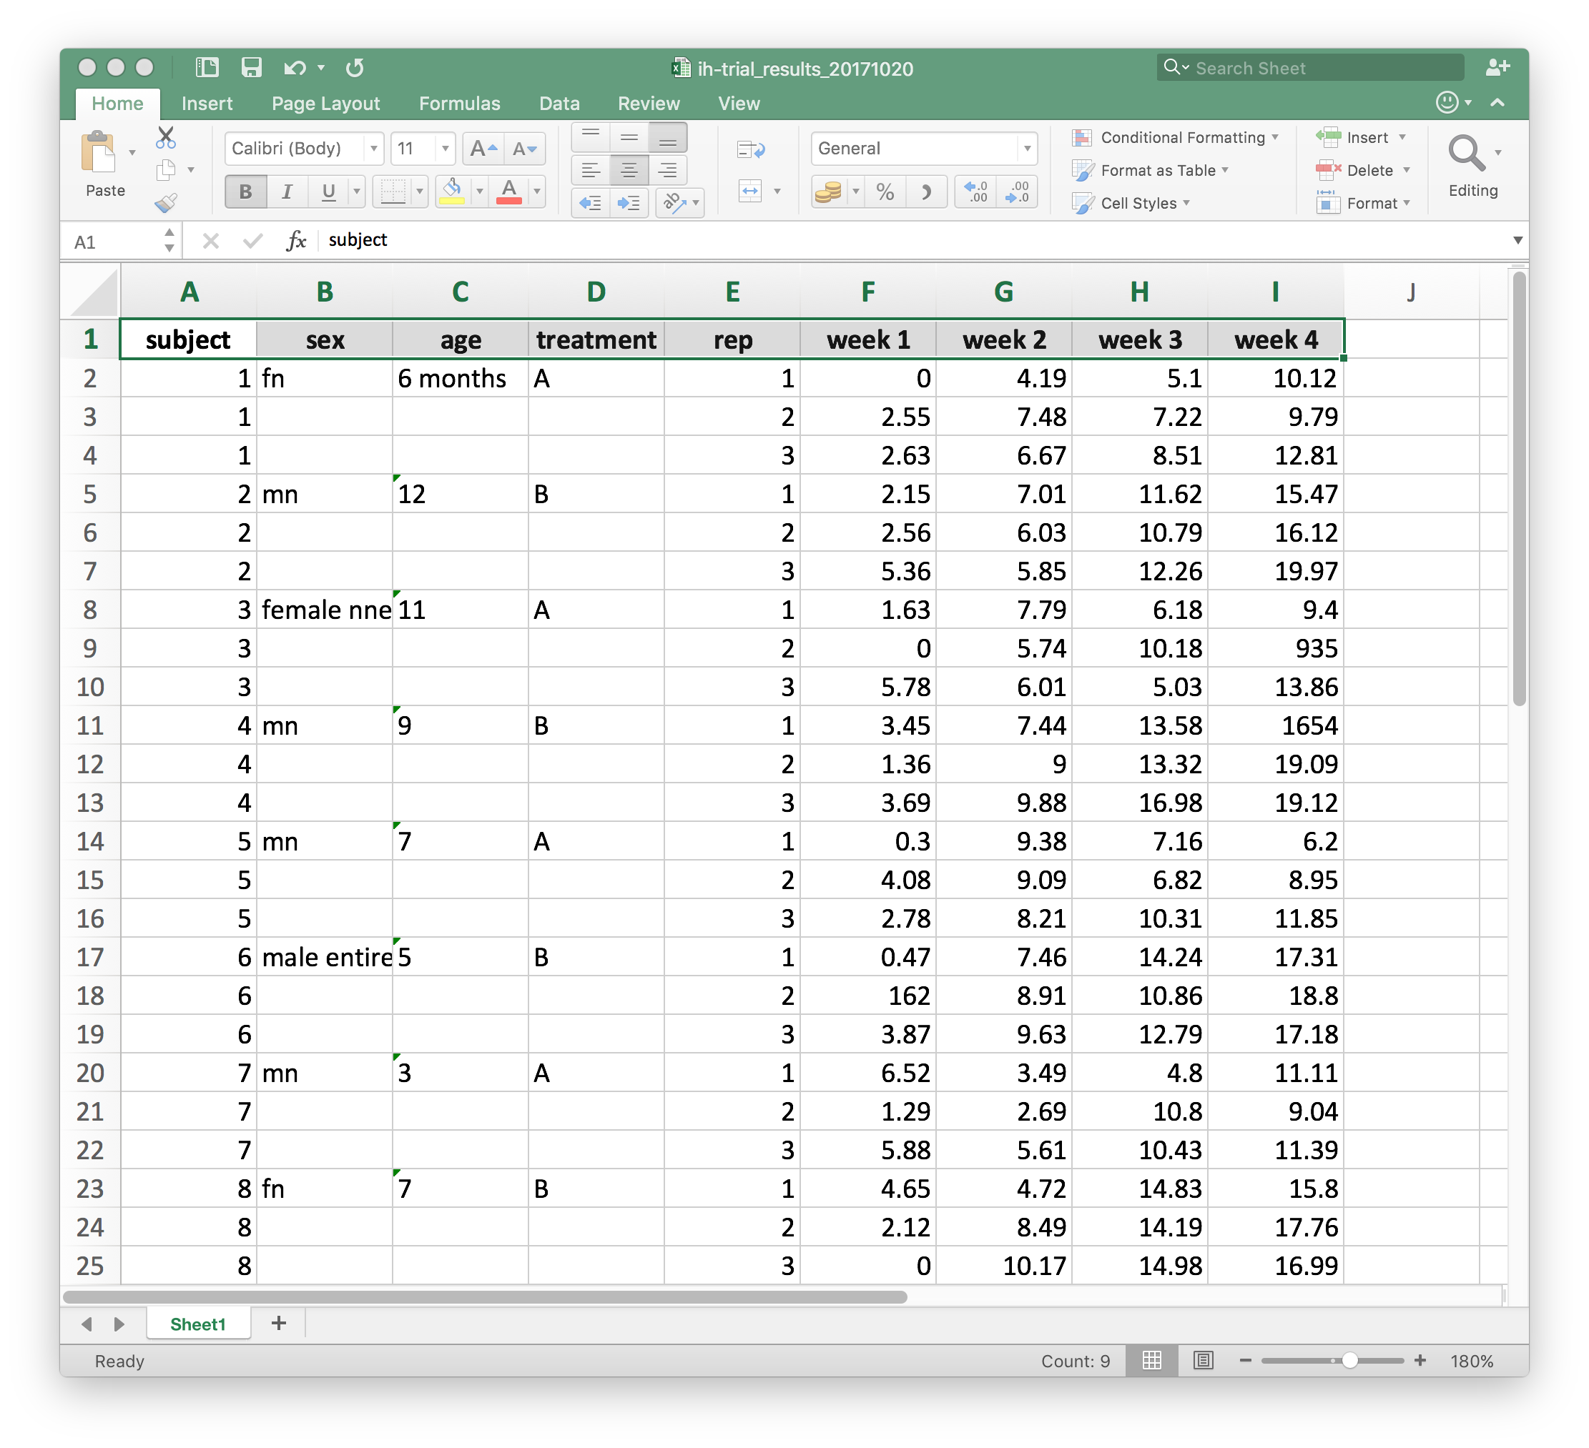

Slide 10
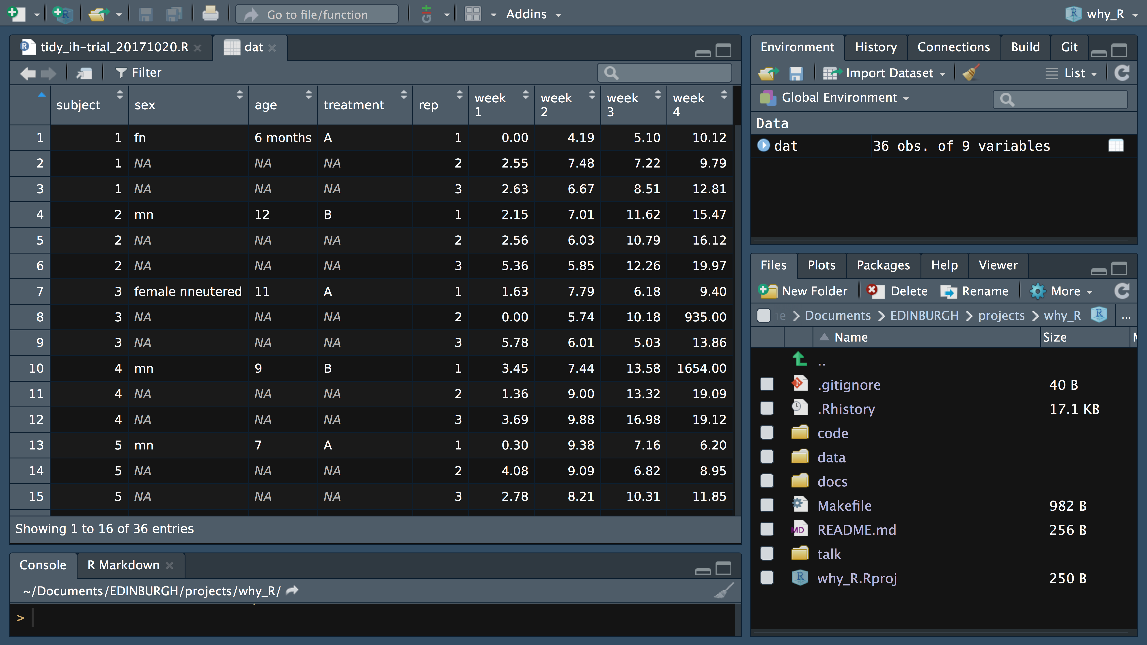
Import the data
dat <- read_excel("../data/ih-trial_results_20171020.xlsx",
sheet = 1)

Slide 11
Fill down missing data
dat <- dat %>%
fill(sex, age, treatment)

Slide 12
Create a sensible subject ID
dat <- dat %>%
mutate(subject = str_c("A", str_pad(subject, 3, "left", "0")))

Slide 13
Examine the sex/status column
dat %>%
group_by(sex) %>%
tally() %>%
kable(format = "html")
sex | n
female nneutered | 3
fn | 9
male entire | 6
mn | 15
MN | 3

Slide 14
Correct sex/status typos (etc)
dat <- dat %>%
mutate(sex = case_when(sex == "female nneutered" ~ "fn",
sex == "male entire" ~ "me",
sex == "MN" ~ "mn",
TRUE ~ sex))

Slide 15
Separate sex/status into two columns
dat <- dat %>%
mutate(sex = case_when(sex == "female nneutered" ~ "fn",
sex == "male entire" ~ "me",
sex == "MN" ~ "mn",
TRUE ~ sex))

Slide 16
Expand sex and status labels
dat <- dat %>%
mutate(sex = fct_recode(sex,
male = "m",
female = "f"),
neuter_status = fct_recode(neuter_status,
neutered = "n",
entire = "e"))

Slide 17
Convert ages in ‘months’ to ‘years’
dat <- dat %>%
mutate(age = case_when(
str_detect(age, "month") ~ parse_number(age) / 12,
TRUE ~ parse_number(age)))

Slide 18
Gather the 4 results columns
dat <- dat %>%
gather("week", "glucose", `week 1`:`week 4`) %>%
mutate(week = parse_number(week))

Slide 19
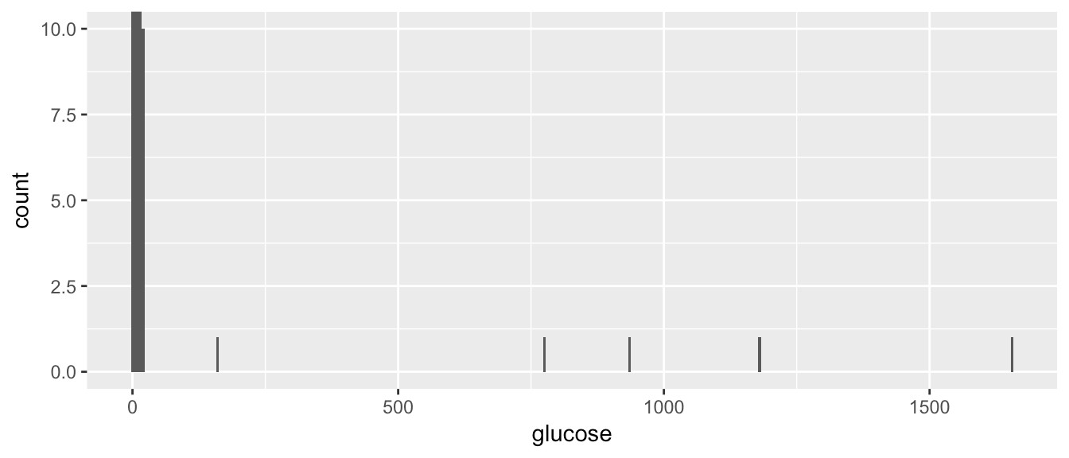
Check the biochem results
ggplot(dat, aes(x = glucose)) +
geom_histogram(binwidth = 5) +
coord_cartesian(ylim = c(0, 10))
dat %>%
filter(glucose > 50) %>%
select(subject, week, rep, glucose) %>%
kable(format = "html")
subject | week | rep | glucose
A006 | 1 | 2 | 162
A012 | 2 | 2 | 776
A012 | 3 | 1 | 1178
A003 | 4 | 2 | 935
A004 | 4 | 1 | 1654

Slide 20
Correct age data typos
dat <- dat %>%
mutate(glucose = case_when(subject == "A006" &
week == 1 &
rep == 2 ~ 1.62,
subject == "A012" &
week == 2 &
rep == 2 ~ 7.76,
subject == "A012" &
week == 3 &
rep == 1 ~ 11.78,
subject == "A003" &
week == 4 &
rep == 2 ~ 9.35,
subject == "A004" &
week == 4 &
rep == 1 ~ 16.54,
TRUE ~ glucose))

Slide 21
Save tidied data
write_csv(dat, "../data/ih-trial_results_20171020_tidy.csv")

Slide 22
What next?
Half day workshop (the saga continues)
R for Datascience
Datacamp
Coursera
Data-Methods-Club…

Slide 23
Data-methods-club
How to get help (with R and other stuff)
Half day workshop on R
Mailing list - just ask
Website - resources

