Slide 1
Note: This presentation was made as a quick pitch presentation to the client, with more emphasis on value projection, less on technicalities

Slide 2
Sparkify User Churn Prediction
Ian Ho

Slide 3
Business Problem & Objective
Problem
Potential Revenue is lost from Users who cancel their subscription (churn). In particular, we have no insight into who these churn users might be, thus preventing follow-up retention strategies.
Objective
To identify potential churn users using individual and usage data, which will subsequently inform targeted user retention strategies

Slide 4
Approach : Feature Engineering
Raw Data
User Behavior Log
User Level Data
Model Training & Evaluation
Value Proposition
Gender
Paying / Free
Daily Number of Sessions
Monthly Number of Sessions
Daily Number of Songs
Monthly Number of Songs
Number of Thumbs Up
Number of Songs added to Playlists
Average Sessions Time
Days since Registration
Number of Artists
Number of Friends
Number of Thumbs Down
Number of Upgrades
Number of Downgrades

Slide 5
Approach : Modelling & Evaluation
Raw Data
User Behavior Log
User Level Data
Model Training & Evaluation
Value Proposition
Logistic Regression
Best LR Model
Precision-Recall
Measures trade-off between
1. identifying more churn users (fewer false negatives) and
2. making sure identification is precise (fewer false positives)
Decision Trees
Best DT Model
HyperParameter Optimization
Training
Evaluation
Gradient Boosted Tree
Best GBT Model
Random Forest
Best RF Model

Slide 6
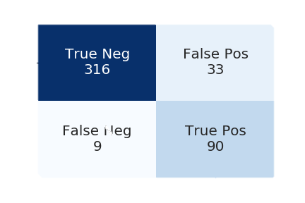
Results : Value Proposition
Raw Data
User Behavior Log
User Level Data
Model Training & Evaluation
Value Proposition
Actual Non-Churn
Actual Churn
Predict Non-Churn
Predict Churn

Slide 7
Out of 100 Churn users, we can identify 90 beforehand.
Given baseline assumptions*, and 100% retention from identification, revenues will increase up to 26%.
Value Proposition
Actual Non-Churn
Actual Churn
Predict Non-Churn
Predict Churn
Assuming proportion of users by paying/free and churn/no-churn are as in the dataset, and a 1:3 revenue ratio for free:paying users (which turns out to not be a crucial assumption)

Slide 8
End of Presentation

