Slide 1


Azure IoT Suite
Ian Hoppes @ianhoppes | https://github.com/ianhoppes http://www.ianhoppes.com

Slide 2
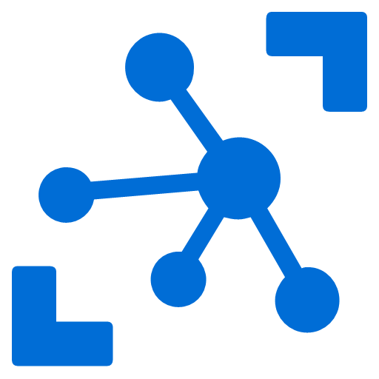
What is IoT?
The Internet of Things (IoT) is the network of physical objects - devices, vehicles, buildings and other items - embedded with electronics, software, sensors, and network connectivity that enables these objects to collect and exchange data.
20,800,000,000 “Things” By 2020
Source: https://en.wikipedia.org/wiki/Internet_of_Things, http://www.gartner.com/newsroom/id/3165317
Notes:
IoT is…
Next wave of innovation
Gartner, Inc. forecasts that 6.4 billion connected things will be in use worldwide in 2016, up 30 percent from 2015, and will reach 20.8 billion by 2020.
This year 5.5 million new things will get connected every day.
Huge business opportunity
Inexpensive, accessible hardware
Ubiquitous internet access
Cloud computing

Slide 3
Microsoft’s IoT Strategy
Azure IoT
IoT Editions Power a Broad Range of Devices
25 years of history in embedded devices
One Windows platform for all devices
Enterprise-ready, OEM-ready, Maker-friendly
Designed for today’s IoT environments
Scalable solutions from free Windows IoT Core to Windows IoT Enterprise on PC-Like Devices
Cloud-Based IoT Services & Solutions
Easy to provision, use and manage
Pay as you go, scale as you need
Global reach, hyper scale
End-to-end security & privacy
Windows, Mbed, Linux, iOS, Android, RTOS support
Notes:
Source: https://channel9.msdn.com/Events/Build/2016/B861

Slide 4
Windows 10 IoT Editions
Cost
Windows 10 IoT Enterprise [same as Windows 10 Enterprise LTSB]
Desktop Shell, Win32 apps, Universal Windows Apps and Drivers
2 GB RAM, 16 GB Storage
X86
Premium
Windows 10 IoT Mobile Enterprise [same as Windows 10 Mobile Enterprise]
Modern Shell, Universal Windows Apps and Drivers
1 GB RAM, 8 GB storage
ARM
Windows 10 IoT Core
No Shell, Universal Windows Apps and Drivers
256MB RAM, 2GB storage
X86 or ARM
Entry
Device Capabilities
Notes:
Source: https://channel9.msdn.com/Events/Build/2016/B861
Enterprise = full x86; non-PC device, like POS terminal, kiosk or outdoor display
Mobile = Windows CE descendant; enterprise mobile, handheld devices like barcode scanners, tablets
Core = free; no shell; x86 or ARM; small, embedded devices – Raspberry Pi

Slide 5
Azure IoT Suite
Azure IoT Hub
Connect, secure, communicate, monitor and manage billions of devices
Azure Stream Analytics
Real time stream processing for billions of IoT devices
Azure Storage
Blob, SQL, DocumentDB, Data Lake. Storage to meet every need at the scale of IoT
Azure App Service
Web and mobile apps for any platform on any device
Power BI
Dashboards and data connectors to visualize any data
Logic Apps
Powerful workflows to automate business processes
Notes:
Source: https://channel9.msdn.com/Events/Build/2016/B861
Designed to help you ingest, manage, make sense of data, and ultimately act on that data

Slide 6
Azure IoT Suite
Devices
Azure IoT SDK (OSS)
Linux, RTOS, mBed, Windows,
Android, iOS
Business Process
ERP/CRM
Web App
Storage Blobs
DocumentDB
IoT Hub
Stream Analytics
Event Hub
Web Jobs
Logic Apps
Azure
Active Directory
Notes:
Source: https://channel9.msdn.com/Events/Build/2016/B861

Slide 7
Connect your devices to Azure
IoT Hub
Event processing and insight
(e.g. hot and cold paths)
1
0
1
1
0
0
1
1
0
0
0
1
1
0
1
0
1
0
1
0
0
1
1
0
IP-capable
0
1
1
0
1
0
Cloud protocol
gateway
0
1
1
1
Field gateway
Device business logic,
Connectivity monitoring
PAN-devices
Application
device provisioning and management
field
cloud
Notes:
Connecting your devices is the 1st challenge that you have when creating an IoT solution. There is a vast variety of devices you may want to connect. Some are internet capable and in that case you can connect them directly to Azure service (eg: IoT Hub) or you can use your own Cloud protocol gateway in case the device you are trying to connect does not have a protocol supported by IoT Hub (at this time AMQP or HTP). However, some devices are not internet capable and those devices need a field gateway to connect to the cloud. This gateway can do many things – not only connectivity and protocol translation but on the application back end side, one of the most important use cases is telemetry. You usually want to have an event processing and insight pipeline and IoT Hub will allow you to get a feed from the devices and events easily.
The 2nd big component that IoT solutions have with cloud is device big logic that takes care of interactive scenarios of your solutions – think about opening your car door or adjusting your home thermostat from your smart phone or sending a command to a device to update a piece of firmware.
Finally IoT Hub has to know which devices have to connect and which devices are present for IoT solution. For this purpose it has to interact with the visioning and management component which is the component that makes sure that the devices are on-boarded and de-provisioned correctly from your own IoT solutions.

Slide 8
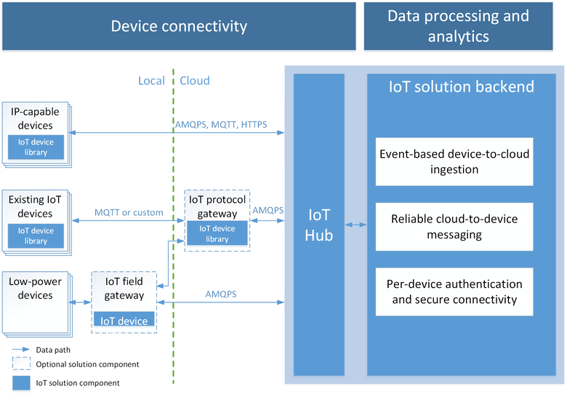
Notes:
Source: https://azure.microsoft.com/en-us/documentation/articles/iot-hub-what-is-iot-hub/

Slide 9
Why use IoT Hub?
Device-to-cloud messaging
Cloud-to-device messaging
Scale up to millions of simultaneously connected devices
Device authentication & security
Service-facing device connectivity monitoring
IoT protocols, device resource optimization
Notes:
Why roll your own custom solution or service bus?
Establish reliable bi-directional communication with IoT assets / Durable messaging
Scales up to millions of simultaneously connected devices you do not have to scale those services on your own. Just by increasing the # of units in your IoT deployment.
Per device authentication and security. Fine grain control on which devices access your solution and you want to make sure that you are sending commands to the right devices.
Delivery receipts, expired messages; Device communication errors
Supports many IoT protocols and is designed to support constrained devices, where device is retrained in networking resources, power resources or computational resources.
Natively supports AMQPS, HTTPS, MQTT
Extensible protocol support for custom protocol needs

Slide 10
IoT Hub endpoints
Your IoT Hub
Event processing
(hot and cold path)
device
Device id
D2C receive endpoint
D2C send endpoint
Device business logic,
Connectivity monitoring
C2D queue
endpoint
1
0
1
1
0
0
1
C2D send endpoint
1
0
0
0
1
1
0
1
0
1
0
1
0
0
1
1
0
0
1
1
0
1
0
0
1
1
1
Field GW /
Cloud GW
Msg feedback and monitoring endpoint
Device …
Device …
Device provisioning and management
Device identity management
Device …
IoT Hub management
Notes:
When you provision an IoT Hub from the Azure Management portal, you will create your own instance of IoT Hub. This instance exposes a set of conceptual endpoints to access its functionalities.
There are two endpoints for each device: one to send D2C msgs, one to receive C2D msgs.
Devices can connect two both endpoints over the same connection.
Field Gateways and Cloud Gateways are able to represent multiple devices by simultaneously connecting to D2C and C2D endpoints for many devices at the same time.
On the app back-end side, the D2C receive endpoint is used by the event processing pipeline (ASA, Storm, custom, …), and by the device runtime logic component, which handles requests and command responses that come from devices.
The device runtime logic component also uses the C2D send endpoint to send notifications and commands to devices.
It also uses the msg feedback and monitoring endpoint. This is critical for IoT solutions where devices are reachable only through IoT Hub. In these very common scenarios, any problem on the connectivity between device and IoT Hub cannot just be reported as errors back to the device, but also to the app back-end in the form of events on this feedback endpoint. This makes possible the kind of monitoring that is required to achieve high operability of an IoT solution.
In addition to these runtime endpoint, IoT Hub also has a device identity management endpoint that is used by your solution’s device provisioning and mgmt component.
Finally, an IoT Hub Manage endpoint is used to set security, functional, performance parameters.

Slide 11

Azure IoT SDKs
Device-facing
For devices and field gateway
Platforms
RTOS (FreeRTOS)
Linux (Ubuntu, Debian, Fedora, Raspbian, Angstrom)
Windows 7/8/10
ARM mbed
Android
iOS
Languages
.NET C#, C, Java, Node, Python
Service-facing
For back-ends and cloud gateway
Languages
.NET C#, Java, Node
https://github.com/Azure/azure-iot-sdks
Notes:
IoT Hub provides a vast variety of SDKs for devices and services. There are 2 different flavors – ones that are device facing and target at device and field gateways. These provide the best variety for platforms and languages. Then there are ones that are service facing and targeted at application back ends and cloud gateways and support many languages.

Slide 12
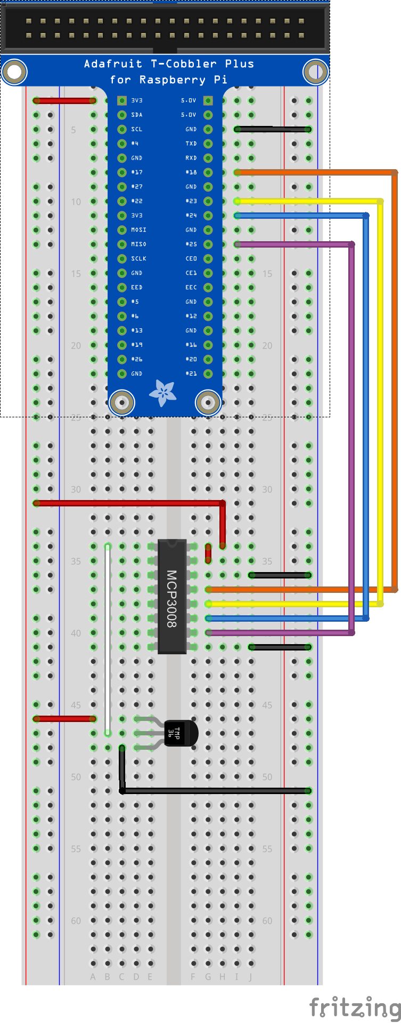

Demo Architecture
<name>data
SQL Database
Send
<name>job
Stream Analytics Job
<name>ns Service Bus Namespace
Receive
Logging
<name>hub
IoT Hub
<name>storage
Storage Account
SEND

Slide 13
Demo
Create an IoT Hub
Notes:
Demo script on Infopedia site

Slide 14


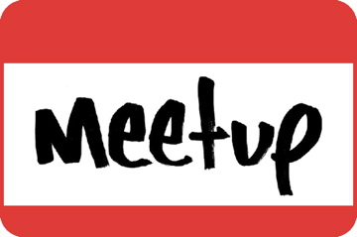
Want to Learn More?
Build 2016 Sessions
https://channel9.msdn.com/Events/Build/2016/
Azure Documentation
https://azure.microsoft.com/en-us/documentation/suites/iot-suite/
Hackster IoT Meetup
http://www.meetup.com/Hackster-Raleigh/

