Slide 1
2-Wheelers information system
BY:
Rojar Maharjan
Binit Maharjan

Slide 2
CONTENT
Introduction
Problem Statement
Objectives
Limitations of the project
Background Study
Methodology
Requirement Analysis
Feasibility Study
Conclusion

Slide 3
Introduction
Our project is a platform that provides information about two-wheelers.
Our project serves as a helping hand for individuals interested in buying vehicles.
Its main focus is to compare bikes and scooters displaying their prices and features and letting other individuals contribute by writing reviews or comments.
It also focuses on calculating EMIs on different vehicles and providing nearest showroom of the desired bike.

Slide 4
Problem statement
In the realm of online bike information platforms, a significant challenge emerges as we strive to create a comprehensive and user-friendly website. Some of the challenges we want to solve include:
Incomplete bike information
Dependence on dealerships
Data security worries.
Device compatibility issues
Understanding user needs

Slide 5
Objectives
To provide a dedicated platform to gather information on two-wheelers.
To design an intuitive and user-friendly interface to enhance the overall user experience.
To develop comparison tools that allow users to compare multiple bikes side by side based on various criteria such as price, mileage, performance, and features.
To build a comprehensive database of bikes with detailed specifications, features, and high-quality images, and regularly update them.
To prioritize the security of user data

Slide 6
Limitations of the project
The website needs the internet to work. If someone doesn't have a good internet connection, they might have trouble accessing the information.
Maintaining accurate and up-to-date information about numerous bike models, specifications, and prices can be challenging. Relying on external sources for data might introduce inaccuracies.
Since our website is still a small project, huge traffic or many number of users at the same time can cause website crashes or inaccessibility.
Regularly updating the website with the latest information, fixing bugs, and addressing user feedback requires ongoing resources and effort.

Slide 7
Background Study
Bike-Arena is a website that primarily serves as a platform for information about two-wheeled automobiles.
Our website includes information such as specifications, features, reviews, prices of the bikes and scooters.
Since many customers regret purchasing their automobile after finding out about other products, our website is designed to address these issues by letting users compare two automobiles for detailed insights.

Slide 8
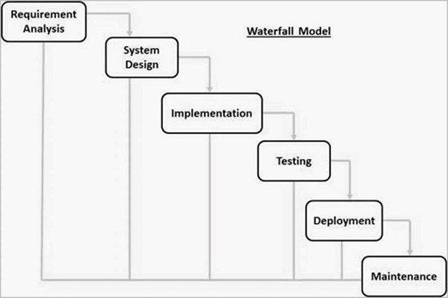
methodology
We are going to use Iterative Waterfall Model to build the website since our project has fixed requirements, well-understood technology, and specific documentation.
In Waterfall model, it is easy to arrange tasks and clearly define stages.

Slide 9
Requirement analysis
1.User Requirements
User Registration & Profiles: User should be able to create accounts providing basic information.
Search & Filtering: A search functionality for users to find motorcycles based on various criteria.
Comparison Tools: Side by side comparison feature to evaluate multiple models at once.
Reviews & ratings: Users can review and rate the motorcycles.

Slide 10
Requirement analysis (CONTD.)
2.Admin & Management
Content Management: A user-friendly content management system for administrators to update information, add new models and manage existing content.
User Management: Tools for admin to manage user accounts for monitoring reviews and address issues.
Dealer Integration: Provide tools for dealers to showcase their inventory, reach a wider audience and to manage their listings and promotions.
Security & Privacy: Ensuring secure handling of user data with privacy regulations.

Slide 11
Feasibility study
Technical Feasibility: Our website is technically feasible as it is being built using simple technologies to reduce technological hindrances. The technical skills and expertise needed for the development are minimal and doable.
Operational Feasibility: The system will weekly update and maintain its content so as to prevent data loss and also implement a support system for user queries and issues. The system will be well documented to operate the system smoothly.
Economical Feasibility: The system will be built in a way that requires less costs. The existing hardware and software will be enough to run the system. Thus, the system will not exceed the initial budget set for development, and maintenance.

Slide 12
Work completed
We have created a home page with a menu, register and log out option.
We created a sign-up and sign-in page using session that allows users to create a
new account and then redirects to sign-in page so that user can now log in.
We also created a session such that it redirects user from home page to sign-in
page in page if user is not logged in.
We also were able to perform CRUD operations for bikes and users.
We created a compare page that allows users to compare two automobiles side by
side.

Slide 13
Work remaining
Bike search function from the home page.
Authorization level for admin, users and dealerships.
Comparation of two wheelers with images.
Device responsive
Better CSS designs for webpages.
Option for users to manage their account information such as changing name and password.

Slide 14
Problem faced
·Irresponsive CSS on PHP file.
·Changing the Sign-up button from menu to log out or account button after successful login.
·Authority level for different level of users not working.
·Calculating Tax and EMI on automobiles.
·Bike Search not working.

Slide 15
INTERFACE DESIGN

Slide 16
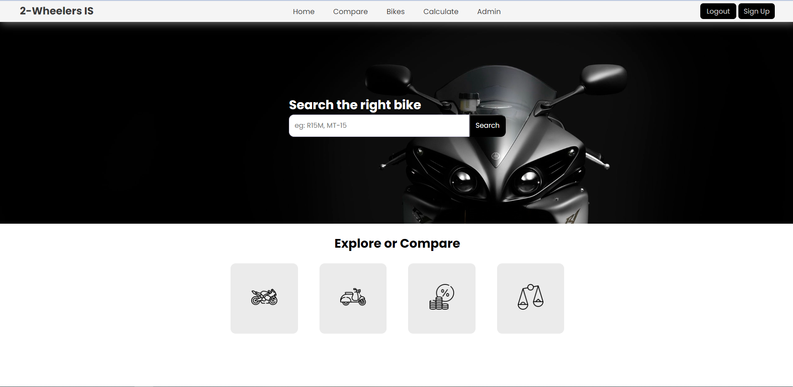
HOME PAGE

Slide 17
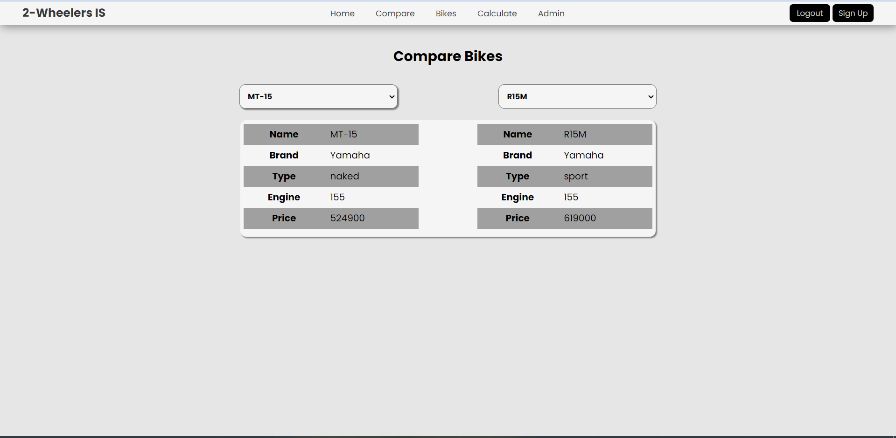
BIKE COMPARING

Slide 18
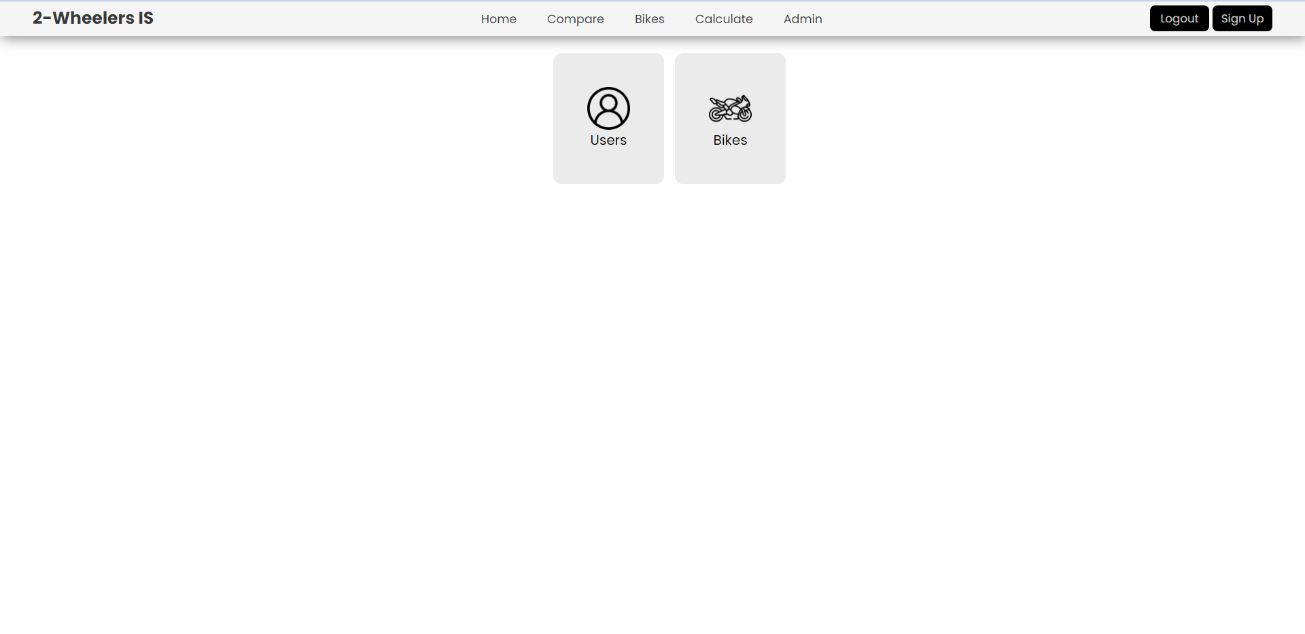
Admin page

Slide 19
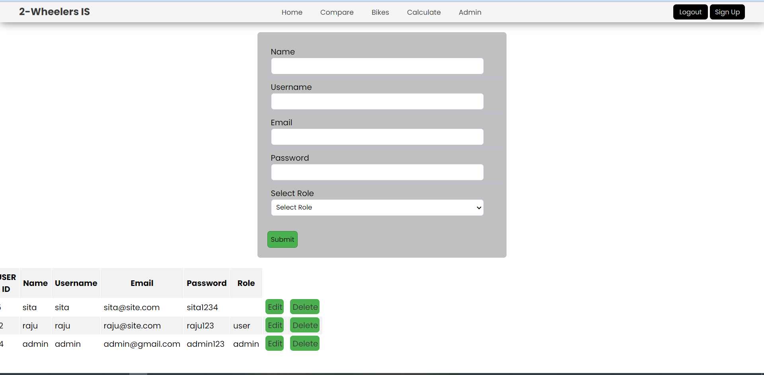
ADMIN USERS PAGE

Slide 20
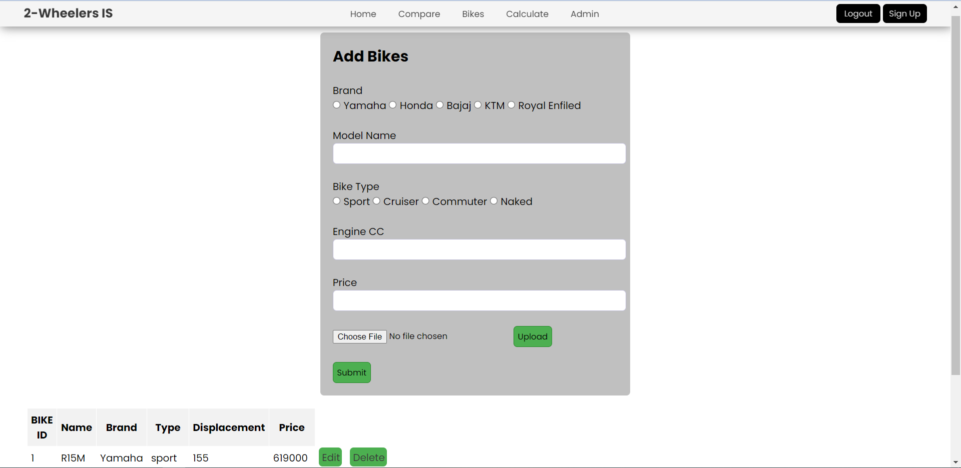
ADMIN BIKES PAGE

Slide 21
Conclusion
In conclusion, through our website, users can find suitable vehicles for them. Similarly, users can also provide feedbacks about the vehicle so that other users can facilitate from them. Hence, we expect our project to help many people in the long term.

