Slide 1
F.P.G.A. Pseudo Terminal
Full Points Grade Association
Ian Chadwick
Jon Ngo
Jack Locke
Sophia Delia
Notes:
Intros ALL OF US

Slide 2
Thrilling Presentation Scenario:
After narrowly escaping the deadly Logic Laser, the federal government has recruited you to be their head FPGA engineer. Your mission, should you choose to accept it, is to fight off the nefarious villains of Verilog- pirates.
The pirates’ latest target is Elon Musk’s Mars colony. 6 months into your perilous journey to the red planet, the SpaceX ® © ™ rocket is ambushed by sequential space scoundrels. The captain rushes to you for help- thank goodness you brought your FPGA.
Notes:
JACK

Slide 3
Goal and Motivation
Goal: Using keyboard inputs, display commands on-screen via a terminal, and execute tasks called by the user.
Motivation: The team wanted to implement a program that emulated every-day computer activity. This included
  Manipulating multiple displays
  Completing calculations
  Processing keyboard data
  Fighting space-pirates
Notes:
JON
Do y’all think this covers the “This slide should include 1 concrete example of how someone could actually use your design in real life” specification in the project docs?
Jon’s Slide

Slide 4
Functionality
Keyboard uses PS2 to UART communication to capture user input
PuTTY serial terminal displays user input
User commands execute actions programmed onto the FPGA
  Manipulating the VGA display
  Manipulating the RGB lights
  Manipulating the seven segment display
    Completing mathematical calculations
    Showing short messages
    Starting and stopping a stopwatch
    Measure reaction time of user
  Activating disco mode
Notes:
JON

Slide 5
Project Specifications
The program must
  Keep accurate time
  Display across eight anodes of the seven segment display
  Be able to execute multiple actions at once
  Control multiple outputs at one time
Constraints
  Keyboard input must be interpreted as eight-bit ascii characters
  Seven segment display must cycle to display full messages
  PS/2 and UART Protocols
  VGA display must operate at 25MHz
  VGA graphics must fit within a 640x480 pixel window
Notes:
IAN

Slide 6
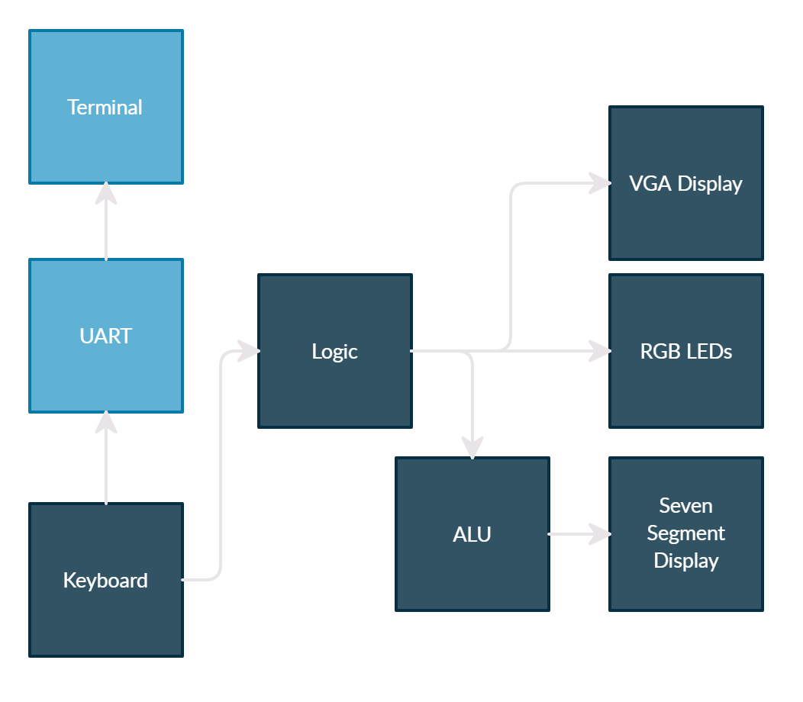
Block Diagram - Whole System
Notes:
SOPHIA
Top module is “Logic”
Keyboard feeds UART and Logic

Slide 7
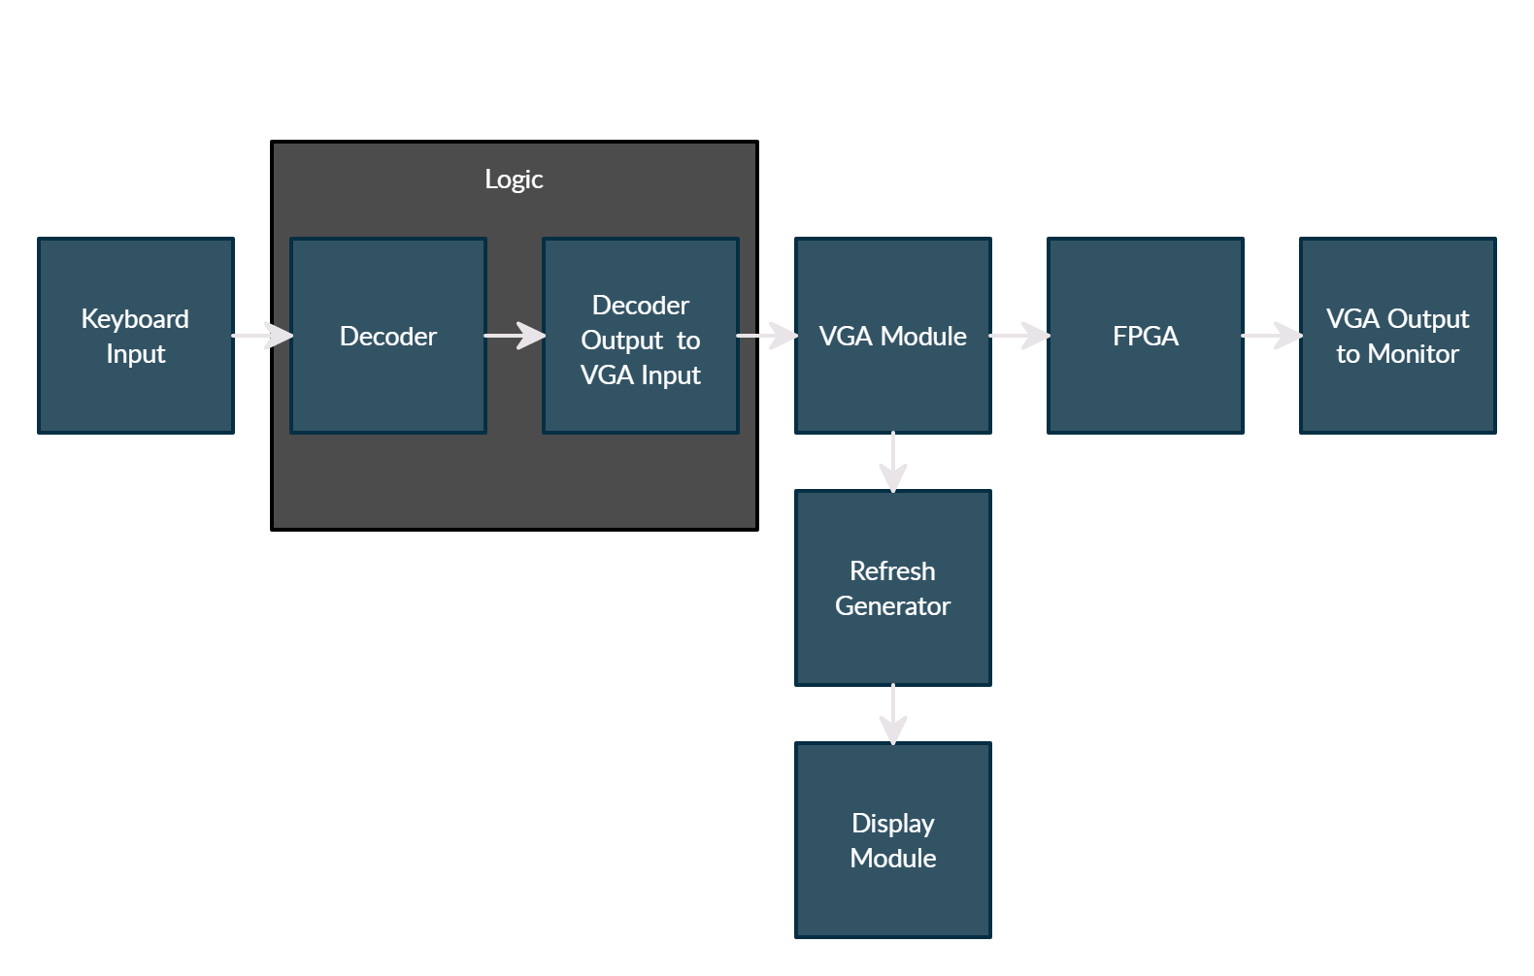
Block Diagram - VGA Display
Notes:
SOPHIA
Decoder output/VGA input is one larger block for logic

Slide 8
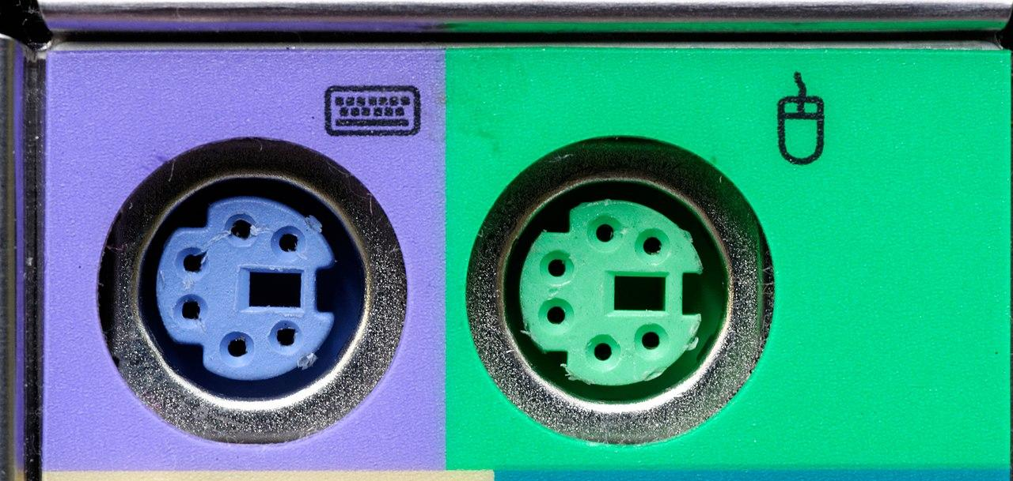
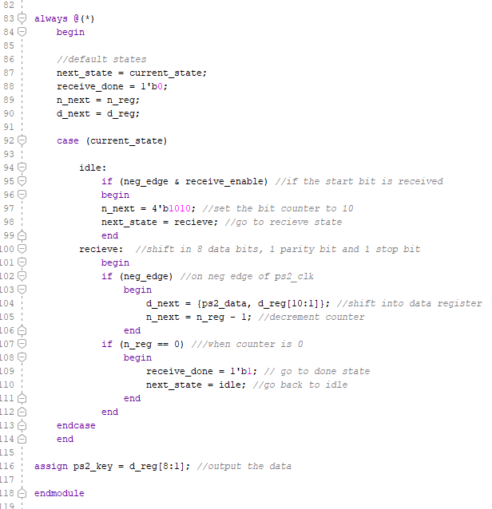
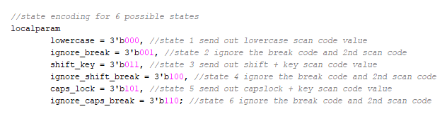
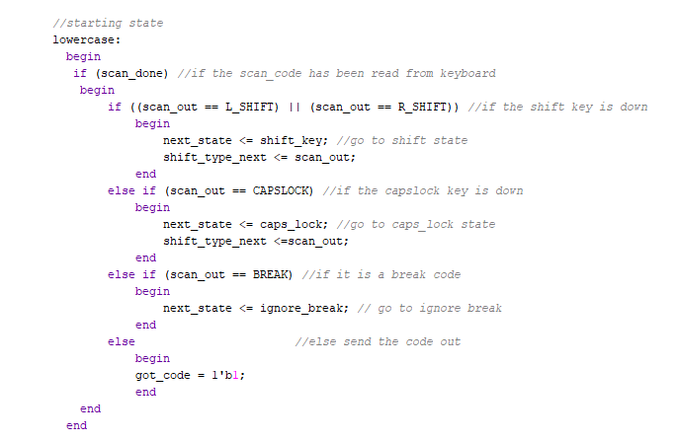
Keyboard Control Module
Notes:
IAN

Slide 9

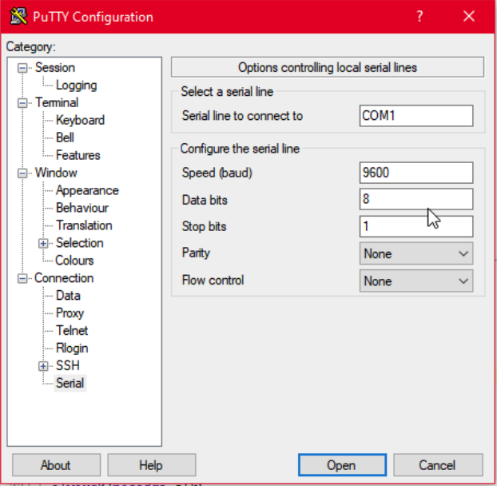
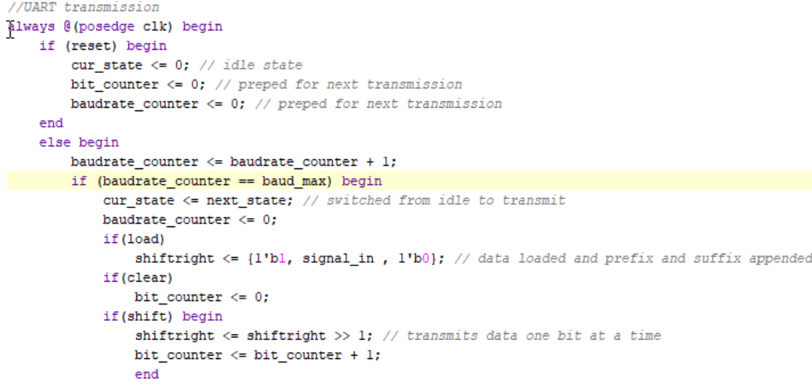
UART Control
https://en.wikipedia.org/wiki/Universal_asynchronous_receiver-transmitter
Notes:
JACK

Slide 10
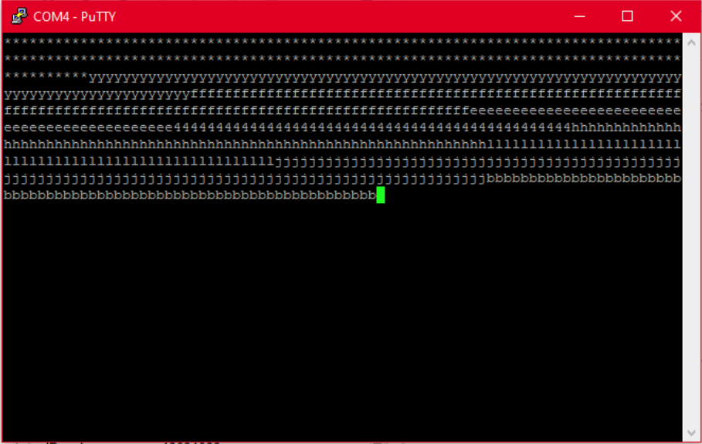
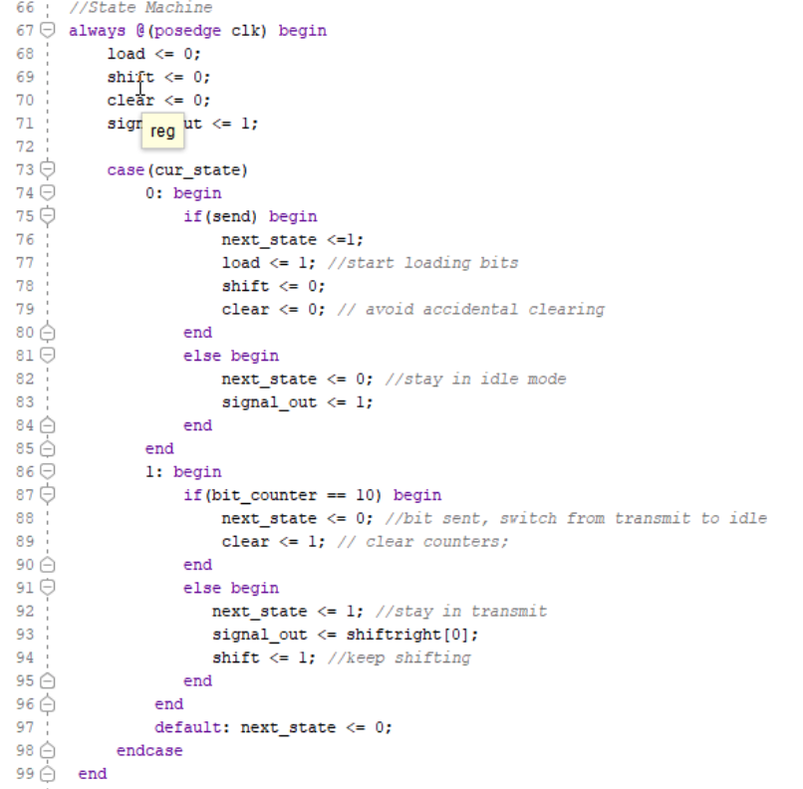
UART Control
INPUT = x OUTPUT = Y
x
IDLE
0
TX
1
x
x’
Y=1
Y=bit[x]

Slide 11
Successes
VGA Display full functionality
  Originally, the VGA display would only show a black screen
  After troubleshooting, the team recognized and resolved a few key problems
    The 25MHz clock module was not generating the correct clock speed
    The 25MHz clock was not being used in the correct module
  Problems were resolved by modifying the 25MHz clock code, and implementing the clock in the refresh module
Pseudo Random output
  In order to randomize responses sent to the 7 segment display, an extremely fast counter was set to run and would only settle on a value when the user entered a greeting command. This way, the outputs would effectively have no pattern since pirates are terrible at pressing buttons
Notes:
SOPHIA - JON

Slide 12
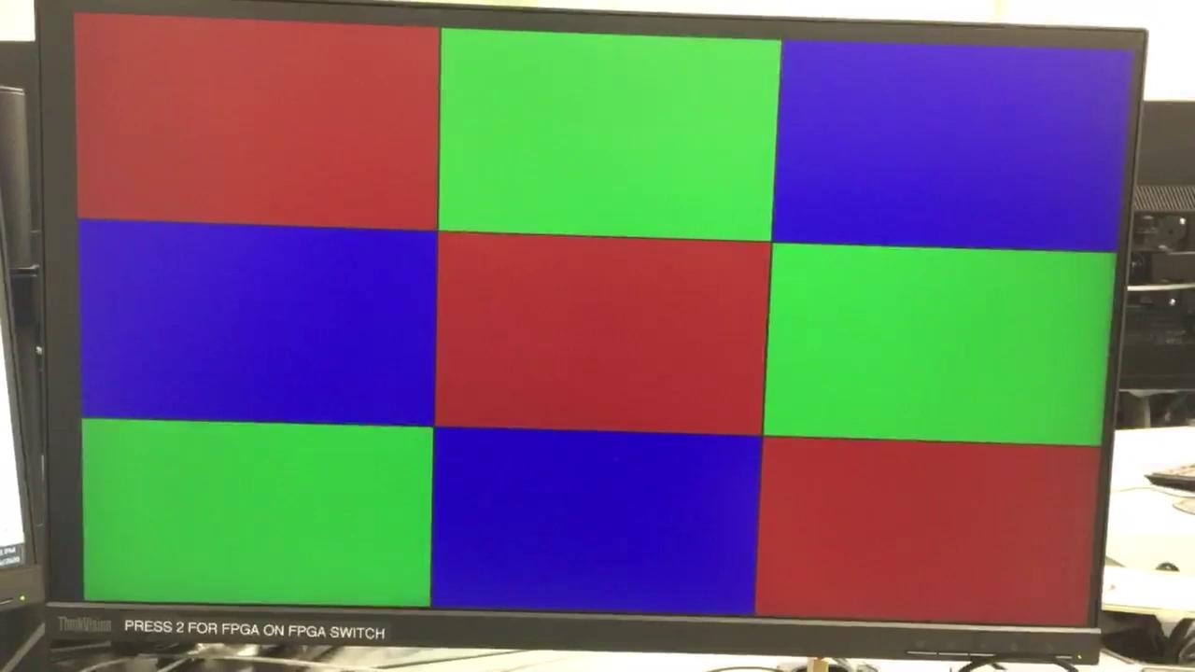
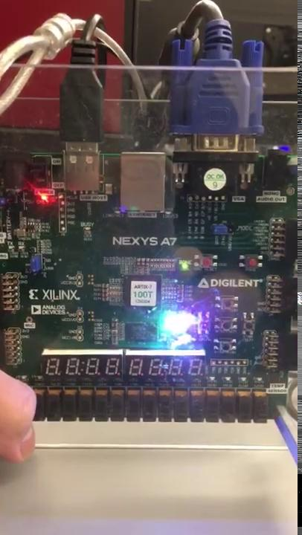
Demonstration - DISCO MODE

Slide 13
Challenges and Setbacks
Keyboard to UART communication
  Keyboard successfully passes ASCII byte to FPGA and UART can read an ASCII byte and pass it to the terminal, however we either can’t successfully automate the “send” command OR we over automate the send command to continuous send.
The 7 segment display alternator
  The 7 segment display was suppose to alternate between the first and second half of a message in response to a greetings command from the user. Currently we are encountering issues with the brightness of the display
Notes:
JACK

Slide 14
Thanks for Watching!
Are there any questions?

