Slide 1
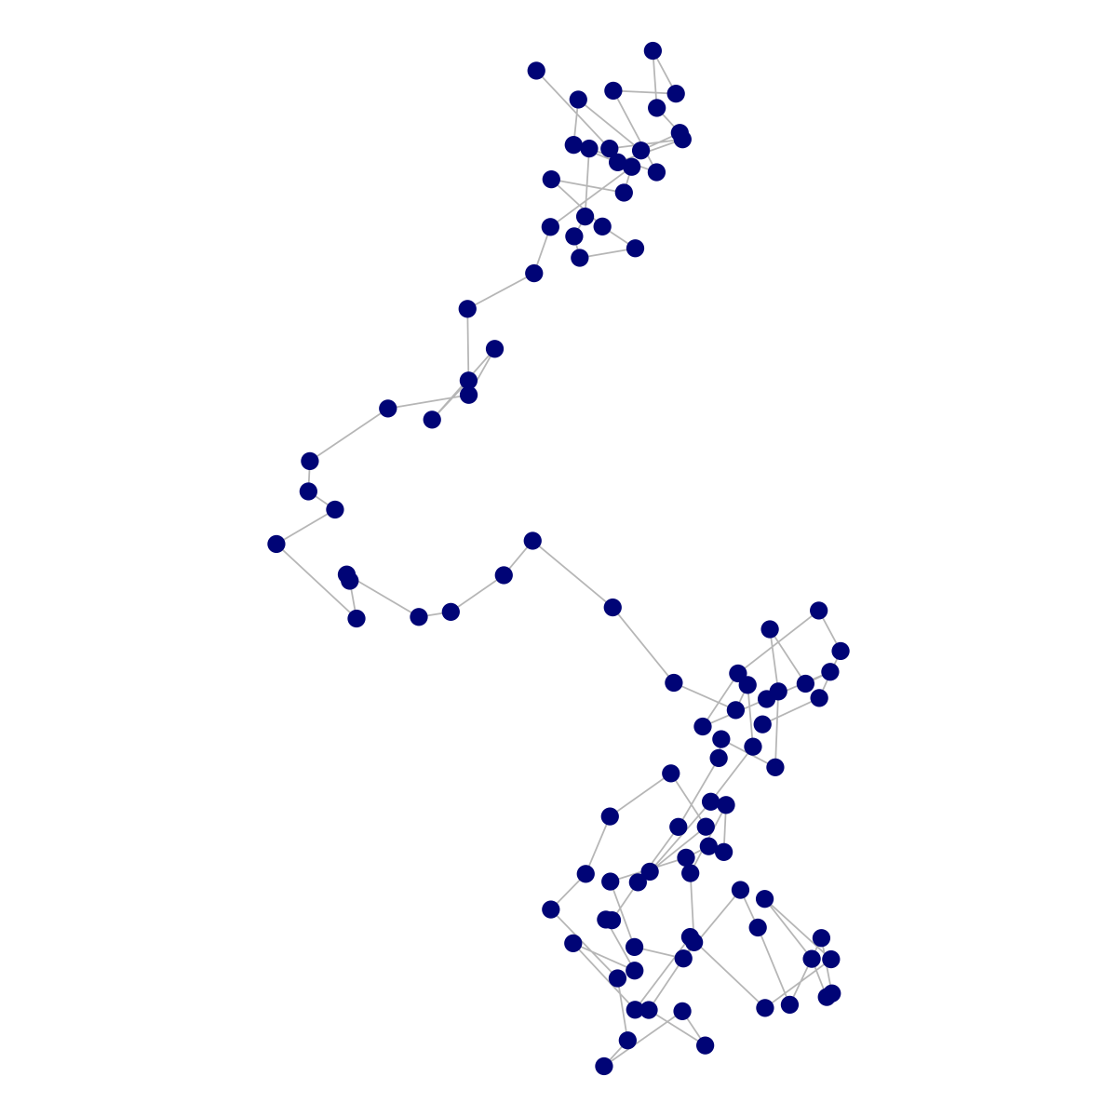
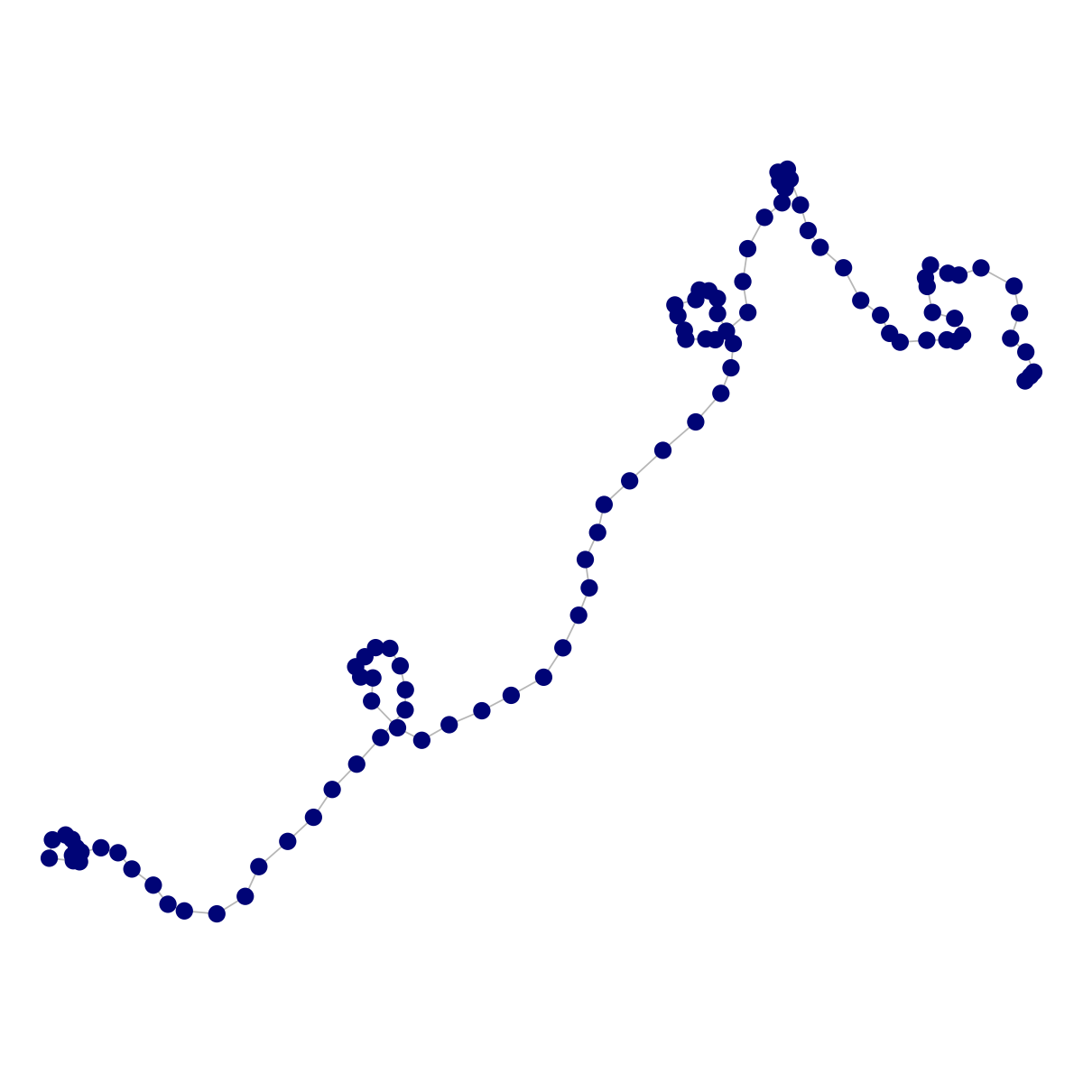
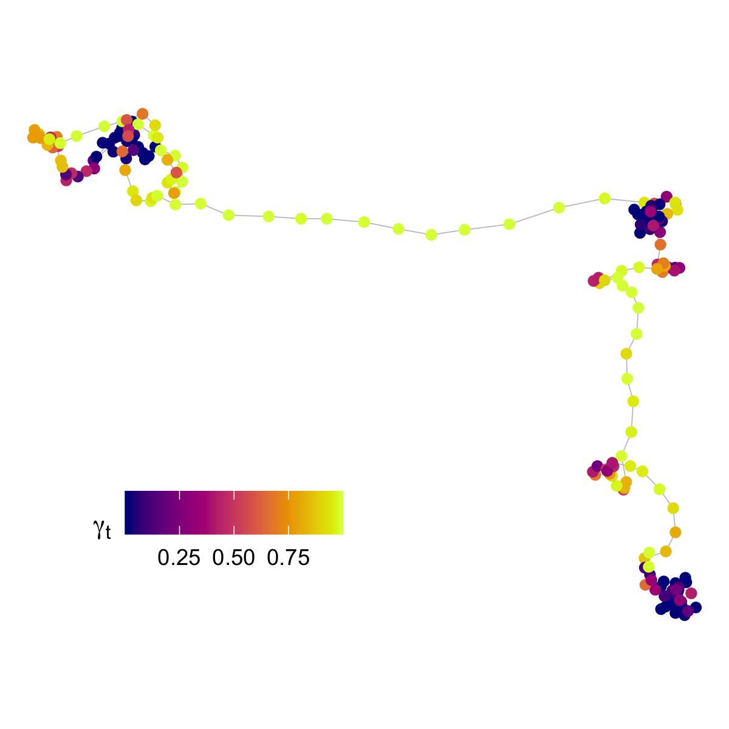
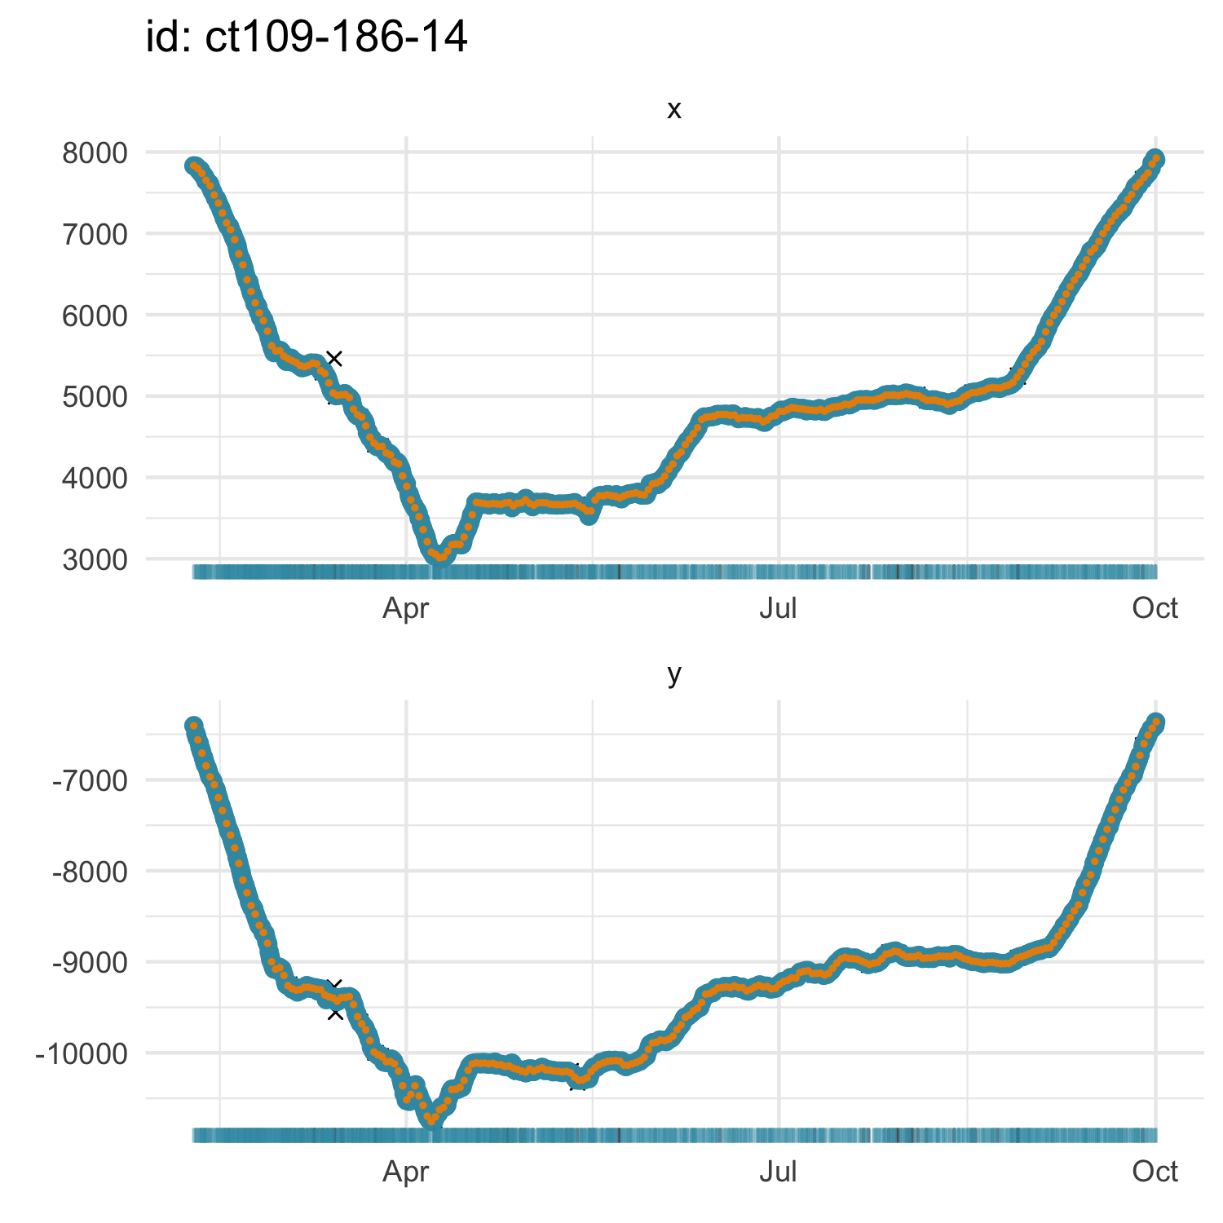
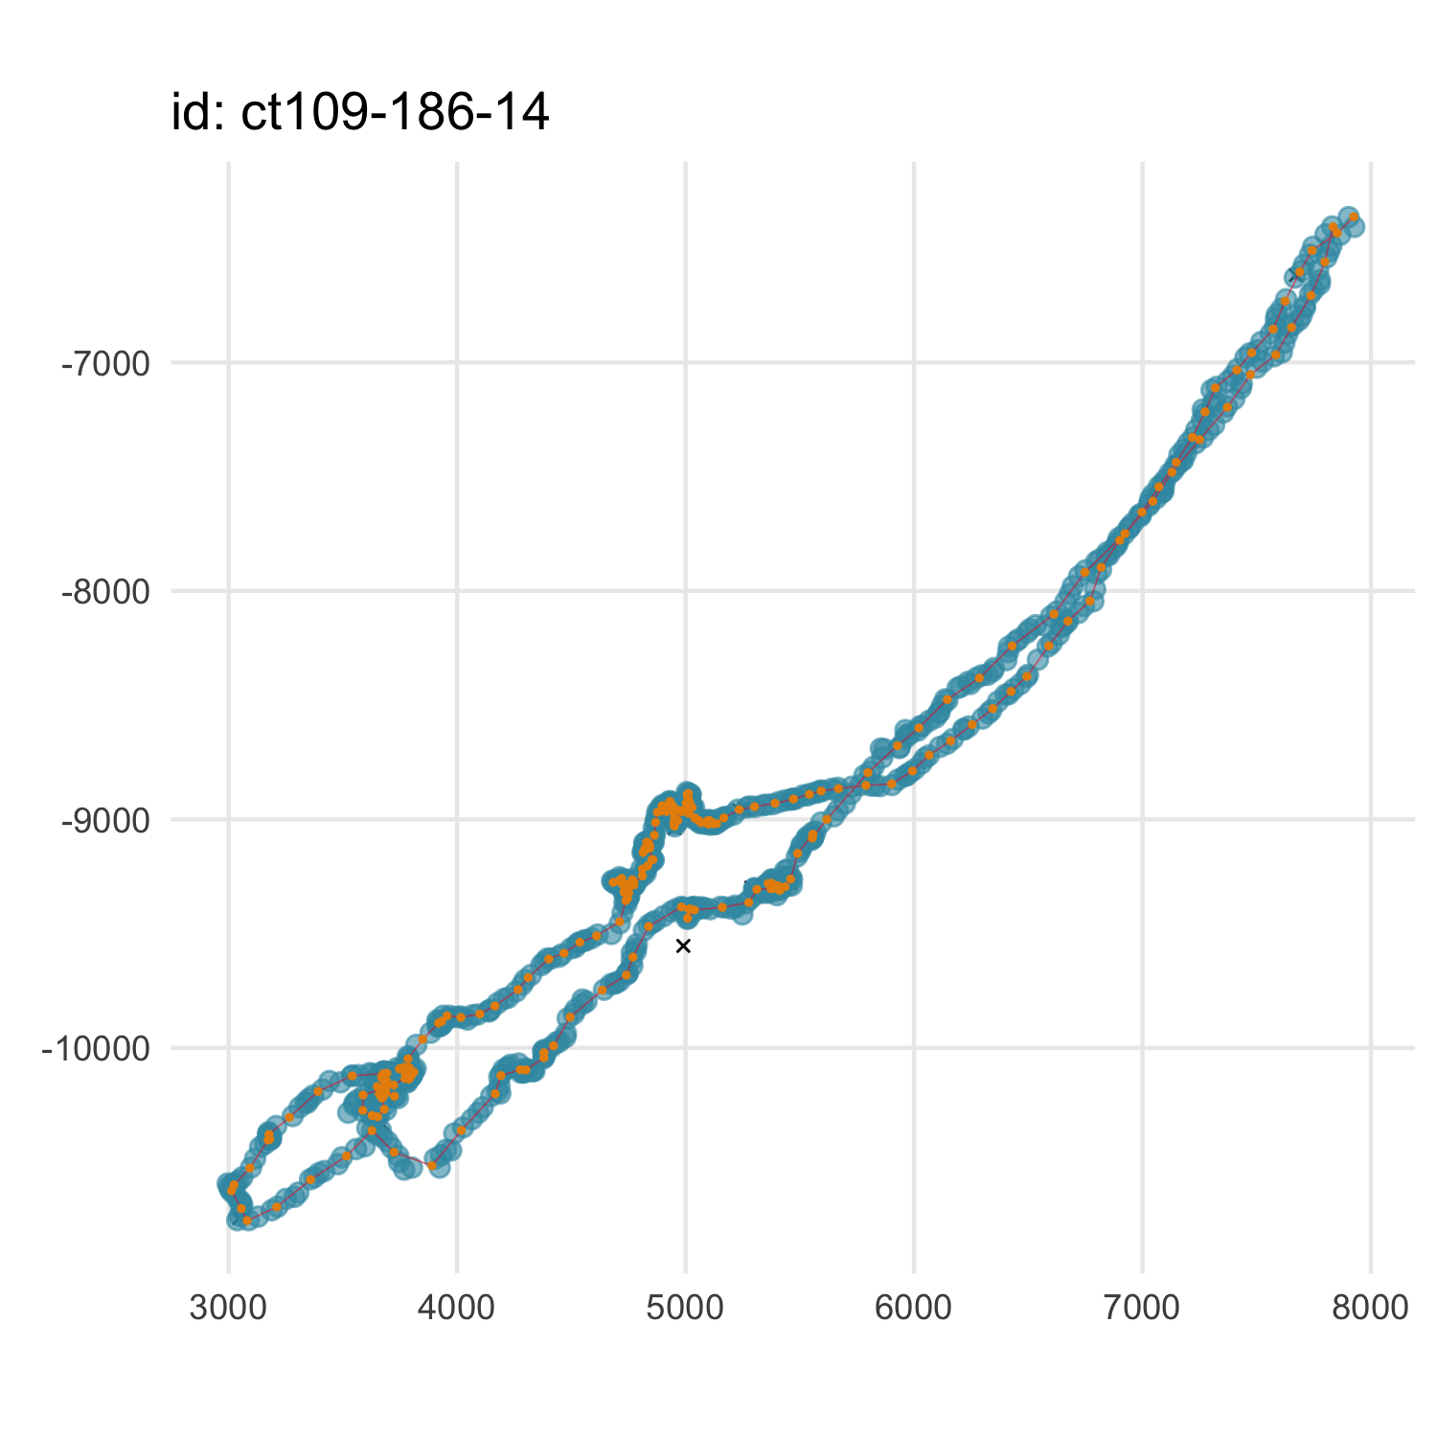
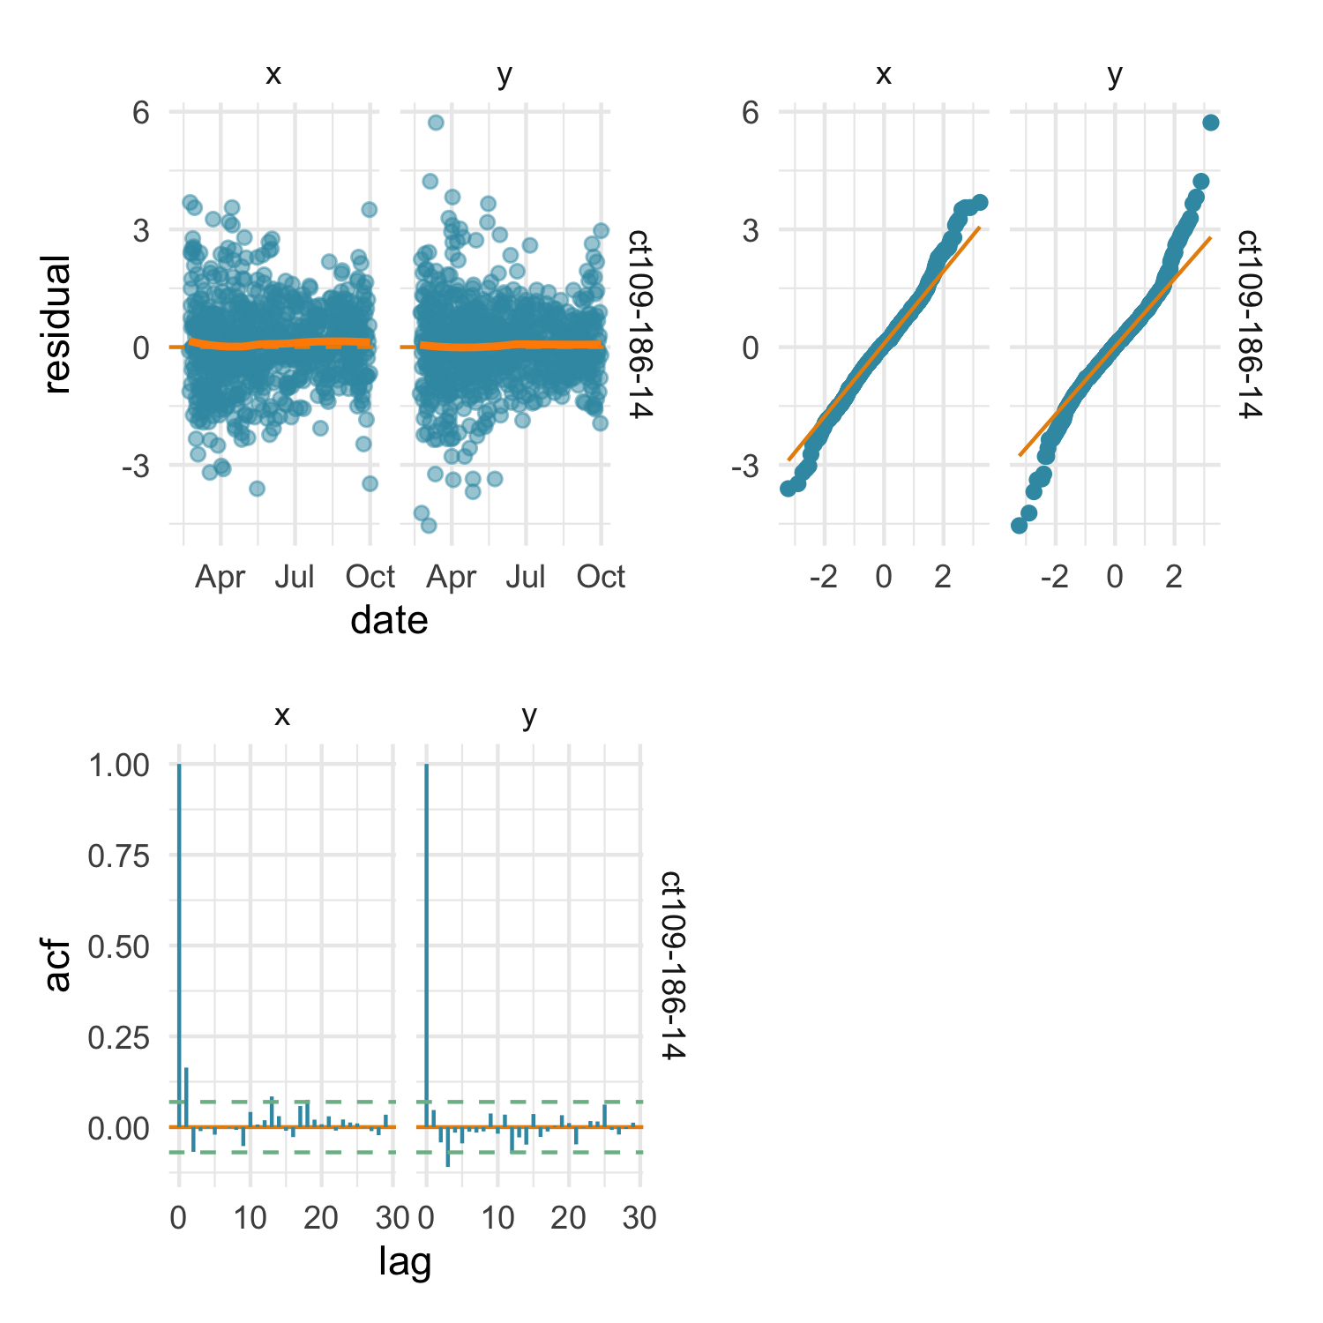
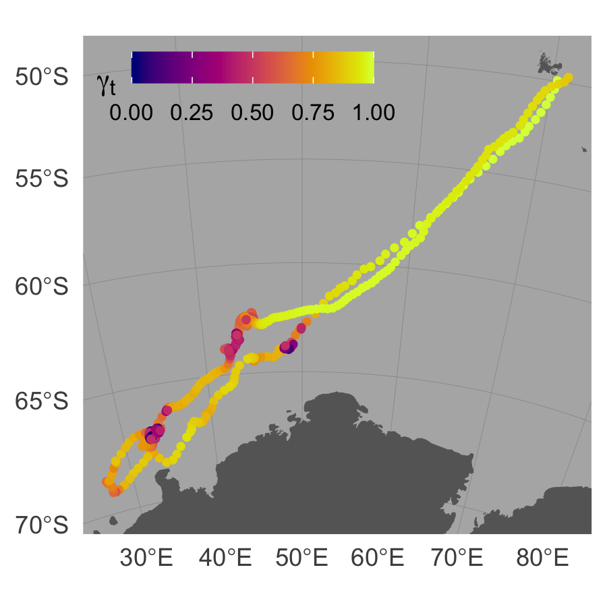
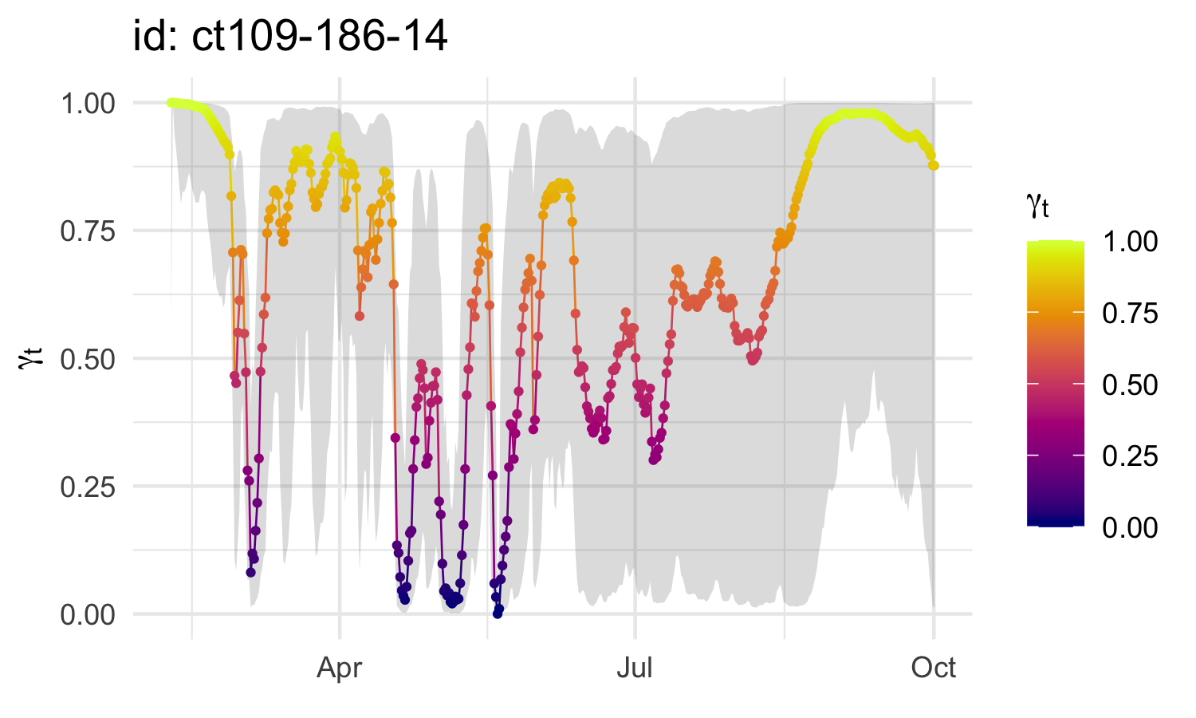
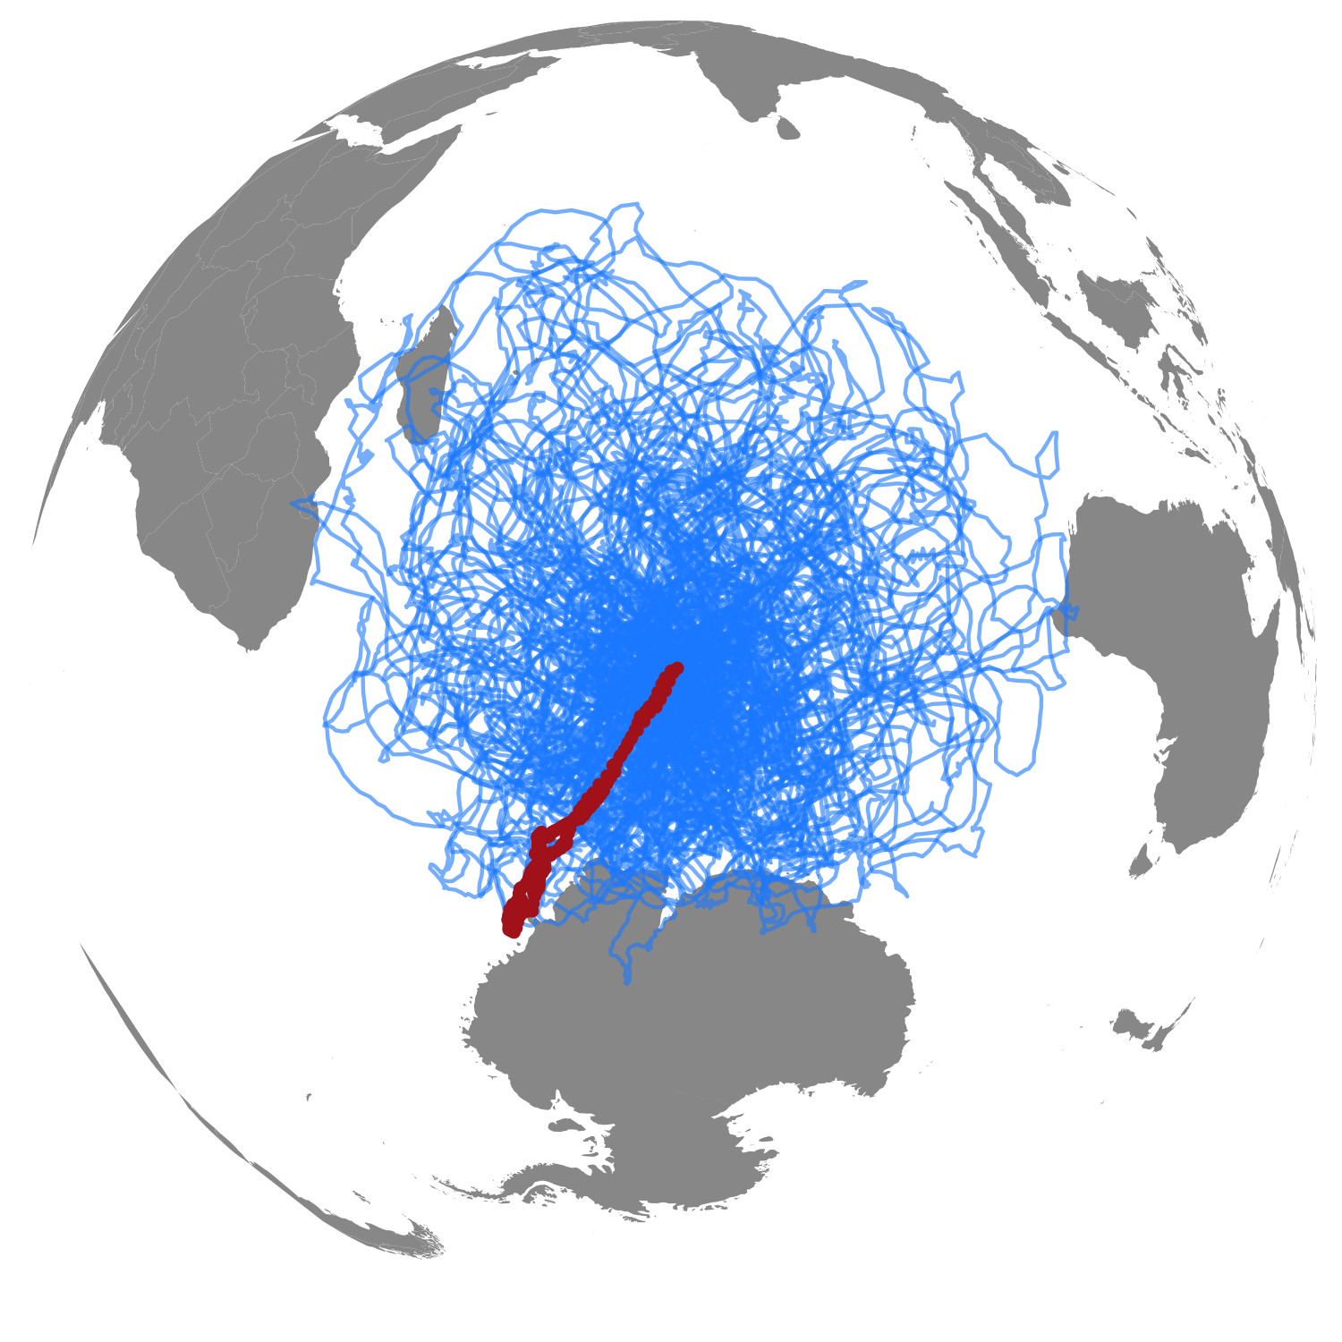
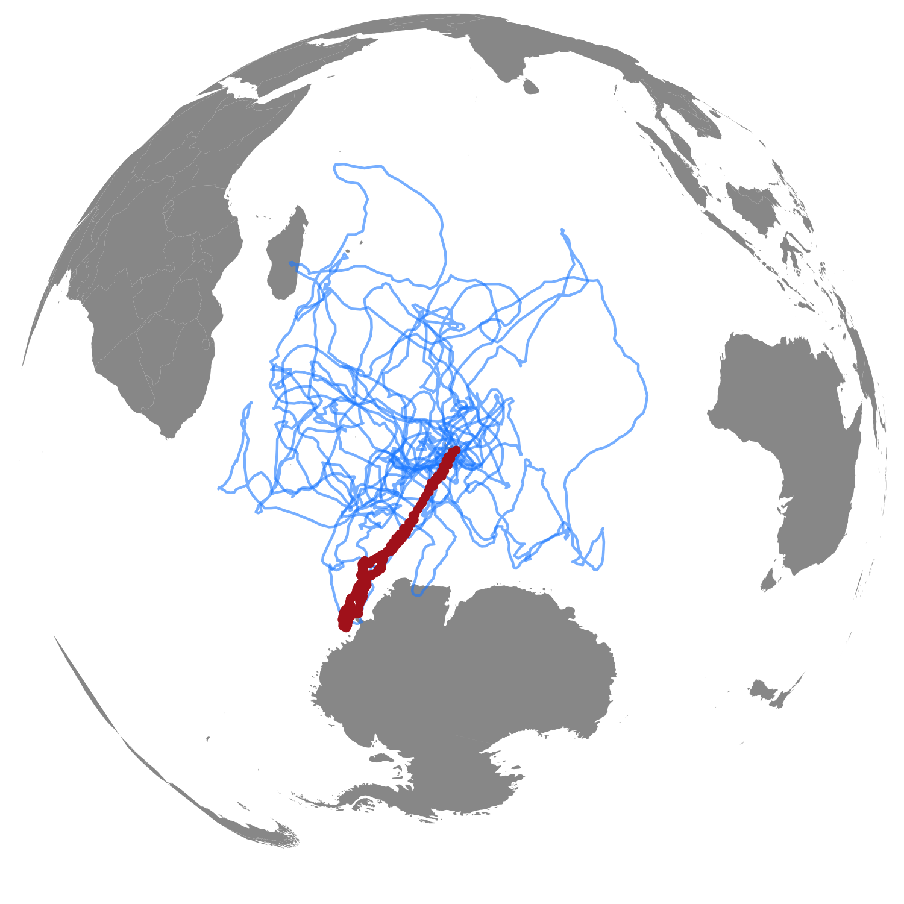

a
Argos Least-Squares
id | date | lc | lon | lat
ct36-E-09 | 2009-02-04 16:34:15 | A | 75.97 | -52.17
Data formats
Argos Kalman filter
id | date | lc | lon | lat | smaj | smin | eor
54591 | 2012-03-05 05:09:33 | 1 | 110.57 | -66.43 | 2442 | 416 | 42
GPS
id | date | lc | lon | lat
L013m01 | 2017-10-12 18:00:29 | G | 150.22 | -36.25
GLS / Other
id | date | lc | lon | lat | lonerr | laterr
54591 | 2012-03-05 05:09:33 | GL | 110.57 | -66.43 | 2442 | 416
b
code
Random Walk (rw)
Correlated Random Walk (crw)
Move Persistence (mp)
Fit SSM or MPM
fit <- fit_ssm(data,
model,
time.step,
...)
fmp <- fit_mpm(fit,
model,
...)
c
code
plot(fit, what = ”p”,
type = 1)
plot(fit, what = “p”,
type = 2)
resid <- osar(fit)
plot(resid, “ts”)
plot(resid, “qq”)
plot(resid, “acf”)
Inspect
SSM fit
d
code
Visualize predicted tracks & behaviour
map(fit, what = ”p”,
...)
plot(fit, what = “p”,
type = 3)
e
code
simulate from SSM fit
keep top 10% similar tracks
re-route track segments off land
s1 <- simfit(fit, what = “p”,
reps = 100,
cpf = TRUE)
s2 <- sim_filter(s1,
keep = 0.1)
s3 <- route_path(s2,
what = “p”,
buffer = 10000,
centroids = TRUE)
plot(s1) | plot(s2) | plot(s3)
Simulate &/or
re-route tracks

