Slide 1
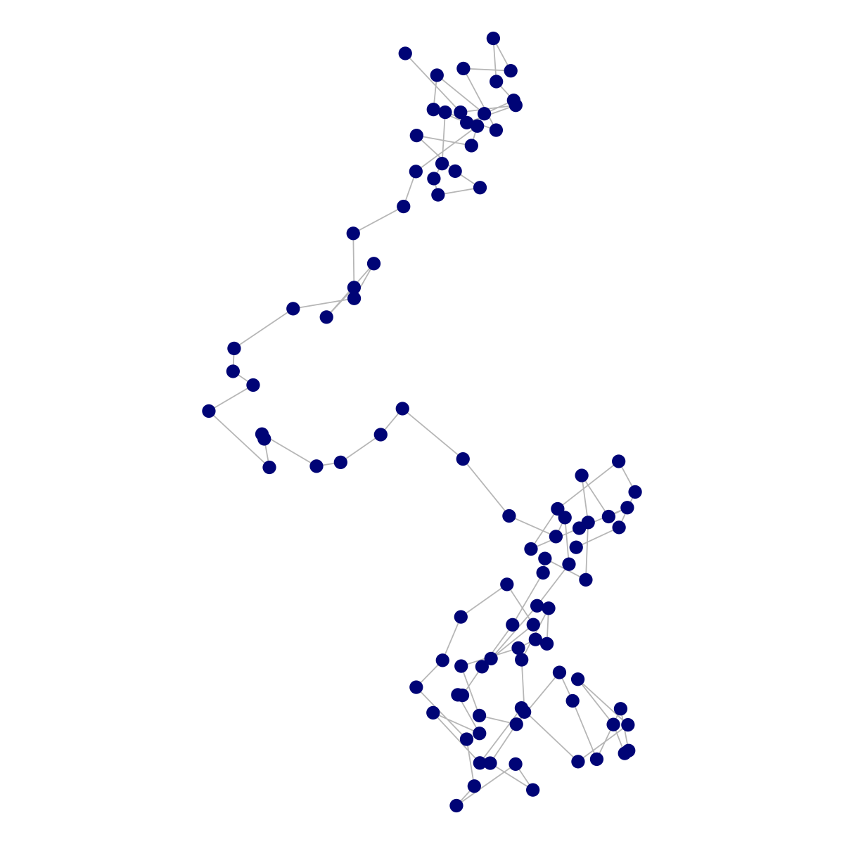
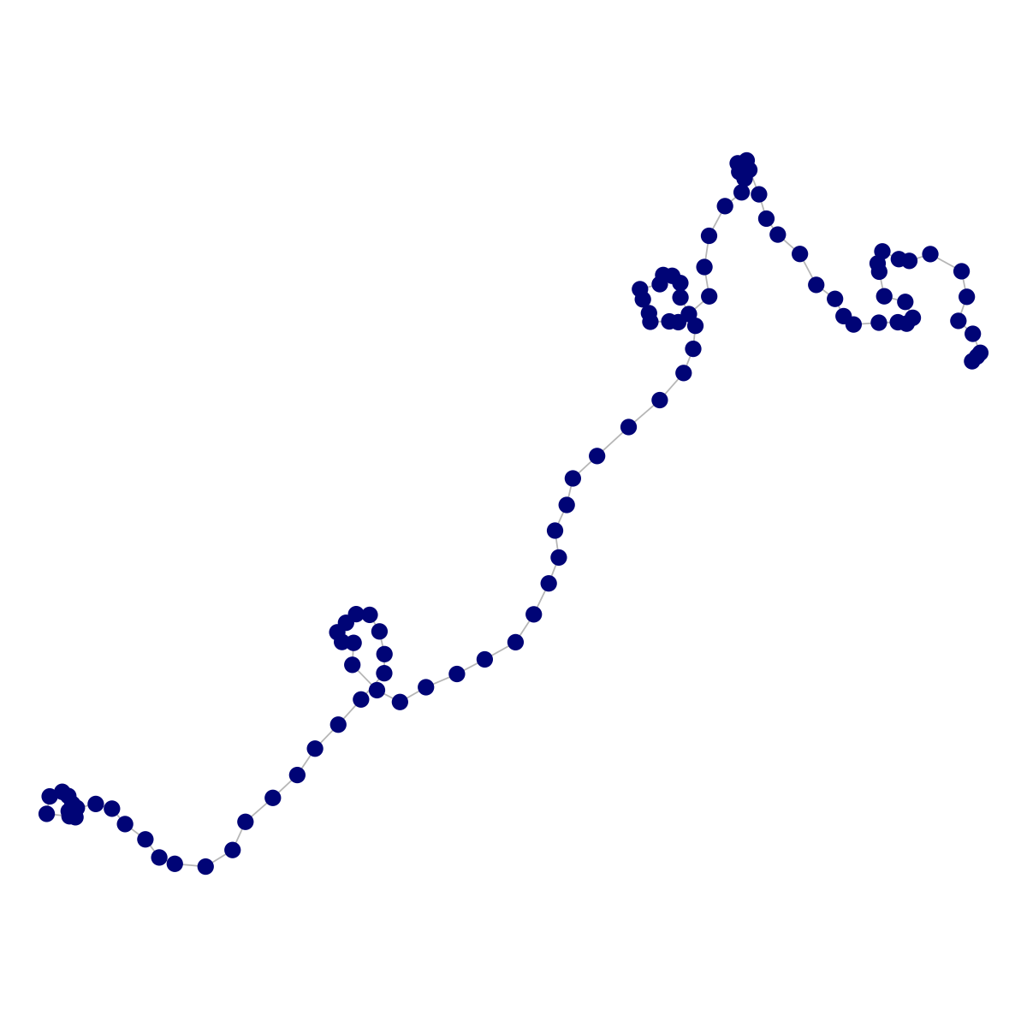
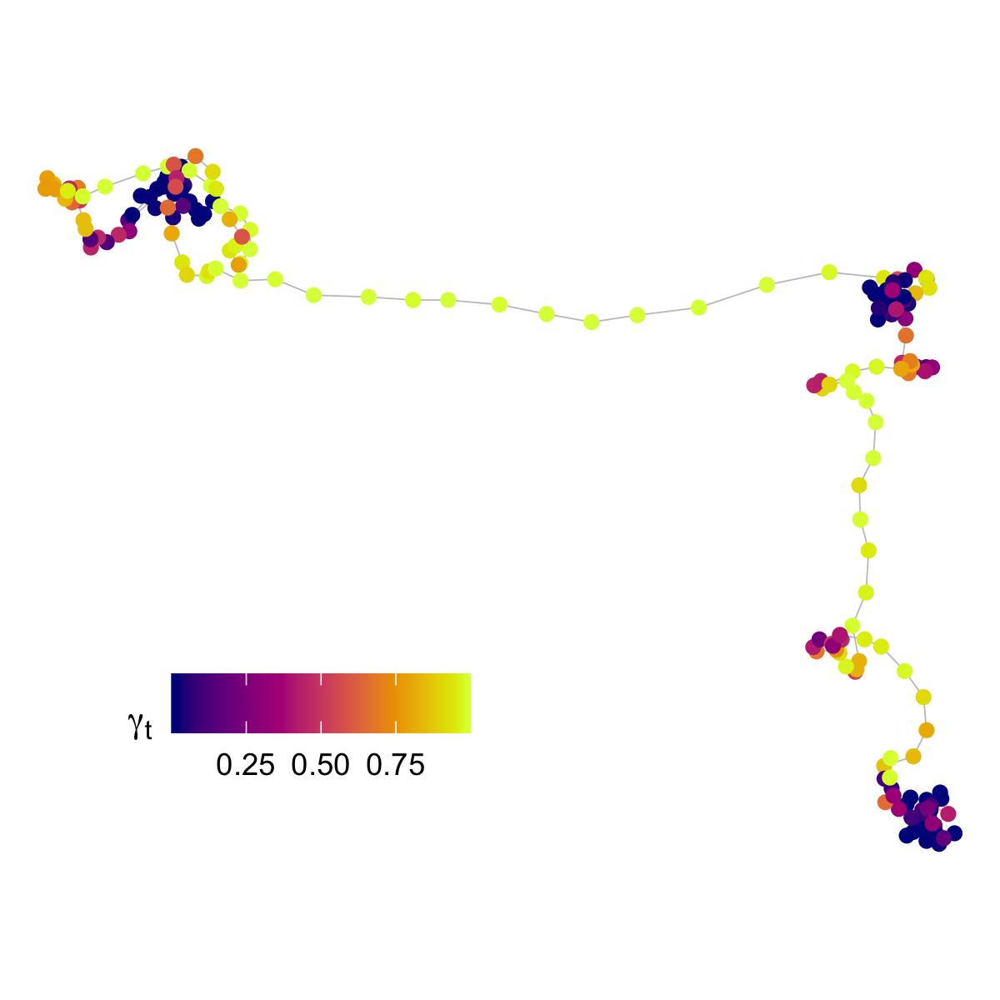
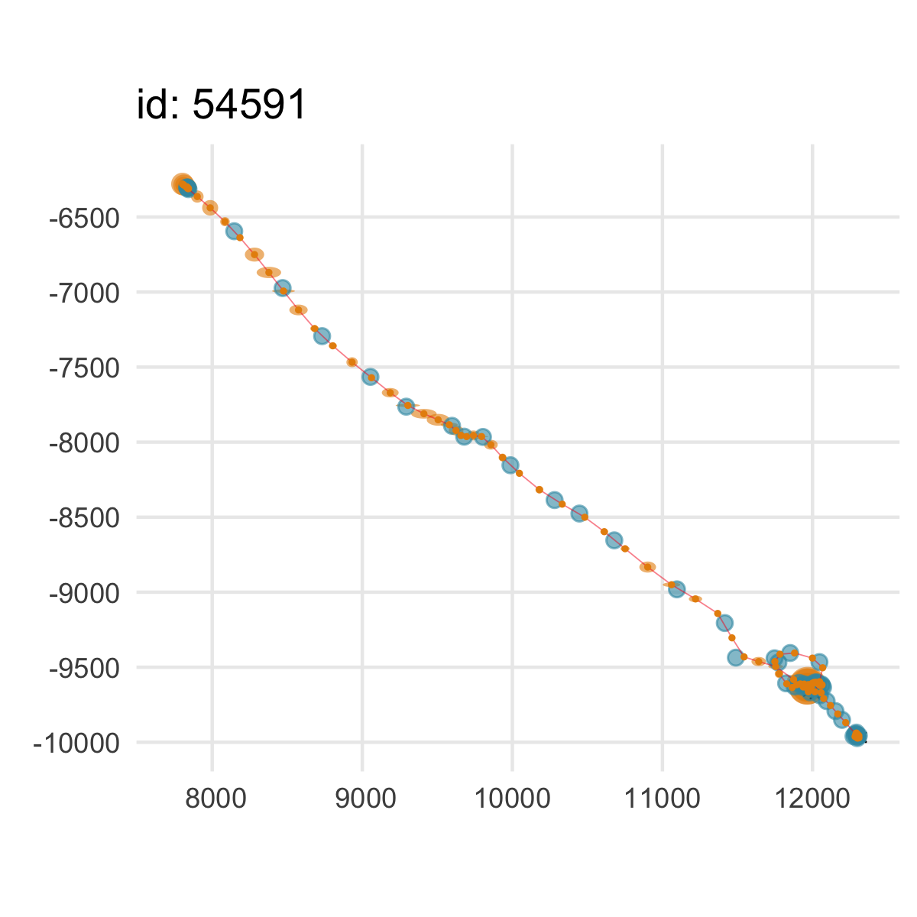
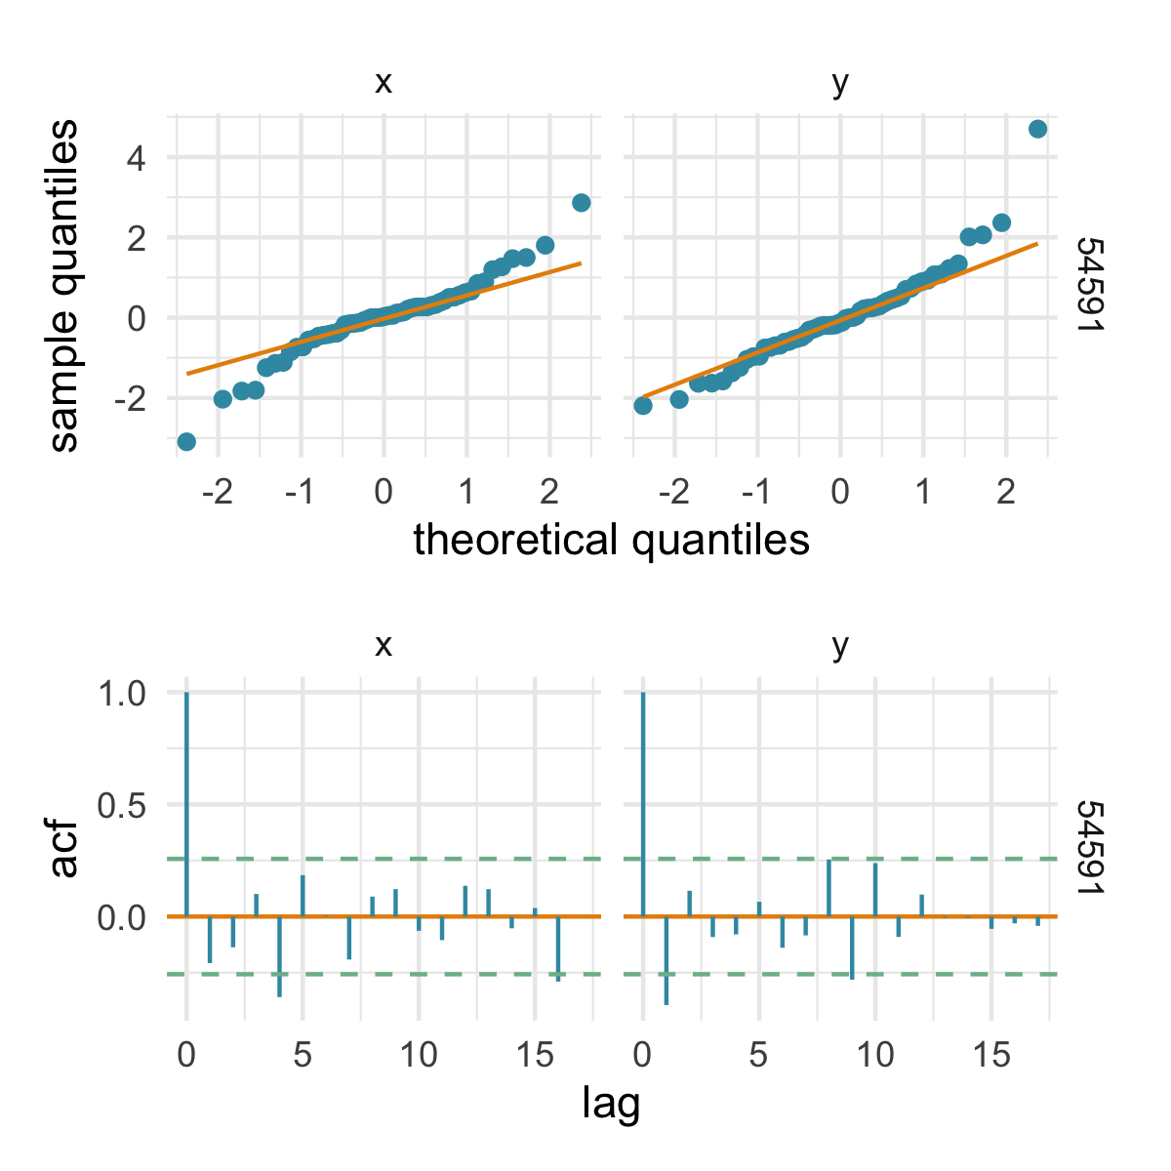
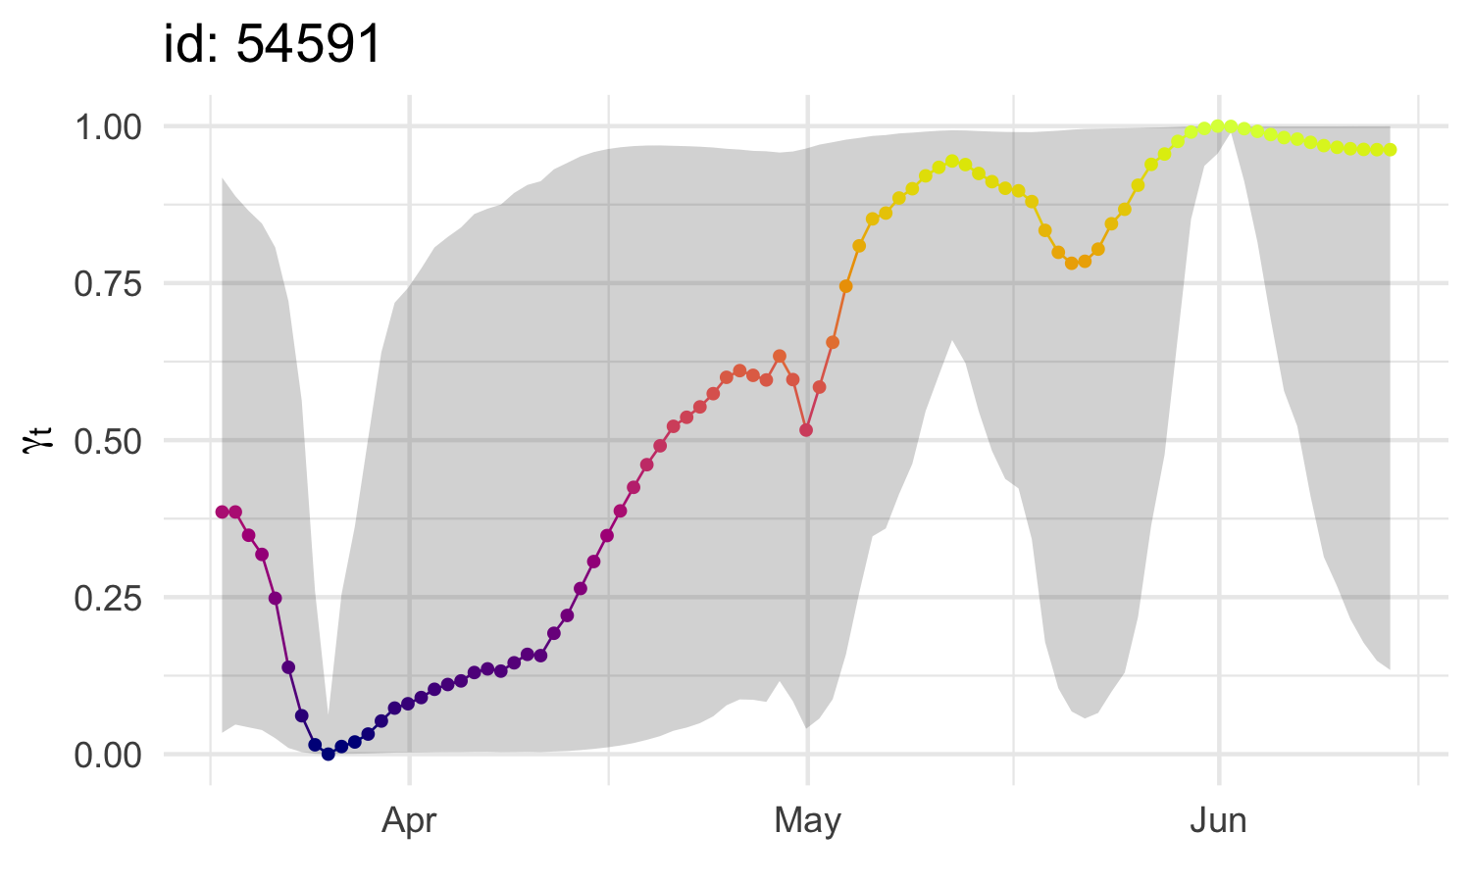
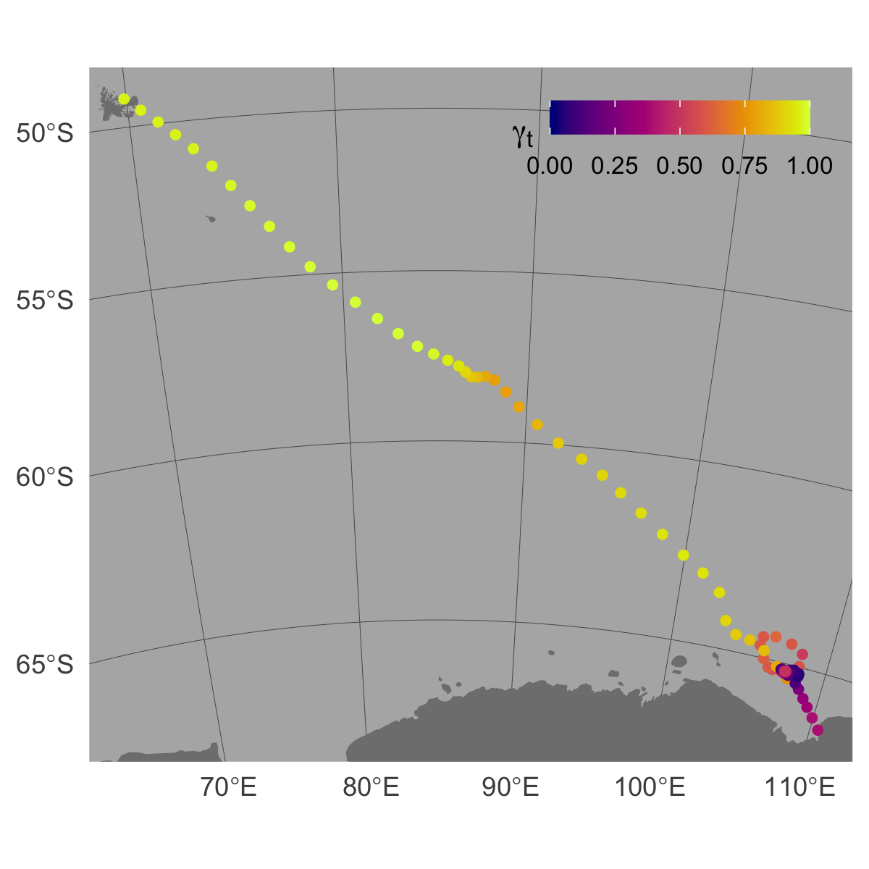
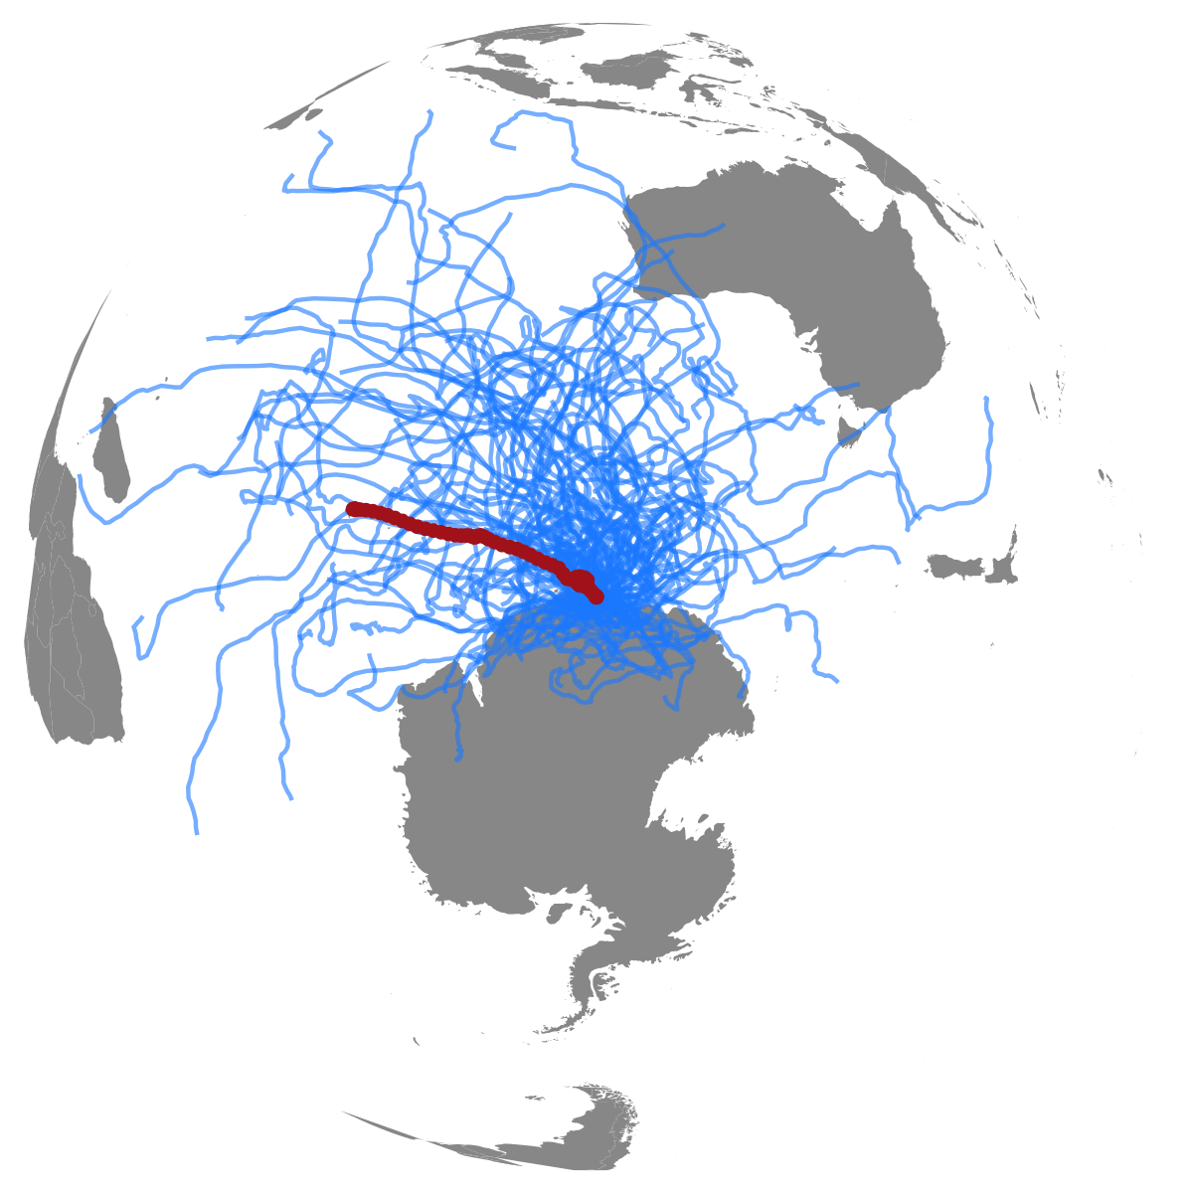
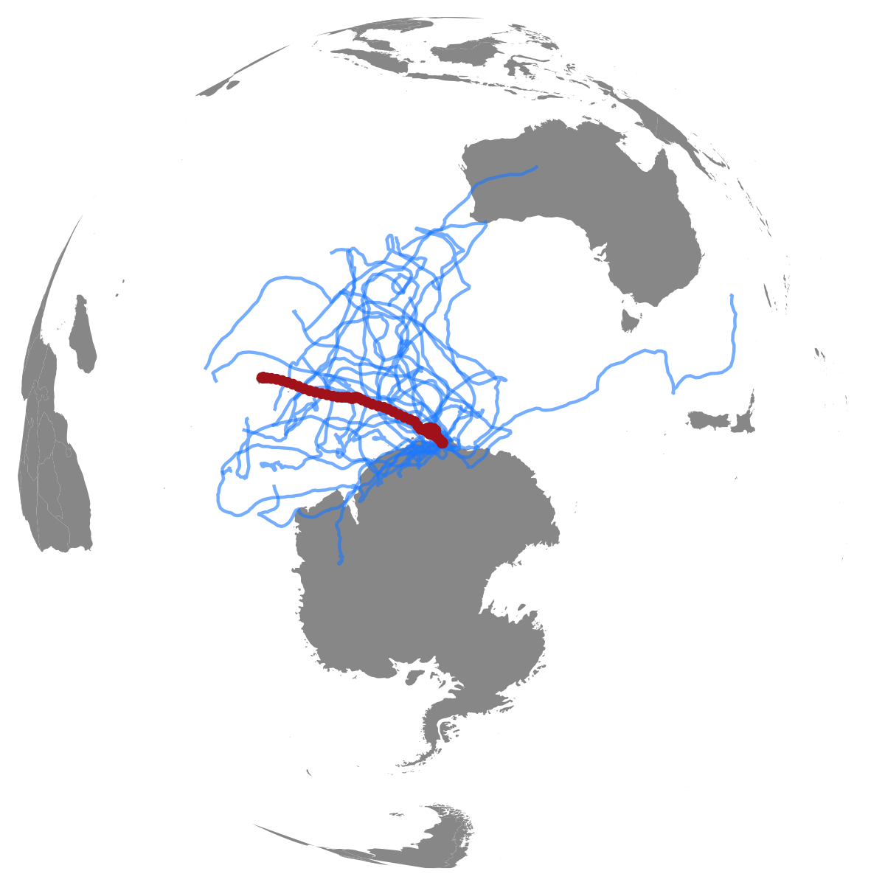

Input data formats
Argos Least-Squares
id | date | lc | lon | lat
ct36-E-09 | 2009-02-04 16:34:15 | A | 75.9712 | -52.1718
Argos Kalman filter
id | date | lc | lon | lat | smaj | smin | eor
54591 | 2012-03-05 05:09:33 | 1 | 110.5701 | -66.4313 | 2442 | 416 | 42
GPS
id | date | lc | lon | lat
L013m01 | 2017-10-12 18:00:29 | G | 150.2201 | -36.2511
GLS / Other
id | date | lc | lon | lat | lonerr | laterr
ARJH-32087 | 2006-08-19 18:21:42 | GL | 63.5837 | 44.6377 | 0.7361 | 1.1015
1. Choose a movement process model
2. Fit SSM to data
RW
CRW
MP
fit <- fit_ssm(data, model = `mp`, time.step = 24, ...)
... = optional arguments, see ?fit_ssm for details
3. Check SSM fit
Predicted vs Observed locations
Prediction residuals
plot(fit, what = “p”, type = 2)
resid <- osar(fit)
plot(resid, “qq”) / plot(resid, “acf”)
4. Visualize move persistence estimates
plot(fit, what = “p”, type = 3)
map(fit, what = “p”, ...)
5. Simulate &/or re-route tracks
Simulate from SSM fit
Keep top 25% similar
tracks
Re-route track segments
off land
s1 <- simfit(fit, what = “p”, reps = 100)
s2 <- sim_filter(s1, keep = 0.25)
s3 <- route_path(s2,
what = “p”,
buffer = 6000,
centroids = TRUE)
plot(s1) | plot(s2) | plot(s3)

