Slide 1
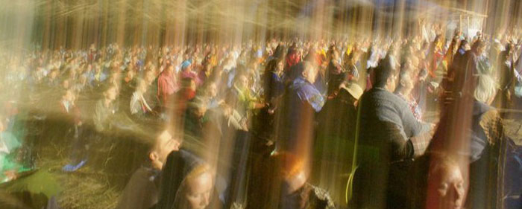
Early perspectives: archetypes & collective unconscious
Ian Kilgore

Slide 2
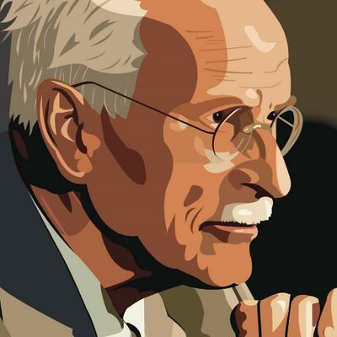
“From the unconscious there emanate determining influences… which, independently of tradition, guarantee in every single individual a similarity and even an sameness of experience, and also of the way is it represented imaginatively.” Carl Jung

Slide 3
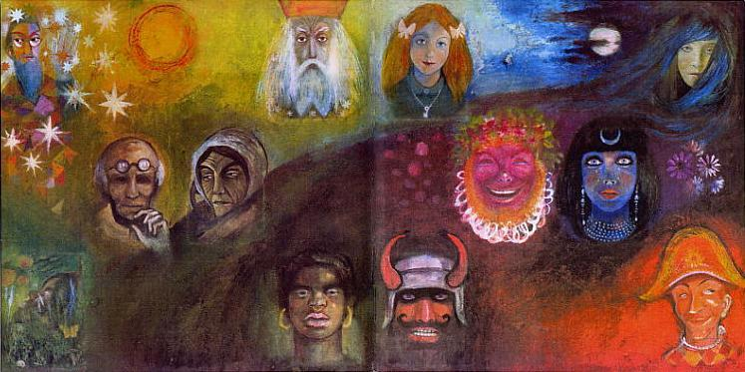
“An archetype is a universally familiar character or situation that transcends time, place, culture, gender and age. It represents an eternal truth.” Jon Howard-Spink
A symbol embodies some essential elements to the universal human experience

Slide 4
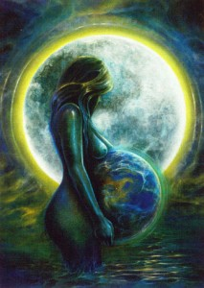
The Great mother
The great mother archetype would be expected to be almost the same in all people, since all infants share inherent expectation of having a loving mother. Every adult must have had a mother and we have an idea of what a mother should be. Mother is the source of life and is nurturing.

Slide 5
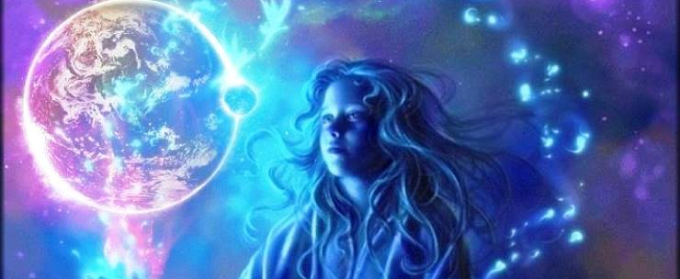
The child
The child archetype stands for original or child-like conditions in the life of the individual. This archetype also takes many forms such as a child, god, dwarf, hobbit, elf, monkey, or even objects like jewels, chalices or the golden ball.

Slide 6
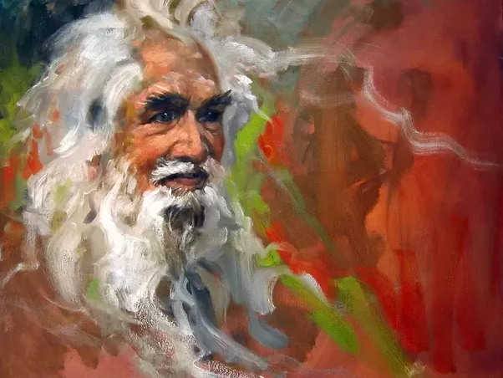
The Wise old man
The wise old man is the archetype of meaning or spirit. It often appears as grandfather, sage, magician, king, or other authority figure. It represents insight, wisdom, and moral qualities. His often warns of dangers and gives protection.

Slide 7
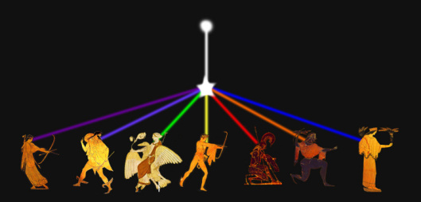
The Self
The self, according to Jung, is the most important archetype. It is called the "midpoint of the personality," a sort of balance between consciousness and the unconsciousness. It signifies the harmony and balance between the various opposing qualities that make up the mind. Common human figures which represent the self are the Buddha or Christ.

Slide 8
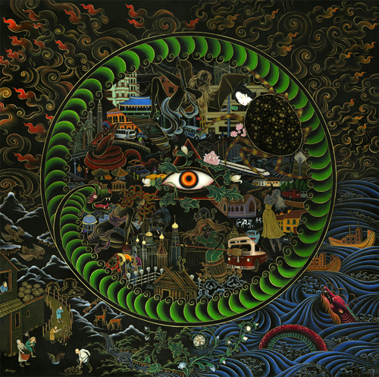
How Does Collective consciousness affect behavior?
“As we experience the power of the archetypes in our lives, we begin to understand that we're part of a bigger picture, the grand experiment of life. We are here on Earth to evolve into higher states of consciousness, which can heal our sadness, fear, ignorance or unconsciousness. When we know that our choices in life affect not only our self but the world around us, we can look at our society and decide if we like what we see. We can see if our society reflects our values and hopes and dreams. If it doesn't, then we have the responsibility to change it once we've changed our self.” Cathy Pagano

Slide 9
Art & sources Cited
Academy of Ideas. “Carl Jung - What are the Archetypes?” YouTube, YouTube, 14 Feb. 2017, www.youtube.com/watch?v=wywUQc-4Opk. Accessed 4 Sept. 2017.
Academy of Ideas. “Introduction to Carl Jung - The Psyche, Archetypes and the Collective Unconscious.” YouTube, YouTube, 9 Jan. 2016, www.youtube.com/watch?v=j0KzUS0b_uc. Accessed 4 Sept. 2017.
“Collective unconscious.” Collective unconscious - New World Encyclopedia, www.newworldencyclopedia.org/entry/Collective_unconscious. Accessed 4 Sept. 2017.

Slide 10
Art & sources Cited
“Collective Unconscious and Cultural Insight (Introduction to Archetypes).” Inspector Insight, www.inspectorinsight.com/archetypes/collective-unconscious-and-cultural-insight-archetypes-part-1/. Accessed 4 Sept. 2017.
“Collective Unconscious 72630 | DZONE.” Collective Unconscious 72630 | DZONE, www.dzone.co/collective-unconscious.html. Accessed 4 Sept. 2017.
“Down the Rabbit HolePaul Kiritsis, PsyD candidate, DPhil., MA (Psychology), MA (History).” A Short Exposition on the Great Mother Goddess (Part Three), www.paulkiritsis.net/_blog/Down_The_Rabbit_Hole/post/A_Short_Exposition_on_the_Great_Mother_Goddess_Part_Three_/. Accessed 4 Sept. 2017.

Slide 11
Art & sources Cited
Jung, Carl. “Carl Jung (@Thecarljung).” Twitter, Twitter, 21 June 2017, twitter.com/thecarljung. Accessed 4 Sept. 2017.
“On the History of the Unconscious III: The Psychological Period (from Faith Healing to Neuroscience).” A Vital Recognition, 5 Jan. 2014, vitalxrecognition.wordpress.com/2014/01/05/on-the-history-of-the-unconscious-iii-the-psychological-period-from-faith-healing-to-neuroscience/. Accessed 4 Sept. 2017.
Pagano, Cathy. “Wisdom Of Dreams.” How Archetypes Affect Us, 1 Jan. 1970, wisdom-of-dreams.blogspot.com/2010/11/how-archetypes-affect-us.html. Accessed 4 Sept. 2017.

Slide 12
Art & sources Cited
“The Greater Picture - Collective Consciousness.” The Greater Picture - Collective Consciousness, thegreaterpicture.com/collective-consciousness.html. Accessed 4 Sept. 2017.
“Time to Grow Up: Which Element of the Child Archetype is Resonating in You?” Fractal Enlightenment, 15 Aug. 2016, fractalenlightenment.com/34734/life/time-to-grow-up-which-element-of-the-child-archetype-is-resonating-in-you. Accessed 4 Sept. 2017.

