Slide 1
Instructions for study tasks related to interoception, affect, and pain
Ian Kleckner
University of Rochester Medical Center
Started 2012/01/21
Last update 2019/04/17
Notes slide – NOT for participant to see

Slide 2
Heartbeat Detection Task
Notes slide – NOT for participant to see

Slide 3
The goal of this task is to assess how well you can detect your heartbeat
Click to proceed

Slide 4
You will hear a series of 10 beeps, each of which is triggered by your heartbeat
Click to proceed

Slide 5
Sometimes, the 10 beeps occur during your heartbeats
Click to proceed

Slide 6
Other times, the 10 beeps occur in between your heartbeats
Click to proceed

Slide 7
For each series of 10 beeps, indicate whether you heard the beeps during or between your heartbeats
Click to proceed

Slide 8
You will also be asked how confident you are in your response
Click to proceed

Slide 9
On the next slide, practice using the scale
Left click the mouse to set your rating
Right click the mouse to commit
Guess
|
Low
High
Click to proceed

Slide 10
Please do not take your pulse directly using your hands or other objects
Click to proceed

Slide 11
Instead, focus on your heart and your chest
Click to proceed

Slide 12
Finally, please remain still during each trial (the beeping)
Click to proceed

Slide 13
Do you have any questions?
Click to proceed

Slide 14
The first trial will be practice with continued beeps during each heartbeat
Click to proceed

Slide 15
Waiting to start

Slide 17
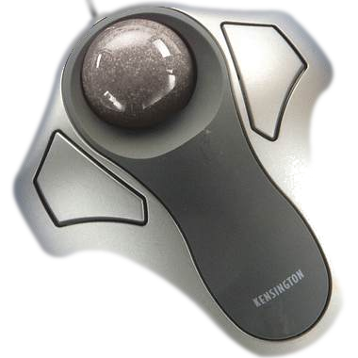
Did the beeps occur during your heartbeats?
Left click for
Yes
Right click for
No
Researcher: Yes = 1, No = 2

Slide 18
How confident are you in your response?
Guess
Low
High
Researcher: Guess = `, Low = 1, High = 2

Slide 19
CORRECT
Beeps were presented during your heartbeats

Slide 20
CORRECT
Beeps were presented between your heartbeats

Slide 21
INCORRECT
Beeps were presented during your heartbeats

Slide 22
INCORRECT
Beeps were presented between your heartbeats

Slide 23
Proceed to next trial
Click to proceed

Slide 24
The task is more than 25% complete
Click to proceed

Slide 25
The task is more than 50% complete
Click to proceed

Slide 26
The task is more than 75% complete
Click to proceed

Slide 27
Please stand by…
The researcher stopped the trial
When instructed, click to proceed

Slide 28
Please stand by…
Electrodes are not playing nicely
When instructed, click to proceed

Slide 29
The task is over
Please remain seated

Slide 30
Heartbeat Tracking Task
Notes slide – NOT for participant to see

Slide 31
The goal of this task is to assess how well you can detect your heartbeat
Click to proceed

Slide 32
When prompted, you will begin silently counting each heartbeat you think you had (whether or not you felt them)
Click to proceed

Slide 33
When prompted again, you will report how many heartbeats you think you had so far
Click to proceed

Slide 34
You will not know in advance how much time you will have to count your heartbeats
Click to proceed

Slide 35
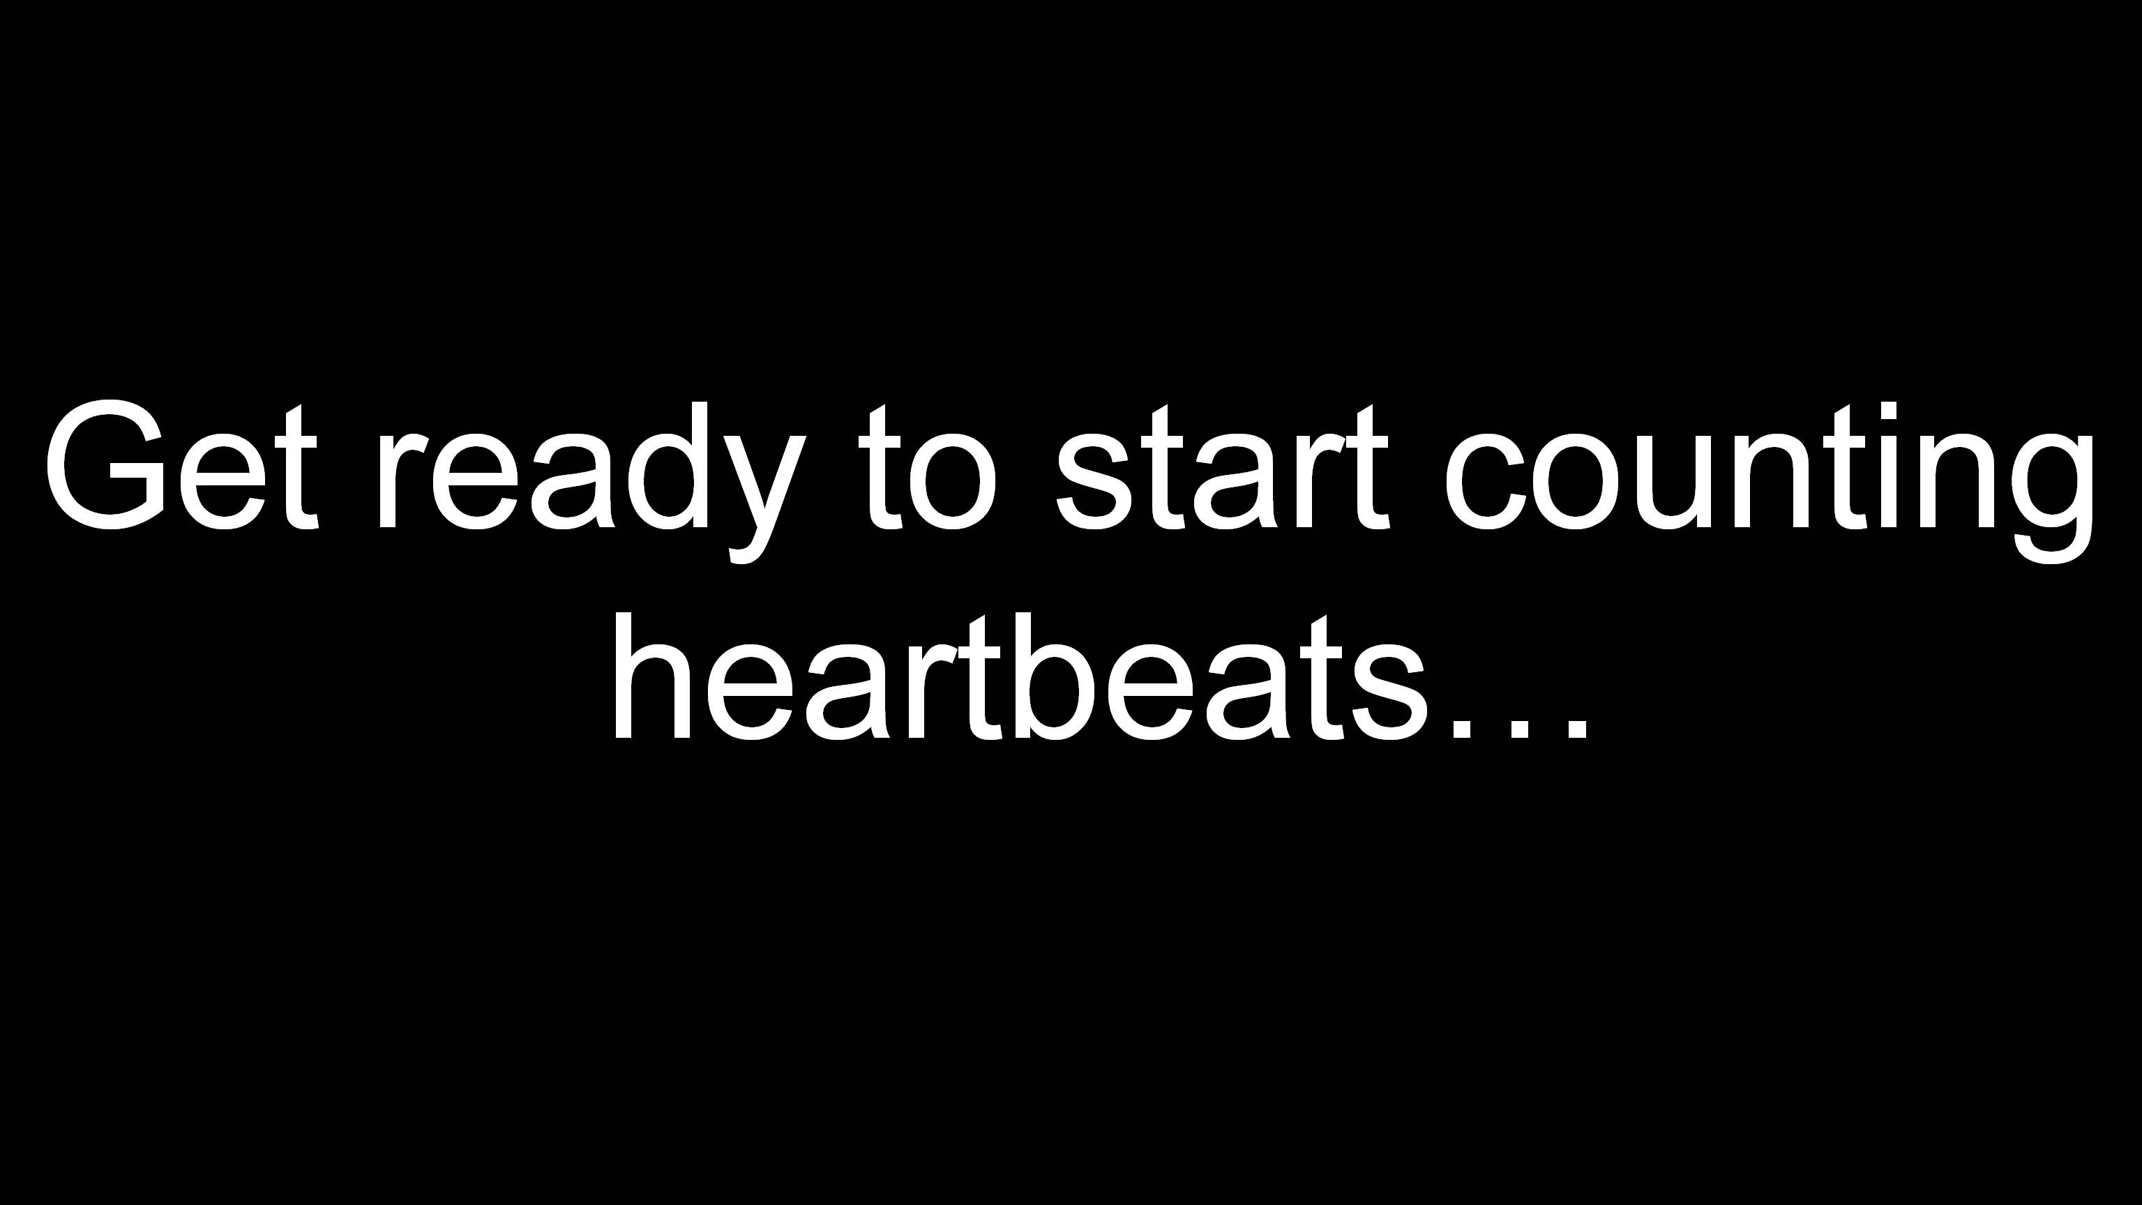



Each trial has three parts
Stop counting.
Remember your number
Count your heartbeats
Beep…Beep…BOOP
BOOP

Slide 36
You will also be asked how confident you are in your response
Click to proceed

Slide 37
On the next slide, practice using the scale
Left click the mouse to set your rating
Right click the mouse to commit
Guess
|
Low
High
Click to proceed

Slide 38
Please do not take your pulse directly using your hands or other objects
Click to proceed

Slide 39
Instead, focus on your heart and your chest and count as many heartbeats you think you had even if you didn’t feel them
Click to proceed

Slide 40
Do you have any questions?
Click to proceed

Slide 41
Please wait while we set up the next trial
Feel free to move if you want

Slide 42
Are you ready to start the next trial?
Click to proceed

Slide 43
Get ready to start
counting heartbeats…

Slide 44
Count your heartbeats

Slide 45
Stop counting
Remember your number

Slide 46
How many heartbeats did you count?

Slide 47
How confident are you in your response?
Guess
Low
High

Slide 48
Saving data, please wait…

Slide 49
The task is over
Please remain seated

