Slide 1
Phase One Walkthrough Guide
From an empty system to a delivered, fully traced sale
Live walkthrough recorded 30 October 2026
Notes:
Welcome. Today we follow one real batch of black soldier fly larvae through the Zehunger ERP: from market waste arriving at the farm to a customer signing for dried larvae and frass fertiliser. Every screen and number you will see was recorded in the system during the walkthrough.

Slide 2
One batch, eleven steps, two products
0
1
2
3
4
5
Set up farm & team
Waste in
Substrate
Production batch
Daily rearing
Harvest + frass
6
7
8
9
10
Drying
Frass curing
Quality control
Sell & deliver
Owner's view
Waste becomes dried larvae (animal feed) and frass fertiliser. Every kilogram stays linked to where it came from.
Notes:
This is the whole journey. Steps 1 to 7 are recorded by the farm team, step 8 by the quality officer, step 9 by sales and step 10 is what the owners see. Notice the harvest produces two products: larvae, which are dried for feed, and frass, which is cured and sold as fertiliser.

Slide 3
Each person sees only their own work
O
P
D
B
Owner
Peter
Daniel
Brian
Super admin
Operator (farmer)
QC officer
Sales officer
Sets up farms, stores and accounts
Sees trace, dashboard, reports
Sees money and customers
Waste, substrate, batches
Feeding, monitoring, health
Harvest, drying, curing
Checks dried larvae and frass
Approves or rejects
Releases product into stock
Adds customers, takes orders
Reserves and dispatches stock
Confirms delivery
Notes:
The system is role-based. Operators record work only for the farms and facilities they are assigned to. Only the QC officer can approve product into stock. Only sales and owners see customers and money. Accounts are created by an administrator; there is no self-registration.

Slide 4
What one batch produced
195 kg
39 kg
13 kg
organic waste received
wet larvae harvested
dried larvae released
52 kg
KES 3,800
9 links
frass fertiliser released
delivered to the first customer
from delivery back to the market
Notes:
These are the real figures from the walkthrough. 150 kilograms of market waste plus a quarantined lot came in; the batch gave 39 kg of wet larvae, dried at about 3 to 1 into 13 kg, and 60 kg of frass cured to 52 kg of fertiliser. The first customer, Mama Grace Agrovet, bought 10 kg of larvae and 40 kg of frass for KES 3,800.

Slide 5
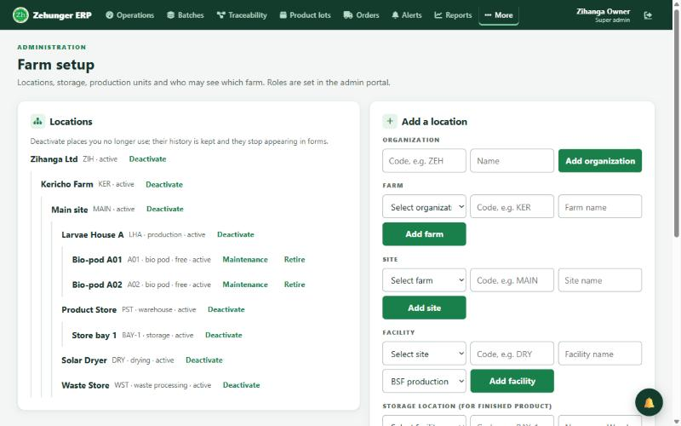
Set up the farm and the team
0
Owner (super admin) · More → Farm Setup
Organization → farm → site → facilities
Facilities: Waste Store, Larvae House A, Solar Dryer, Product Store
Store location Store bay 1 receives released product
Bio-pods A01, A02 in the larvae house
Accounts by role, with access to the farm
Places are deactivated, never deleted, so history is kept
Notes:
Before anyone records work the farm must exist. The owner builds the location tree on the Farm Setup page, adds the storage location where finished product is received, and creates an account for each person with the right role. On the live site this is the first thing to do.

Slide 6
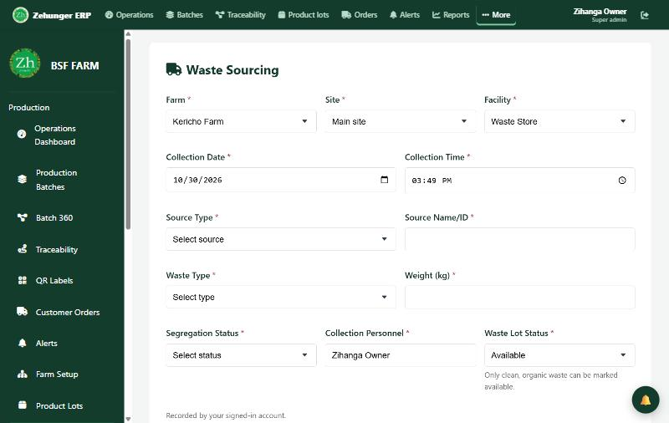
Record the waste coming in
1
Operator · Data entry → Waste Management → Waste Sourcing
Farm, site and facility; date and time filled in
Source: Kericho Municipal Market (market)
Vegetable waste, 150 kg, organic, Available
A mixed 45 kg lot is set to Quarantined
Quarantined waste can never be used
Result: WL-2026-00001 · 150 kg available
Notes:
The operator weighs and records each delivery of waste. Only clean organic waste can be marked available. The second lot arrived mixed with plastic, so it was quarantined: it will not appear when preparing substrate. Point out the green confirmation and the last five entries under the form.

Slide 7
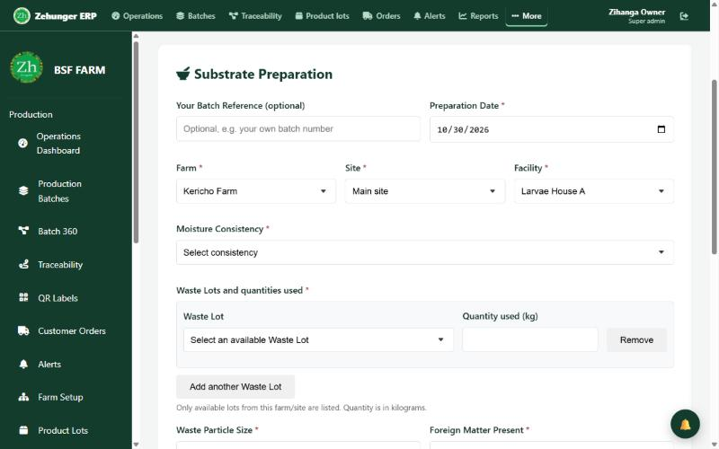
Prepare the substrate
2
Operator · Data entry → Larval Production → Substrate Preparation
Only available waste lots on the farm are offered
Use 120 kg of WL-2026-00001
Several lots can go into one batch
You cannot use more than a lot has left
Result: SUB-2026-00001 · 120 kg (30 kg waste left)
Notes:
Substrate is the larvae feed. The form lists only available waste lots, and refuses more kilograms than a lot has left. Each waste lot used is stored as a link, which is what makes traceability work later.

Slide 8
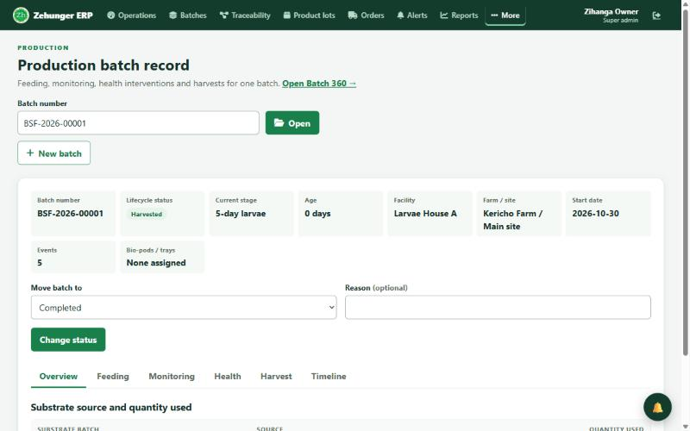
Start a production batch
3
Operator · Batches → Production batch record → New batch
Larvae House A, bio-pod A01
100 kg of SUB-2026-00001 issued
Harvest limit 40 kg caps every harvest
Planned → Active → Monitoring → Ready for harvest → Harvested
Result: BSF-2026-00001 · status history kept
Notes:
A production batch is one rearing cycle. The harvest limit stops anyone recording more harvest than the batch could produce. Every status change is kept with who made it and why.

Slide 9
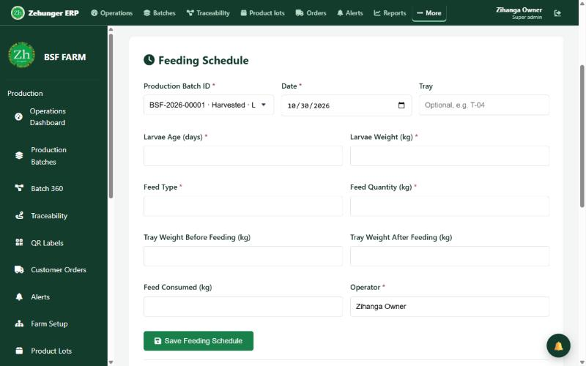
Record daily rearing
4
Operator · Data entry → Larval Production
Feeding: feed type and kilograms offered and eaten
Environmental monitoring: temperature, humidity
Health and intervention: issue, severity, action
Batch picker attaches every record to the right batch
Health issues and due harvests raise alerts
Result: EVT-000001 to EVT-000003
Notes:
Daily work is quick to record, also from a phone through the Farmer Portal. Everything is in kilograms. Open health issues, harvests that are due, QC waiting and low stock appear as alerts for the people responsible.

Slide 10
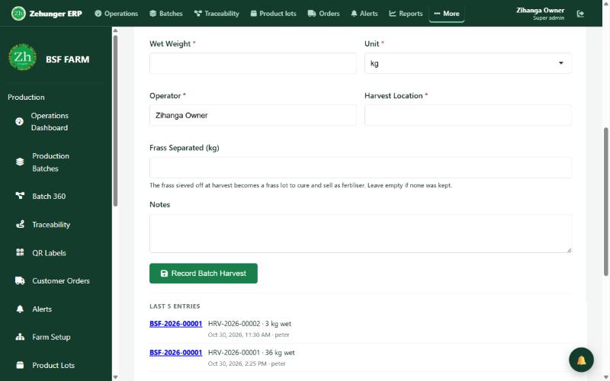
Harvest the larvae and separate the frass
5
Operator · Data entry → Larval Production → Harvest & Yield
Batch must be Ready for harvest
Wet weight 36 kg, stage prepupae
Frass separated: 52 kg → a frass lot starts curing
Second pick: 3 kg larvae, 8 kg frass
Total stays under the 40 kg limit
Result: HRV-2026-00001 · FRS-2026-00001 (52 kg)
Notes:
At harvest the frass is sieved off. Entering its weight on the same form creates a frass lot automatically, so the second product is tracked from this moment. The batch is then moved to Harvested.

Slide 11
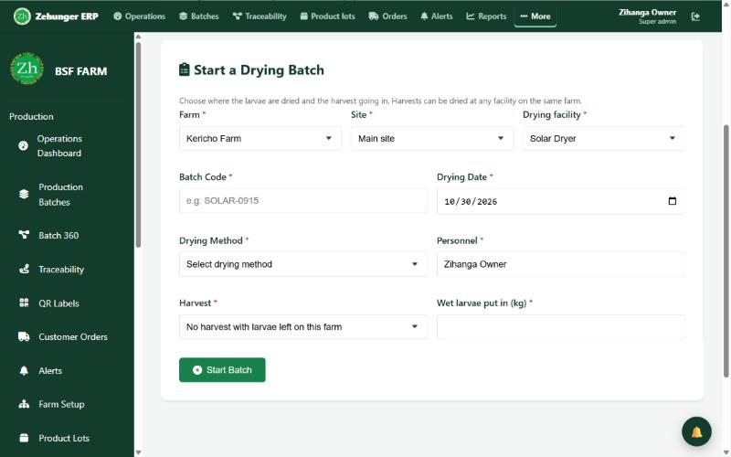
Dry the larvae
6
Operator · Data entry → Drying Process
Start a drying batch at the Solar Dryer with 36 kg wet
Draft → Received → Drying → Waiting for QC
Record dried output: 12 kg at 8% moisture
Yield 33.3%, about 3 to 1 as the guideline says
Result: DRY-2026-00001 · waiting for QC
Notes:
Drying can take harvests from several batches; the links are kept. The dried output is weighed and its moisture recorded, then the batch waits for the quality officer.

Slide 12
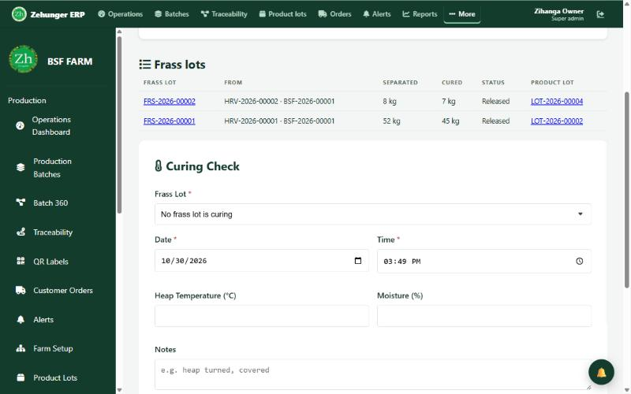
Cure the frass
7
Operator · Data entry → Frass & Fertiliser
Frass lots table shows every lot and its status
Curing checks: heap temperature and moisture
Finish curing: 52 kg became 45 kg
At least one check needed; cured weight cannot exceed separated
Result: FRS-2026-00001 · cured, waiting for QC
Notes:
Frass is cured in heaps before it can be sold. The table at the top of the section shows where each lot is: curing, waiting for QC, approved or released.

Slide 13
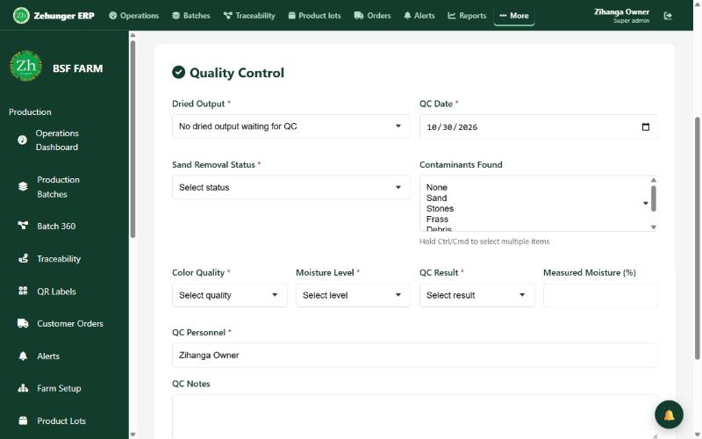
Quality control: check, decide, release
8
QC officer (Daniel) · Drying Process and Frass & Fertiliser
Check: sand, contaminants, colour, moisture, result
Decide: approve, or reject with a reason
Release: into Store bay 1, filled in for him
Frass passes only when mature and clean
No product reaches stock without both
Result: LOT-2026-00001 (12 kg) · LOT-2026-00002 (45 kg)
Notes:
This is the quality gate. Daniel records a check, then a decision, then releases the product into stock. The database itself refuses any product lot without a passed check and an approval. Every output of a drying batch must be settled before it completes, only the latest check can be decided, and rejecting needs a reason.

Slide 14
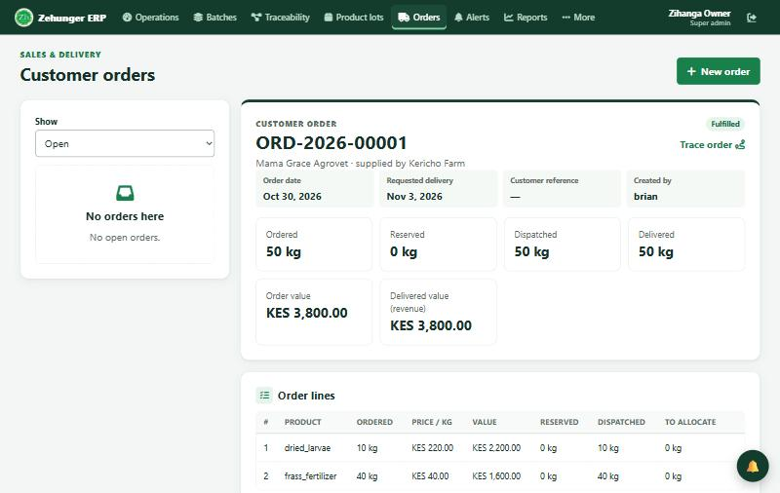
Sell and deliver
9
Sales officer (Brian) · Orders
New customer: Mama Grace Agrovet
Order: 10 kg larvae at KES 220, 40 kg frass at KES 40
Reserve stock, oldest lots first
Dispatch: KDA 123B, driver Joseph Kiprono
Confirm delivery: received by Grace Chebet
Result: ORD-2026-00001 · DEL-2026-00001 · KES 3,800
Notes:
Brian adds the customer from the order form, prices each line, reserves real lots so no other order can take them, dispatches with the vehicle and driver, and confirms delivery. Revenue counts only when the customer confirms receipt.

Slide 15
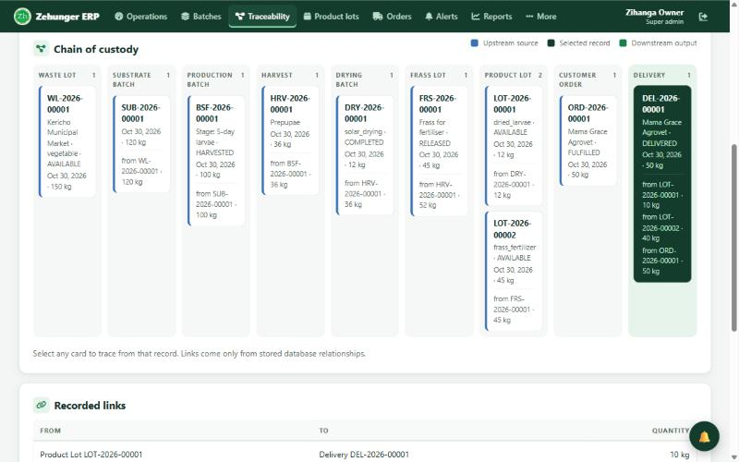
Trace any delivery back to the market
10
Enter DEL-2026-00001 and press Trace
9 upstream records, every link stored
Both products, one harvest
Waste lot from Kericho Municipal Market
Click any card to trace from there
Notes:
This is the answer to any complaint. From the delivery, the system walks back through both product lots, the drying batch and the frass lot, the harvest, the production batch, the substrate and the waste lot. Nothing is inferred: every link was recorded when the work was done.

Slide 16
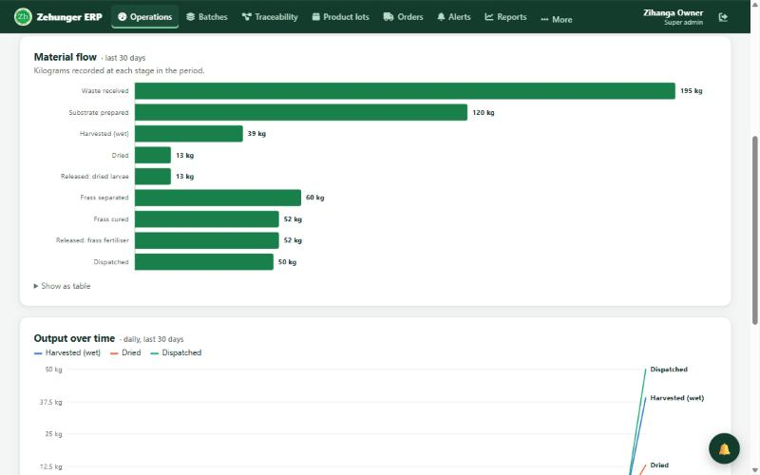
The operations dashboard
39 kg
harvested
13 kg
dried
52 kg
frass cured
KES 3,800
revenue
Material flow: waste 195 → substrate 120 → harvest 39 → dried 13; frass 60 → cured 52 → released 52
Notes:
The dashboard shows live figures for any farm, facility and period. Material flow follows both products stage by stage. The tiles show harvest, drying, frass, QC waiting, stock, open orders, deliveries, revenue and alerts.

Slide 17
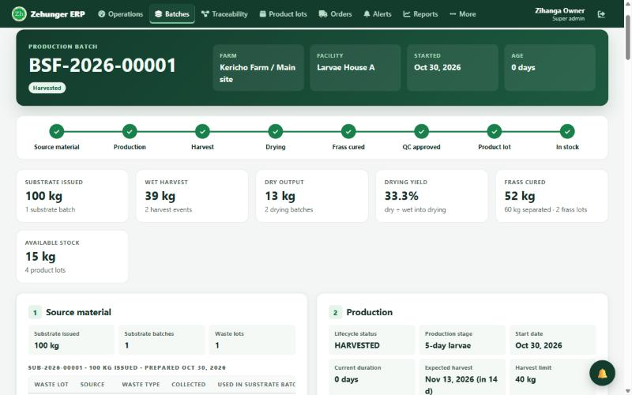
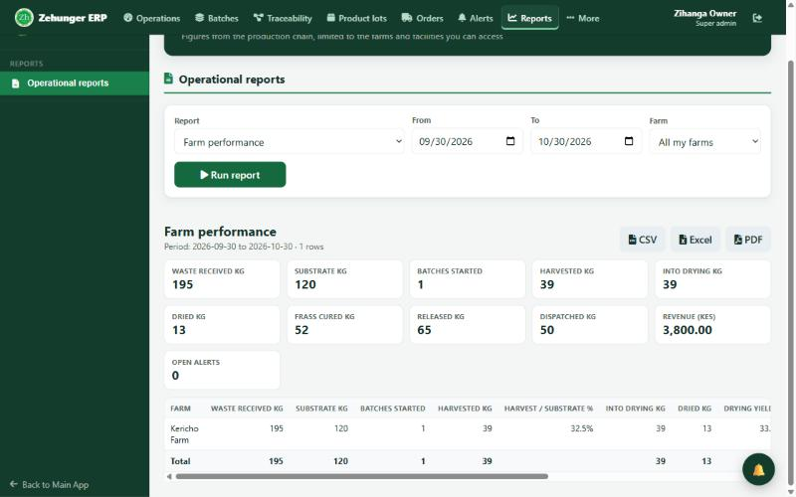
Batch 360 and reports
Batch 360: one batch end to end, with frass, quality, stock, customers and audit trail
14 reports, including Frass & fertiliser and Farm performance, each to CSV, Excel or PDF
Notes:
Batch 360 puts one batch on one page: a lifecycle strip, key figures and numbered cards from source material to the audit trail. Reports cover production, processing, stock and sales, traceability and farm performance; farm performance shows waste 195 kg, harvest 39 kg, drying yield 33.3%, frass cured 52 kg and revenue KES 3,800.

Slide 18
Rules the system enforces
1
Traceability built in
Every record links to its source
5
Location access
People see only their farms and facilities
2
Quality gate
No stock without a passed check and approval
6
Roles
Operators record, QC decides, sales sells
3
Mass balance
Never use more than exists or the harvest limit
7
Full audit trail
Every change records who and when
4
No future dates
Records cannot be dated ahead
8
Nothing deleted once used
Deactivate or reverse instead
Notes:
These are the guarantees to emphasise to the owners. They are enforced by the system and the database, not by trust: a product cannot reach stock without approval, quantities cannot be invented, and history cannot be erased.

Slide 19
What comes next
Sales ledger Invoices, payments (M-Pesa, bank, cash), customer balances
Waste collection page Redesigned intake screen, already built
Cost tracking Cost per kilogram and margins
Breeding links Hatchery and fly records connected to batches
Questions?
Notes:
Close with what comes next and open for questions. Likely questions: can a farmer fake a harvest (no: limits, links and audit trail); what if QC fails (rejected with a reason, never reaches stock); can we sell frass (yes, exactly like larvae); how do we see profit (revenue today, full sales ledger next); does it work on a phone (yes).

