Slide 1
KF Parameter Prediction
from Frequency-Stability Curves
Instant initial guesses for Kalman-filter tuning on atomic clock data.
Ian Lapinski
PH 551 Final Project • April 20, 2026

Slide 2
The problem
Kalman filters need good q-values. Getting them is slow.
Use case
Research question
“I have clock phase measurements.
I don't know the q values.
I want to optimize the Kalman filter
— give me a quick initial guess.”
Can supervised learning on frequency-stability features predict KF q-parameters accurately enough to seed or replace iterative optimizers?
Current options:
Sub-question
NLL optimization — multi-minute, highly sensitive to warm start
ALS — well-conditioned but iterative, needs seed
Manual MHDEV fit — requires expert τ-region selection
Which stability statistic is most informative — ADEV, MDEV, HDEV, or MHDEV?
Targets: log₁₀(q0), log₁₀(q1), log₁₀(q2)
PH 551 Final Project • Ian Lapinski • Apr 2026
2 / 15

Slide 3
Why it matters
Clocks are everywhere — but their noise models aren't automatic.
⏱
⚙
✦
Atomic clocks drift
KF tuning is slow
ML can do it in ms
GPS, telecom, defense timing, scientific instrumentation. Operators get phase data; they want stability predictions.
NLL optimization: 10–60 s per sample, sensitive to warm start. Lab workflow bottleneck.
Trained regressor: sub-millisecond inference on raw features. Quantified uncertainty included.
PH 551 Final Project • Ian Lapinski • Apr 2026
3 / 15

Slide 4
Dataset pipeline
10,000 synthetic samples anchored to real GMR6000 Rb data.
Real GMR6000
Rb phase
h-range
sampling
Composite
noise gen.
196-feature
extraction
ALS label
optimizer
35 days, 1 PPS
Kasdin 1992
N = 524,288 (~6 days)
ADEV, MDEV, HDEV, MHDEV
noise-free vs truth
Key design decisions
Physically grounded
4+1 noise types
Targets are log₁₀(q)
ALS-optimized labels
h_α ranges anchored to measured GMR6000 Rb (not arbitrary noise blends).
WPM + WFM + FFM + RWFM always; FPM in ~30% of samples.
Log-space equalizes multi-decade dynamic range; KF-native.
Probed on 10 draws: ALS matches truth to ≤10⁻³ dec; NLL drifted ±8 dec.
PH 551 Final Project • Ian Lapinski • Apr 2026
4 / 15

Slide 5
Feature engineering
196 features per sample from 20 log-spaced τ values.
Feature decomposition
Why these four statistics?
Group | Count | Description
Raw σ values | 80 | 4 stats × 20 τ: log₁₀ of ADEV, MDEV, HDEV, MHDEV
Log-log slopes | 76 | 4 stats × 19 adjacent-τ slopes (noise-type signature)
Variance ratios | 40 | MVAR/AVAR (20) + MHVAR/HVAR (20) — bias-type detectors
Total | 196 | Per-sample feature vector
ADEV — standard reference; baseline comparison
MDEV — distinguishes WPM vs FPM (slope −3 vs −2)
HDEV — Hadamard; rejects frequency drift
MHDEV — modified Hadamard; best for long τ on drifting clocks
Secondary research hypothesis
Feature-importance analysis will reveal which statistic carries the most information about KF noise parameters.
PH 551 Final Project • Ian Lapinski • Apr 2026
5 / 15

Slide 6
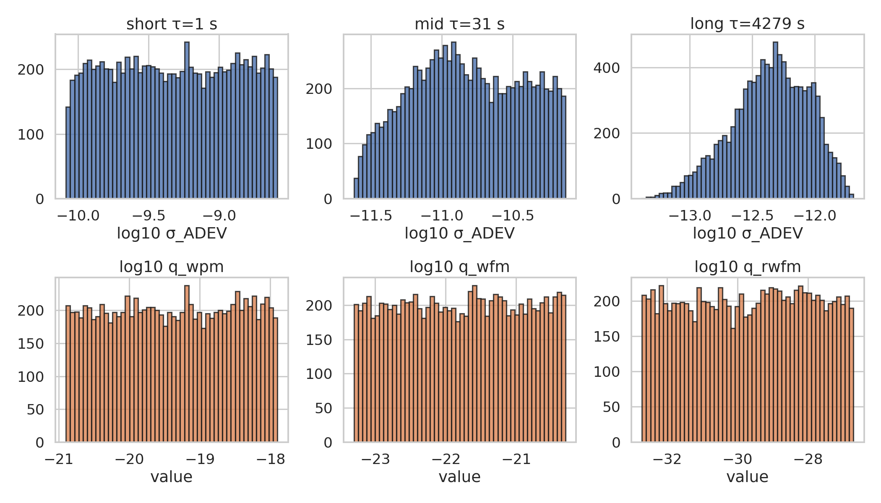
Data exploration
Target distributions, example σ(τ) curves, feature–target correlations.
What the data shows
Targets span ~6 log decades (q2 widest; q0 tightest)
Short-τ features (top row) correlate strongest with q0
Long-τ features correlate with q2 (log₁₀ q ~ −30)
FPM-present samples (30%) have steeper short-τ slope
NaN rate 0%; no outliers at |z|>5 — clean dataset
PH 551 Final Project • Ian Lapinski • Apr 2026
6 / 15

Slide 7
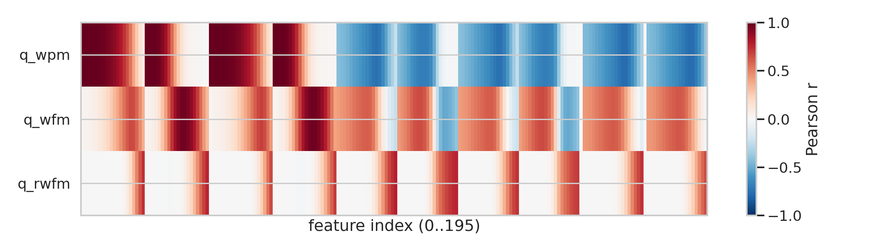
Statistical baselines
Setting the bar: what does 'good' look like?
Baseline predictors
Method | RMSE (log₁₀ q) | Notes
Naive (train mean) | 0.87 / 0.87 / 1.73 | Ignores features (R² ≈ 0)
MHDEV 3-region fit | see slide 13 | Real-data only, requires expert τ-regions
RF (ours) | 0.05 / 0.08 / 0.79 | ~18×/11×/2× vs naive
Correlation pattern above: short-τ features drive q0; long-τ features drive q2. Relationships are monotonic but clearly nonlinear — motivates tree ensembles.
PH 551 Final Project • Ian Lapinski • Apr 2026
7 / 15

Slide 8
Methodology
Random Forest + XGBoost, multi-output regression.
Random Forest
XGBoost (Gradient Boosted)
Bagged ensemble of decision trees
Built-in UQ via tree-variance (forestci)
Invariant to monotone feature transforms
Robust baseline for tabular data
Sequential boosting — corrects errors
Typically ~1–3× better RMSE than RF on tabular
UQ via quantile regression (α=0.05, 0.95)
Best-in-class for multi-output regression
Why both?
Head-to-head comparison on identical features. Different bias/variance tradeoffs → diagnostic of whether signal is smooth (boosting wins) or rough (RF wins). UQ mechanisms differ — cross-check coverage.
PH 551 Final Project • Ian Lapinski • Apr 2026
8 / 15

Slide 9
Hyperparameter tuning
Two-pass 5-fold GridSearchCV: expand, then re-center around boundary winners.
Random Forest grid
XGBoost grid
Parameter | Grid | Best
n_estimators | {1000, 1500, 2000} | 1000
max_depth | {20} | 20
min_samples_leaf | {1, 2, 3} | 1
max_features | {0.5} | 0.5
Parameter | Grid | Best
n_estimators | {500, 750, 1000} | 750
learning_rate | {0.003, 0.01} | 0.01
max_depth | {6} | 6
subsample | {0.7, 0.8} | 0.7
CV protocol
5-fold CV • Pass 1 landed on boundaries (n_est top, lr bottom, subsample bottom) • Pass 2 probe = 45 RF + 60 XGB fits centered on pass-1 winners, extending past boundaries → new winners are interior; scoring = neg-MSE in log₁₀-q; seed = 42.
PH 551 Final Project • Ian Lapinski • Apr 2026
9 / 15

Slide 10
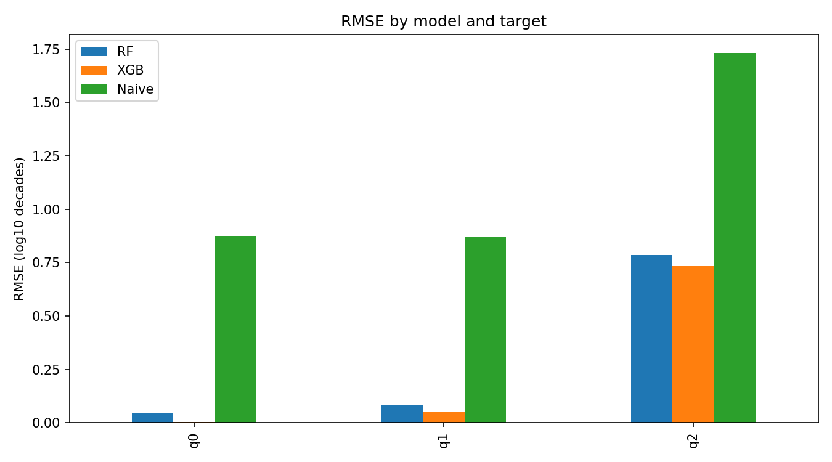
Results
Per-target metrics + model comparison.
Target | Model | RMSE | R² | MAE
q0 | Naive | 0.874 | 0.000 | 0.759
q0 | RF | 0.047 | 0.997 | 0.034
q0 | XGB | 0.004 | 0.99998 | 0.003
q1 | Naive | 0.873 | 0.000 | 0.758
q1 | RF | 0.080 | 0.992 | 0.055
q1 | XGB | 0.048 | 0.997 | 0.027
q2 | Naive | 1.732 | 0.000 | 1.494
q2 | RF | 0.786 | 0.794 | 0.552
q2 | XGB | 0.733 | 0.821 | 0.506
Headline: XGB → <0.05-dec RMSE on q0 & q1 (R² ≥ 0.997); q2 R² = 0.82 (vs 0.65 before switching labels from NLL → ALS).
PH 551 Final Project • Ian Lapinski • Apr 2026
10 / 15

Slide 11
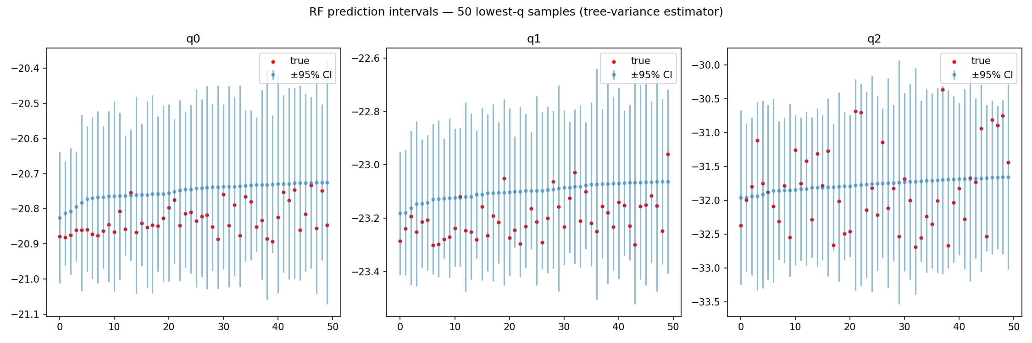
Uncertainty quantification
Grad-student requirement — the model knows when it doesn't know.
Two complementary approaches
Random Forest — forestci
Infinitesimal jackknife on tree predictions
→ analytic variance
XGBoost — quantile regression
Two extra models at α=0.05, α=0.95
→ non-parametric prediction intervals
Empirical 90% PI coverage (XGB):
q0 84% q1 81% q2 81%
PH 551 Final Project • Ian Lapinski • Apr 2026
11 / 15

Slide 12
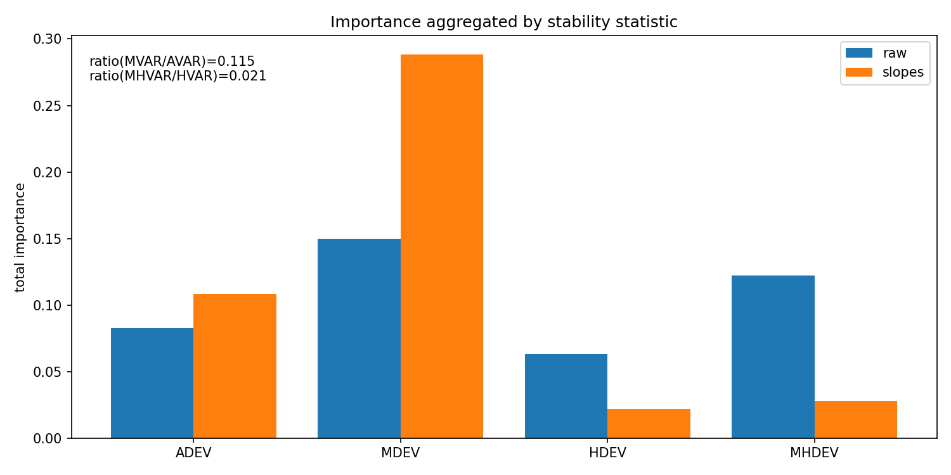
Which statistic carries the signal?
Headline: feature-importance answer to the sub-question.
What the data says
MDEV dominates (Σ importance ≈ 0.59)
MHDEV 5× less important (Σ ≈ 0.12)
ADEV / HDEV contribute the remaining ~0.29
Slopes carry more signal than raw σ values —
consistent with noise-type diagnostics driving q.
Contribution: MDEV is the most informative stability statistic for KF tuning.
PH 551 Final Project • Ian Lapinski • Apr 2026
12 / 15

Slide 13
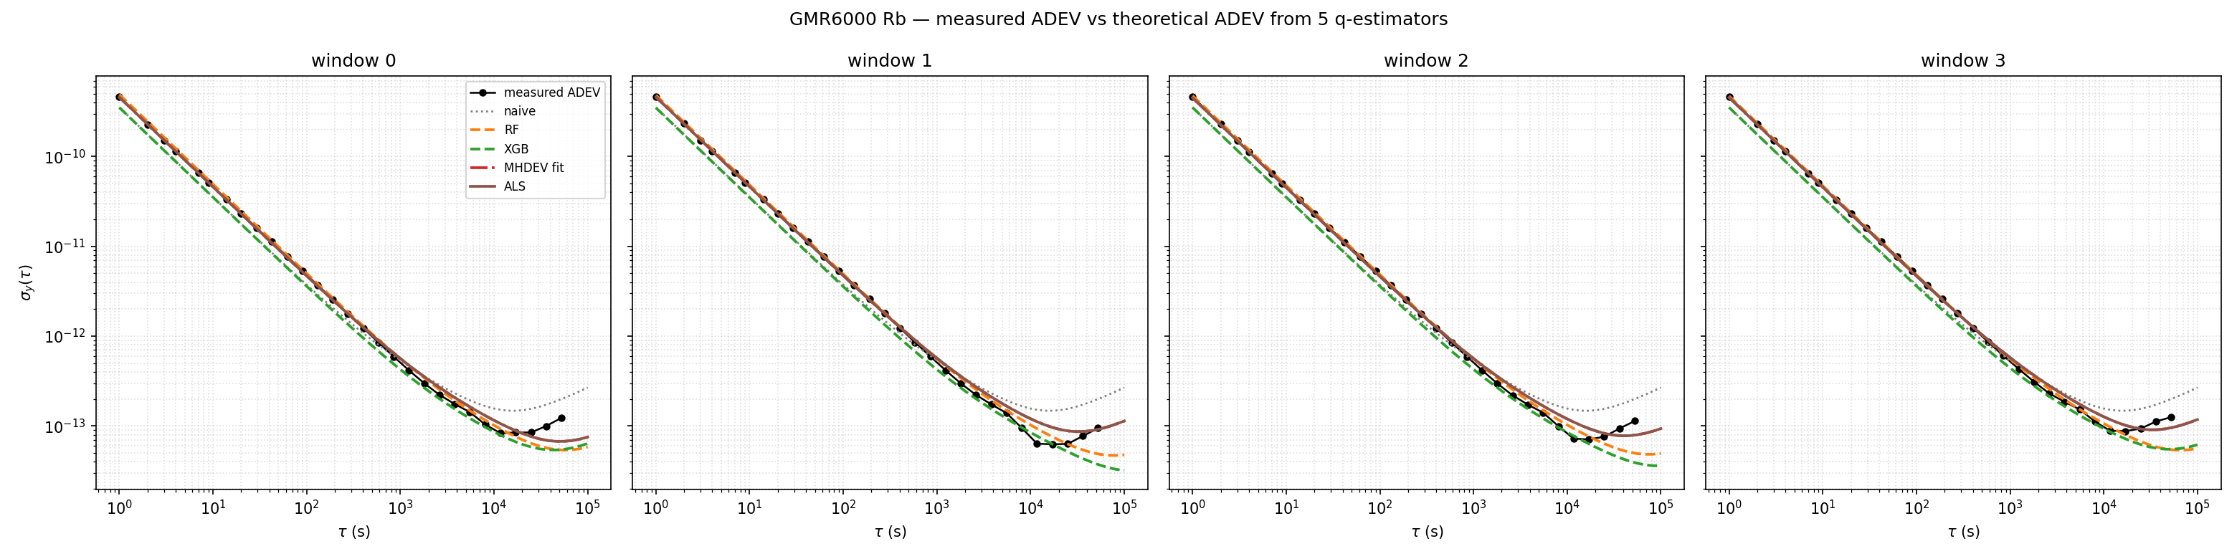
Real-data validation
GMR6000 Rb phase → ML prediction → ADEV overlay on 4 windows.
Headline: RF & XGB σ(τ) predictions track measured ADEV across all 4 windows — model generalizes from synthetic to real hardware.
PH 551 Final Project • Ian Lapinski • Apr 2026
13 / 15

Slide 14
Takeaways & limitations
What worked
Limitations
Future work
ALS labels → noise-free targets (key finding; lifted q2 R² from 0.65 → 0.82)
XGB → 0.004-dec RMSE on q0 (R² = 0.99998); <0.05-dec on q1
forestci + quantile UQ → 80–84% empirical coverage of nominal 90% PIs
Feature importance → MDEV quantitatively most informative (5× MHDEV)
Trained on Rb GMR6000-class h-ranges only
3-state KF model lacks flicker-FM — limits long-horizon holdover
Single real-data record (6k27feb) for cross-check
XGB 90% PI under-covers by 6–10 pp (conservative regularization)
Extend to OCXO, HSO, cesium training ranges
4-state model with explicit FFM for sub-ns long-term holdover
End-to-end NN on raw phase (current: hand-crafted features)
Active learning on where the model is least confident
PH 551 Final Project • Ian Lapinski • Apr 2026
14 / 15

Slide 15
Thank you
Questions?
Code
github.com/ianlap/SigmaTau
Ian Lapinski • PH 551 Final Project • April 2026

