Slide 1
Image, filtering, convolution
ISTD 50.035
Computer Vision
Acknowledgement: Some images are from various sources: UCF, Stanford cs231n, etc.

Slide 2
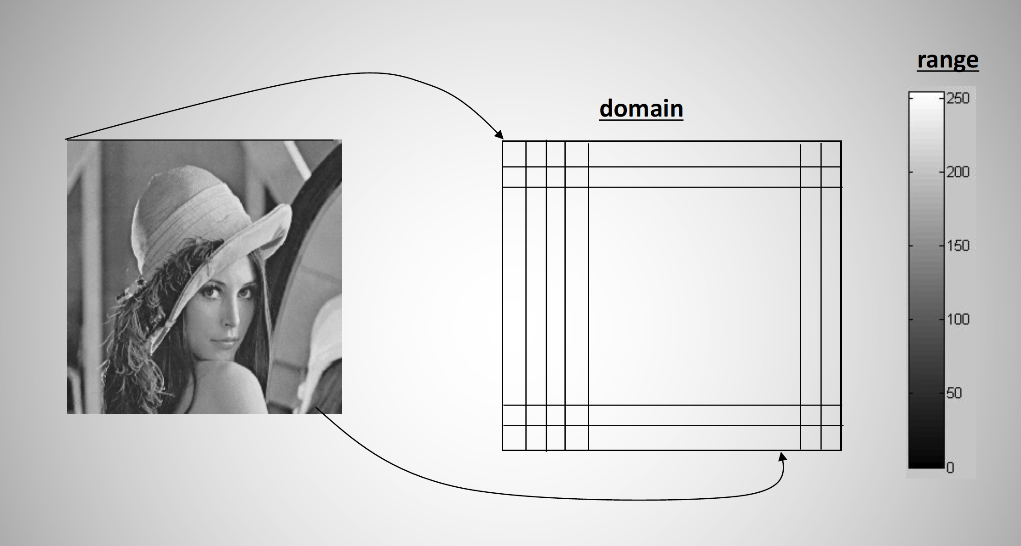
Image is an array of numbers
-Grayscale image
-2D array of numbers (pixels) / matrix
-Number indicates the intensity: [0,255] for 8-bit representation
-Image resolution / number of pixel in an image: 100x100, 1920x1080, etc.
A pixel
0: black, 255: white

Slide 3
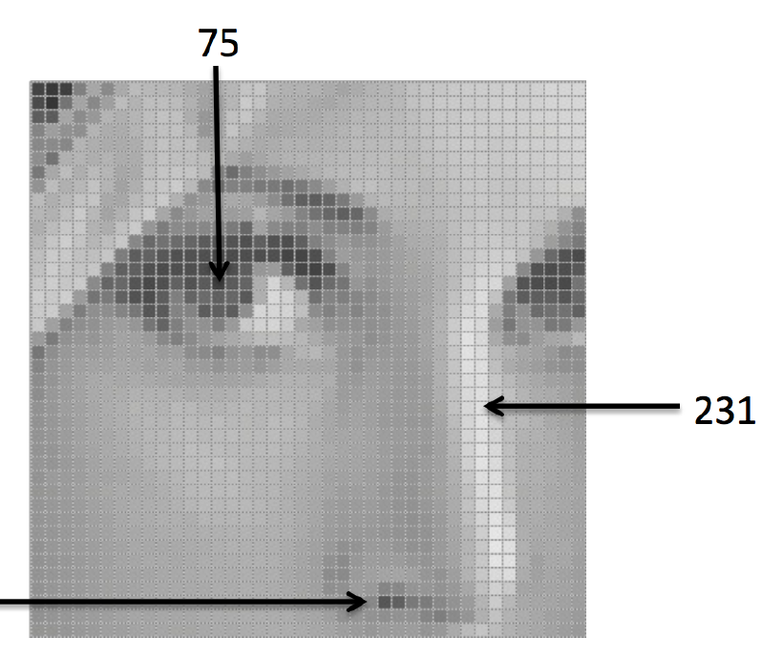
Image is a discrete array of numbers
-Samples from continuous object
-quantized to have a finite number of possible values: [0,1,2 to 255]
- Sometimes normalized from 0 to 1

Slide 4
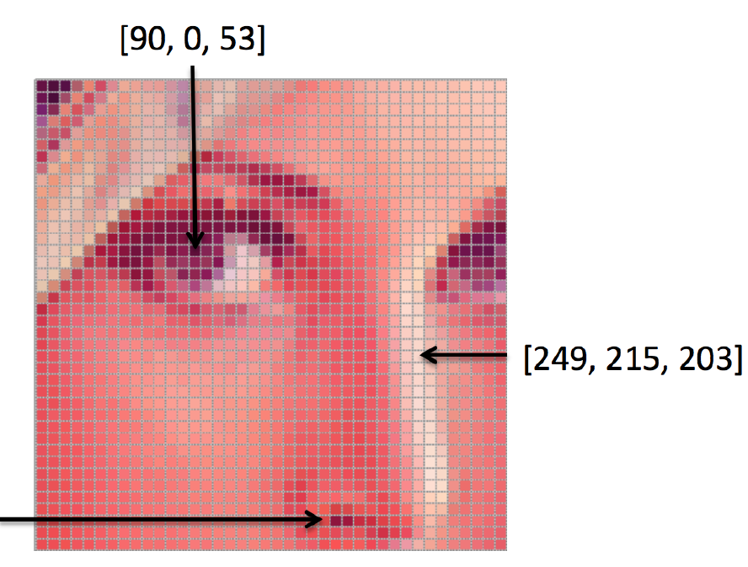
Color image
-Each pixel has three numbers to represent the red, green, blue color intensity
-RGB
-Other color format: HSV, YUV
-Image can be stored in different format: JPEG, PNG, TIF, etc.

Slide 5
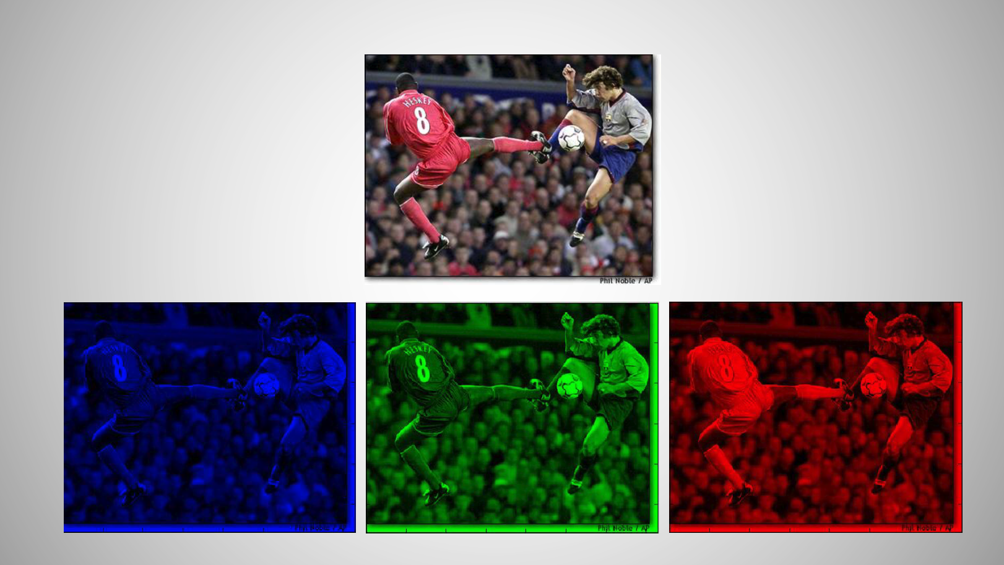
Color image with R, G, B channels

Slide 6
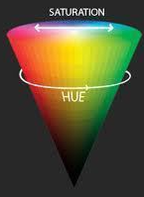
HSV color space
Hue represents color in angle of HSV cone
  0-60: red
  60-120: yellow
  120-180: green
  180-240: cyan
  240-300: blue
  300-360: magenta
Saturation represents the amount of ‘grey’ in the color: ‘0’ is grey, ‘1’ is pure primary color
  Small saturation means faded color
  It is the radius of the HSV cone
Value represents intensity
  It is the height of the HSV cone
VALUE
HSV represents color in a similar way as humans perceive color, is easy to work with in some applications

Slide 7
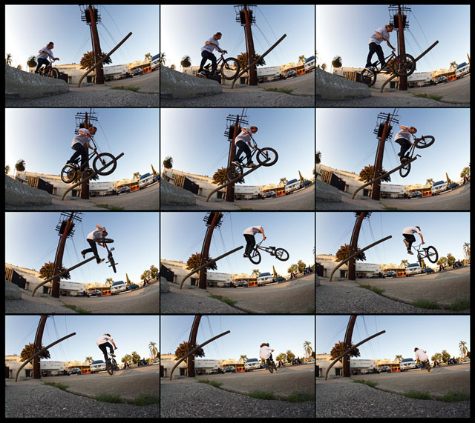
Video
A video is a sequence of images (frames)
30 frame per second (fps)
Spatial dimension: x,y
Temporal dimension: t

