Slide 1
Image histogram
ISTD 50.035
Computer Vision
Acknowledgement: Some images are from various sources: UCF, Stanford cs231n, etc.

Slide 2
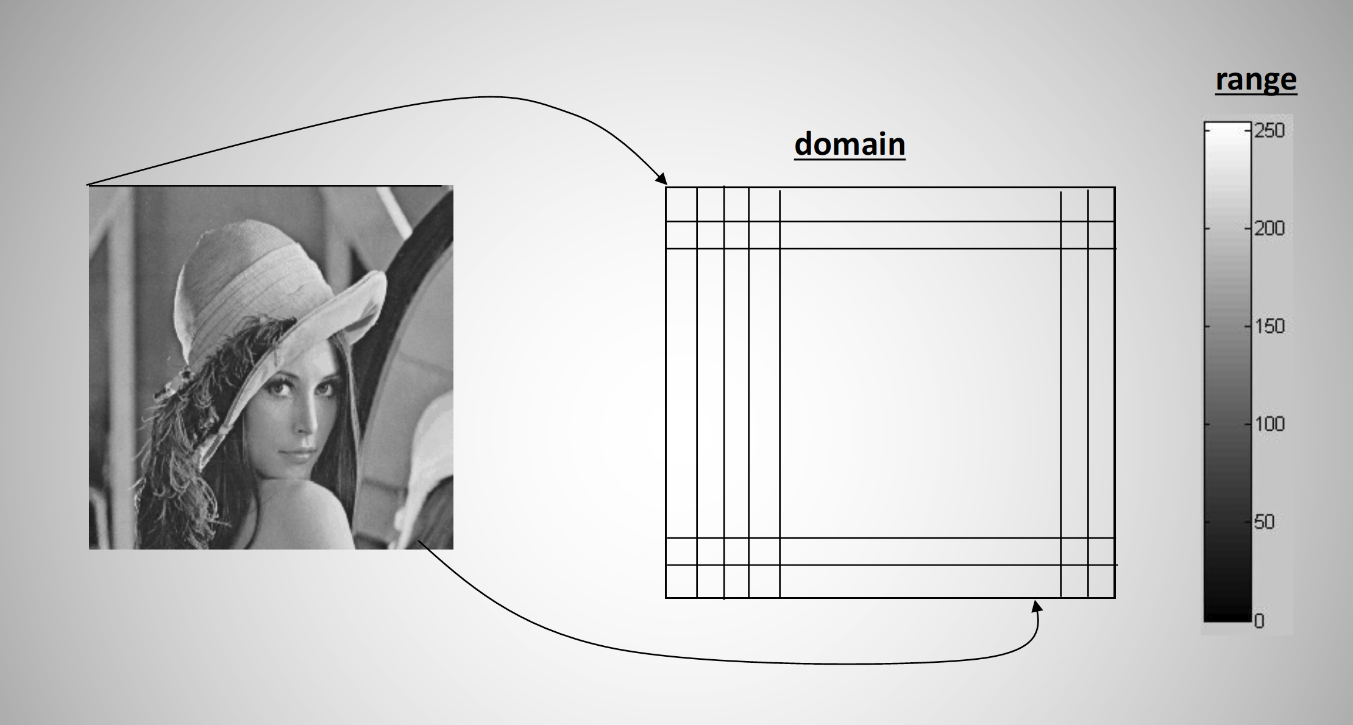
Image is an array of numbers
-Grayscale image
-2D array of numbers (pixels) / matrix
-Number indicates the intensity: [0,255] for 8-bit representation
-Image resolution / number of pixel in an image: 100x100, 1920x1080, etc.
A pixel
0: black, 255: white

Slide 3
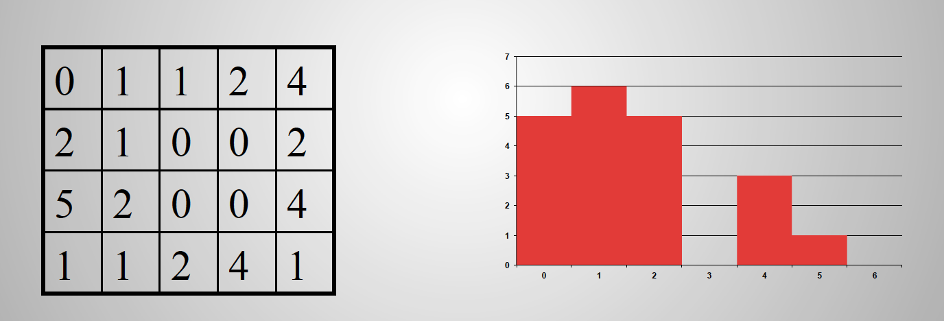
Image Histogram
Histogram
  X-axis: bins of possible values
  Y-axis: frequency of a value (number of samples)
Normalize Y-axis => probability mass function
Area = total number of pixels
Image (In general, data)
Histogram

Slide 4
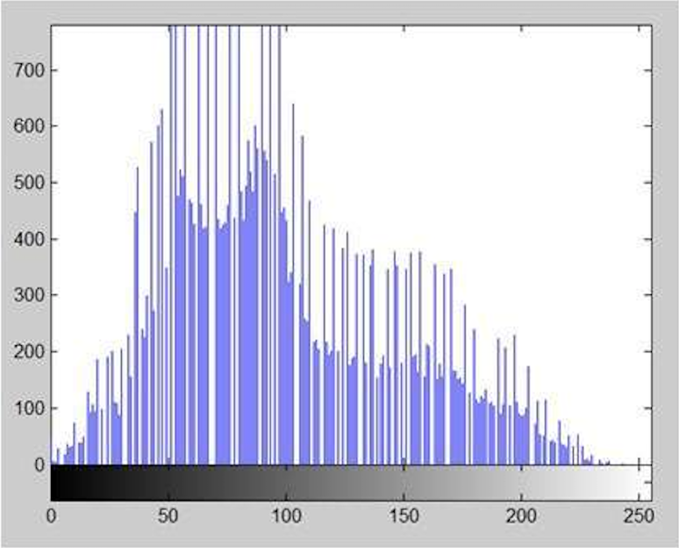
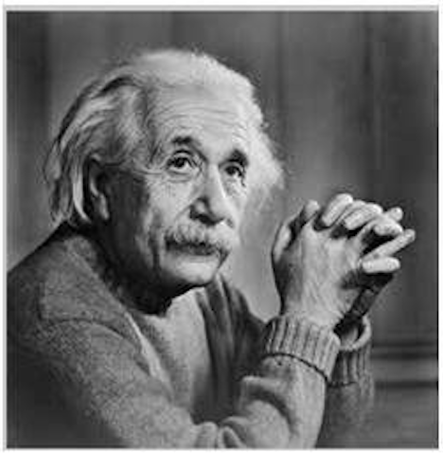
Image Histogram
Image Histogram
X-axis: pixel values, i.e. 0 to 255
Y-axis: number of pixels with a certain pixel value

Slide 5
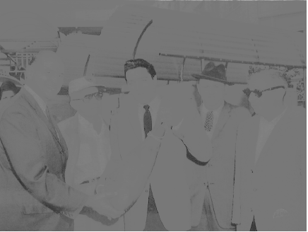
Histogram equalization
To increase the contrast of an image
  Over or under-exposed photographs
  Medical imaging: x-ray images, etc.
Distribute intensities more evenly over the range: spread out the most frequent intensity values
Image with low contrast, what would be the histogram?

Slide 6
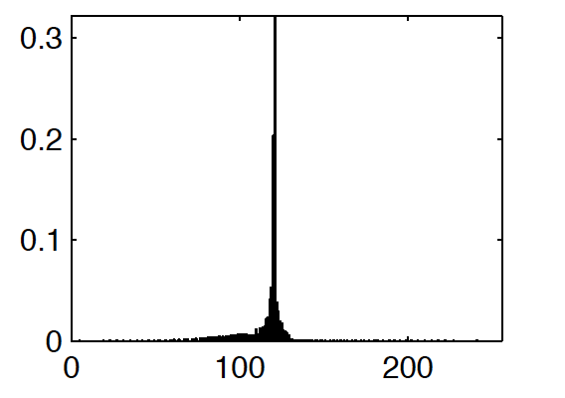
Histogram equalization
To increase the contrast of an image
  Over or under-exposed photographs
  Medical imaging: x-ray images, etc.
Distribute intensities more evenly over the range: spread out the most frequent intensity values
Image with low contrast, what would be the histogram?

Slide 7

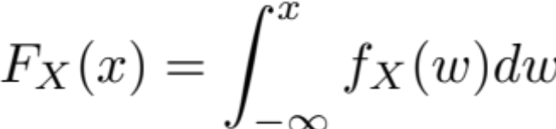
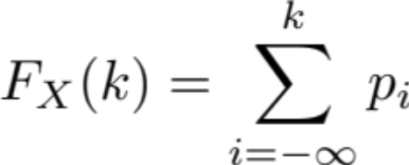
Cumulative distribution / density function (cdf)
The cdf of a random variable X is given by
If X is a continuous r.v., cdf is given by (f_{X}(x) is the probability density function, pdf)
If X is a discrete r.v., cdf is given by (p_{i} is the probability mass of X at i)

Slide 8
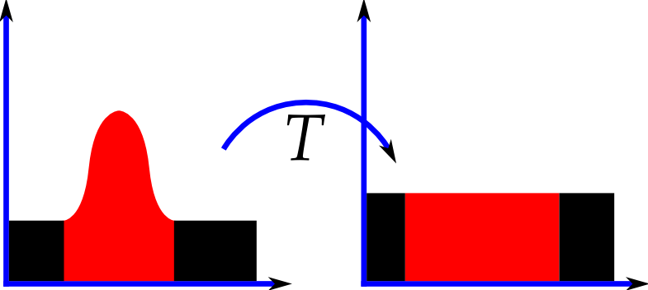
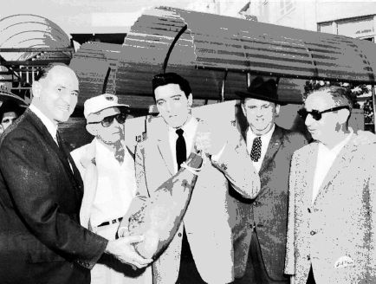
Histogram equalization
Apply a transformation T to distribute intensities evenly over the range -> increase contrast
A mapping of pixel value
Note area (no. of pixel) in the histogram remains the same after transformation

Slide 9
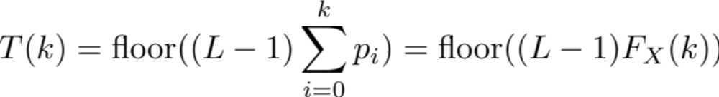
Histogram equalization
A mapping of pixel value
For a pixel with intensity k, transform it using (L = number of level = 256)
k
T(k)
A pixel with value k
A pixel with value T(k)

Slide 10
Histogram equalization
A mapping of pixel value
For a pixel with intensity k, transform it using (L = number of level = 256)
Algorithm:
  Compute cdf at k [*]
  Multiply by L-1, then floor(.)
  The result is the new intensity value
k
T(k)
[*] normalize cdf to [0,1] by:
[acc – acc.min()] / [acc.max() – acc.min()]
Check that acc.max() equals to number of pixels

Slide 11
Histogram equalization
Cohort exercise
Input:
[[ 1 3 1 3]
[ 2 3 10 11]
[11 10 2 3]
[ 1 2 3 3]]
Output:
[[ 0 176 0 176]
[ 58 176 215 255]
[255 215 58 176]
[ 0 58 176 176]]
Input:
[[52 52 53 72]
[72 72 53 53]
[88 72 52 52]
[88 88 53 53]]
Output:

Slide 12

Histogram equalization - Justification
Discrete case:
Continuous case: T(.) transforms a continuous r.v. X ~ p_{X}(x) into Y ~ p_{Y}(y), so that p_{Y}(y) = U[0,L-1]
Note that for any X ~ p_{X}(x), Y is U[0,1] when the transformation is the cdf of X

Slide 13
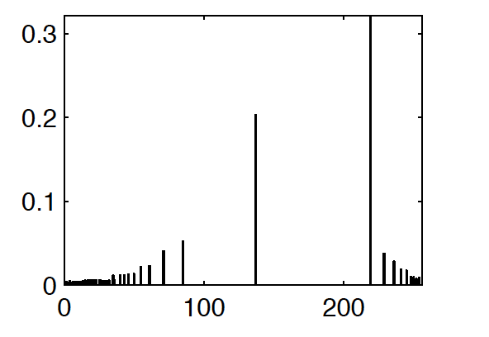
Histogram equalization
An example
All pixels here are mapped to the same new intensity

Slide 14
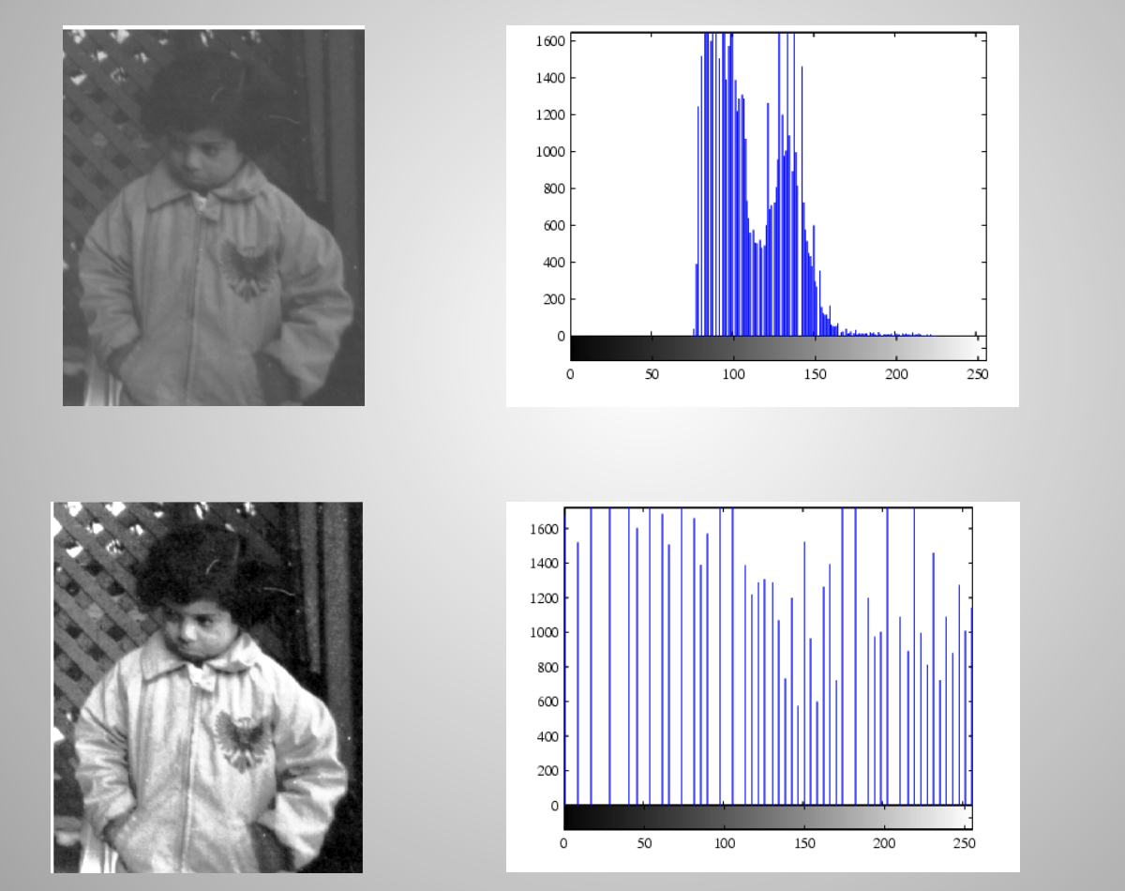
Histogram equalization
An example

Slide 15
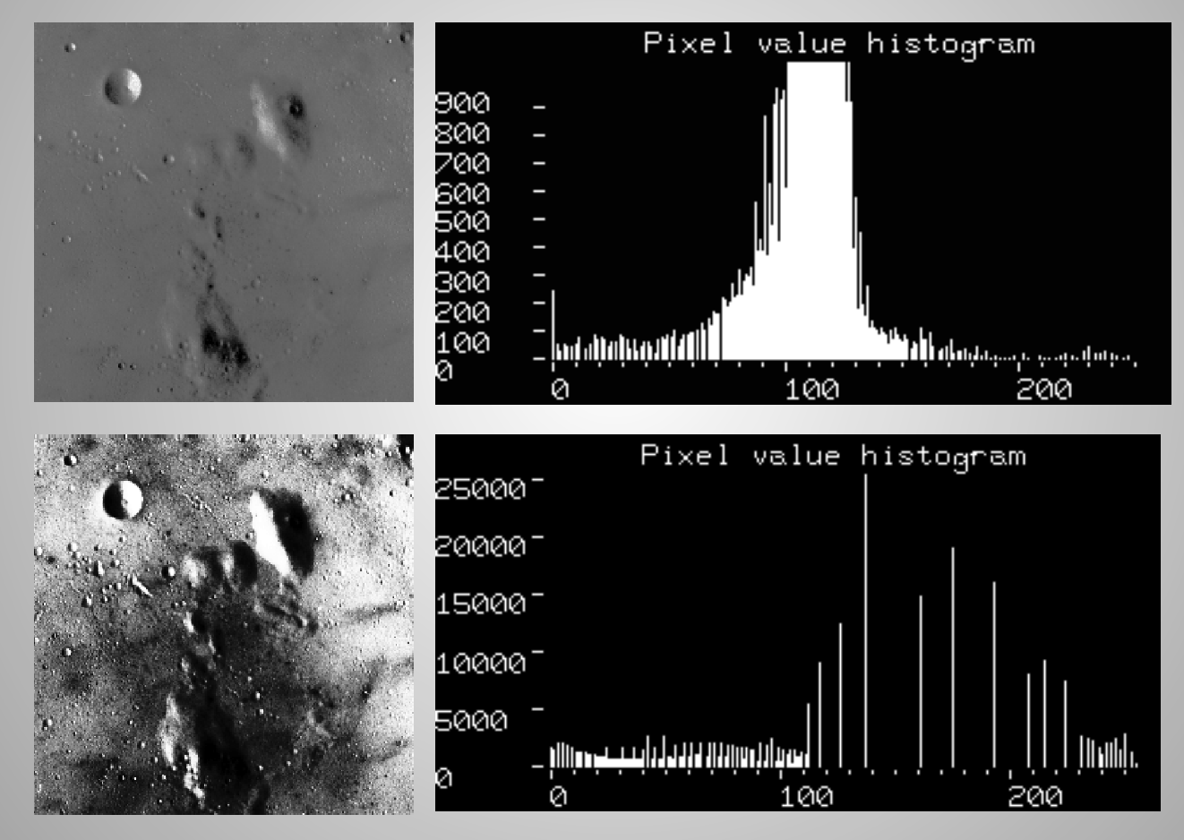
Histogram equalization
An example

Slide 16
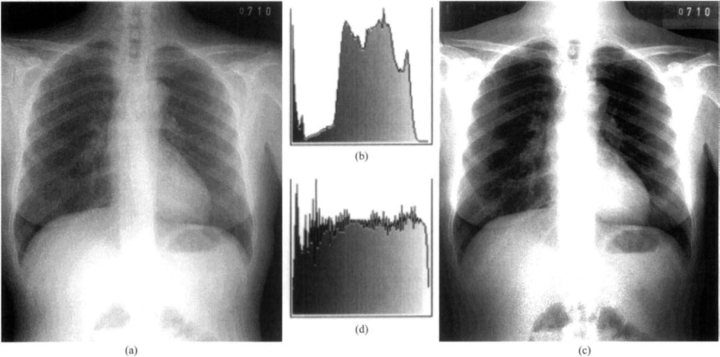
Histogram equalization
Chest x-ray

Slide 17
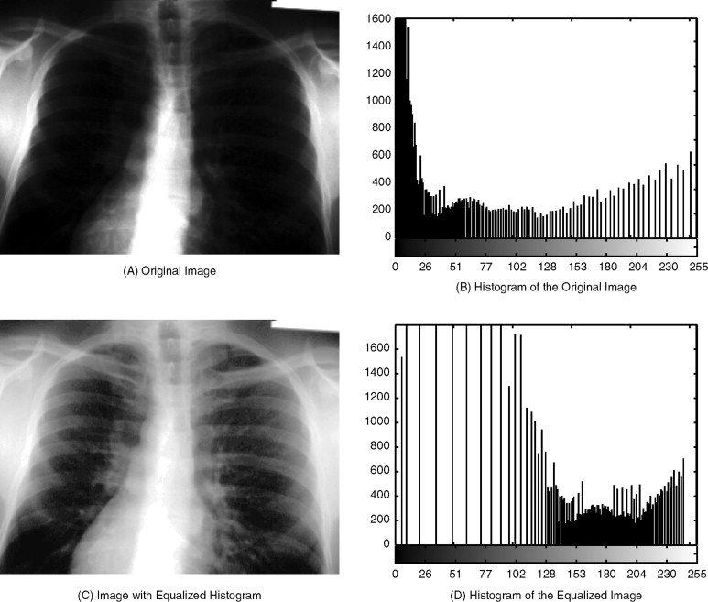
Histogram equalization

Slide 18
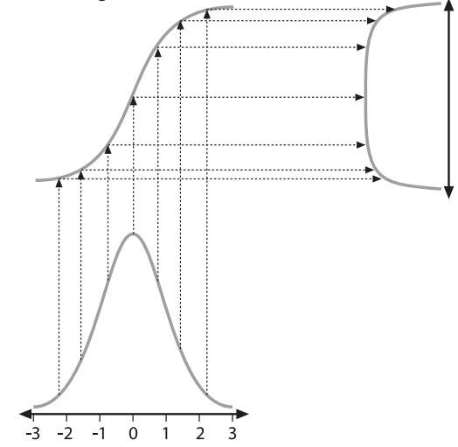
Histogram equalization
Cdf: transform a r.v. to a uniform one, ~U[0,1]
Cdf of X
pdf of transformed r.v. Y
pdf of original r.v. X

Slide 19
Histogram equalization
Linear?
Invertible?
Notes:
Non linear
Invertible in principle; not so for discrete case (floor is not invertible)

Slide 20
Histogram equalization
Cohort exercise
Input:
[[ 1 3 1 3]
[ 2 3 10 11]
[11 10 2 3]
[ 1 2 3 3]]
Output:
[[ 0 176 0 176]
[ 58 176 215 255]
[255 215 58 176]
[ 0 58 176 176]]
Input:
[[52 52 53 72]
[72 72 53 53]
[88 72 52 52]
[88 88 53 53]]
Output:
[[ 0 0 106 191]
[191 191 106 106]
[255 191 0 0]
[255 255 106 106]]

