Slide 1
Deep Learning

Slide 2




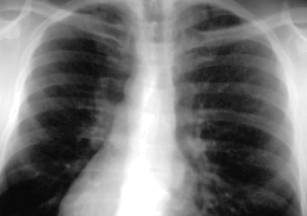

Classification
Map to a different category
Classification function for image is complex, non-linear
Given data points (training examples)
Able to generalize to unseen example
Our goal is to learn a good approximation of F(x)
Deep neural network: a class of function with large capacity to provide this approximation
  With certain parameters learned in training
Map to same category
x =
y = 1, 2, ... or K (class index)
x =
y = 1, 2, ... or K (class index)

Slide 3
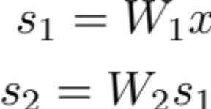
Stacking linear classifiers
Stacking linear classifiers to improve representational power (to approximate F(x))
Still linear, W = W₂W₁

Slide 4
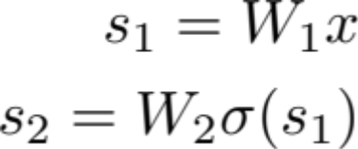
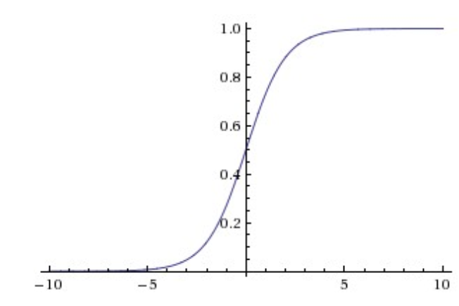
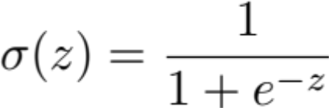
Stacking linear classifiers
Stacking linear classifiers to improve representational power (to approximate F(x))
Add non-linearity between layers (stages)
Activation function is applied elementwise
Sigmoid:
Still linear, W = W₂W₁
Can approximate any continuous function F(x)
We obtain a neural network

Slide 5

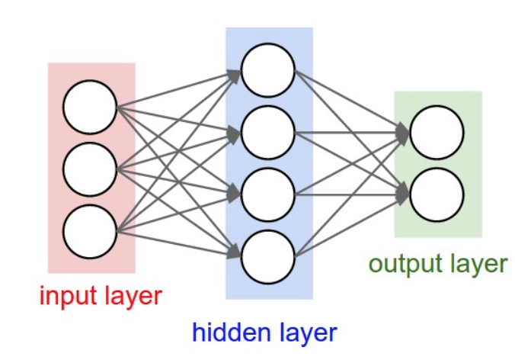




Neural Network
Neural network: collection of neurons
  Connected in an acyclic graph
  Output of a neuron can be input of another
K outputs for K classes
W₁
W₂
Linear classifier with activation as input
x
x1
w1
x2
w2
x3
w3
+1
b

Slide 6
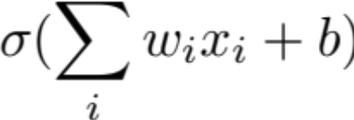
A neuron
Neuron: a computational unit, take input x, output:
Activation (Sigmoid) function is applied elementwise
->
=
x1
w1
x2
w2
x3
w3
+1
b

Slide 7
Neural Network
Neural network: collection of neurons
  Connected in an acyclic graph
  Output of a neuron can be input of another
->
=
x1
w1
x2
w2
x3
w3
+1
b

Slide 8
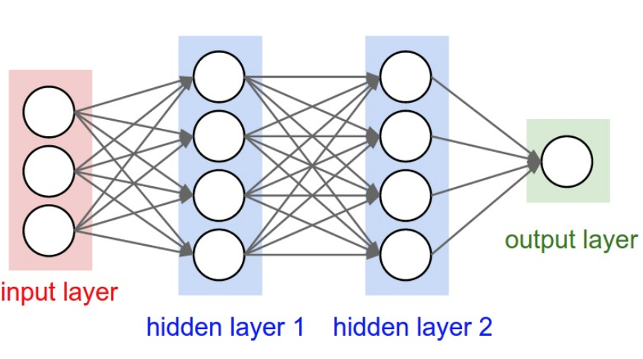
Neural Network
Hidden layer: values are not observed in the training set
Output layer: no activation
2-layer NN: 1 hidden, 1 output layer
3-layer NN: 2 hidden, 1 output layer
Artificial neural network (ANN)
Multi-layer perceptrons (MLP)
x1
w1
x2
w2
x3
w3
+1
b

Slide 9
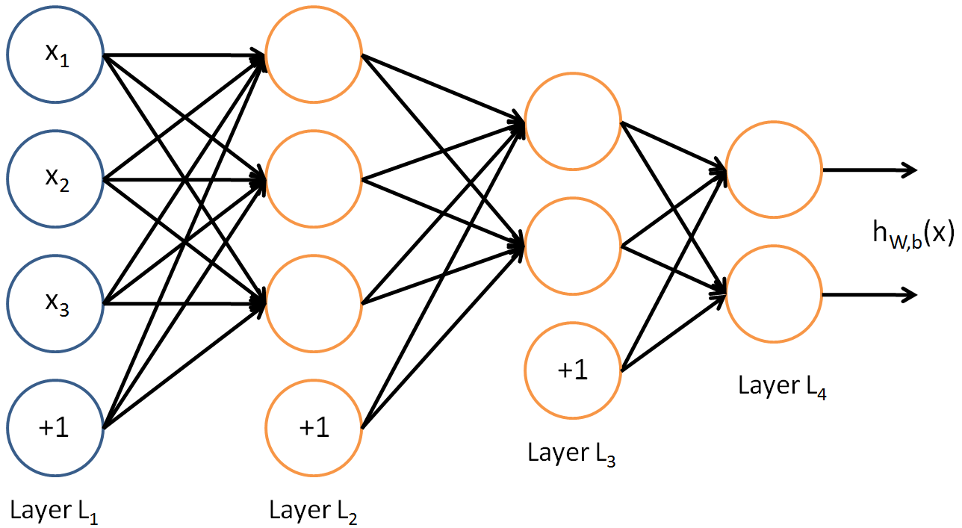
Neural Network
Hidden layer: values are not observed in the training set
Output layer: no activation
Explicit indication of bias
Output layer
Hidden layer
Input layer
Hidden layer
Artificial neural network (ANN)
Multi-layer perceptrons (MLP)
x1
w1
x2
w2
x3
w3
+1
b

Slide 10


Activation function
Sigmoid
-Incorporate non-linear
-Limit the output range (or additional normalization)
-Decision / probabilistic interpretation
  -Detect feature or not
  -Biological neuron: to fire or not
x1
w1
x2
w2
Easy to compute gradient:
x3
w3
+1
b

Slide 11
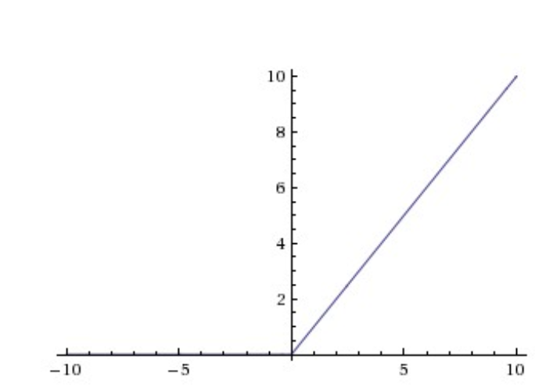
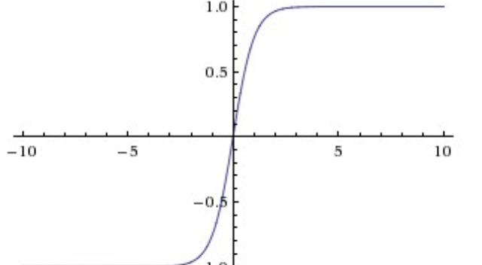
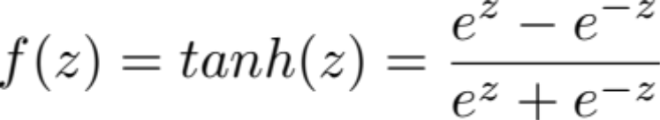

Activation function
Hyperbolic tangent
Rectified linear unit (ReLU)
-Saturation, vanishing gradient
-Slow and difficult to train with gradient descent
-Reduce issue of vanishing gradient
-Sparse representation
x1
w1
x2
w2
x3
w3
+1
b

Slide 12
NN as a function approximation
NN with one hidden layer can approximate any continuous function F(x)
Classification function in our case
In practice, NN with multiple hidden layers performs better

