Slide 1

Linear Classifier
Given a test image x, produce the confidence score for each class using linear transformation (total: K classes)
Higher confidence score for a class -> more likely to be the ground-truth class
Test image x: flatten to a Dx1 column vector, D is the image resolution times number of channel
Score function
Input x: Dx1
Weight W: KxD
Bias b: Kx1
Score s:Kx1

Slide 2
Linear Classifier
Testing: W, b are fixed, x is the input
Training: Given N training samples (x_{i}, y_{i}), y_{i} takes value in [1,...,K], learn W and b
The ground truth class is y_{i}
Example: K=3, x_{i}= y_{i} = 2 {cat, dog, ship}
Training: (x_{i},y_{i}) are given and fixed; W, b are the variables to be determined

Slide 3
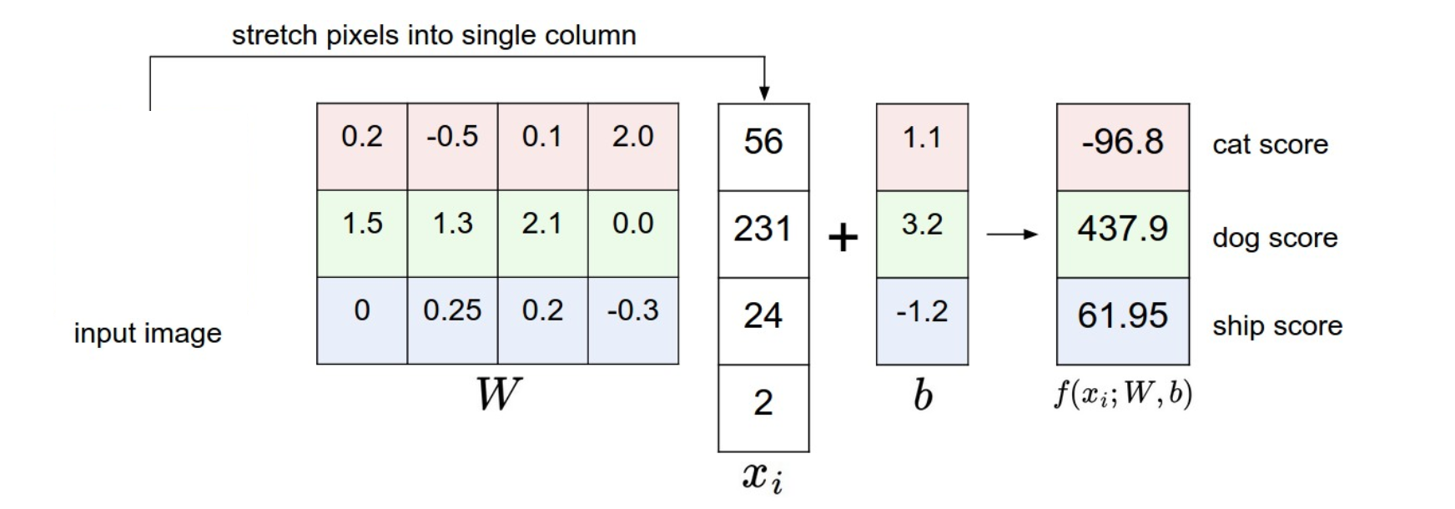
Linear Classifier
Testing: W, b are fixed, x is the input
Training: learn W, b to discriminate the classes
Each row of W extracts the features (template) of a specific class from input
60.75

Slide 4

Linear Classifier
Testing: W, b are fixed, x is the input
Training: learn W, b to discriminate the classes
Each row of W extracts the features (template) of a specific class from input
Measure similarity between w_{k} and x_{i}
60.75

Slide 5


Linear Classifier
Shorthand notation
W
x
Input x: (D+1)x1
Weight W: Kx(D+1)
Score s:Kx1

Slide 6
Loss function
Training: Given N training samples (x_{i}, y_{i}), y_{i} takes value in [1,...,K], learn W
Loss function: measure how consistent are the ground-truth labels and the score function outputs, for some W
Small loss: good W
Softmax classifier with cross-entropy loss

Slide 7
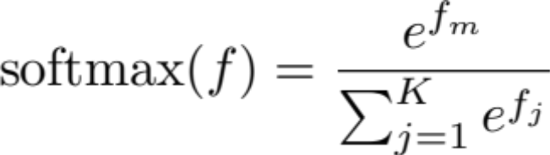
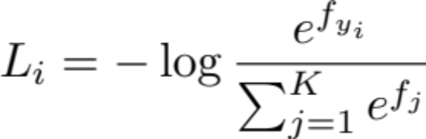
Softmax classifier
Regard output of the score function f(x; W) as the unnormalized log probability of each class
Probability of each class can be obtained by applying a softmax function (exp, then normalize):
Cross-entropy loss (apply –log(.) to only the ground-truth class):
For the m-th class
For the i-th training sample

Slide 8
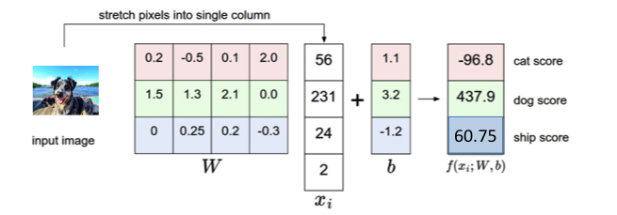
Softmax classifier
Cross-entropy loss (apply –log(.) to only the ground-truth class):
For the i-th training sample
Example: a dog (which looks like a dog)
print(np.exp(f))
print(np.exp(f) / sum(np.exp(f)))
[ 9.12628762e-043 1.50505935e+190 2.41762966e+026]
[ 6.06373937e-233 1.00000000e+000 1.60633510e-164]
y_{i}=2
L_{i} = -log(1) = 0
Probability

Slide 9
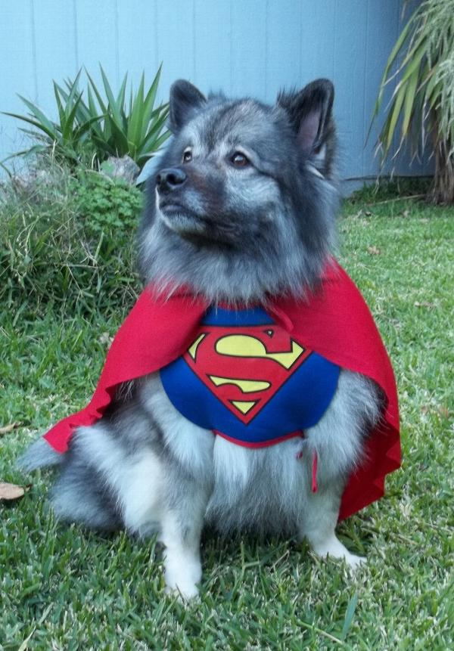
Softmax classifier
Cross-entropy loss (apply –log(.) to only the ground-truth class):
For the i-th training sample
10
63
Example: a dog (which does not look like a dog)
5
70

Slide 10
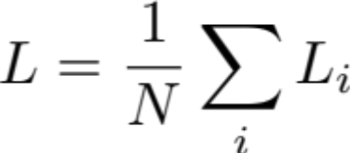
Softmax classifier
The entire loss for N training samples (x_{i}, y_{i}):
We determine W to minimize this loss given the training dataset
Additional regularization of W

Slide 11
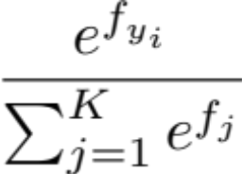
Understand Softmax classifier
Cross-entropy loss
  First apply softmax function
  Then apply –log(.) to only the ground-truth class
The term is the probability of the correct class (i.e., y_{i})
Therefore, want this to be large, i.e., max_{W} log(.)
Thus, want this to be small min_{W} –log(.)
For the i-th training sample
Notes:
Min with respect to W

Slide 12
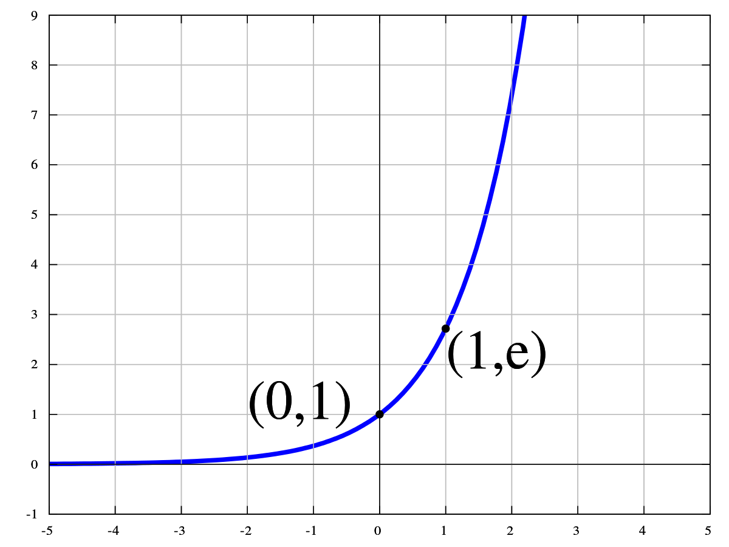
Understand Softmax classifier
Why exp before normalization?
exp() >= 0
Much higher confidence if the activation is large (clear images)
s = np.array([1,2])
print(np.exp(s) / sum(np.exp(s)))
[ 0.26894142 0.73105858]
s = np.array([10,20])
print(np.exp(s) / sum(np.exp(s)))
[ 4.53978687e-05 9.99954602e-01]
Notes:
Min with respect to W

Slide 13
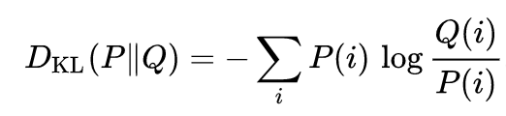
Understand cross entropy loss
Interpretation of the cross entropy loss
Difference between:
  The model (estimated) prob Q:
  The data (true) prob P: [0,0,....,1,....,0] (1 at the y_{i}-th position)
  Measured by Kullback-Leibler (KL) divergence (D_{KL}=0 when P, Q are “the same”
Want Q to be close to P
Notes:
Min with respect to W

Slide 14
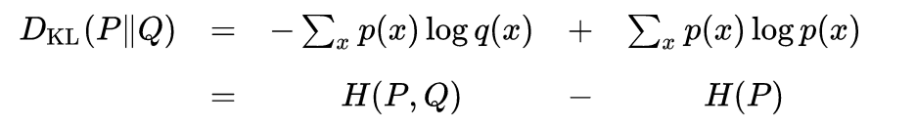
Understand Softmax classifier
Another interpretation of the cross entropy loss
Difference between P and Q as measured by Kullback-Leibler (KL) divergence
Cross entropy of P and Q
Entropy of P H(P) = 0 in this case
Notes:
Min with respect to W

Slide 15
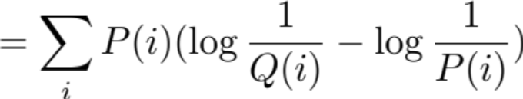

KL Divergence
Measure how one probability distribution is different from the other
; Equality holds iff P=Q almost everywhere

Slide 16
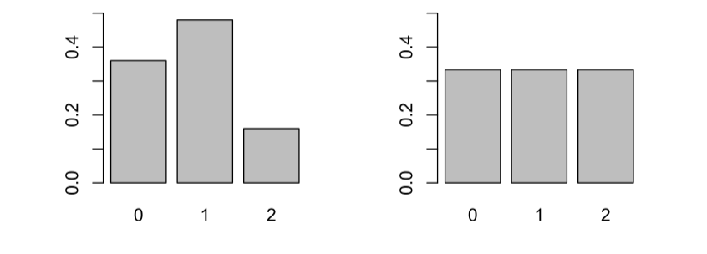
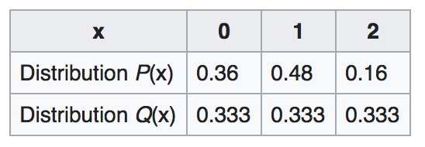
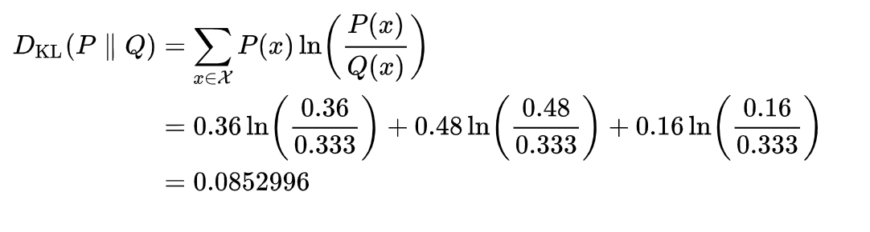
KL Divergence
Is it true:
Notes:
It is not true; in general D(P||Q ) and D(Q|| P) are different.

Slide 17
Linear classifier - Summary
The entire loss for N training samples (x_{i}, y_{i}):
We determine W to minimize this loss given the training dataset
After learning of the parameter W, do not need the training data in deployment

Slide 18

backup

Slide 19
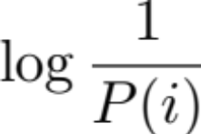
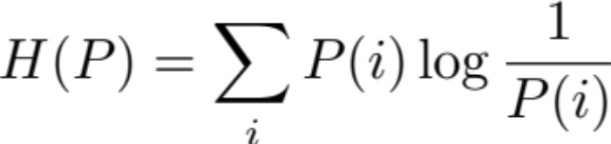
Probability, self information, entropy
P = (0,1)
P = (0.4,0.6)
Self information=
Fail Pass
Fail Pass
Information theoretic entropy = average amount of information an observer would gain when sampling a random variable
Rare event has more information
Information ~= “surprise”
bit if base 2; nat for base e

Slide 20
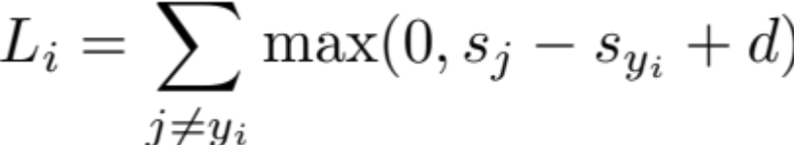
Multiclass SVM loss
SVM loss: The correct class has a score higher than the incorrect class by some fixed margin d
For this test image i, zero score contributed by class j iff
0 >= s_{j} – s_{yi} + d
s_{yi} >= s_{j} + d
Correct class score s_{yi} is higher than class j score s_{j} by at least d
(otherwise, +ve. contribution of loss from class j)

Slide 21
Multiclass SVM loss
S = [13,-7,11]
y_{i}= 1
d=10
L_{i} = max(0, -7-13+10) + max(0, 11-13+10)
= 0 + 8
Ground-truth score 13 is higher than -7 by more than the margin d=10
Ground-truth score 13 is not higher than 11 by d=10
Train W so that the correct class y_{i} has a score higher than the incorrect classes by at least d
For test image i

Slide 22



Softmax classifier in binary classification
f₀
f₁
p₀
p₁
x
w₀, w₁
softmax
Softmax output:
Equivalent design with sigmoid
x
w₁-w₀
f
sigmoid
p

Slide 23
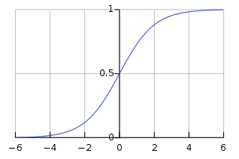

Sigmoid

Slide 24
Softmax classifier
Cross-entropy loss (apply –log(.) to only the ground-truth class):
For the i-th training sample
10
63
Example: a dog (which does not look like a dog)
5
70
print(f)
print(np.exp(f))
print(np.exp(f) / sum(np.exp(f)))
[ 112.1 110.6 -5.45]
[ 4.83516636e+48 1.07887144e+48 4.29630469e-03]
[ 8.17574476e-01 1.82425524e-01 7.26458780e-52]
y_{i}=2
L_{i} = -log(0.182) = 1.7
Probability

