Slide 1
CNN Architectures

Slide 2
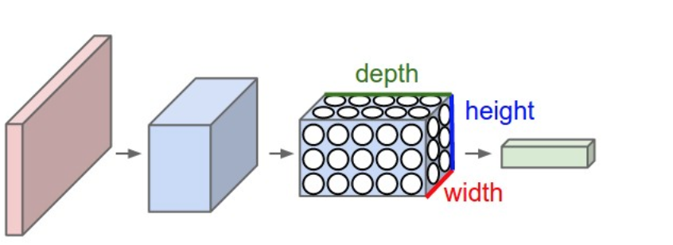
CNN
3D volumes of neurons
Stack of
  Convolutional layer
  Fully connected layer
  Pooling layer
Input: width x height x numChannel
Output: 1 x 1 x numClass

Slide 3
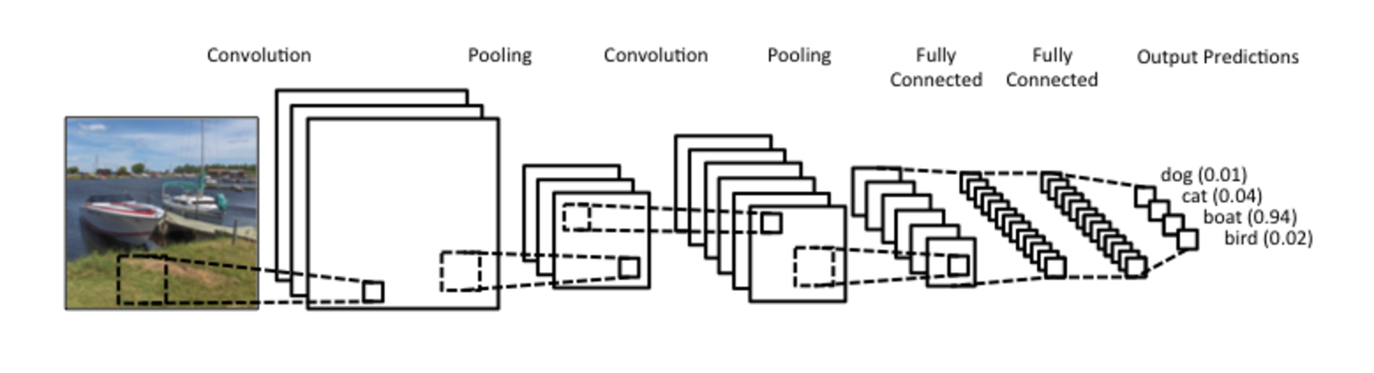
CNN
One example
Stack of
  Convolutional layer
  Fully connected layer
  Pooling layer
Depth
Input:
width x height x numChannel
Output:
1 x 1 x numClass

Slide 4
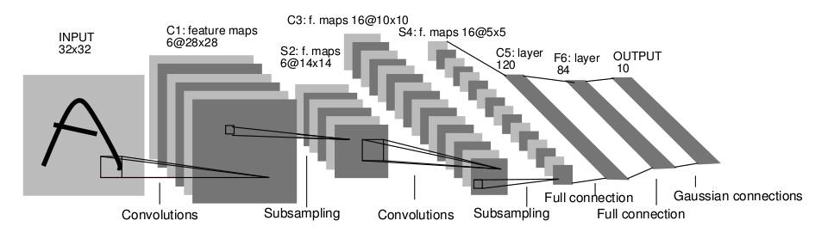
CNN Architecture
LeNet for character recognition
-Average pooling
-Sigmoid or tanh nonlinearity
-Trained on MNIST digit dataset (60K training examples)
Y. LeCun, L. Bottou, Y. Bengio, and P. Haffner,
Gradient-based learning applied to document recognition, Proc. IEEE 86(11): 2278–2324, 1998

Slide 5
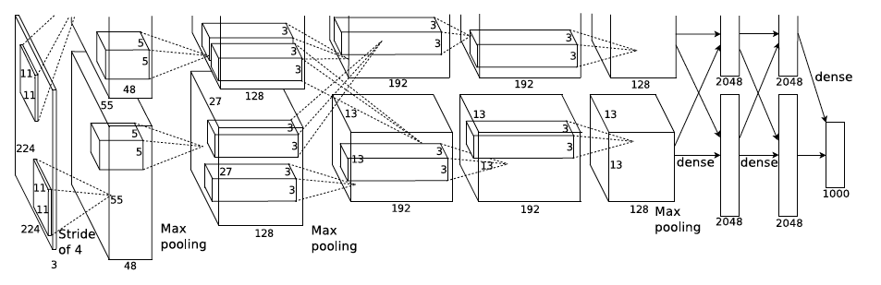
CNN Architecture
AlexNet for image recognition
-8 layers, 650K neurons, 60M parameters
-Max pooling, ReLU nonlinearity
-1.2M training images of 1000 classes
A. Krizhevsky, I. Sutskever, and G. Hinton, ImageNet Classification with Deep Convolutional Neural Networks, NIPS 2012

Slide 6
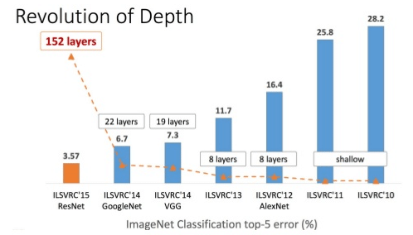
CNN Architecture

Slide 7
Inception module and GoogLeNet
Filter size: hyperparameter
What is the right filter size?
Inception module
  Use filters of different size in the same layer
  Concatenate all the filter results as output
  Use 1x1 convolution to reduce complexity
  Increase width and depth of the network
  All convolutions use ReLU, including 1x1 convolution for reduction / projection
Christian Szegedy, Wei Liu, Yangqing Jia, Pierre Sermanet, Scott Reed, Dragomir Anguelov, Dumitru Erhan, Vincent Vanhoucke, Andrew Rabinovich, “Going Deeper with Convolutions,” CVPR 2015

Slide 8
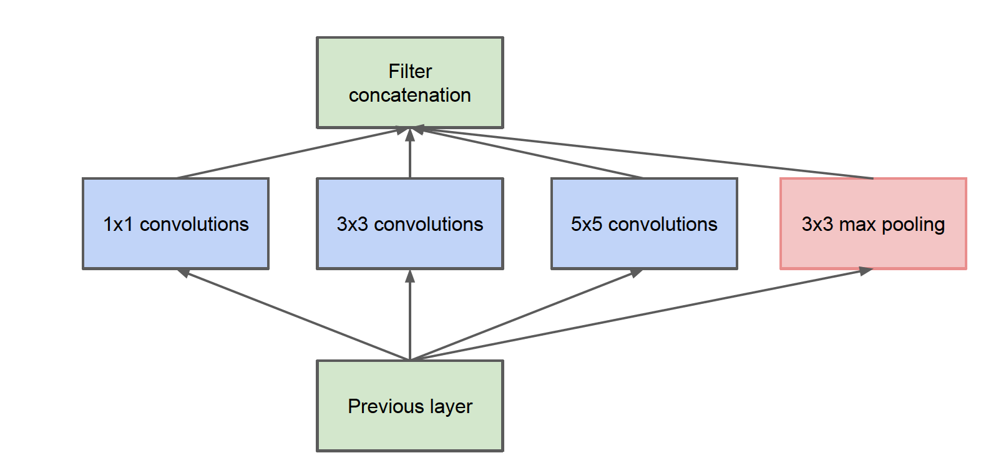
Inception module and GoogLeNet
Inception module, naïve version
Computation expensive: 28x28x192 input, need 5x5x192 filtering

Slide 9
Inception module and GoogLeNet
1x1 convolution for dimensionality reduction: reduce number of channels
1x1xC1
HxWx1
HxWxC1
(stride = 1)
[Lin et al.; 2014]
-With C2 filters (1x1xC1 each), output HxWxC2; usually C2 < C1
-Followed by non-linear as in ordinary convolution

Slide 10
Inception module and GoogLeNet
1x1 convolution for dimensionality reduction
Conv 5x5x192; 32
28x28x192
28x28x32
Computation: (5x5x192x28x28)x32 = 120.4M
Computation: (1x1x192x28x28)x16 + (5x5x16x28x28)x32 = 12.4M
28x28x192
28x28x16
28x28x32
Conv 1x1x192; 16
Conv 5x5x16; 32

Slide 11
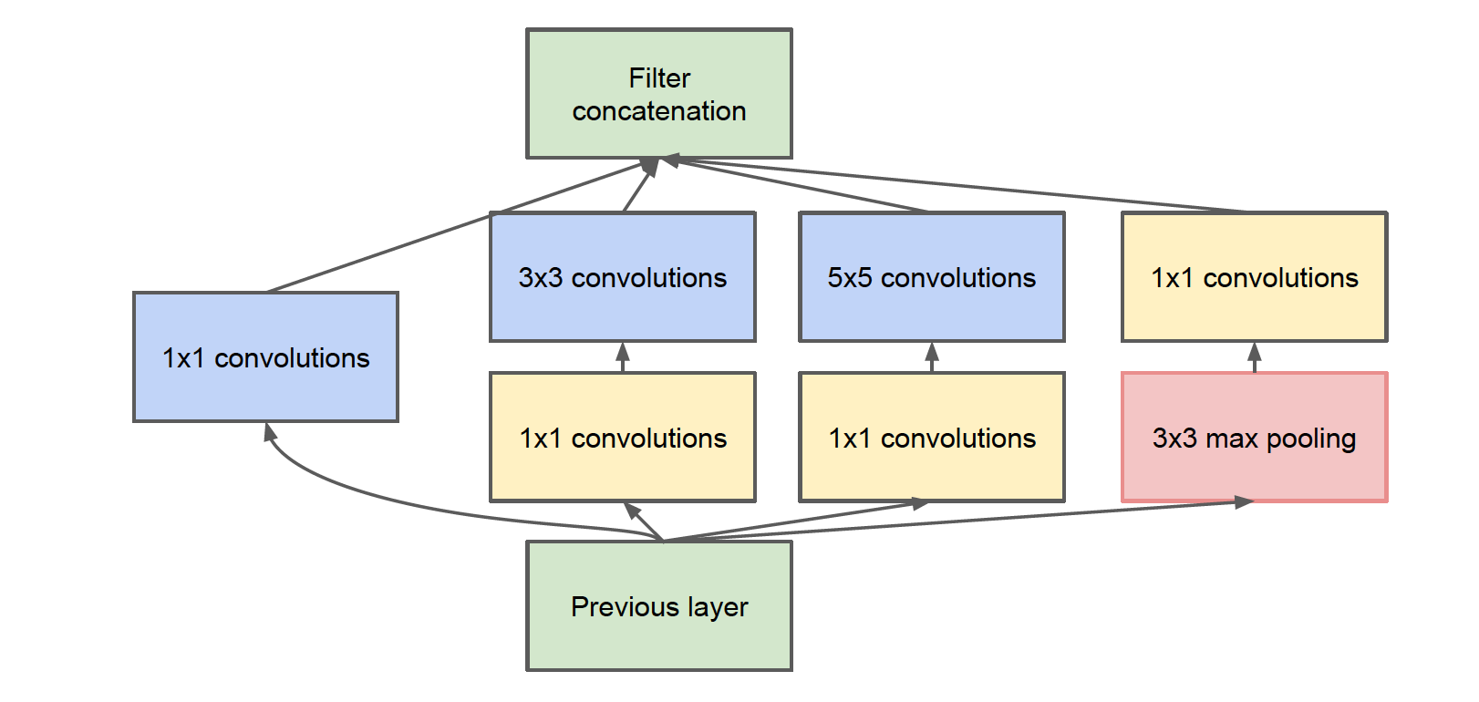
Inception module and GoogLeNet
Inception module with dimensionality reduction

Slide 12
Inception module and GoogLeNet
Inception module with dimensionality reduction
28x28x256 output
inception 3a
28x28x32
28x28x64
28x28x128
28x28x32
3x3x96;128
5x5x16;32
1x1x192;32
28x28x96
28x28x16
28x28x192
1x1x192; 64
1x1x192; 96
1x1x192; 16
28x28x192 input

Slide 13
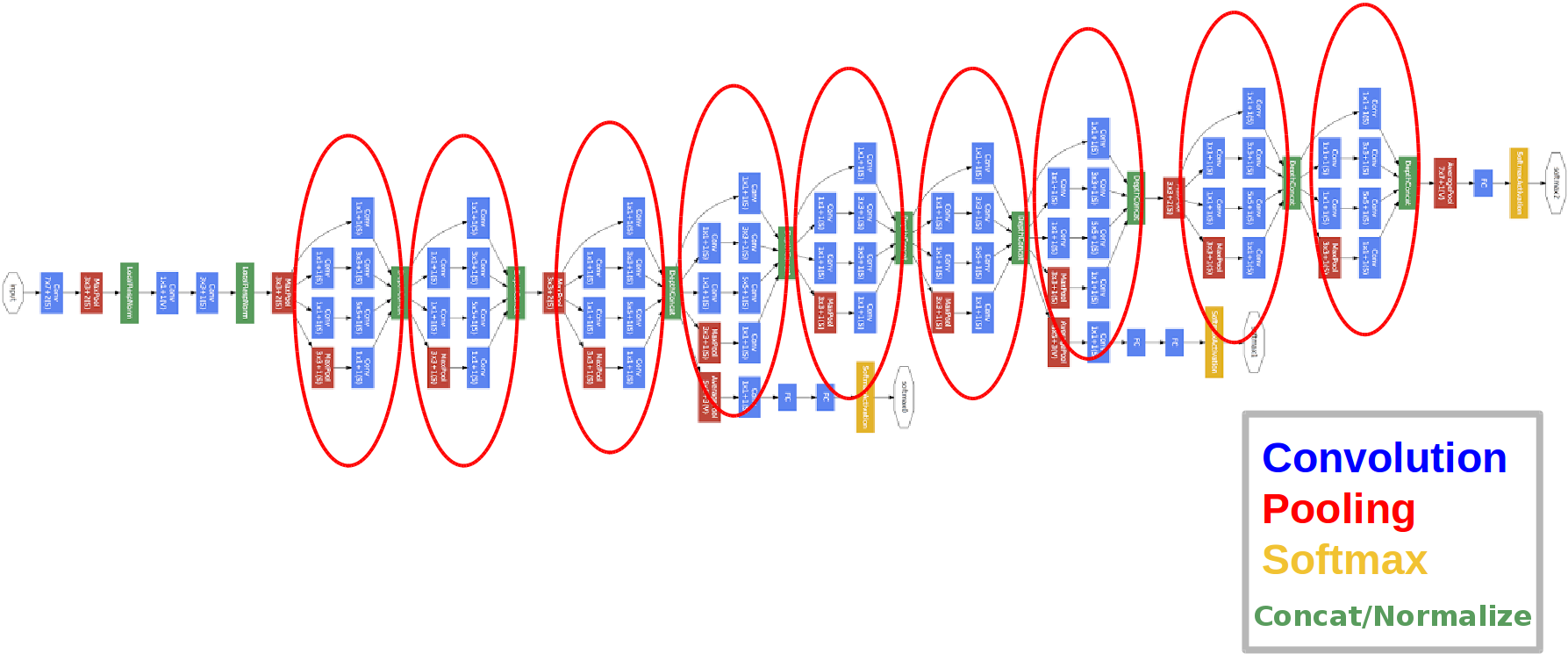
Inception module and GoogLeNet
GoogLeNet

