Slide 1
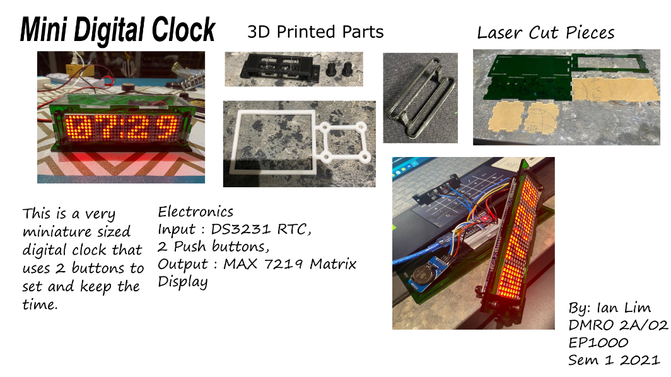
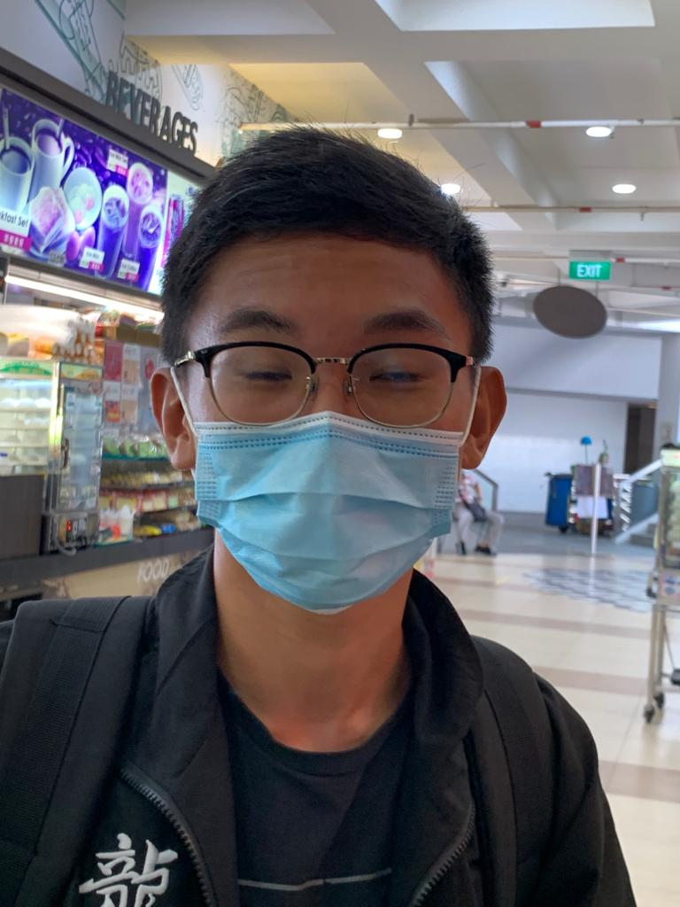
Mini Digital Clock
Ian Lim
DMRO Yr 2
2021 Sem 1
MAX7219 Matrix Display
Uses buttons to set time, and rtc module to keep time
Notes:
Do not change the size of fonts, spacing etc.
To create the rounded selfie image for insertion, please follow the instructions from this site:
How to Crop an Imange into a circle (https://www.avantixlearning.ca/microsoft-powerpoint/how-to-crop-an-image-to-a-circle-in-powerpoin
Scale your selfie to the circle. Use the rounde black border as a frame.
Enter in the space on the left of your selfie your
Full Name
Course e.g. DEEE, DBNS, DBE and year of study
The current year and semester e.g. 2021 Sem 1
Insert the image of your presentation slide on the right, scale it. Use the black borders as a frame
Enter 3~4 important points, features or applications of the project you have created.

Slide 2
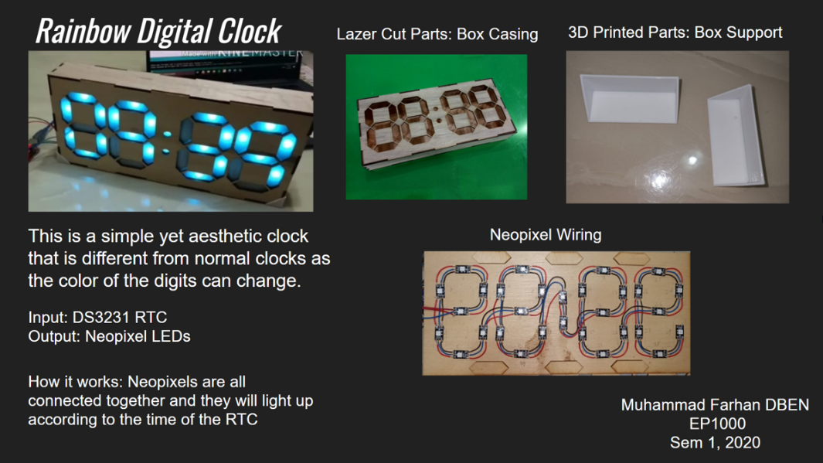

Rainbow Digital Clock
Alfred E Neuman
DEEE Yr 2
2021 Sem 1
Large 7-segment display
Uses WS2818 Neopixel RGB LEDs
Time accuracy using Real-time Clock
Changes colors during the day
Notes:
Do not change the size of fonts, spacing etc.
To create the rounded selfie image for insertion, please follow the instructions from this site:
How to Crop an Imange into a circle (https://www.avantixlearning.ca/microsoft-powerpoint/how-to-crop-an-image-to-a-circle-in-powerpoin
Scale your selfie to the circle. Use the rounde black border as a frame.
Enter in the space on the left of your selfie your
Full Name
Course e.g. DEEE, DBNS, DBE and year of study
The current year and semester e.g. 2021 Sem 1
Insert the image of your presentation slide on the right, scale it. Use the black borders as a frame
Enter 3~4 important points, features or applications of the project you have created.

