Slide 1
All about Hadoop
企業智慧系統設計養成班 – YB801
07 June, 2014 - 10 June, 2014
講師： Ian Yu-Hsun Lin
Henry Hung-Hsien Lin
^{『經濟部工業局暨國際軟體人培育計畫』}

Slide 2
Prerequisite
Install VirtualBox
Import Cloudera VM CDH 4.6
Clone sample codes repository
  $ git clone https://github.com/ianlin/small-data.git

Slide 3
Agenda
Day 1
  Hadoop Ecosystem Introduction
  Hadoop Cluster Setup
  Open Data / API Introduction
  ETL Introduction
Day 2
  ETL Hands On
  HDFS Introduction
  MapReduce Introduction
Day 3
  MapReduce Hands On
  Pig Introduction and Hands On
Day 4
  Hive Introduction and Hands On
  Q & A

Slide 4
Agenda
Day 1
  Hadoop Ecosystem Introduction
  Hadoop Cluster Setup
  Open Data / API Introduction
  ETL Introduction
Day 2
  ETL Hands On
  HDFS Introduction
  MapReduce Introduction
Day 3
  MapReduce Hands On
  Pig Introduction and Hands On
Day 4
  Hive Introduction and Hands On
  Q & A

Slide 5
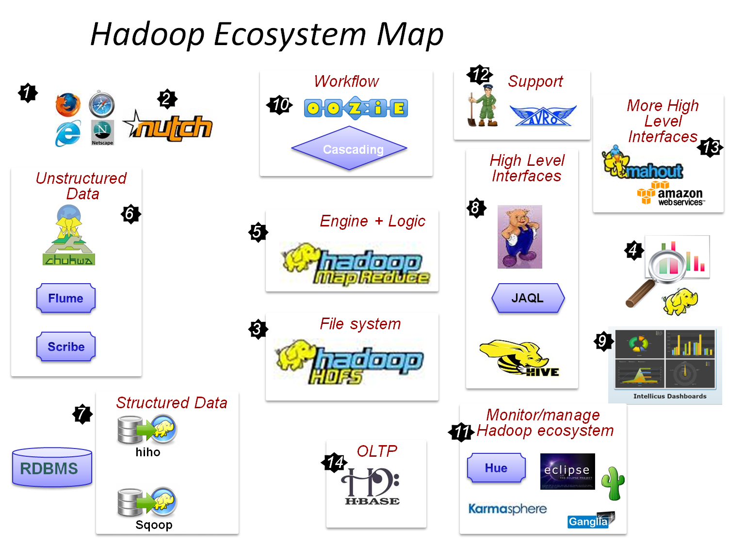
Hadoop Ecosystem Introduction
Members in Hadoop
Reference: http://indoos.files.wordpress.com/2010/08/hadoop_map1.png

Slide 6
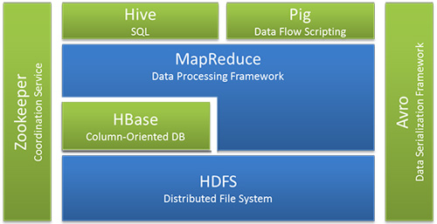
Hadoop Ecosystem Introduction
Members in Hadoop
Reference: http://united.softserveinc.com/img/tips/hadoop-ecosystem.jpg

Slide 7
Agenda
Day 1
  Hadoop Ecosystem Introduction
  Hadoop Cluster Setup
  Open Data / API Introduction
  ETL Introduction
Day 2
  ETL Hands On
  HDFS Introduction
  MapReduce Introduction
Day 3
  MapReduce Hands On
  Pig Introduction and Hands On
Day 4
  Hive Introduction and Hands On
  Q & A

Slide 8
Hadoop Cluster Setup
Different Mode
Local (Standalone) Mode
Pseudo-Distributed Mode
Fully-Distributed Mode

Slide 9
Hadoop Cluster Setup
Local (Standalone) Mode
Non-distributed mode, as a single Java process
Useful for debugging
  hadoop-2.2.0/bin/hadoop jar hadoop-2.2.0/share/hadoop/mapreduce/hadoop-mapreduce-examples-2.2.0.jar wordcount input output

Slide 10
Hadoop Cluster Setup
Pseudo-Distributed Mode
Install a clean Linux
  Recommended RedHat/CentOS or Ubuntu
Download and install a stable Apache Hadoop release
Configuration
  core-site.xml
    fs.defaultFS
      hdfs://localhost.localdomain:8020
  hdfs-site.xml
    dfs.replication
      1
  mapred-site.xml
    mapred.job.tracker
      localhost:8021

Slide 11
Hadoop Cluster Setup
Pseudo-Distributed Mode – Cont.
Passphraseless SSH
  $ ssh-keygen -t dsa -P '' -f ~/.ssh/id_dsa
  $ cat ~/.ssh/id_dsa.pub >> ~/.ssh/authorized_keys
Format HDFS
  bin/hdfs namenode –format
Start all daemons
  bin/start-all.sh

Slide 12
Hadoop Cluster Setup
Fully-Distributed Mode
tl;dr
http://hadoop.apache.org/docs/stable/hadoop-project-dist/hadoop-common/ClusterSetup.html

Slide 13
Hadoop Cluster Setup
Cloudera CDH 4.6
Automates the installation and configuration of CDH on an entire cluster
  Setup SSH passphrase
  Configure Parcel/Package repositories
  Install Cloudera Manager Agent, CDH, Impala and Oracle JDK
  Determine mapping of services to hosts
  Suggest a Hadoop configuration and start services
All actions are performed via web UI

Slide 14
Hadoop Cluster Setup
Other Hadoop distributions
Hortonworks
  Open source
Etu Solutions
  Taiwan based Big Data solution provider

Slide 15
Agenda
Day 1
  Hadoop Ecosystem Introduction
  Hadoop Cluster Setup
  Open Data / API Introduction
  ETL Introduction
Day 2
  ETL Hands On
  HDFS Introduction
  MapReduce Introduction
Day 3
  MapReduce Hands On
  Pig Introduction and Hands On
Day 4
  Hive Introduction and Hands On
  Q & A

Slide 16
Open Data / API Introduction
Why Open Data ?
Innovation
Avoid duplicated effort
Cooperation Union
Transparency and democratic control
Measurement of Policies

Slide 17
Open Data / API Introduction
What is API ?
Application
Programming
Interface

Slide 18
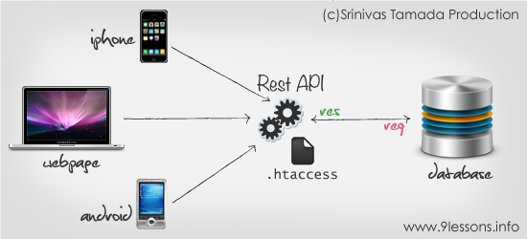
Open Data / API Introduction
What is API ?
Reference: www.9lessons.info

Slide 19
Open Data / API Introduction
API - SOAP
SOAP, Simple Object Access Protocol
  XML based
  Rigid ( Type Handling )
  Complexity

Slide 20
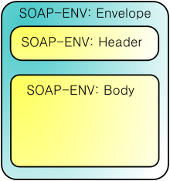
Open Data / API Introduction
API - SOAP

Slide 21
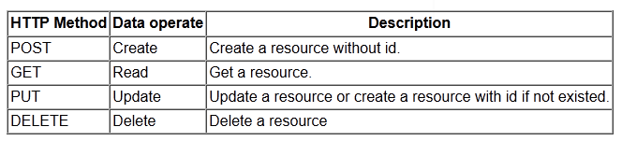
Open Data / API Introduction
API - REST
REST – Representational State Transfer
  Lightweight
  Standard-less
  Flexibility & Simplicity

Slide 22
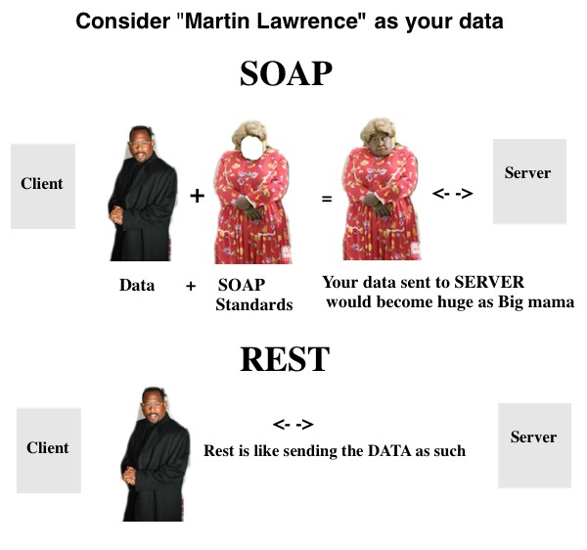
Open Data / API Introduction
API – SOAP v.s. REST
Reference: stackoverflow.com

Slide 23

Open Data / API Introduction
Common Format Used in API
Reference: devcentral.f5.com

Slide 24
Open Data / API Introduction
Common Format Used in API
JSON
  userinfo={“user”:{“id”: “1”, “name”: “Ian”}}
XML
  <?xml version=“1.0”?>
  <userinfo>
  <user>
  <id>1</id>
  <name>Ian</name>
  </user>
  </userinfo>

Slide 25
Open Data / API Introduction
Tools for Implement API
Tools
  Any programming language which has HTTP library
    CURL
    PHP
    Python
    Etc…
Python
  Fairly powerful and easy to learn

Slide 26
Open Data / API Introduction
Open API Example
Taipei City Open Data
  http://data.taipei.gov.tw/opendata
UK Government Open Data
  http://data.gov.uk/

Slide 27
Agenda
Day 1
  Hadoop Ecosystem Introduction
  Hadoop Cluster Setup
  Open Data / API Introduction
  ETL Introduction
Day 2
  ETL Hands On
  HDFS Introduction
  MapReduce Introduction
Day 3
  MapReduce Hands On
  Pig Introduction and Hands On
Day 4
  Hive Introduction and Hands On
  Q & A

Slide 28
ETL Introduction
What is ETL?
Extracts data from different sources
  Existed application
  Logs
  Web data
  Web API
Transforms data to fit operational needs
  Eliminates unnecessary data
  Keeps useful information
  Sorting
  Generates commonly used output (JSON, CSV, etc.)
  Etc…
Loads data into the end target
  Database

Slide 29
ETL Introduction
Extract / Transform
API
  Provided by website itself
  Standardised way to get data programmatically
Web Scraping
  A technique of extract information from websites
  Adopted by most search engines
  Typically parse data in HTML format

Slide 30
ETL Introduction
Extract / Transform – API DEMO
get_opendata_tpe.py
  Calls API by GET method to get the result in JSON format
  Removes things we don’t need
  Keeps things we need
  Generates output in CSV format
Demo
  Public toilet
  Store discounts
  Companies in NeiHu

Slide 31
ETL Introduction
Load
Hadoop File System Shell
WebHDFS
Sqoop

Slide 32
ETL Introduction
Load – Hadoop File System Shell
Copy file to HDFS
  copyFromLocal
    # hdfs dfs -copyFromLocal local_file remote_file
  put
    # hdfs dfs -put local_file remote_file
    Read from stdin
      # echo ‘file content’ | hdfs dfs -put - remote_file
http://hadoop.apache.org/docs/r2.4.0/hadoop-project-dist/hadoop-common/FileSystemShell.html

Slide 33
ETL Introduction
Load – WebHDFS : Create File
Create and write to a file
  2 Steps
    Get datanode url
    Upload file to datanode

Slide 34
ETL Introduction
Load – WebHDFS : Create File : Step 1
curl -i -s -X PUT “http://localhost:50070/webhdfs/v1/user/cloudera/band_charts.from_webhdfs?user.name=cloudera&op=CREATE”

Slide 35
ETL Introduction
Load – WebHDFS : Create File : Step 1
HTTP/1.1 307 TEMPORARY_REDIRECT
Cache-Control: no-cache
Expires: Thu, 01-Jan-1970 00:00:00 GMT
Date: Thu, 09 Jan 2014 15:21:43 GMT
Pragma: no-cache
Date: Thu, 09 Jan 2014 15:21:43 GMT
Pragma: no-cache
Content-Type: application/octet-stream
Set-Cookie: hadoop.auth="u=cloudera&p=cloudera&t=simple&e=1389316903004&s=NtJcMTlXJdACtfquJHqBDycFtgI=";Path=/
Location: http://localhost.localdomain:50075/webhdfs/v1/user/cloudera/band_charts.from_webhdfs?op=CREATE&user.name=cloudera&namenoderpcaddress=0.0.0.0:8020&overwrite=false
Content-Length: 0
Server: Jetty(6.1.26.cloudera.2)

Slide 36
ETL Introduction
Load – WebHDFS : Create File : Step 2
curl -i -s -X PUT –T band_charts “http://localhost.localdomain:50075/webhdfs/v1/user/cloudera/band_charts.from_webhdfs?op=CREATE&user.name=cloudera&namenoderpcaddress=0.0.0.0:8020&overwrite=false”

Slide 37


ETL Introduction
Load – Sqoop
Sqoop is a tool to transfer data
between Hadoop and RDBMS such as MySQL or Oracle.

Slide 38
ETL Introduction
Load – Sqoop
Normal import
  sqoop import --connect "jdbc:mysql://localhost/hadoop" --table user --username cloudera -P -m 1
Specify the destination folder
  sqoop import --connect "jdbc:mysql://localhost/hadoop" --table user --username cloudera -P --target-dir user2 -m 1
Select the data to import – WHERE argument
  sqoop import --connect "jdbc:mysql://localhost/hadoop" --table user --where "id <= 3" --username cloudera -P --target-dir user3 -m 1

Slide 39
ETL Introduction
Load – Sqoop
Free-form query imports
  sqoop import --connect "jdbc:mysql://localhost/hadoop" --username cloudera -P --target-dir user4 --query 'select id, name from user where id <= 3 AND $CONDITIONS' -m 1
Split
  sqoop import --connect "jdbc:mysql://localhost/hadoop" --table big_table --username cloudera -P --split-by name --target-dir big_table_1

Slide 40
ETL Introduction
Load – Sqoop
Import data to Hive
  sqoop import --connect "jdbc:mysql://localhost/hadoop" --table user --username cloudera -P --hive-import -m 1 --target-dir test (--hive-table table1)
Impor data to Hbase
  sqoop import --connect "jdbc:mysql://localhost/hadoop" --table user --username cloudera -P --hbase-table test_table --column-family info --hbase-create-table (--columns id,name,mobile)
Import all tables
  sqoop import-all-tables --connect "jdbc:mysql://localhost/hadoop" --username cloudera -P

Slide 41
Agenda
Day 1
  Hadoop Ecosystem Introduction
  Hadoop Cluster Setup
  Open Data / API Introduction
  ETL Introduction
Day 2
  ETL Hands On
  HDFS Introduction
  MapReduce Introduction
Day 3
  MapReduce Hands On
  Pig Introduction and Hands On
Day 4
  Hive Introduction and Hands On
  Q & A

Slide 42
ETL Hands On
Find a topic you are interested on any website have open data API
Extract the data using API programmatically
Transform the data you get
Load data into HDFS

Slide 43
Agenda
Day 1
  Hadoop Ecosystem Introduction
  Hadoop Cluster Setup
  Open Data / API Introduction
  ETL Introduction
Day 2
  ETL Hands On
  HDFS Introduction
  MapReduce Introduction
Day 3
  MapReduce Hands On
  Pig Introduction and Hands On
Day 4
  Hive Introduction and Hands On
  Q & A

Slide 44
HDFS Introduction
Concept Overview
Hadoop Distributed File System
Block Size
Namenode – Metadata
Datanode – Replica
Namenode Web UI
  http://localhost:50070

Slide 45
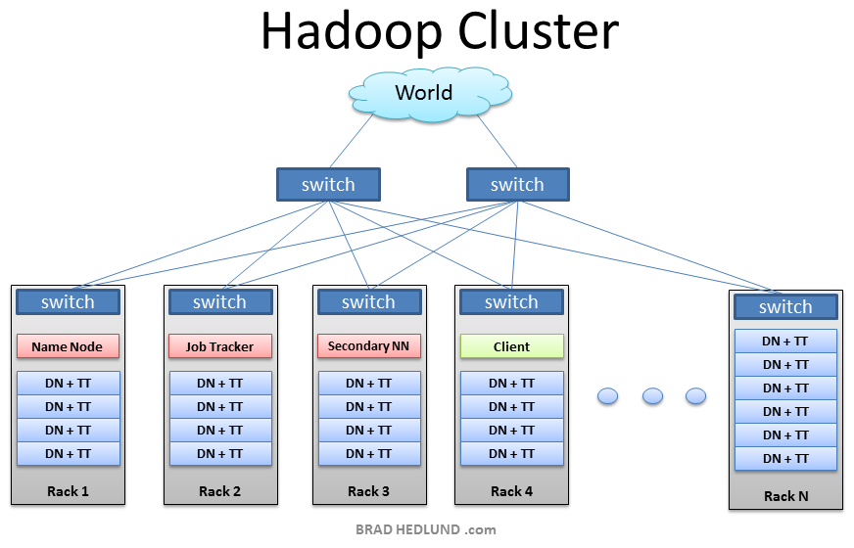
HDFS Introduction
Cluster Structure

Slide 46
HDFS Introduction
Rack Awareness
distance(/D1/R1/N1,/D1/R1/N1) = 0
distance(/D1/R1/N1,/D1/R1/N2) = 2
distance(/D1/R1/N1,/D1/R2/N3) = 4
distance(/D1/R1/H1,/D2/R3/N4) = 6

Slide 47
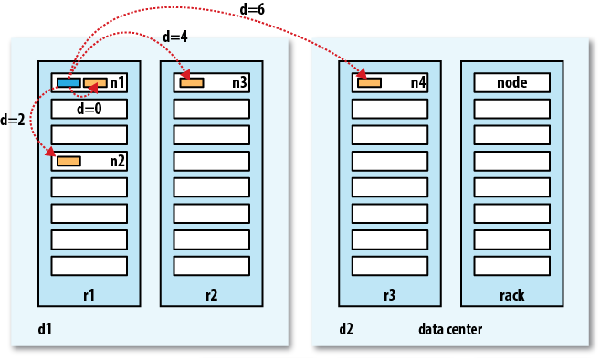
HDFS Introduction
Rack Awareness

Slide 48
HDFS Introduction
Configure Rack Awareness
Enable in core-site.xml
<property>
<name>topology.script.file.name</name> <value>/path/to/RackAware.py</value> </property>

Slide 49
HDFS Introduction
Rack Awareness Script
#!/usr/bin/python
#-*-coding:UTF-8 -*-
import sys
rack = {
"datanode-1.tw1":“/dc1/rack1",
"datanode-2.tw1":“/dc1/rack1",
"datanode-3.tw1":“/dc1/rack2",
"datanode-4.tw2":“/dc2/rack1",
"datanode-5.tw2":“/dc2/rack2",
"datanode-6.tw2":“/dc2/rack2”,
“10.1.1.101":“/dc1/rack1",
“10.1.1.102:“/dc1/rack1"
}
if __name__=="__main__":
print rack.get(sys.argv[1],“/rack0")

Slide 50
HDFS Introduction
Read and Write
Read Strategy
Write Strategy

Slide 51
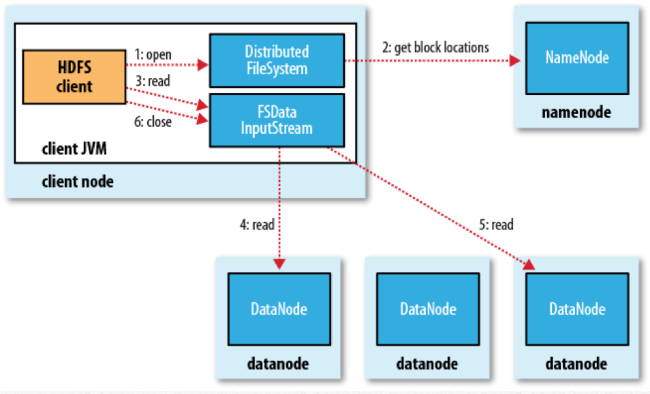
HDFS Introduction
Read Flow

Slide 52
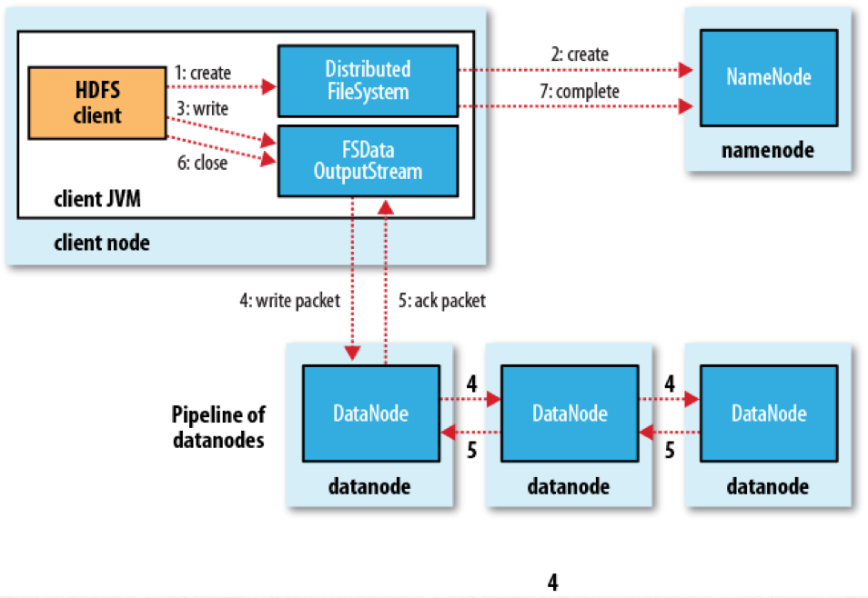
HDFS Introduction
Write Flow

Slide 53
Agenda
Day 1
  Hadoop Ecosystem Introduction
  Hadoop Cluster Setup
  Open Data / API Introduction
  ETL Introduction
Day 2
  ETL Hands On
  HDFS Introduction
  MapReduce Introduction
Day 3
  MapReduce Hands On
  Pig Introduction and Hands On
Day 4
  Hive Introduction and Hands On
  Q & A

Slide 54
MapReduce Introduction
Overview
A programming model for processing and generating large data sets with a parallel, distributed algorithm on a cluster
Mapping data sets into a collection of <key, value> pairs, then reducing over all pairs with the same keys

Slide 55
MapReduce Introduction
Input/Output Format
Map(k1,v1) → list(k2,v2)
Reduce(k2, list (v2)) → list(k3, v3)

Slide 56
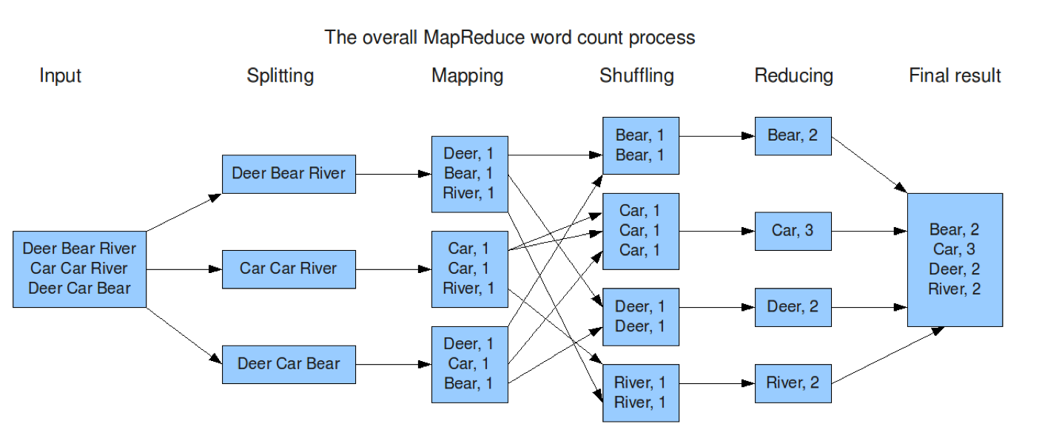
MapReduce Introduction
Workflow
Reference: http://hci.stanford.edu/courses/cs448g/a2/files/map_reduce_tutorial.pdf

Slide 57
MapReduce Introduction
Input Split
Divides the input into appropriate size 'splits’
  In practice typically 16 MB to 128 MB; a block size
The framework assigns one split to each Map function

Slide 58
MapReduce Introduction
Map
Takes a series of key/value pairs
Processes each key/value pair
Generates zero or more output key/value pairs

Slide 59
MapReduce Introduction
Combiner
A reduce-type function
Used when the map key-value pairs are not immediately written to the output
Reduce Mapper’s output size and network traffic
NOT all functions can use Combiner
  Calculating mean temperatures
    Mean(1, 3, 5, 7, 9) = 5, but
    mean(mean(1, 3, 5), mean(7, 9)) =
    mean(3, 8) = 5.5
Performs in many stages

Slide 60
MapReduce Introduction
Shuffle / Sort / Merge
Shuffle
  Allocate Mapper’s output to a particular Reducer by the application’s Partition function
  Default is to hash the key and use the hash value modulo the number of reducers
  Sort
  Map
    Before Mapper writes the output to disk (Spill)
      Run Combiner if specified
    During spill files are merging
  Reduce
    After all the map outputs have been copied
      Should properly be called Merge phase

Slide 61
MapReduce Introduction
Shuffle / Sort / Merge
Merge
  Map
    Merge spill files
      after Mapper has written its last output record
  Reduce
    Merge and spill Mapper’s output (Reducer’s input) when reaches a threshold size
    Merge files on disk into large, sorted files (background)
    After all the Mapper’s outputs have been copied

Slide 62
MapReduce Introduction
Reduce
Be called once for each unique key in the sorted order
Iterate through the values that are associated with that key
Produce zero or more outputs

Slide 63
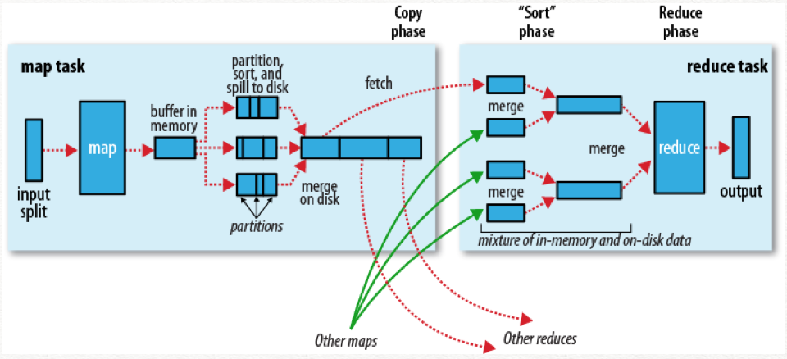
MapReduce Introduction
Detail Workflow
Reference: Hadoop: The Definite Guide Book

Slide 64
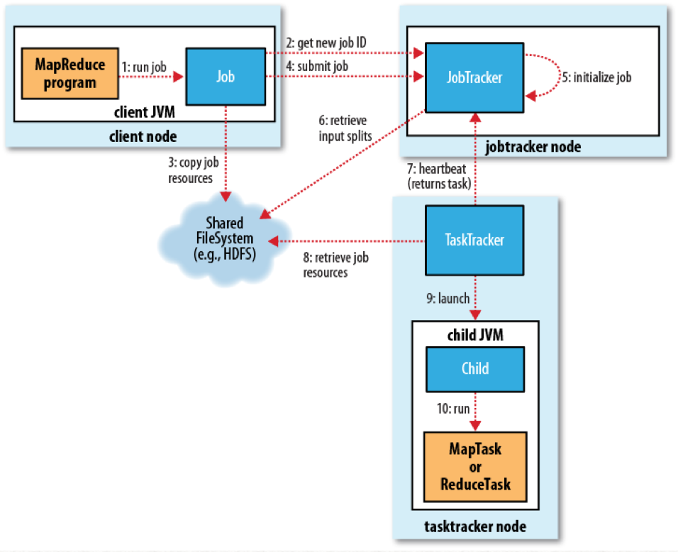
MapReduce Introduction
Framework (MRv1)
Reference: Hadoop: The Definite Guide Book

Slide 65
MapReduce Introduction
MRv1
JobTracker Web UI
  http://localhost:50030

Slide 66
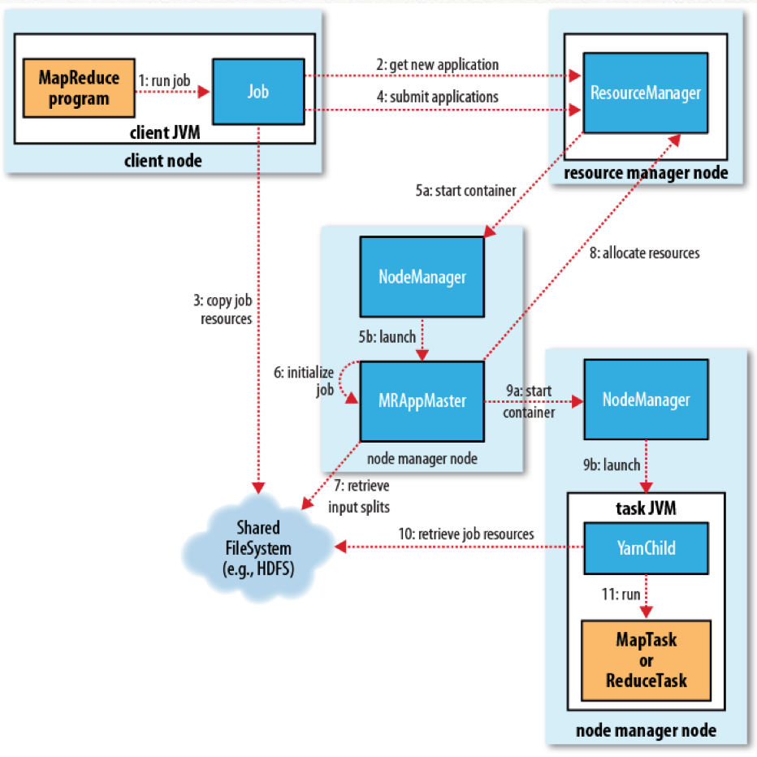
MapReduce Introduction
Framework (YARN)
Reference: Hadoop: The Definite Guide Book

Slide 67
MapReduce Introduction
Yarn
CDH 4.6 use MRv1 by default
How to enable YARN on CDH 4.6
  Go to YARN Configuration tab
  Search for “Alternatives Priority”
  Change the priority value to be higher than MRv1
    (MRv1 by default is set to 92)
  (Re)Start YARN service
  Redeploy the client configuration
Resource Manager Web UI
  http://localhost:8088
Node Manager Web UI
  http://localhost:50060

Slide 68
MapReduce Introduction
Java
Demo

Slide 69
MapReduce Introduction
Streaming (Python)
Demo

Slide 70
Agenda
Day 1
  Hadoop Ecosystem Introduction
  Hadoop Cluster Setup
  Open Data / API Introduction
  ETL Introduction
Day 2
  ETL Hands On
  HDFS Introduction
  MapReduce Introduction
Day 3
  MapReduce Hands On
  Pig Introduction and Hands On
Day 4
  Hive Introduction and Hands On
  Q & A

Slide 71
MapReduce Hands On

Slide 72
Agenda
Day 1
  Hadoop Ecosystem Introduction
  Hadoop Cluster Setup
  Open Data / API Introduction
  ETL Introduction
Day 2
  ETL Hands On
  HDFS Introduction
  MapReduce Introduction
Day 3
  MapReduce Hands On
  Pig Introduction and Hands On
Day 4
  Hive Introduction and Hands On
  Q & A

Slide 73
Pig Introduction and Hands On
Overview
A high-level platform for creating MapReduce programs used with Hadoop
Grunt
Pig Latin
Piggybank
Execution
  $ pig -x local
  $ pig -x mapreduce (default)

Slide 74
Pig Introduction and Hands On
Data Structure
Tuple
  (radiohead, 3)
Relation
  (radiohead, 1)
  (radiohead, 8)
  (pinkfloyd, 2)
  (pinkfloyd, 3)
  (oasis, 2)
  (oasis, 5)
Bag
  (radiohead, {(radiohead, 1), (radiohead, 8)})
  (pinkfloyd, {(pinkfloyd, 2), (pinkfloyd, 3)})
  (oasis, {(oasis, 2), (oasis, 5)})

Slide 75
Pig Introduction and Hands On
Example
orig_records = LOAD 'input/band_charts.csv’
AS (band:chararray, album:chararray, score:int);
bands_has_winner = FILTER orig_records BY score == 1;
grouped_bands = GROUP bands_has_winner BY band;
best_band = FOREACH grouped_bands GENERATE group, COUNT(bands_has_winner.score) AS times;
--best_band2 = ORDER best_band BY times, group
DUMP best_band;
--STORE best_band INTO 'output/best_band_ans' USING PigStorage();

Slide 76
Pig Introduction and Hands On
JOIN
row_user_login = load '/home/cloudera/small-data/data-analysis/data/test_user_login' as (uuid:chararray, name:chararray, password:chararray);
row_user_data = load '/home/cloudera/small-data/data-analysis/data/test_user_data' as (uuid:chararray, email:chararray, iq:int, score:int);
--DUMP row_user_login;
--DUMP row_user_data;
after_join = JOIN row_user_login BY uuid RIGHT OUTER, row_user_data BY uuid;
DUMP after_join;

Slide 77
Pig Introduction and Hands On
Macro
IMPORT 'my_macro.pig';
DEFINE my_macro(A, sortkey) RETURNS C {
B = FILTER $A BY my_filter(*);
$C = ORDER B BY $sortkey;
}
X = my_macro(orig_relation, id);
STORE X INTO 'output';

Slide 78
Pig Introduction and Hands On
UDF (User Defined Function)
Python
Register 'test.py' using org.apache.pig.scripting.jython.JythonScriptEngine as myfuncs;
b = foreach a generate myfuncs.uppercase(name), myfuncs.normalise(phone);
JAVA
REGISTER myudfs.jar;
b = foreach a generate myudfs.uppercase(name), myudfs.normalise(phone);

Slide 79
Pig Introduction and Hands On
Hands On

Slide 80
Agenda
Day 1
  Hadoop Ecosystem Introduction
  Hadoop Cluster Setup
  Open Data / API Introduction
  ETL Introduction
Day 2
  ETL Hands On
  HDFS Introduction
  MapReduce Introduction
Day 3
  MapReduce Hands On
  Pig Introduction and Hands On
Day 4
  Hive Introduction and Hands On
  Q & A

Slide 81
Hive Introduction and Hands On
Overview
A data warehouse infrastructure built on top of Hadoop for providing data summarization, query, and analysis
SQL-like syntax
Schema on Read

Slide 82
Hive Introduction and Hands On
Example
select band, count(*) as cnt from band_charts where rank=1 group by band order by cnt desc;

Slide 83
Hive Introduction and Hands On
Partition
CREATE TABLE logs_p (ts BIGINT, line STRING)
PARTITIONED BY (dt STRING, country STRING)
ROW FORMAT DELIMITED
FIELDS TERMINATED BY ',';
LOAD DATA LOCAL INPATH '/home/cloudera/henry/testdata/fakelog2.log'
OVERWRITE INTO TABLE logs_p
PARTITION (dt='2014-02-07', country='CN');

Slide 84
Hive Introduction and Hands On
Bucket
CREATE TABLE logs_b0 (id INT, name STRING)
CLUSTERED BY (id) SORTED BY (id ASC) INTO 2 BUCKETS
ROW FORMAT DELIMITED
FIELDS TERMINATED BY ',';
CREATE TABLE logs_b1 (id INT, name STRING)
CLUSTERED BY (id) SORTED BY (id ASC) INTO 2 BUCKETS
ROW FORMAT DELIMITED
FIELDS TERMINATED BY ',';
SET hive.enforce.bucketing=true;
LOAD DATA LOCAL INPATH '/home/cloudera/henry/testdata/fakelog3.log'
OVERWRITE INTO TABLE logs_b0;
INSERT OVERWRITE TABLE logs_b1
SELECT * FROM logs_b0;

Slide 85
Hive Introduction and Hands On
Sampling
SELECT * FROM bucketed_users
TABLESAMPLE(BUCKET 1 OUT OF 2 ON id)

Slide 86
Hive Introduction and Hands On
Multiple Insert
FROM final_result
INSERT OVERWRITE TABLE grp1
SELECT id, name, SUM(score)
GROUP BY id
INSERT OVERWRITE TABLE grp2
SELECT id, count(1)
GROUP BY id;

Slide 87
Hive Introduction and Hands On
CTAS (Create Table As Select)
CREATE TABLE tmp
AS
SELECT id, name
FROM orig_data;

Slide 88
Hive Introduction and Hands On
Transform (TAB Delimiter)
ADD FILE '/home/cloudera/henry/testdata/age_filter_gt_25.py'
FROM orig_data
SELECT TRANSFORM( user, score, age )
USING 'age_filter_gt_25.py'
AS user, score;

Slide 89
Hive Introduction and Hands On
MapReduce (TAB Delimiter)
ADD FILE '/home/cloudera/henry/testdata/my_maper.py'
ADD FILE '/home/cloudera/henry/testdata/my_reducer.py'
FROM (
FROM table
MAP table.f1 table.f2
USING 'my_maper.py’
AS mp1, mp2
CLUSTER BY mp1
) map_output
INSERT OVERWRITE TABLE result
REDUCE map_output.mp1, map_output.mp2
USING 'my_reducer.py’
AS reducef1, reducef2;

Slide 90
Hive Introduction and Hands On
Hands On

Slide 91
Agenda
Day 1
  Hadoop Ecosystem Introduction
  Hadoop Cluster Setup
  Open Data / API Introduction
  ETL Introduction
Day 2
  ETL Hands On
  HDFS Introduction
  MapReduce Introduction
Day 3
  MapReduce Hands On
  Pig Introduction and Hands On
Day 4
  Hive Introduction and Hands On
  Q & A

Slide 92
Thanks

