Slide 1
NodeJS, the Joomla Framework, and the Future
Ian MacLENNAN

Slide 2
About ME
Various roles with the Joomla! Project since 2005/2006 including:
Developer Documentation Team Leader
Bug Squad Co-maintainer
1.5 Release Maintainer
Production Working Group Leadership Team Member
Joomla Platform/Framework Maintainer

Slide 3
Introduction
Brief History of the World Wide Web
Why APIs?
Example / DEMO
Questions

Slide 4
A Brief HISTORY OF THE WEB (WITH PICTURES)
The web used to be…
A collection of HTML files, scattered with images, icons and logos
Primarily Passive – you could click on links to other pages, but things were mostly static
Creating content was hard

Slide 5
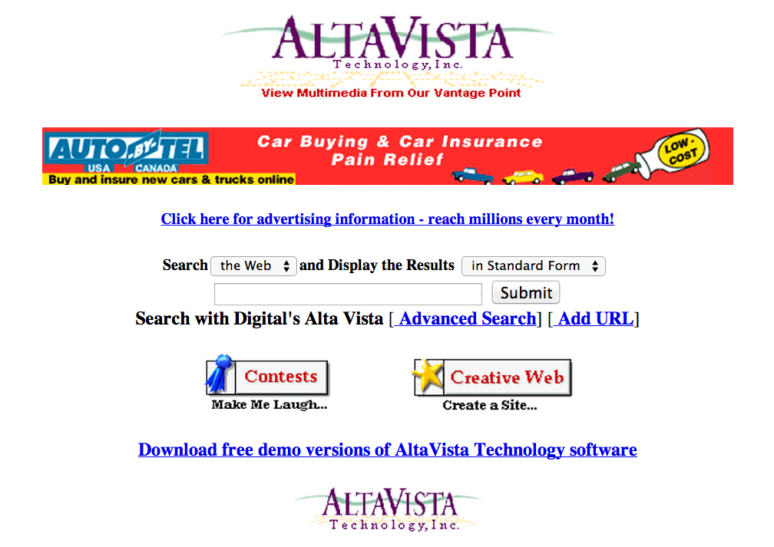
ALTAVISTA

Slide 6
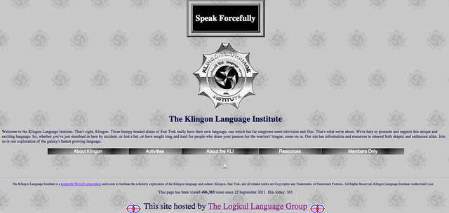
KLINGON LANGUAGE INSTITUTE

Slide 7
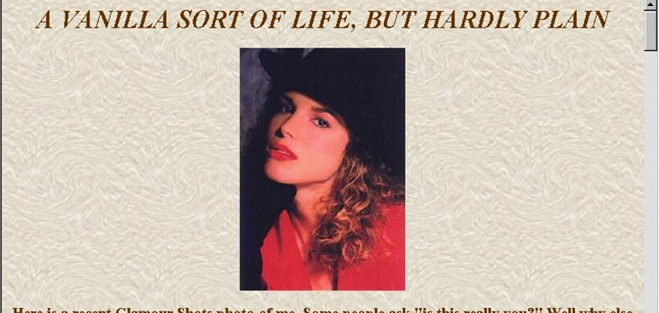
PERSONAL HOME PAGES

Slide 8
ENTER CGI
CGI gives you the ability to generate dynamic pages.
You can add all sorts of nifty doodads to your pages.

Slide 9
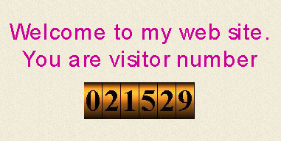
WEB COUNTERS!

Slide 10
CGI…
Some sites even take things as far as storing data in flat files on the web server…

Slide 11
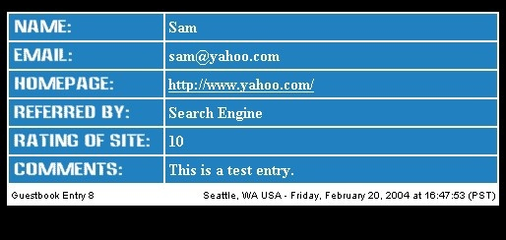
GUESTBOOKS!

Slide 12
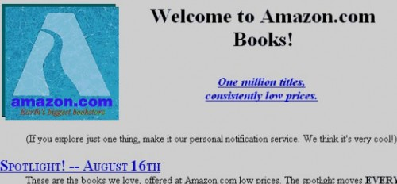
AMAZON!

Slide 13
ENTER GEOCITIES!
It becomes easier for users to create their own home page on the World Wide Web
Users can add all sorts of images, and sometimes, they can even add music!
If your website doesn’t play Beethoven (or at least ask to download and install RealPlayer or the like), don’t bother!

Slide 14
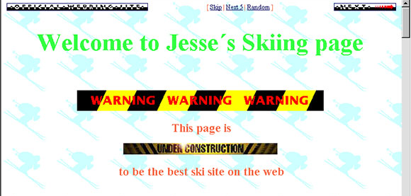
GEOCITIES

Slide 15
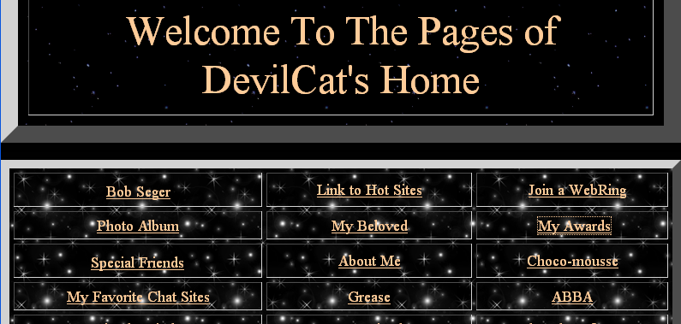
FANCY BACKGROUNDS AND BORDERS

Slide 16
Enter the CMS
Templates and Content are Separated
Users can download templates, and only have to write the content and add a few pictures
Empowers users to create their own web sites like they never could before
Content stored in a database
Every page generated with a script

Slide 17
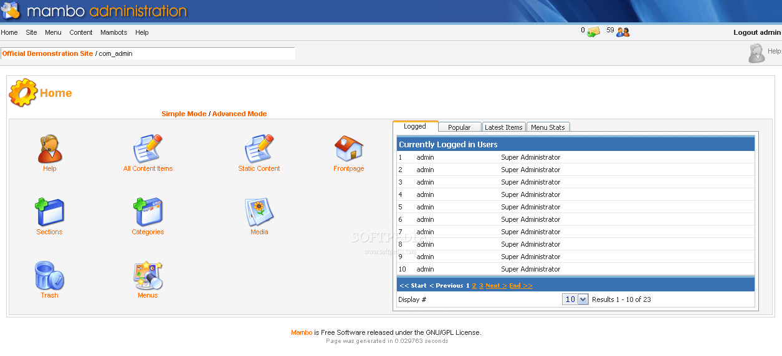
MAMBO!

Slide 18
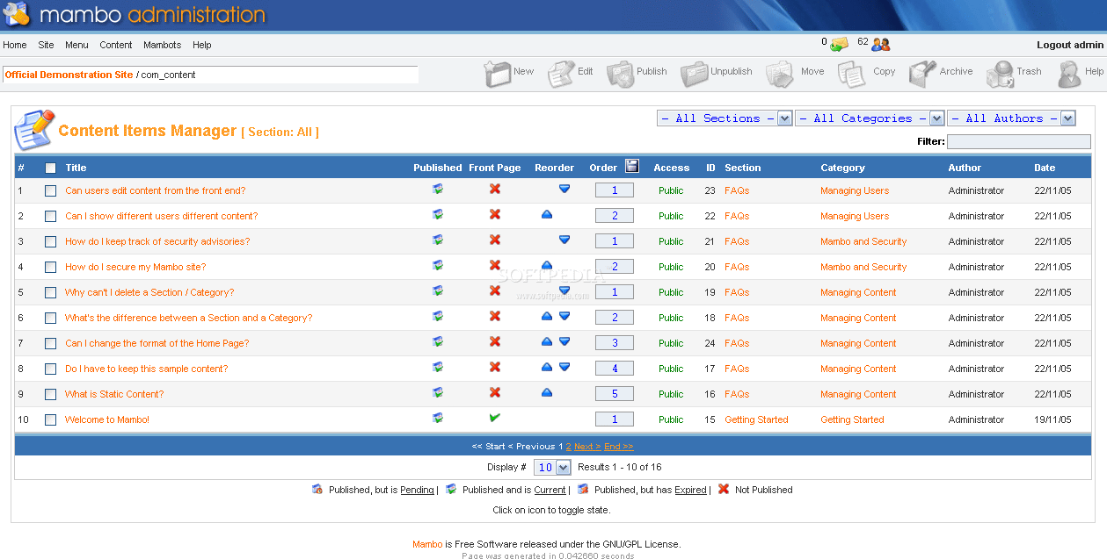

Slide 19
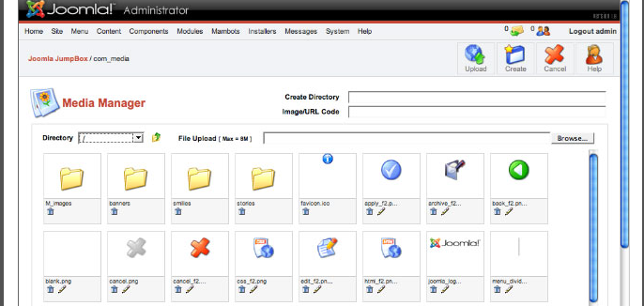
JOOMLA!

Slide 20
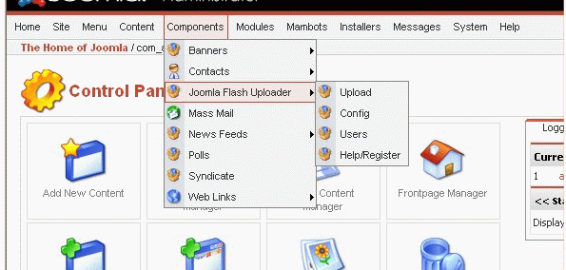

Slide 21
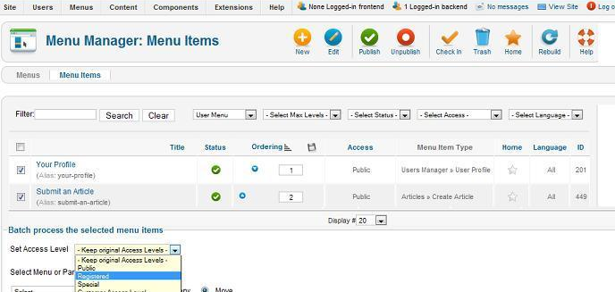

Slide 22
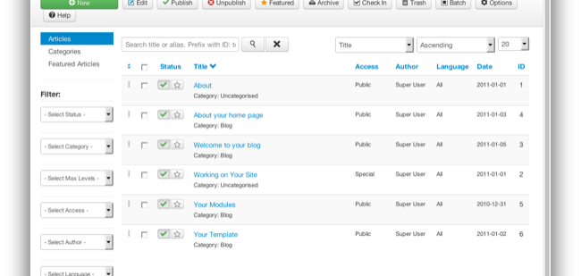

Slide 23
BUT…
Primary interaction with web sites is still the web browser
You can get a feed of content from a site, but it is hard to automate in any way
Inter System Communication is hard

Slide 24
Perl and MUTUAL FUND QUOTES

Slide 25
THE RISE OF THE API
API references used to be lists of functions, classes and methods for a library written in a specific programming language
Api.joomla.org was a list of classes and methods available in the Joomla Framework that extension developers could use in their extensions.
Extensions had to be written in PHP.
They have to all live on the same system.
They are all tightly integrated and coupled.

Slide 26
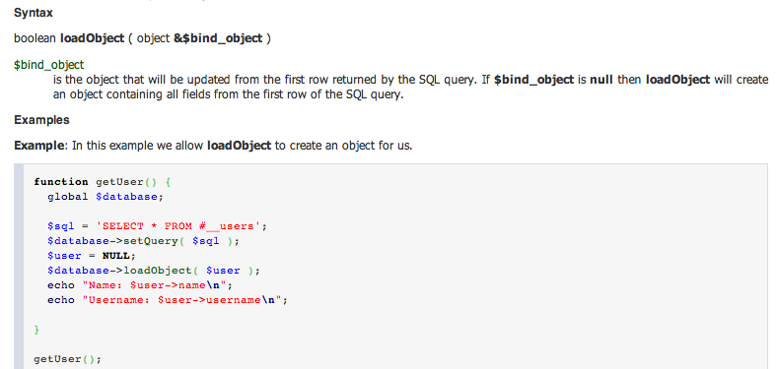
JOOMLA API REFERENCE

Slide 27
APIs TODAY
The definition of API has rather changed.
An API is now frequently recognized as a way to interact with a website or system

Slide 28
VARIOUS FLAVOURS
SOAP
XML-RPC
JSON-RPC
JSON-WSP
WSDL
REST

Slide 29




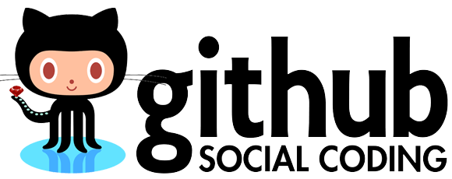



COMPANIES WITH APIs

Slide 30
WHY APIs?
Easy to share and propagate content
Separate server from the client (Mobile anyone?)
Enable others to build new and interesting interfaces for you (search for twitter apps on your phone if you want examples)

Slide 31
LANGUAGE AGNOSTIC SYSTEM INTERFACES
You can write an API in <pick language> and interface with it from <pick other language>
You can easily tie multiple systems using disparate technologies together

Slide 32
SO WHAT LANGUAGE SHOULD I USE?
It doesn’t matter.
Pick one and build it.

Slide 33
EXAMPLE
WEB CLIENT (Javascript)
Joomla Framework Layer (Articles)
NodeJS Layer (Activities/Proxy)

Slide 34
THAT’S NOT THE ONLY WAY
The example shows an application where all the display logic lives in the browser – HTML and Javascript controls the application logic
You can also create an application that generates your page on the server and prepopulates your data

Slide 35
EXAMPLE
PHP Application
Joomla Framework Layer (Articles)
NodeJS Layer (Activities/Proxy)

Slide 36
THAT’S NOT THE ONLY WAY
You can mix and match the layers any way you want

Slide 37
QUESTIONS

Slide 38
DEMO Code AVAILABLE
https://github.com/ianmacl/JAB

