Slide 1
Bidirectional Path Tracing & Multiple Importance Sampling with Progressive Photon Mapping
Xiangzheng Mao, cs184-afn
Ian Marshall, cs184-aby

Slide 2
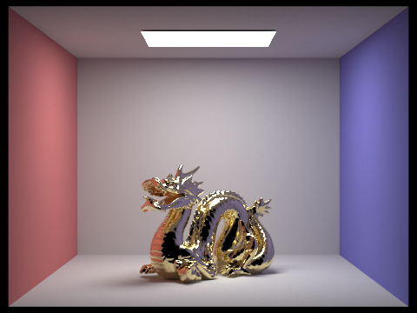
Overview
Extending pathracer from project 3 to include:
Bidirectional Path Tracing
Multiple Importance Sampling
Progressive Photon Mapping
Added special handling for glass materials to further reduce noise.

Slide 3
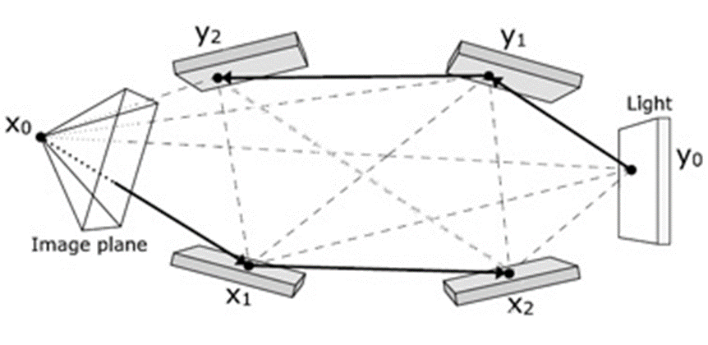
Bidirectional Path Tracing
Light rays originate from light sources and accumulate on a surface in the scene.
Works well for directional lights.
Samples are fired out of the camera into the scene and bounce until they hit a light source.
Good for specular reflection
Join light rays and samples at vertices to form complete paths.
Many different paths, how to choose the right ones?

Slide 4

Multiple Importance Sampling
Monte Carlo estimator based on using multiple sampling techniques and combining their results using a weighting function.
Balance Heuristic:
A provably good weighting function
$\hat{w}\left(x\right)=\frac{n_{i}p_{i}(x)}{\sum_{k}{n_{k}p_{k}(x)}}$
For a measurement I_{j} over the space of paths Ω:
$F= \sum_{s≥0}{\sum_{t≥0}{w_{s,t}({\overline{x}}_{s,t})\frac{f_{j}({\overline{x}}_{s,t})}{p_{s,t}({\overline{x}}_{s,t})}}}$ where s,t are the lengths of the light and eye subpaths and w_{s,t} are given by the balance heuristic.

Slide 5



Implementation
Shoot paths from the eye and light then connect pairs of vertices in the two paths to sample from the space of possible paths.
Store contributions in an eye graph and a light graph.
Contributions of paths are calculated as:
$w\left(\overline{x}\right)∗\frac{S(\overline{x})}{p(\overline{x})}$
For a path with s = t = 2:

Slide 6
Progressive Photon Mapping
Where BDPT connects vertices, PPM merges them. Storing information as rays rather than photon map increases memory efficiency.
Consists of two passes:
First rays are traced from the eye until the first non-specular intersection. Rays are stored in a kd-tree for efficiency.
Second photons are traced like light rays. Whenever a photon hits a non-specular surface it searches for nearby rays and merges with them if they are near enough. A photons contribution is its spectrum divided by the probability of the sampled path and the area of the disk around the ray and a pixels spectrum is the sum of all the rays passing through it divided by the number of rays passing through it and the total number of photons.
The radii of rays are progressively decreased in subsequent photon passes leading to increasingly accurate estimates of the illumination.

Slide 7
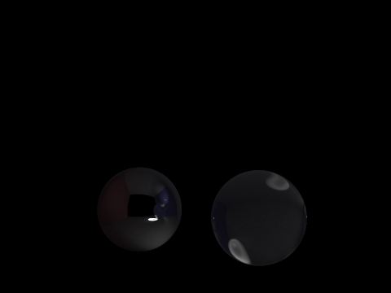
Why PPM?
For scenes containing only diffuse and specular surfaces some paths will consist of a diffuse vertex between two specular vertices.
SDS paths can introduce significant noise because BDPT is slow to converge on these paths.
Use PPM for all paths where the first vertex on the light and eye path are specular and there is non specular vertex on the path between them, BDPT for all other paths.

Slide 8
Glass Handling
In project 3 we used a Russian roulette technique to determine whether light was reflected or transmitted.
The winner took all the energy.
Instead split energy between reflected and transmitted paths proportionally to the winning probability.
For performance considerations only paths consisting entirely of specular vertices use this.

Slide 9
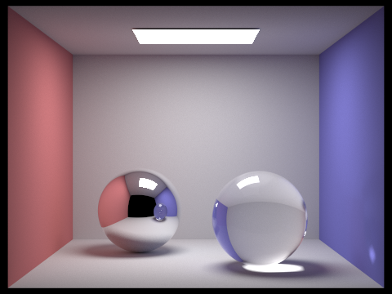
Results

Slide 10
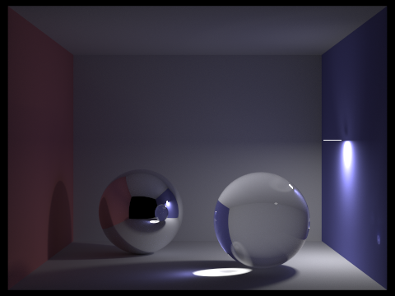
Results

Slide 11
References
Veach, E. (1997). Robust monte carlo methods for light transport simulation (Doctoral dissertation, Stanford University).
Hachisuka, T., Ogaki, S., & Jensen, H. W. (2008). Progressive photon mapping. ACM Transactions on Graphics (TOG), 27(5), 130.

