Slide 1
Bidirectional Path Tracing and Multiple Importance Sampling with Photon Mapping
CS184: Computer Graphics and Imaging, Spring 2017
Xiangzheng Mao, cs184-afn; Ian Marshall, cs184-aby

Slide 2
Overview
Completed:
Bidirectional Pathtracing
Multiple Importance Sampling
Aspirational goals:
Photon mapping

Slide 3
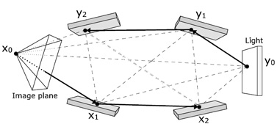
Bidirectional Path Tracing
Light rays originate from light sources and accumulate on a surface in the scene.
Work well for directional lights.
Samples are fired out of the camera into the scene and bounce until they hit a light source.
Good for specular reflection
Join light rays and samples at vertices to form complete paths.

Slide 4
Multiple Importance Sampling
k+1 paths of length k consisting of a light ray joined to a sample ray can be made for a given path.
Each path has a corresponds to a different density function and in turn samples different lighting effects more or less efficiently.
MIS can then be used over these different densities to efficiently sample the space of paths and thereby many different lighting effects.

