Slide 1
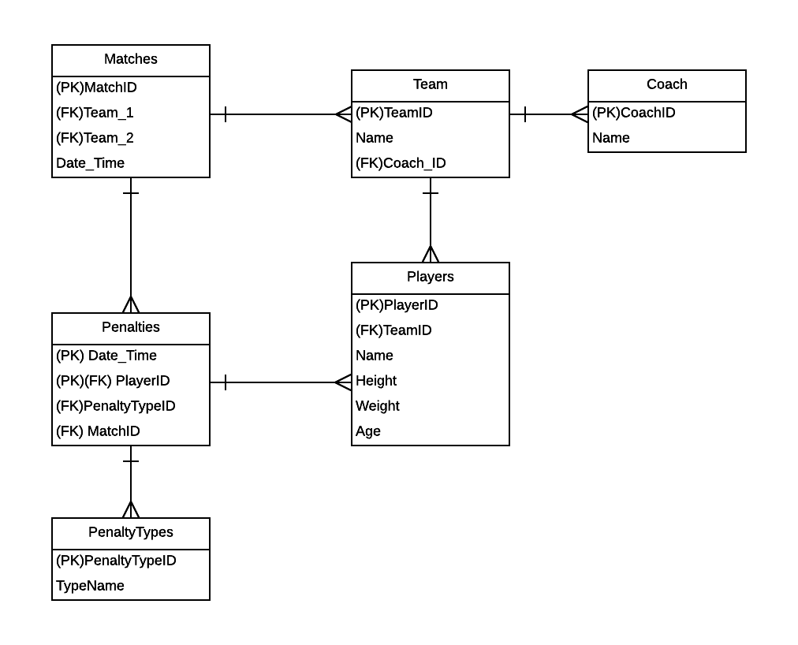
Ian Boyd
Week 2 DB Design Assignment

