Slide 1
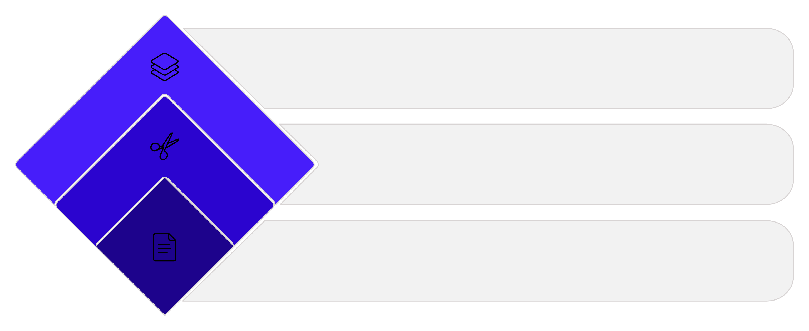
FRAMEWORK
Decomposing a Candidate Use Case
One sentence. Multiple kinds of work. Separate them before you score anything.
Cut by Scope
Split core vs supporting tasks
Cut by Work Type
Separate functional vs non-functional
Write Use Case
One clear sentence

Slide 2
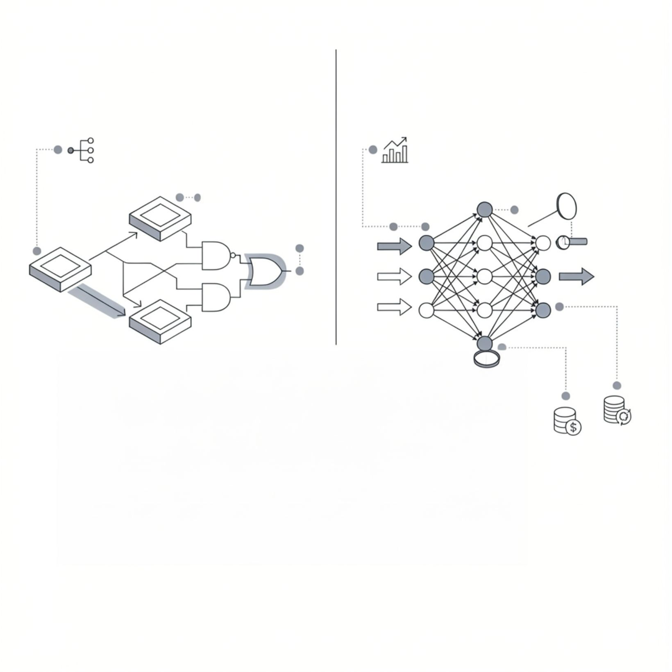
CUT ONE
Rules vs. Patterns
RULES-BASED
PATTERN-LEARNING
SYSTEMATIC PROCESS
USES DATA, NEEDS MONITORING
Why it matters
AUDITABLE & CHEAPER
MODEL GOVERNANCE
Rules-based work is cheaper, faster, and auditable.
Pattern-learning carries ongoing costs — training, monitoring, governance — that must be priced accordingly.
ONGOING COSTS

Slide 3
CUT TWO
One Process, Three Buckets
An invoice handling proposal — one use case, three very different kinds of work:
Interpretation
Arithmetic
Rule
Extract figures from scanned docs with varying layouts
Check that line items sum to the total
Route amounts above a threshold to a second approver
One proposal. Three buckets. Never score them as one.

Slide 4

Scoring the Composite Is a Mistake
Overbuild
Under-govern
Score the composite as a single thing and you mis-price it in both directions at once.
Pay for training & monitoring where a written rule would have done the job
Oversight budget gets spread across steps that never needed any

Slide 5

PRACTICE
Try It on a Process You Know
1
Write out every step
2
Mark each step
3
Read the marks
Map the process you already understand
Rule somebody wrote — or judgment somebody makes
They tell you what a model must earn — and what ordinary software already handles

