Slide 1
FRAMEWORK
Screening Dimensions
A screening dimension is a separable question you judge a candidate on — each one answers something unique and important.

Slide 2
The Seven Dimensions
Business Value
Workflow Fit
Data Readiness
Does the outcome matter to the organization?
Does the change land where work actually happens?
Do the inputs exist and can they be used?
Technical Feasibility
Risk
Sponsorship
Can a team build and maintain it?
What exposure does it create?
Will a named person own it after the project team leaves?
Measurement Clarity
Could anyone tell, six months later, that it worked?

Slide 3
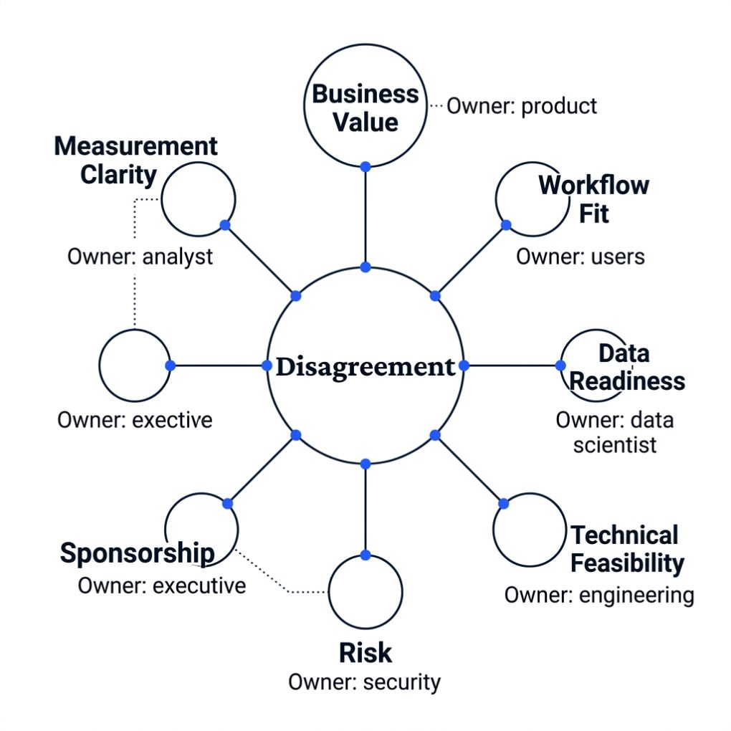

Why Separation Buys Traceability
When two reviewers disagree, the difference sits in one dimension — which points to a fact, and the fact belongs to somebody who knows it.
Data Readiness dispute?
Sponsorship dispute?
→ Go to the person who owns the records.
→ Go to the function that would inherit the system.

Slide 4
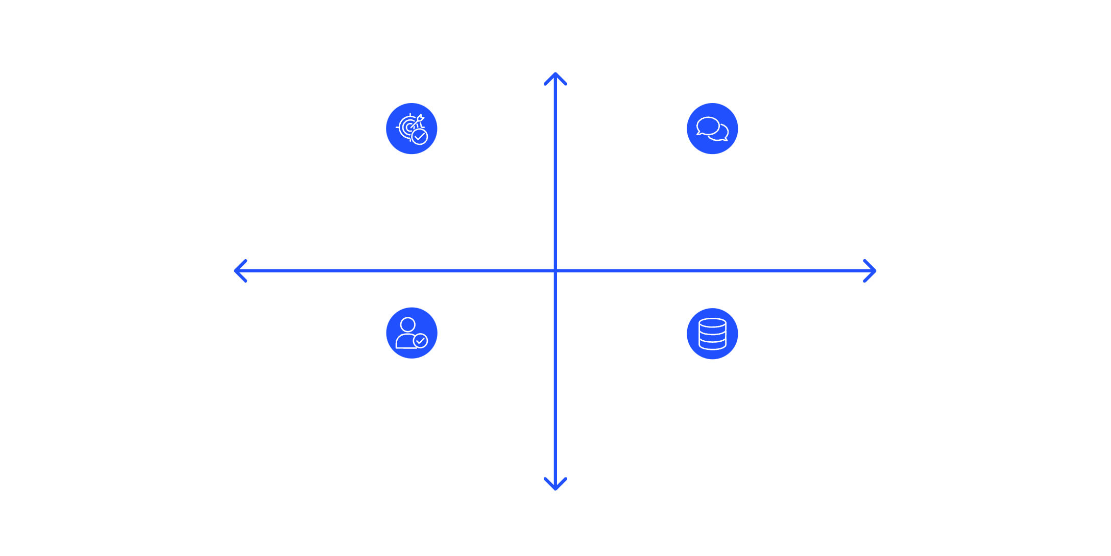
What Blending Costs You
High Traceability
Blend these dimensions into one overall impression and you lose traceability. The conversation then runs on conviction and personality instead of precise screening data everyone understands.
Precise & Traceable Decisions
Blended Impression Decisions
Low Persuasion
High Persuasion
Conviction-Driven Choices
Data-First Screenings
Low Traceability

Slide 5

TRY THIS
One Sentence Per Dimension
With the next proposal that crosses your desk, write one sentence under each of the seven questions.
Notice which sentences you cannot write.
Every blank names a person.
Those blanks are conversations you need to have.
Someone holds the answer you do not have yet.

