Slide 1

FRAMEWORK
Accuracy & Actionability
Two conditions every prediction must meet.
Accurate
Actionable
Outputs track reality within a measurable range
Reaches the right person in time to change a decision
If either condition fails, the prediction has no benefit.

Slide 2
DEFINITIONS
Two Different Claims
Accuracy
Actionability
A claim about outputs — how closely a model tracks reality.
A claim about the organization — whether a prediction reaches the right person in time to matter.

Slide 3
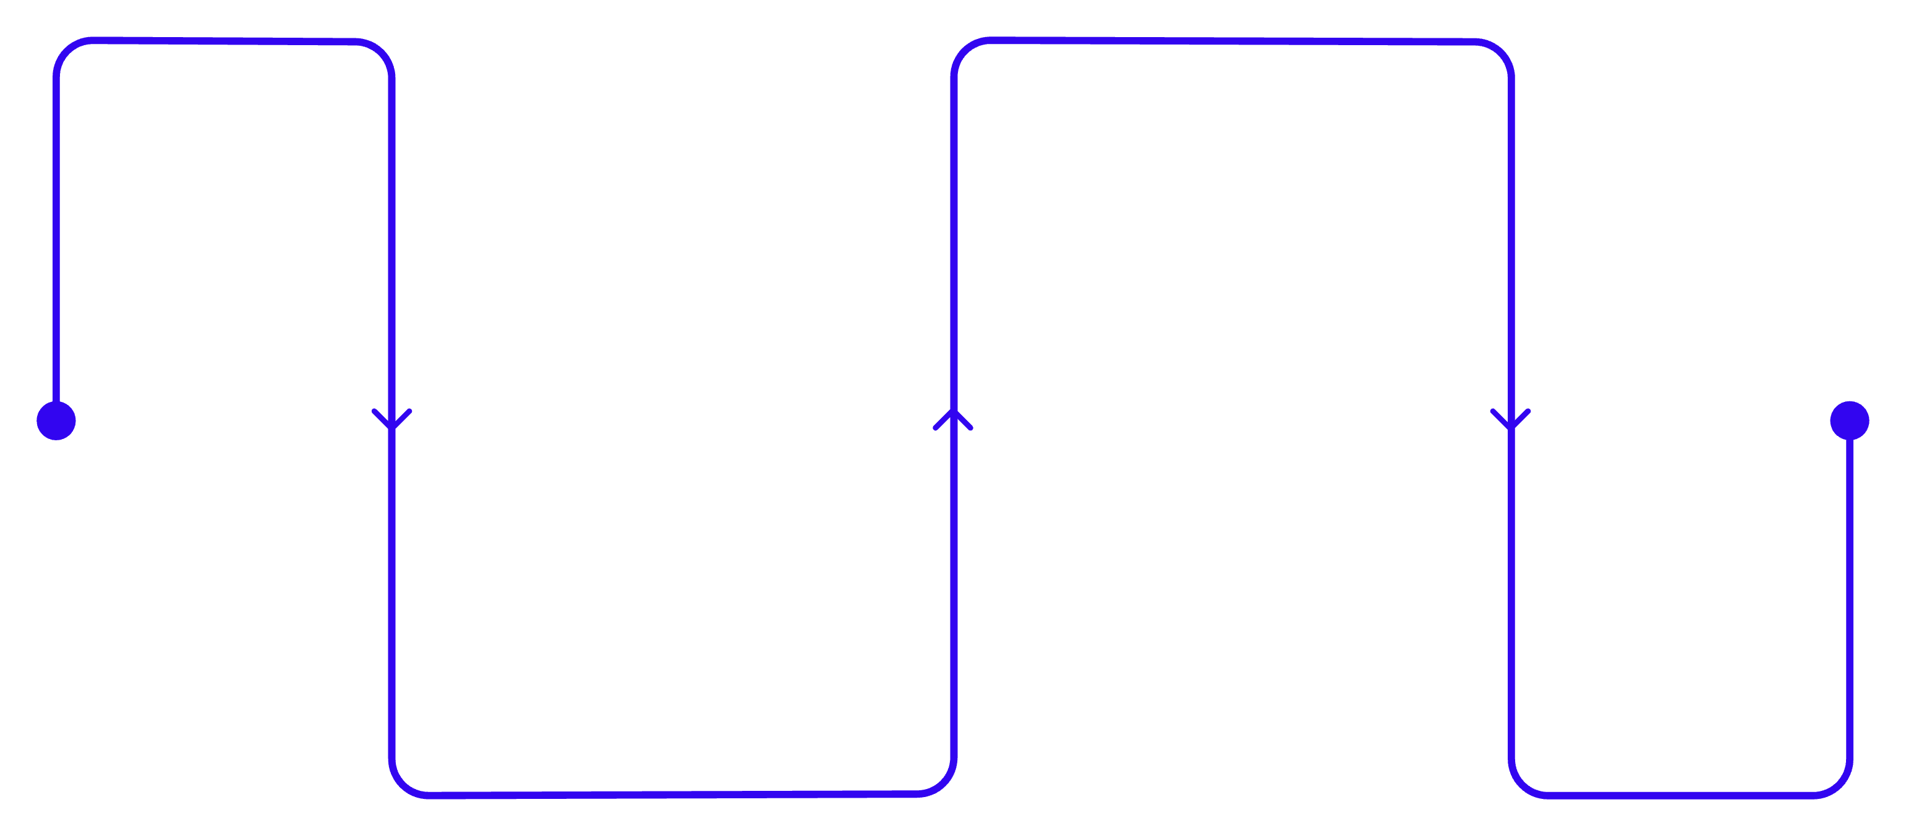
THE GAP
They Come Apart More Than You Think
Orders Locked
POs sent and decisions finalized
Forecast Arrives
Accurate but delayed delivery
A demand forecast that calls next quarter correctly — but lands two days after purchase orders go out — is accurate but not actionable.

Slide 4
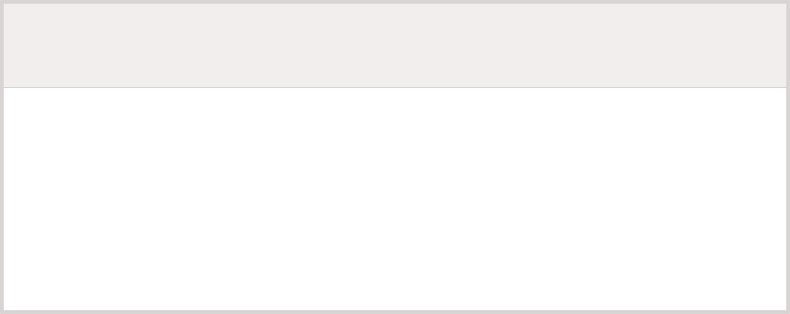
Different Problems, Different Fixes
1
2
Accuracy
Actionability
More data, better features, stronger models
Engineering work moves the needle.
Change a timetable, redraw an approval, train a team
No amount of model work will help.

Slide 5
PUTTING IT TO WORK
Three Questions to Ask First
1
Who receives it?
2
Which decision does it change?
3
What does that person do differently on the day it arrives?
When the third answer comes back blank, the accuracy question hasn't started to matter yet.

