Slide 1

AI SCREENING FRAMEWORK
The Data-Readiness Gate
A pass-or-fail condition that sits in front of every other judgment.
Inputs Must Be
Outcomes Must Be
Reachable, trusted, and lawfully usable for the stated purpose.
Recorded consistently, by a stable definition.

Slide 2




SEVEN SCREENING DIMENSIONS
Most Dimensions Trade Against Each Other
Business Value
Workflow Fit
A large prize can carry a moderate build cost.
A determined sponsor can carry weak workflow fit.
Data Readiness
Risk & Sponsorship
The one dimension that does not trade.
Plus technical feasibility and measurement clarity.

Slide 3
The Gate Returns One Answer
All other scores wait on it.
✅ Clears the Gate
❌ Fails the Gate
Candidate moves forward — assessed on all other dimensions.
Candidate stops there, however well it scored elsewhere.

Slide 4

THE LABEL QUESTION
The Sharp Form of the Gate
It can reverse the judgment on candidates that looked ready.
Record Situation
Assign Outcome
Build Training Set
That paired outcome is the label. A collection of labels is a training set.

Slide 5
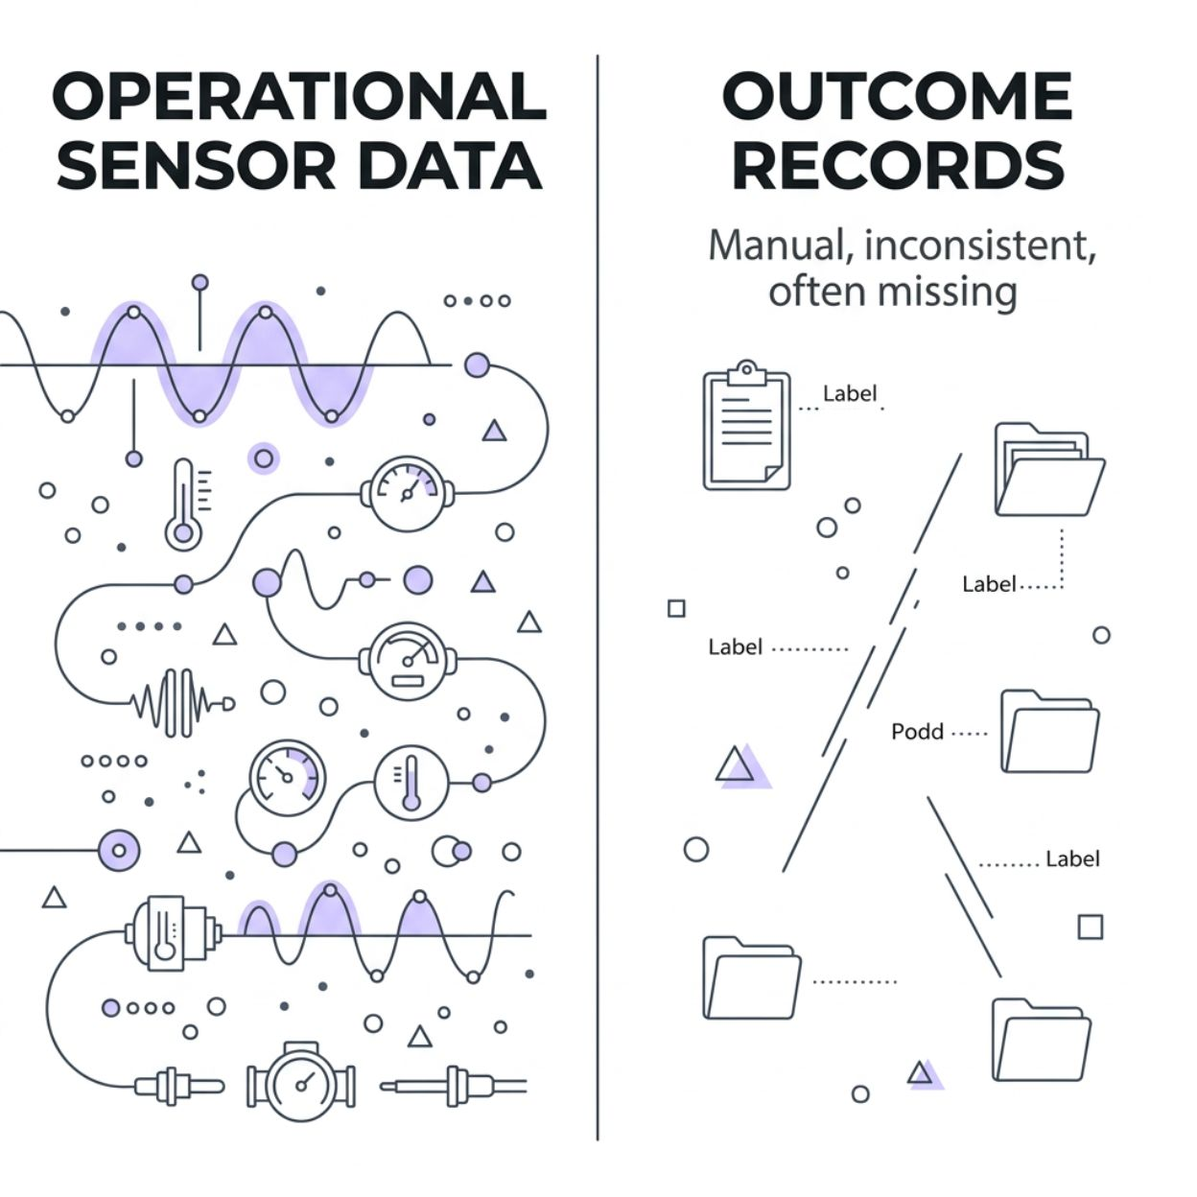
Operational Data ≠ Training Labels
What You Have
Ten years of equipment readings — every machine state, every hour.
What You Need
Someone had to decide to write down each failure — time, standard, definition — in a separate record.

Slide 6

Outcome Record Exists?
Yes → Buildable
No → On Wait
Screen moves on. Candidate has passed the gate.
Start recording the outcome. Assign a start date and an owner.
Making the recording project clear helps a sponsor far more than a low score on a data column.

Slide 7
PRACTICE
Ask It in Its Sharpest Form
1
What had to be written down?
2
What gives you reason to believe they did?
Every time, by the same definition,
for this prediction to be learnable at all.
Find the evidence in the candidate — or stop there.

