Slide 1
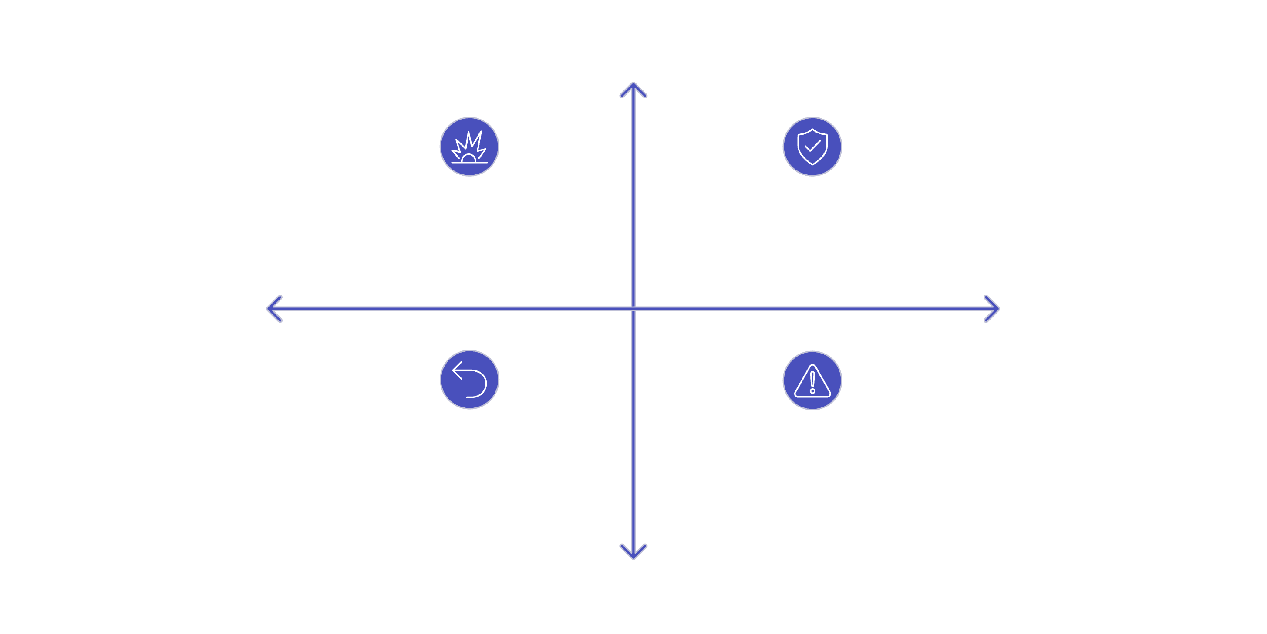
Blast Radius
Sizing a candidate's exposure by how far a wrong output travels — and how easily the resulting action can be undone.
High Spread
High Spread, Low Reversibility
High Spread, High Reversibility
High Reversibility
Low Reversibility
Low Spread, High Reversibility
Low Spread, Low Reversibility
Low Spread

Slide 2
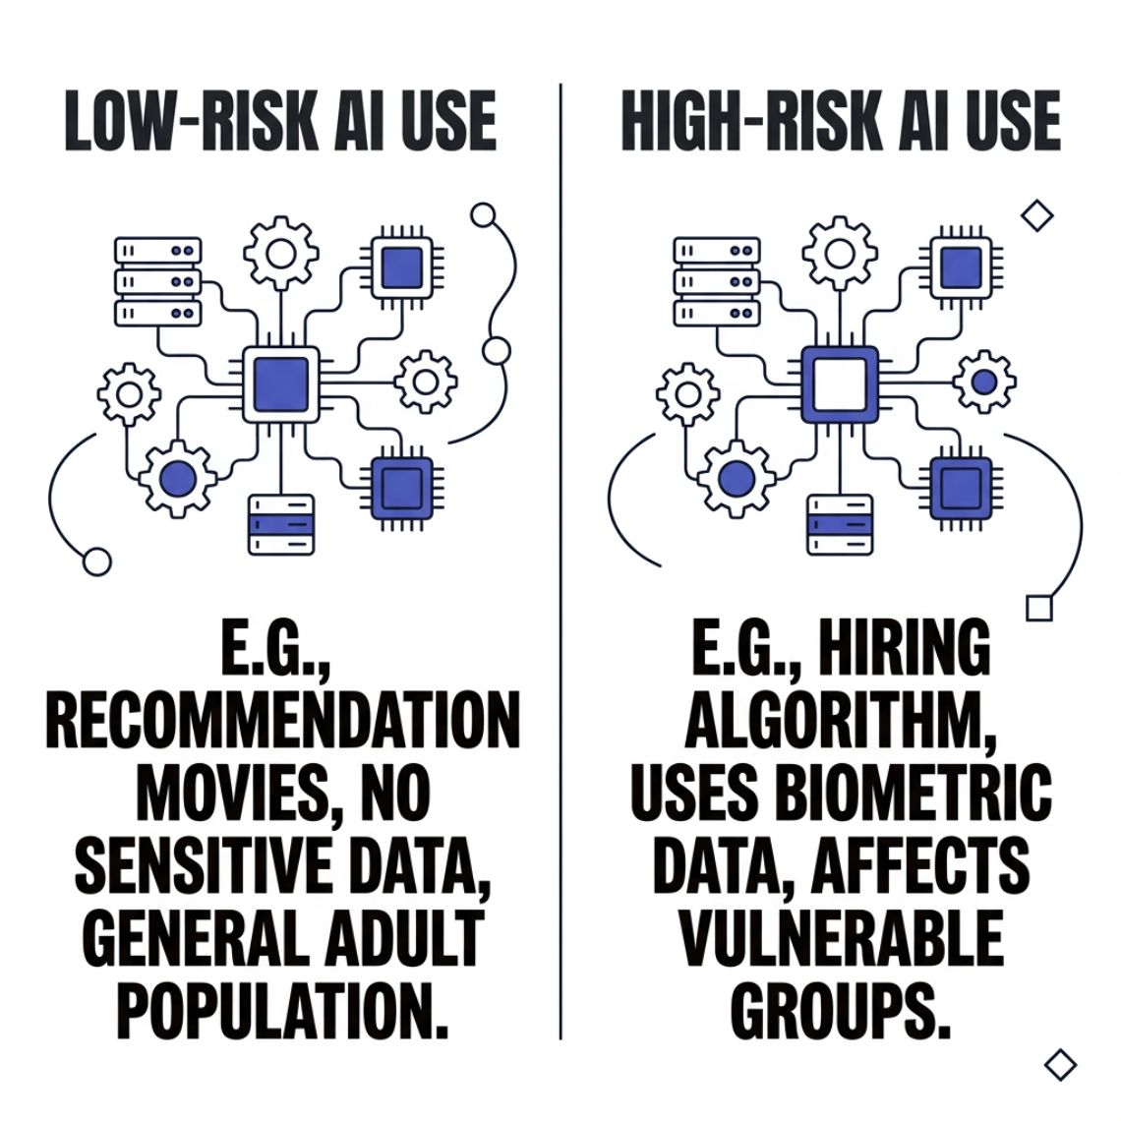
RISK FRAMEWORK
Obligations Follow Use, Not Method
Public law sorts AI systems into risk categories based on how much — and how long — their use can affect people.
Two systems built with identical methods can carry different obligations, because the category follows what the system does and
who ends up affected.

Slide 3

TWO QUESTIONS
Sort Any Candidate in Minutes
Who & What Does It Touch?
Can the Action Be Reversed?
How many people or systems does a wrong output reach — and at what breadth?
Once someone acts on the output, is there a way back?

Slide 4
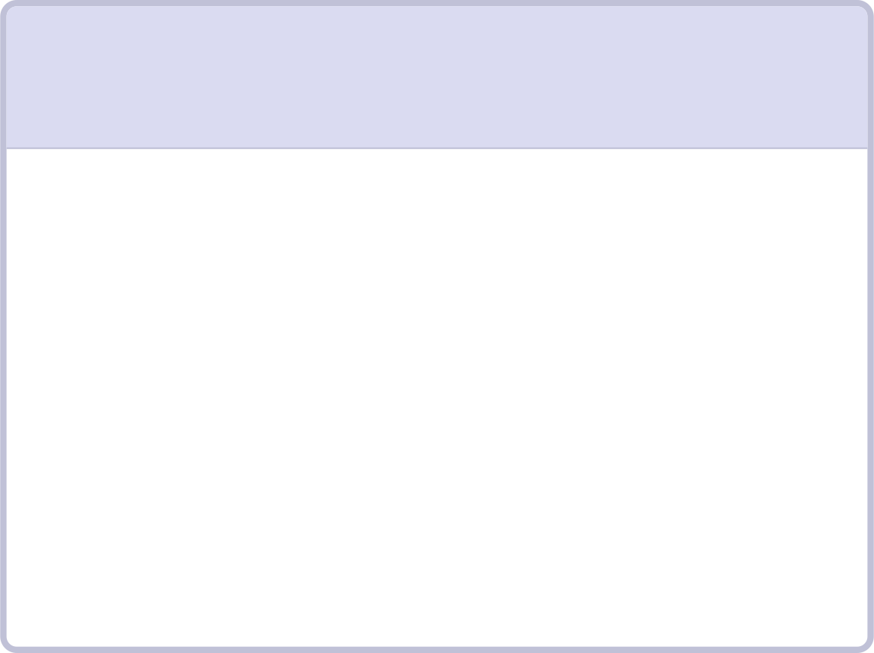



SCREENING LOGIC
Radius Determines Scrutiny
Small Radius + Easy Reversal
Wide Radius or Irreversible
Human-Approval Line
Earns real scrutiny — regardless of value score.
Where exposure exceeds tolerance, a person holds the trigger. The screen records exactly where that line sits.
Light screen. Clears in minutes.

Slide 5
The Swap Test
A sound exposure judgment stays the same when you swap the technique underneath it — and changes when you change the use.
Pass ✅
Fail ❌
Swap the method. Exposure description unchanged. You sized the use.
Swap the method. Description changes. You were sizing the machinery.

Slide 6

PRACTICE
Rewrite Until the Use Carries All the Weight
01
02
03
Describe the exposure
Imagine a simpler method
Does your sentence change?
One sentence: the use and the people affected.
Same output, much simpler technique underneath.
If yes — you were describing the machinery. Rewrite.
The use and the people affected must carry all the weight — not the technology.

