Slide 1
THE CORE PROBLEM
An unscored backlog sorts itself by whoever pitched best.

Slide 2
A Familiar Situation
The Setup
The Challenge
You advise a multinational manufacturer. The list of AI ideas is already long.
Functions across the company have answered the call — plant supervisors, supply chain, quality, service, corporate teams.
Now it's your job to make sense of it.

Slide 3

No Two Requests Share a Shape
A quarter of submissions — and no common format.
A prediction someone wants
A system, not a problem
A workflow complaint with "AI" appended
Plant supervisors, supply chain, quality, service — each entry a different shape, a different level of clarity.

Slide 4

Four Kinds of Judgment — No Common Scale
Business Value
Buildability
Does this idea matter?
Can it be built?
Data Readiness
Exposure
Can the data be reached and trusted?
Is the risk tolerable?
Without a shared scale, the room falls back on pitch quality and seniority — not merit.

Slide 5
The Cost of No Screen
Function head
Why it falls to you
Already promised a plant something is coming.
You alone hold no stake in any particular entry.
That's exactly why everyone expects the ordering from you.
Data lead
Fielding access requests for candidates that may never proceed.
Finance partner
Reserving budget against a number nobody can trace.

Slide 6
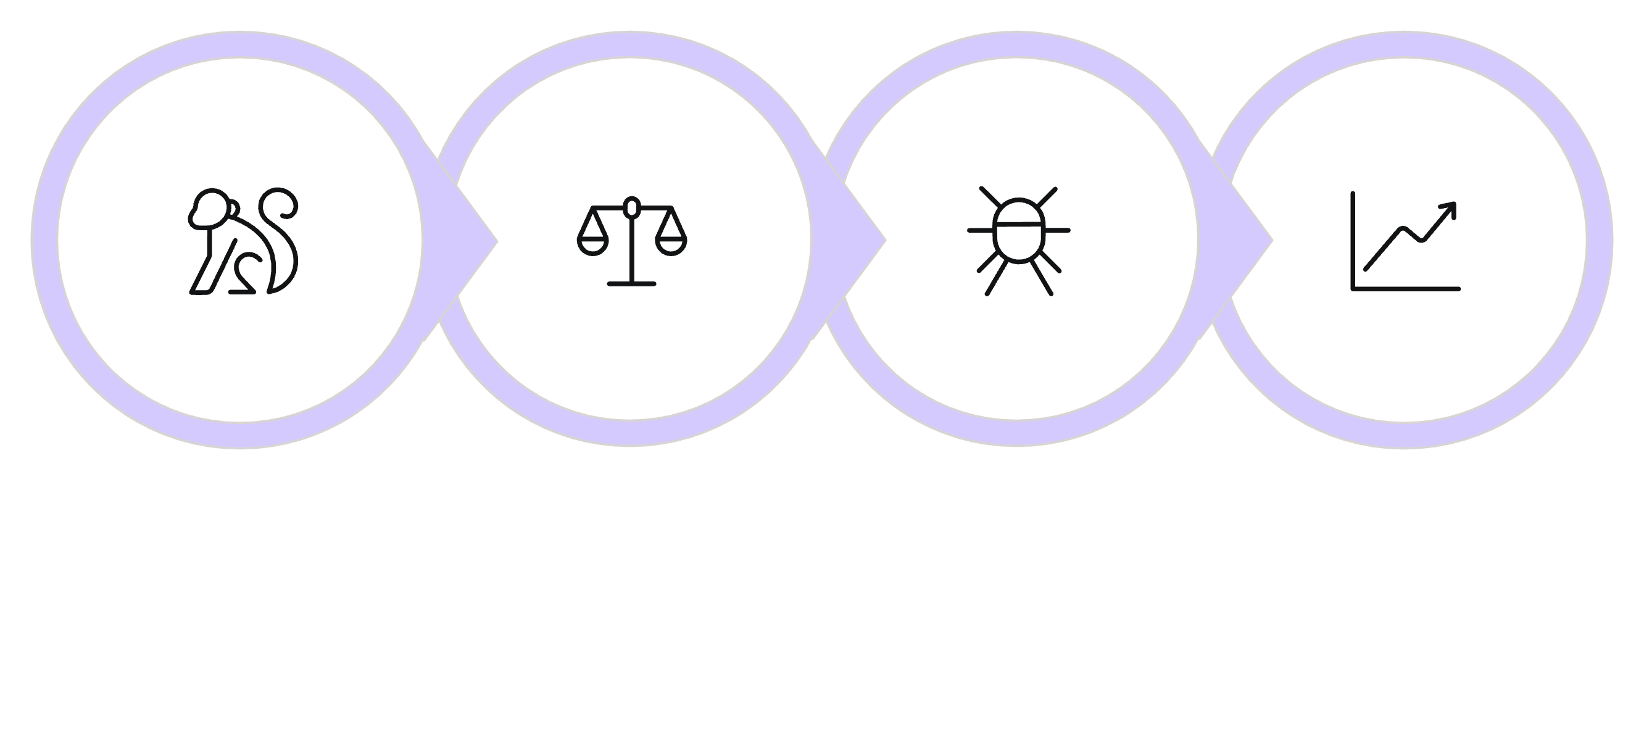
Judgment Before Tools
Define Candidates
Separate Questions
Test Failure Conditions
Size Exposure
When you practice these skills, you can land each candidate on a verdict that helps the business.

