Slide 1
CORE SKILL
Win the Role:
Triage Judgment
Hold four dimensions apart — simultaneously — when evaluating any single proposal.
Value
Feasibility
Data Readiness
Exposure
Then say which dimension the decision turns on.

Slide 2

WHY IT MATTERS
A Systems Skill, Not a Template
Employers use differently labelled scoring sheets. The same four questions recur underneath them all.
With triage judgment you can:
Template thinking
Systems thinking
Learn the dimensions — build a sheet where none exists.
Learn one company's scoring sheet — fill in that sheet only.
Read any sheet for what it quietly omits
Tell a sponsor why a candidate scored well on three dimensions but still should not proceed

Slide 3
Expect This in an Interview
"We have more AI ideas than we can pursue. How would you decide which ones to look at first?"
Your answer to this question signals whether you have triage judgment — or just a matrix.

Slide 4
INTERVIEW STRATEGY
Weak vs. Strong Answer
❌ Weak
✅ Strong — Triage Judgment
Describe a decision matrix.
Agree criteria before seeing candidates
Define in writing which classes earn real scrutiny: customer-facing outputs, irreversible actions, data the org lacks rights to use
Result: only a small fraction pass the gate to genuine review

Slide 5
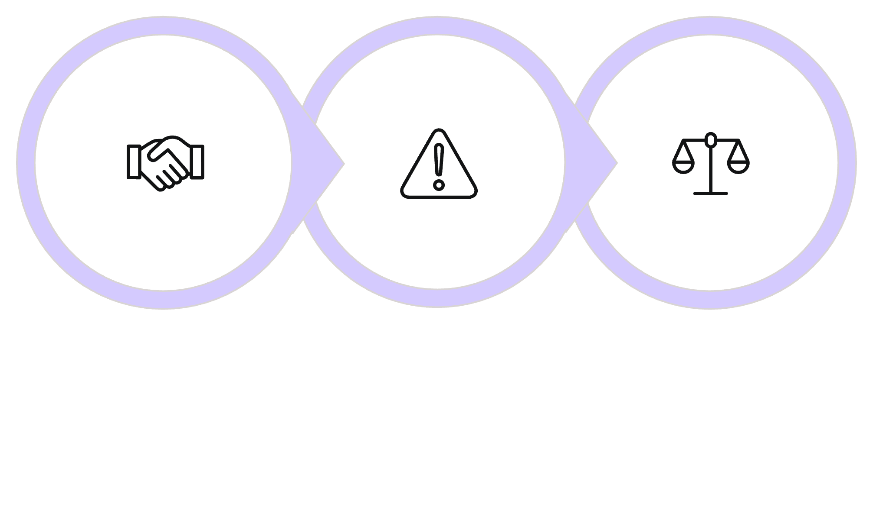
FIRST 90 DAYS
Triage Judgment in Practice
Informal Endorsement
Unrecorded Outcome
Shift to Criteria
Written criteria let you redirect pressure — away from personalities, into evidence.

Slide 6



Use Occupational Language
Speak in the terms your stakeholders already use — not technical jargon.
Gather
Analyze
Document
Collect evidence each role holds in that role's own terms
Translate into distinct alternative courses of action
Recommendation someone can act on without attending the meeting

Slide 7




The Takeaway
Hold the Dimensions
Gate Before You Review
Speak the Role's Language
Value, feasibility, data readiness, exposure — simultaneously
Agree criteria in writing first; let only a small fraction through
Gather, analyze, document — accurate and actionable
Triage judgment is the skill that turns a good analyst into a trusted advisor.

