Slide 1

Bash Scripting in Three Weeks
Ian Miell
Twitter: @ianmiell
Ian.miell@gmail.com

Slide 2
Pipes and Redirects
Basic redirects
Basic pipes
File descriptors
Special files
Standard out vs standard error

Slide 3
Simple pipes and redirects
Standard in/out/error
File Descriptors
Pipes and Redirects - Walkthrough

Slide 4
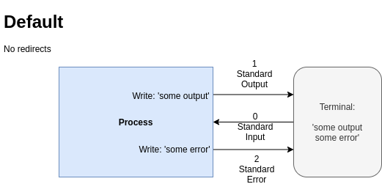
Pipes and Redirects

Slide 5
Every process gets three file descriptors:
0 - ‘standard input’
1 - ‘standard output’
2 - ‘standard error’
‘Normal’ output goes to file descriptor 1
Programs generally output errors to file descriptor 2
Normally ‘stderr’ and ‘stdout’ both go to the terminal – but you can change that!
File Descriptors (I)

Slide 6
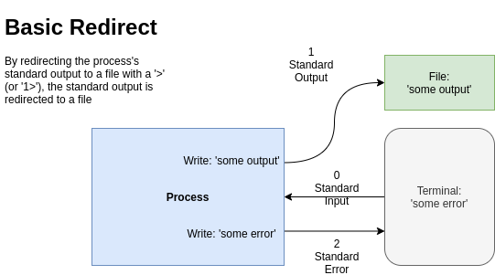
Pipes and Redirects

Slide 7
Pipes and Redirects

Slide 8
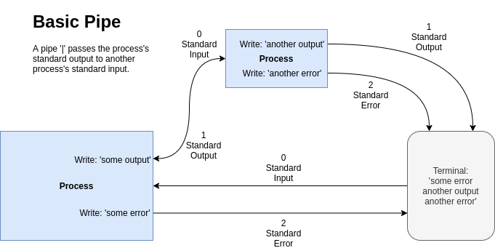
Pipes and Redirects

Slide 9
File Descriptors (II)
‘>’ operator sends standard output to a file
‘1>’ is the same (1 is assumed)
‘2>’ sends standard error to a file
‘|’ sends standard output to a process
Advanced, but often seen:
2>&1 sends standard error to whatever standard output is pointed at
A way of sending ‘all’ output to a file

Slide 10
The main 3 file descriptors
‘>’ vs ‘|’
n> and standard error
2>&1 and ordering
Recap – Pipes vs Redirects

Slide 11
Exercises
https://learning.oreilly.com/scenarios/-/9781098138530/
https://learning.oreilly.com/scenarios/-/9781098138547

Slide 12
Subshells
What is a subshell?
How to create a subshell
Why they are useful
() vs {}

Slide 13
The ‘<()’ operator
Substitution of file arguments
Process Substitution

Slide 14
Exercises
Subshells
https://learning.oreilly.com/scenarios/-/9781098138554/

Slide 15
cat > file << MARKER ... MARKER
'MARKER'
<<<
Here docs

Slide 16
Exercises
Here Docs
https://learning.oreilly.com/scenarios/-/9781098138561/

Slide 17
What shell scripts are
What happens on bash startup
This has cost me many hours!
Executable files
‘source’ vs ‘./’
Startup

Slide 18
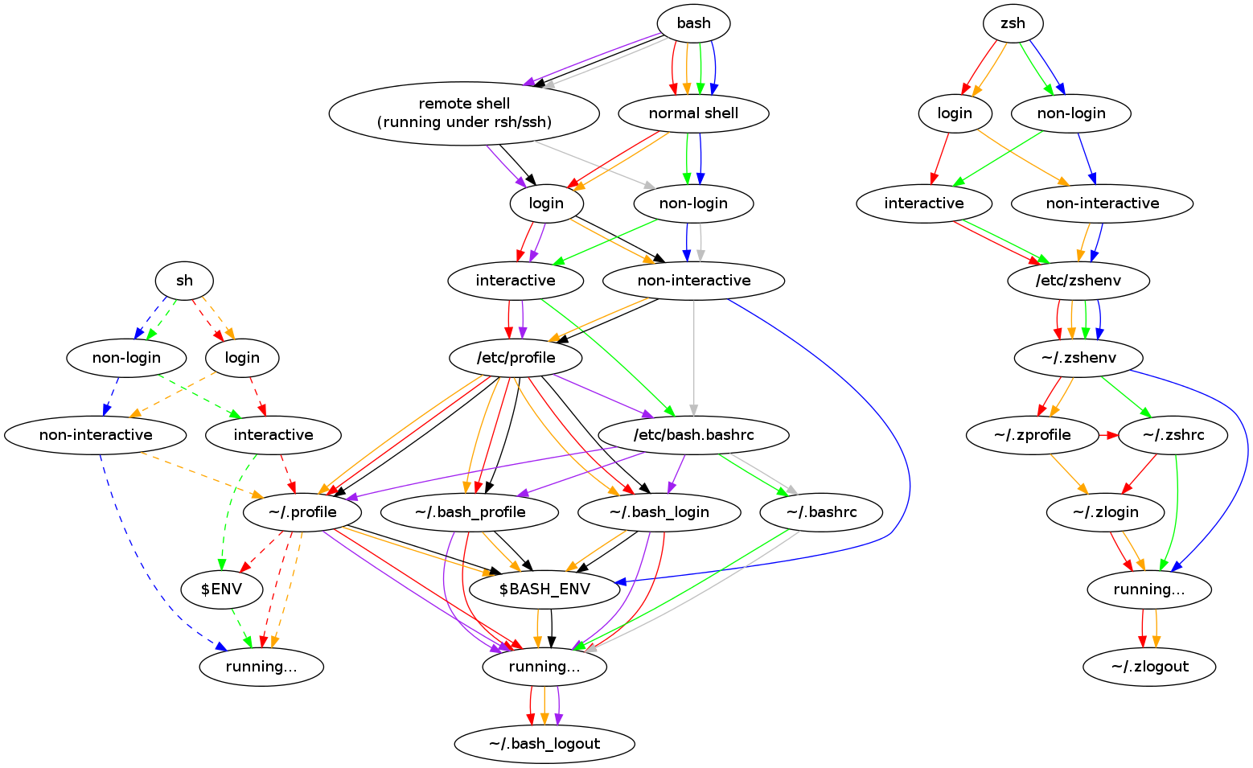
Walkthrough – Startup Explained

Slide 19
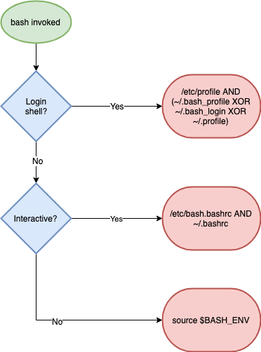
Walkthrough – Startup Explained (simpler)

Slide 20
Recap - Scripts and Startup
What shell scripts are
How complex bash startup can be
Keep diagram handy!

Slide 21
Exercises
Homework
https://learning.oreilly.com/scenarios/-/9781098138578/

Slide 22
FIN

Slide 23
Part I Recap
Globs
vs regexps
Variables, arrays
Pipes and redirects
File descriptors

Slide 24
2.1 Command Substitution
2.2 Functions
2.3 Tests
2.4 Loops
2.5 Exit Codes
Part II – Further Bash Basics

Slide 25
Is bash a programming language?
What is a programming language?
Why has bash lasted so long?
Discussion

Slide 26
Bash tests
Different ways of writing tests
Logical operators
Binary and unary operators
‘if’ statements
2.3 Tests

Slide 27
2.5 Exit Codes
What an Exit Code is
The ‘$?’ variable
How to set one
Exit Code conventions
Other ‘special’ parameters

Slide 28
0 – OK
1 – General Error
2 – Misuse of shell builtin
126 – Cannot execute
127 – No file found matching command
128 – Invalid exit value
(128 + n) – Process killed with signal ‘n’
Standard Exit Codes

Slide 29
Standard exit codes
Exit code usage (eg grep)
Setting exit codes
‘return’ing from functions
Special parameters
Recap – Exit Codes

Slide 30
Discussion / Recap – Part II
Bash more as programming language:
Functions
Tests / ifs
Loops
Return/Exit codes
Process and command substitution
$() vs ``

Slide 31
Scripts and Startup
The ‘set’ Command
Debugging in bash
Subshells
IFS
Part III - Scripting

Slide 32
What shell scripts are
What happens on bash startup
This has cost me many hours!
Executable files
‘source’ vs ‘./’
3.1 Scripts and Startup

Slide 33
Walkthrough – Startup Explained

Slide 34
Walkthrough – Startup Explained (simpler)

Slide 35
Recap - Scripts and Startup
What shell scripts are
How complex bash startup can be
Keep diagram handy!

Slide 36
3.2 The ‘set’ builtin
Setting options in bash
What POSIX is
Most useful options:
nounset
xtrace
errexit
‘set’ vs ‘shopt’

Slide 37
Recap - ‘set’
Options: + off, - on
POSIX
Most common options
shopt and set
xtrace, nounset, errexit

Slide 38
3.3 Subshells
What is a subshell?
How to create a subshell
Why they are useful
() vs {}

Slide 39
aka IFS
Why it’s important
How to use it
3.4 Internal Field Separator

Slide 40
Walkthrough – Spaces in Filenames
‘for’ looping over files
The IFS shell variable
The $’’ construct

Slide 41
Setting IFS
The ‘find’ command and ‘xargs’
find, xargs and the null byte separator
Walkthrough – Spaces in Filenames

Slide 42
Part III – Discussion / Recap
Shell Startup
Practical bash usage
Shell options
Shell debugging
IFS

Slide 43
Optional – Advanced Bash
Traps
String manipulation
Autocomplete
Walkthrough a ‘real’ script

Slide 44
Background jobs
Traps and signals
The ‘kill’ command
The ‘wait’ builtin
Trapping signals
Process groups
4.1 Jobs and Traps

Slide 45
Standard Exit Codes - Refresher
0 – OK
1 – General Error
2 – Misuse of shell builtin
126 – Cannot execute
127 – No file found matching command
128 – Invalid exit value
(128 + n) – Process killed with signal ‘n’

Slide 46
The ‘<()’ operator
Substitution of file arguments
4.2 Process Substitution

Slide 47
The ‘<()’ operator
Substitution of file arguments
Process Subsitution - Walkthrough

Slide 48
Thank You!
Ian Miell
https://github.com/ianmiell/introduction-to-bash
Twitter: @ianmiell
ian.miell@gmail.com

