Slide 1
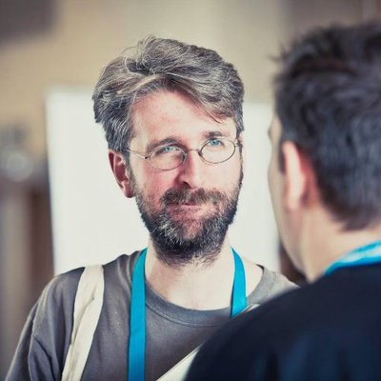
GitOps First Steps
Ian Miell
Twitter: @ianmiell
Ian.miell@gmail.com

Slide 2
Part I – Introduction
About Me
Course Overview
Discussion
What is GitOps in One Slide

Slide 3
GitOps and Me
Worked in GitOps in Banks
Consulting, working with smaller companies to make GitOps happen
Blog on GitOps and related subjects at https://zwischenzugs.com
Written books on Git, Docker, Terraform, Bash

Slide 4
Part I – Introduction
Part II - Why GitOps?
Part III – Defining GitOps
Break
Park IV – Key GitOps Tools
Part V – Demo
Part VI – Implementation Challenges
Course Overview

Slide 5
How do you deploy software now?
What are the challenges/bottlenecks?
What tools do you use, and what are their characteristics?
What do you understand by GitOps?
Discussion

Slide 6
Can be defined in various ways, but at core:
1) Everything as Code
2) Declarative system operation definition
3) Control Loop
Packaging of older ideas (eg DevOps, Scripting, Versioned Source Control, configuration management, Make) into an opinionated movement.
What is GitOps?
In One Slide

Slide 7

Part II – Why GitOps?

Slide 8
Various deployment anti-patterns
Deployment by hand
State in a spreadsheet
Pipeline by GUI
‘It’s all up here’
Anti-patterns cost money
GitOps (like DevOps) reduces cost of deployment
What Problems Does GitOps Solve?

Slide 9
Place code into environments through a manual process
May be sped up by scripting
Documents with deployment commands in them are still not uncommon
‘Deployment By Hand’ Anti-Pattern

Slide 10
‘State in a Spreadsheet’ Anti-Pattern
State of system stored in a spreadsheet
Often associated with firewall or proxy rule management
Also often associated with traditional change control systems, eg ServiceNow

Slide 11
Rise of DevOps brought Jenkins et al to the fore
Pipeline was step forward in automation but often stateful through configuration by GUI
‘Pipeline By GUI’ Anti-Pattern

Slide 12
Anti-Pattern Outcomes
Uncertain Desired State
Uncertain Actual State
Gap Between Desired and Actual State
Control Challenges

Slide 13
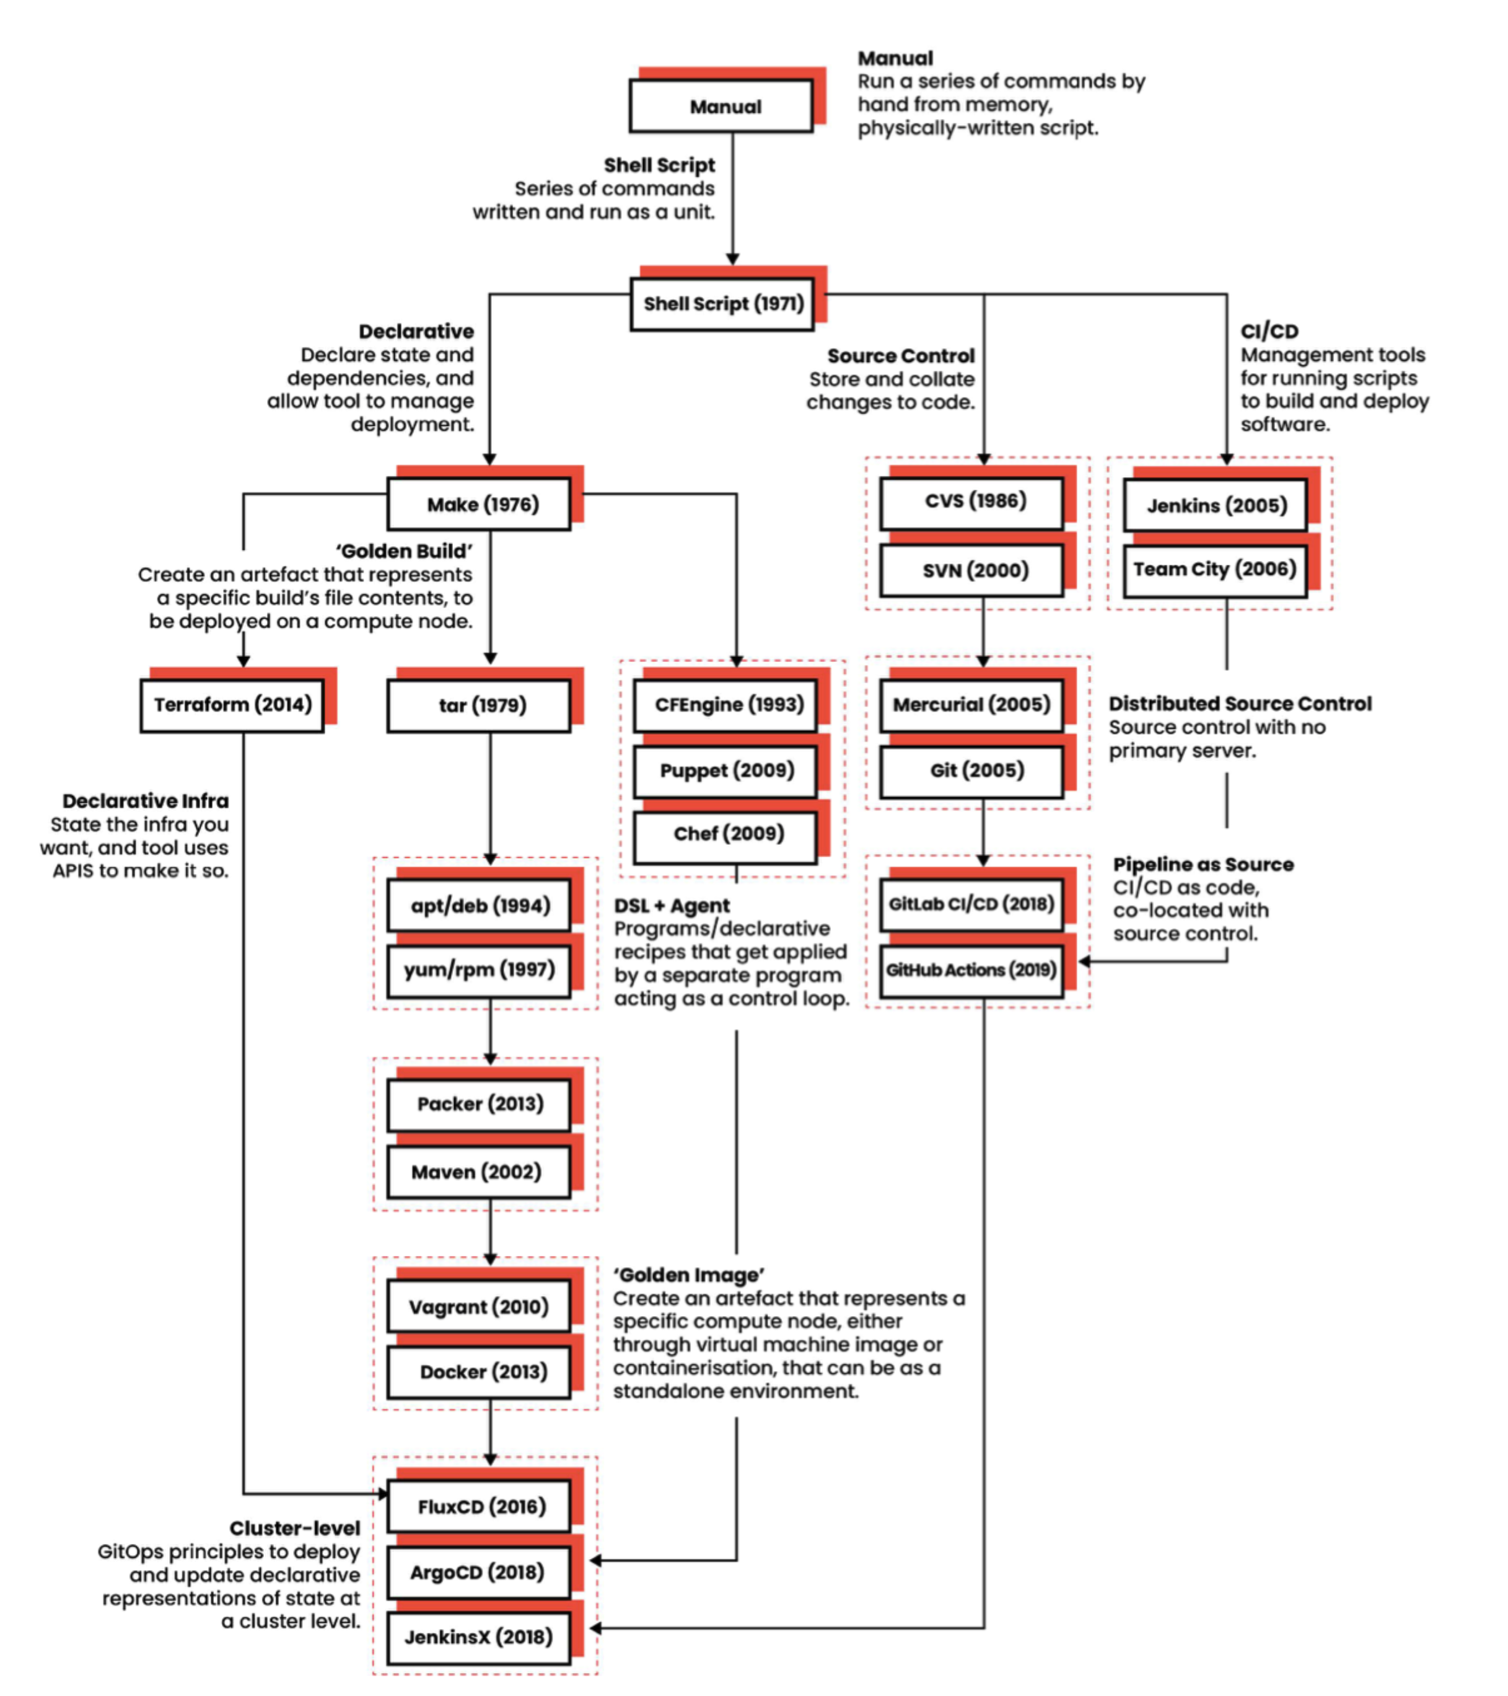
Part III – Defining GitOps

Slide 14
Official Weave definition (2017)
An operating model for Kubernetes and other cloud native technologies, providing a set of best practices that unify deployment, management and monitoring for containerized clusters and applications.
A path towards a developer experience for managing applications; where end-to-end CICD pipelines and Git workflows are applied to both operations, and development.
What Exactly Is GitOps?

Slide 15
Audited source control and configuration management
Declarative data definition of system configuration
Reconciling control loop for configuration management
The Three Key Concepts of GitOps?

Slide 16
Declarative
Code that declares the desired configuration statically, rather than dynamically based on switching procedures
eg
Make
Puppet
YAML
JSON
Declarative

Slide 17
SCM (Source Control Management) tool should provide:
Easy and cheap branching of code
Change history integrity
Change sharing protocols
Integration with identity systems
Source Controlled (I)

Slide 18
Source Controlled (I)
Git is the de facto tool here
Branching is O(1)
SHA hashing of commit contents
GitHub, GitLab et al have evolving standards and enterprise integrations
Extremely widespread adoption
Stack Overflow: 83% of devs on GitHub

Slide 19
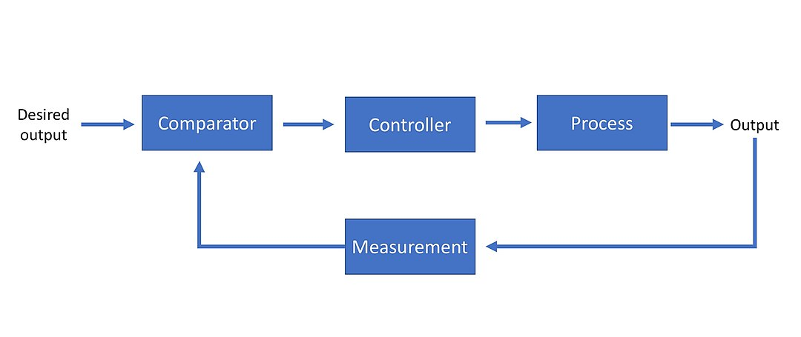
Control Loop (I)
Control Systems (Wikibooks link)

Slide 20
Control Loop (II)
A control loop:
Checks whether system is in desired state
If it is not, effects changes to get into desired state
eg thermostat
‘Controller’ a familiar concept to Kubernetes users – K8s name itself means ‘governor’, a similar engineering concept around speed of system

Slide 21
How GitOps Helps (I)
These concepts, together, improve:
Reliability
Automated, zero-touch, self-correcting systems
Fewer ad hoc, unmonitored system changes
Reduced bespoke logic
Auditability and accountability
Full audit history via souce control

Slide 22
How GitOps Helps (II)
Which deliver benefits:
Improved productivity and lower cost of system ownership
Less time spent debugging systems in unknown state
Less time maintaining systems with recurring problems
Cheaper and simpler workflow/approval systems
Easier to implement automated testing

Slide 23
Fast-growing space
Kubernetes (Deployment Platforms)
Terraform (Infrastructure Provisioning)
ArgoCD/FluxCD (‘Pull’ tools)
Kustomize / kubectl (‘Push’ tools)
JenkinsX (Curated GitOps products)
Part IV – Key
GitOps
Tools

Slide 24
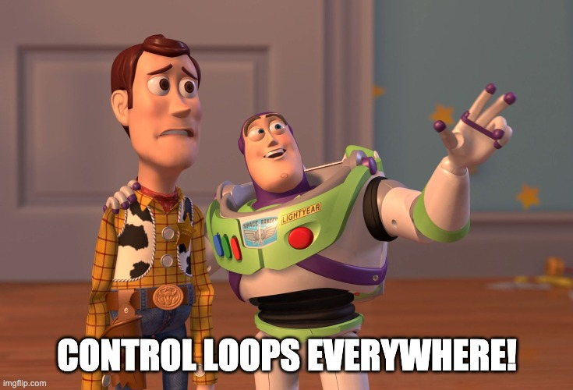
Kubernetes
Runs Docker (or industry standard) containers
Deployment configurable by code (YAML/JSON)

Slide 25
Specifies and maintains infrastructure setup
Declarative language (HCL)
Source-code friendly
Terraform

Slide 26
Two similar ‘control loop’ solutions
Within Kubernetes clusters, these applications track git repositories and apply changes to cluster
Projects’ efforts are consolidating to https://github.com/argoproj/gitops-engine
ArgoCD / FluxCD

Slide 27
Monolithic ‘all-in-one’ GitOps solution
Nothing (much) to do with Jenkins CI
JenkinsX

Slide 28
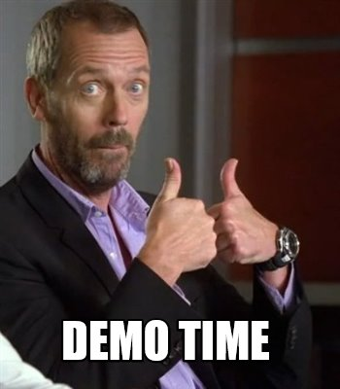
Part V – Demo

Slide 29
Demo Resources
https://github.com/ianmiell/gitops-example
Uses:
GitHub
GitHub Actions
Terraform (optional)
Kubernetes
Shell
Flux
Docker

Slide 30
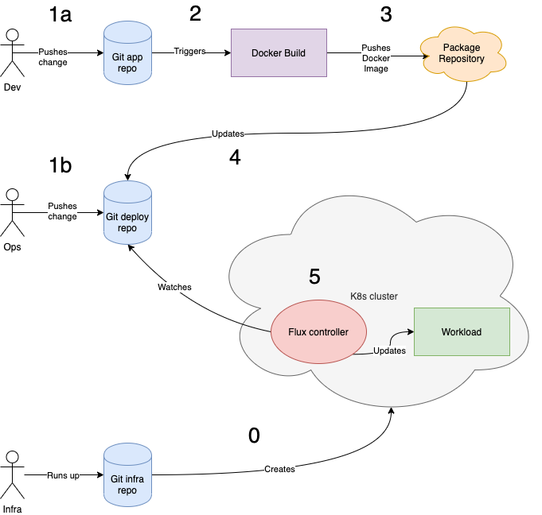
Demo Overview

Slide 31

Part VI – GitOps Implementation Challenges

Slide 32
Challenges - Technical
Many new technologies to learn/master
Git, Terraform, Kubernetes (none of these are trivial)
Many small decisions need to be made when building up your GitOps capability

Slide 33
Need to change delivery mindset
‘Hero’ culture of ‘logging in and fixing’ needs to be challenged
The deployment process/code is king and discipline needs to be maintained
Onboarding new teams to this way of working can generate a lot of friction if they are not prepared
Challenges - Cultural

Slide 34
Challenges - Business
GitOps work is very front-loaded
Can take a long time to ‘bed in’ good practices within an organization before seeing a return on investment
Benefits are not immediately obvious to non-technical people
Emergent area: there is no ‘safe, proven choice’ for a GitOps approach

Slide 35
Technical: Invest in spreading expertise and gaining experience across teams. Ensure documentation and pairing etc used to pass on knowledge.
Cultural: Invest early in outreach, bring staff with you. Point out opportunities for growth and development.
Business: Be realistic, don’t over-promise, and measure costs and compare old/new costs to demonstrate business value.
Challenges - Solutions

Slide 36
Thank you!
Ian Miell
Twitter: @ianmiell
Ian.miell@gmail.com

