Slide 1

Introduction to Bash
Ian Miell
@ianmiell

Slide 2
Introduction
About me
Contact:
  Twitter: @ianmiell
  Email: ian.miell@gmail.com

Slide 3
Bash and Me
Used throughout career
Never learned formally
Stumbled around, lots of mistakes
Slowly learned concepts and key points
Wrote a book

Slide 4
This Course
Live Walkthroughs
  Encourage you to follow - ‘Hard Way’ Method
Exercises
Polls / yes/no ‘temperature checks’
Group chat
Materials:
  https://github.com/ianmiell/introduction-to-bash

Slide 5
Bash and Me
Used throughout career
Never learned formally
Stumbled around, lots of mistakes
Slowly learned concepts and key points
Wrote a book

Slide 6
Pre-Requisites
Familiar with command line
Bash version 4+
  $ echo $SHELL
  $ bash --version
  <4 is still ok
Basic shell utilities (eg grep, cat, ls)
Any editor (I use vim)

Slide 7
Target Audiences
No knowledge assumed
  Advanced questions outside the course please
‘Hardly/never used bash’
  Coverage of 90% of bash features
‘Used bash casually for a while’
  Refresher on some topics, learn some new things
‘Used bash for years, but never studied’
  A-ha moments

Slide 8
Why This Course?
Bash is everywhere
Shells are everwhere
Work with it every day
Taken for granted that it’s known
Studying it pays massive dividends
    Gateway to deeper OS concepts

Slide 9
Bash is under-served
Man page is hard to follow if you don’t know the jargon
One-liners are easy to find but concepts give you real power
Guides that assume knowledge you may not have

Slide 10
Ever been confused by…?
Diffference between ‘[‘ and ‘[[‘
Globs vs regexes
Single vs double quotes
Difference between `` and $()
What a subshell is

Slide 11
Recently I’ve used bash to…
Fix a Terraform script
Robustly apply changes in a cloud-init VM script
Automate the renaming of files with spaces in my backup folders
Setup environments at work

Slide 12
Poll - Experience
Never used bash
Used bash for <2 years
Used bash for >2 years
Used bash for >5 years
Studied bash seriously

Slide 13
Structure of Course
Part I – Bash Basics
Part II – Further Bash Basics
Part III - Scripting
Part IV - Advanced

Slide 14
Discussion
What do you want to achieve in bash?
  Any specific goals?
  What have you been frustrated by with bash?

Slide 15
Part I – Bash Basics
  1.1 Bash background
  1.2 Variables
  1.3 Globs
  1.4 Pipes and Redirects

Slide 16
1.1 What is Bash?
  What is a shell?
  A program takes input from a terminal
  Translates input into:
    System calls
    Calls to other programs
    Computation within the bash program
  Bash excels at ‘gluing’ other commands together

Slide 17
Other shells
  sh
  ash
  ksh
  tcsh
  tclsh

Slide 18
Walkthrough
  Run tcsh from bash

Slide 19
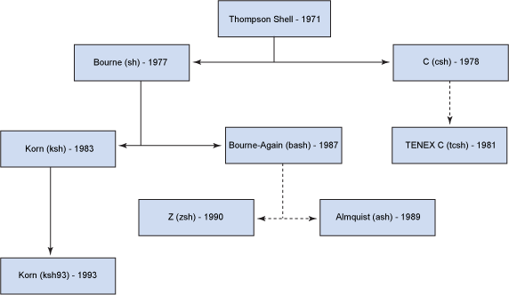
History of Shells

Slide 20
Bash in the Market
  Most popular shell
  Lots of competition:
    zsh will be default on mac
    fish is also popular
  Very rarely, you find servers that don’t have bash on still

Slide 21
1.2 Variables
  Basic variables
  Quoting variables
  ‘env’ and ‘export’
  Simple arrays

Slide 22
Walkthrough - Basic Variables
  Assignment
  Dereferencing

Slide 23
Walkthrough – Variables and Quotes
  Why Quote?
  Space separation
  Double quotes and variables
  Single quotes and variables

Slide 24
Walkthrough – Shell Variables
  Why Quote?
  Space separation
  Double quotes and variables
  Single quotes and variables

Slide 25
Walkthrough – Shell Variables
  What are Shell Variables?
  Readonly variables
  Exporting variables
  Ouptutting exported and shell variables

Slide 26
Walkthrough - Arrays
  Zero-indexed
  Curly braces required
  All variables are arrays!
  declare -a

Slide 27
Recap - Variables
  $ dereferences
  Variables in double quotes are interpreted, single quotes not
  Exported variables are passed to programs run within the shell
  Env shows exported variables, compgen -v shows all variables

Slide 28
1.3 Globbing
  What does ‘*’ mean?
  Differences to regular expressions
  Not familiar with regexes?

Slide 29
Activity – Basic globbing
  ls *
  Shell interpretation
  Globbing and quoting

Slide 30
Activity – Other Glob Characters
  Character classes
  Dots and dotfiles
  .* vs *
  ?
  Special directories

Slide 31
Activity – Difference to Regexps
  Renaming a set of files
  ‘.*’ is not the same as ‘*’!
  Extended globbing available in bash (not covered)

Slide 32
Recap - Globs
  What a glob is
  What a dotfile is
  Special directory files
  Globs, regexps and dots

Slide 33
Exercise I

Slide 34
1.4 Pipes and Redirects
  Basic redirects
  Basic pipes
  File descriptors
  Special files
  Standard out vs standard error

Slide 35
Walkthrough – Basic Pipes and Redirects
  The ‘>’ operator
  Simple pipe

Slide 36
Walkthrough – Standard out / error
  Errors and pipes
  ‘Channels’
  File descriptors
    0 – standard input
    1 – standard output
    2 – standard error

Slide 37
Walkthrough – Standard out / error
  ‘n>’ notation
  2>&1
  Ordering is important
  Bash parses left to right

Slide 38
Walkthrough – Pipes vs Redirects
  Pipes ‘eat’ standard output from a command
  Pipes ‘output’ standard input to another command
  Redirects send a channel of output to a file
  The ‘<’ operator
  The ‘>>’ operator

Slide 39
Recap – Pipes vs Redirects
  The main 3 file descriptors
  ‘>’ vs ‘>>’
  n> and standard error
  2>&1 and ordering

Slide 40
Part I Recap
  Globs
    vs regexps
  Variables, arrays
  Pipes and redirects
  File descriptors

Slide 41
Exercise II

Slide 42
Break

Slide 43
Part II – Further Bash Basics
  2.1 Functions
  2.2 Tests
  2.3 Loops
  2.4 Exit Codes
  2.5 Process Substitution
  2.6 Command Substitution

Slide 44
Discussion
  Is bash a programming language?
  What is a programming language?
  Why has bash lasted so long?

Slide 45
2.1 Functions in Bash
  Four types of command:
    Function
    Alias
    Program
    Builtin

Slide 46
Walkthrough - Basic Functions
  Declaring a function
  Function arguments
  Variable scope
  Local variables

Slide 47
Walkthrough - Builtins
  cd is a builtin
  Builtins can also be programs
  ‘builtin’ is a builtin!
  Functions and builtins
  unset -f
  declare -f / -F

Slide 48
Walkthrough - Programs
  ‘which’

Slide 49
Walkthrough - Aliases
  ‘alias’
  ‘unalias’
  The ‘type’ builtin

Slide 50
2.2 Tests
  Bash tests
  Different ways of writing tests
  Logical operators
  Binary and unary operators
  ‘if’ statements

Slide 51
Walkthrough – Basic Tests
  Tests and exit codes
  Comparing values
  What is ‘[‘?

Slide 52
Walkthrough – Logical Operators
  ‘!’ means ‘NOT’
  ‘||’ means ‘OR’
  ‘&&’ means ‘AND’
  ‘(...)’ evaluates first
  ‘-a’ vs ‘&&’

Slide 53
Walkthrough – The ‘[[‘ Operator
  Why do both exist?
  Confused?

Slide 54
Walkthrough – Unary and Binary Operators
  ‘-z’
  ‘-a’
  ‘-d’
  Types in bash

Slide 55
Walkthrough – if Statements
  Basic ‘if’ statements
  Bare ‘if’ statements

Slide 56
Recap - Tests
  Tests in bash
  ‘[‘ vs ‘[[‘
  Unary vs Binary operators
  Types in bash (limited)

Slide 57
2.3 Loops
  ‘C’-style for loops
  ‘for’ loops over items ‘in’ lists
  ‘while’ and ‘until’ loops
  ‘case’ statements

Slide 58
Walkthrough – Loops
  C-style - ‘((‘
    Different variable referencing
  ‘for f in $()’
    Beware!
  ‘while’ and ‘until’
  Infinite loop form with ‘break’

Slide 59
Walkthrough – Loops
  ‘case’ statements
  ‘esac’, ;; and *)
  Command line options

Slide 60
Recap – Loops
  Two types of for loop
  while and until
  case statements
  command line options

Slide 61
2.4 Exit Codes
  What an Exit Code is
  How to set one
  Conventions
  Other ‘special’ parameters

Slide 62
Walkthrough – Exit Codes
  The ‘$?’ variable
  ‘0’ or ‘not 0’
  Exit codes and tests

Slide 63
Standard Exit Codes
  0 – OK
  1 – General Error
  2 – Misuse of shell builtin
  126 – Cannot execute
  127 – No file found matching command
  128 – Invalid exit value
  (128 + n) – Process killed with signal ‘n’
  (Signals covered in Part IV)

Slide 64
Walkthrough – Exit Codes
  Exit codes used differently by different apps
  eg grep
  The ‘exit’ builtin
  The ‘return’ builtin

Slide 65
Walkthrough – Special Parameters
  Special parameters == special variables
  $?
  $$
  man bash

Slide 66
Recap – Exit Codes
  Standard exit codes
  Exit code usage (eg grep)
  Setting exit codes
  ‘return’ing from functions
  Special parameters

Slide 67
Exercise III

Slide 68
2.5 Process Substitution
  The ‘<()’ operator
  Substitution of file arguments

Slide 69
Walkthrough – Process Subsitution
  The ‘<()’ operator
  Substitution of file arguments

Slide 70
2.6 Command Substitution
  The ‘$()’ operator

Slide 71
Walkthrough – Command Substitution
  The ‘$()’ operator
  $() vs ``
  Nesting

Slide 72
Discussion / Recap – Part II
  Bash more as programming language:
    Functions
    Tests / ifs
    Loops
    Return/Exit codes
    Process and command substitution
  $() vs ``

Slide 73
Break

Slide 74
Part III - Scripting
  Scripts and Startup
  The ‘set’ Command
  Debugging in bash
  Subshells
  IFS

Slide 75
3.1 Scripts and Startup
  What shell scripts are
  What happens on bash startup
  This has cost me many hours!

Slide 76
Walkthrough – Shell Startup
  The ‘shebang’ - ‘#!’
  What happens on bash startup
  Running an executable file
  Making a file executable

Slide 77
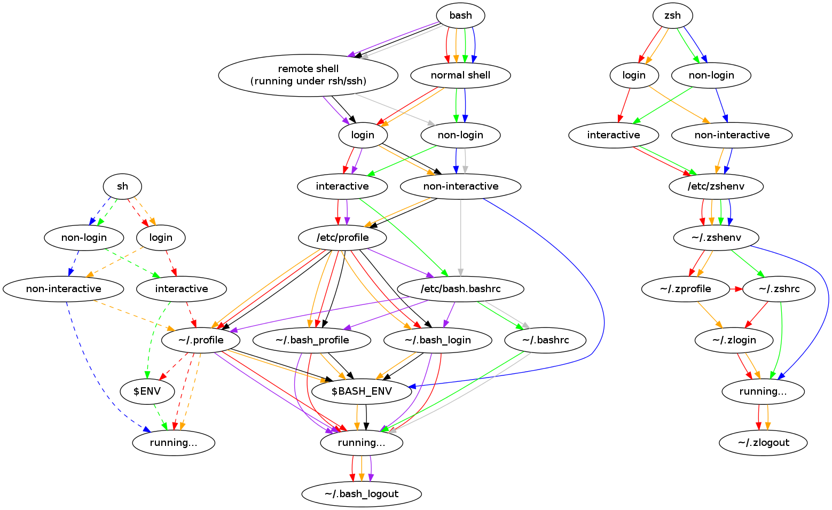
Walkthrough – Startup Explained

Slide 78
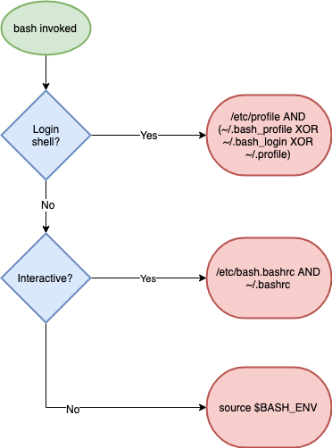
Walkthrough – Startup Explained (simpler)

Slide 79
Walkthrough - sourcing
  The ‘source’ builtin
  ‘source’ vs ‘./’
  The ‘sh’ suffix
  Debugging with ‘env -i’

Slide 80
Recap - Scripts and Startup
  What shell scripts are
  What happens on bash startup
  This has cost me many hours!

Slide 81
3.2 The ‘set’ builtin
  Setting options in bash
  What POSIX is
  Most useful options:
    nounset
    xtrace
    errexit
    pipefail
  ‘set’ vs ‘shopt’

Slide 82
3.2 The ‘set’ builtin
  Setting options in bash
  What POSIX is
  Most useful options:
    nounset
    xtrace
    errexit
    pipefail
  ‘set’ vs ‘shopt’

Slide 83
Walkthrough – Running ‘set’
  ‘set’
  POSIX
  set POSIX off
  + is off – is on (this IS confusing)
  ‘set’ vs ‘env’

Slide 84
Walkthrough – ‘set’ Options
  errexit
  xtrace
  nounset
  flags vs -o name
  pipefail
  ‘set’ vs ‘shopt’

Slide 85
Recap - ‘set’
  Options: + off, - on
  POSIX
  Most common options
  shopt and set

Slide 86
3.3 Debugging bash
  ‘set’ flags already covered
  Syntax checking
  Profiling bash and ‘PS4’
  Shellcheck

Slide 87
Walkthrough – bash Arguments
  bash -n
  bash -v
  bash -x
  bash -x and PS4
  shellcheck my bashrc

Slide 88
Exercise IV

Slide 89
3.4 Subshells
  What is a subshell?
  How to create a subshell
  Why they are useful
  () vs {}

Slide 90
Walkthrough - subshells
  A simple subshell
  Subshells and variable scope
  Subshells and redirection
  () or {}?
  Subshells and working directory

Slide 91
3.5 Internal Field Separator
  aka IFS
  Why it’s important
  How to use it

Slide 92
Walkthrough – Spaces in Filenames
  ‘for’ looping over files
  The IFS shell variable
  The $’’ construct

Slide 93
Walkthrough – Spaces in Filenames
  Setting IFS
  The ‘find’ command and ‘xargs’
  find, xargs and the null byte separator

Slide 94
Exercise V

Slide 95
Part III – Discussion / Recap
  Shell Startup
  Practical bash usage
    Shell options
    Shell debugging
    IFS

Slide 96
Break

Slide 97
Part IV – Advanced Bash
  Traps
  String manipulation
  Autocomplete
  Walkthrough a ‘real’ script

Slide 98
4.1 Traps
  Traps and signals
  The ‘kill’ command
  The ‘wait’ builtin
  Trapping signals
  Process groups

Slide 99
Exercise VI

Slide 100
4.2 String Manipulation
  Why use bash for this?
    Quicker
    No dependencies
  Editing/examining strings in bash
  Avoiding common quoting problems

Slide 101
Walkthrough – String Manipulation
  Get string length
    ${#VAR}
  String slicing
    ${VAR:2}
    ${VAR:2:3}
  String editing
    ${VAR/234/432}
    ${VAR//234/432}

Slide 102
Walkthrough – Advanced Strings
  Requires 4.x+
    ${VAR,}
    ${VAR,,}
    ${VAR^}
    ${VAR^^}

Slide 103
Walkthrough – Quoting Hell
  Quotes in quotes
  Changing quotes mid-line

Slide 104
4.3 – Autocomplete
  How autocomplete works
  The ‘shift’ command
  Writing your own autocompletes

Slide 105
Walkthrough – A Simple Program
  myecho
  ‘shift’
  Colours
  ‘$@’

Slide 106
Walkthrough – Autocomplete Script
  myechocomplete
  Sourcing
  Advanced autocompletion
  Write your own!

Slide 107
Discussion – cheapci script
  https://github.com/ianmiell/cheapci

Slide 108
Wrapup
  Feedback welcome
  Thanks!
  Any questions:
    @ianmiell
    ian.miell@gmail.com

Slide 109
Wrapup
  https://github.com/ianmiell/cheapci

Slide 110
Introduction to Bash
Ian Miell
@ianmiell

