Slide 1
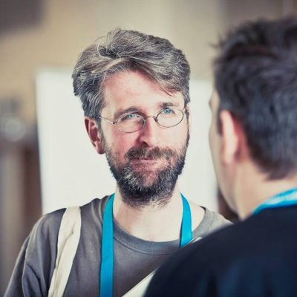
Introduction to the Command Line
Ian Miell
Twitter: @ianmiell
Ian.miell@gmail.com

Slide 2
Started in tech in 2000, Comp Sci degree
Only knew windows before
Command line was a mystery to me
Grew to love it
Book on bash, spend most of my time on the command line today
About Me

Slide 3
Pre-requisites
Access to a command line
Ideally bash
Nice to have – knowledge of basic bash
Introduction to Bash course available
Pipes most common feature likely to be used

Slide 4
Why This Course?
Command line is efficient
For people who are:
New to it
Want to learn more about it
Want to progress further
NOT a complete list of all commands used
Try to cover wide ground, beginner to expert
Try to show how to learn more

Slide 5
A lot of commands
Some techniques
Some key concepts
Readline
History of terminals
Anything you want...
We Will Cover

Slide 6
Part I – The Core
Commands
Part II – Text and Files
Text and file manipulation and search
Readline
Part III – Networking and System (Time Permitting)
Web requests
Network debugging
Service management
System monitoring
Structure of Course

Slide 7
Discussion - Experience
Never used command line
Used a little (less than one year)
Use rarely (longer than a year)
Use all the time

Slide 8
Discussion
What do you want to learn about?
What problems have you faced?

Slide 9
Materials
https://github.com/ianmiell/introduction-to-the-command-line

Slide 10
Part I – Core Commands
cd
mkdir
rm
ls
cat
echo

Slide 11
less
How to use + tips
man
How to use + tips
Part I – Core Commands

Slide 12
Part I – Exercise / Break

Slide 13
Globs vs Regexps
Commonly confused – similar but different
Both used to select things:
Eg glob wildcard, eg select all files with:
ls *
Regexp wildcard is ‘.*’, eg:
grep “before.*after” *
Shells use globs, programs use regexps.
If it’s in quotes, the program uses it.
Part II – Globs vs Regexps

Slide 14
grep
tr
sed
sort / uniq
tail
diff / sdiff
Part II – Text and File Manipulation

Slide 15
Part II – Readline Shortcuts
Readline
CTRL + a
CTRL + e
CTRL + r

Slide 16
Part II – Exercise / Break

Slide 17
Part III – Networking and System
Networking:
Web requests
TCP connections
ICMP connections
DNS

Slide 18
System:
top
ps
kill
Part III – Networking and System

Slide 19
Wrapup Q&A

Slide 20
Thanks!
Ian Miell
@ianmiell

