Slide 1
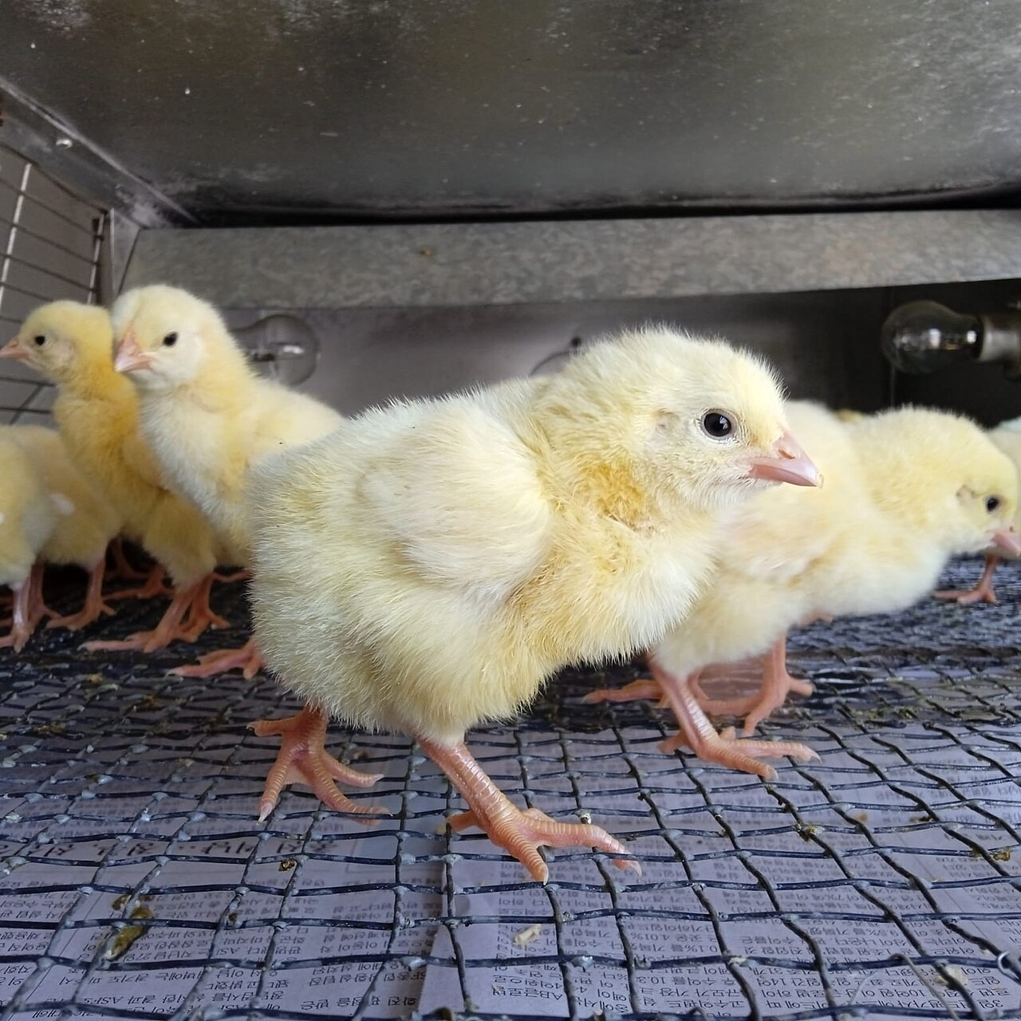
PROJECT 14 • ENGINEERING OVERVIEW
Smart Incubator /
Brooder Controller
From thermal equations to a beginner-friendly web simulation
PI/PID control • Euler and RK4 • Flask + Pygame
Real brooder photo • ELTORO.VET • CC0
A learning model—not a real brooder controller.

Slide 2
01 | THE CHALLENGE
Why model a brooder?
Temperature is affected by weather, insulation, chick heat and a heater with a finite capacity.
WEATHER
HEATER LIMIT
CHICK COMFORT
Cold nights and rain increase heat loss.
A heater can add heat, but cannot cool or exceed its power rating.
The model tracks whether the target and comfort band can be maintained.
The question
Can feedback control keep the brooder near 35 °C when conditions change?
PROJECT GOAL
Make the physics, controller response and practical limits visible to learners.
SMART BROODER | PROJECT 14
02

Slide 3
02 | THERMAL MODEL
Follow the heat
A single well-mixed temperature represents the air and bedding inside the brooder.
C dT/dt = P + Q_chicks - [(1 + k_rain · rain(t)) / R] · (T - T_a(t))
C
Thermal capacity: how quickly the enclosure warms or cools.
P
Delivered heater power, clipped between 0 and P_max.
DEFAULT EXAMPLE
Q_chicks
Metabolic heat from chicks; default total is 8 W.
R
Insulation resistance; larger R means less heat loss.
C = 8,000 J/K
R = 0.20 K/W
P_max = 150 W
Q_chicks = 8 W
k_rain = 0.30
T_a, rain
Weather inputs; rain raises the heat-loss rate.
T_set
Controller target: 35 °C in the example configuration.
Simplifications: one temperature node; ideal sensor and heater; no humidity, ventilation or spatial gradients.
SMART BROODER | PROJECT 14
03

Slide 4
03 | CONTROL LOOP
Feedback turns temperature error into heater power
The model integrates both the brooder temperature and controller states at each time step.
TARGET + SENSOR
P / PI / PID
HEATER LIMIT
THERMAL PLANT
FEEDBACK
e = T_set - T
u = Kp·e + Ki·I − Kd·(T−Tm)/τd
P = clip(u, 0, P_max)
temperature changes
measure T again
P
Simple response; steady load can leave a temperature offset.
PI
Integral action removes steady error when the heater has enough capacity.
PID
Derivative action anticipates trends; it adds little for this slow first-order plant.
ANTI-WINDUP
Back-calculation stops the integral term growing while the heater is saturated.
SMART BROODER | PROJECT 14
04

Slide 5
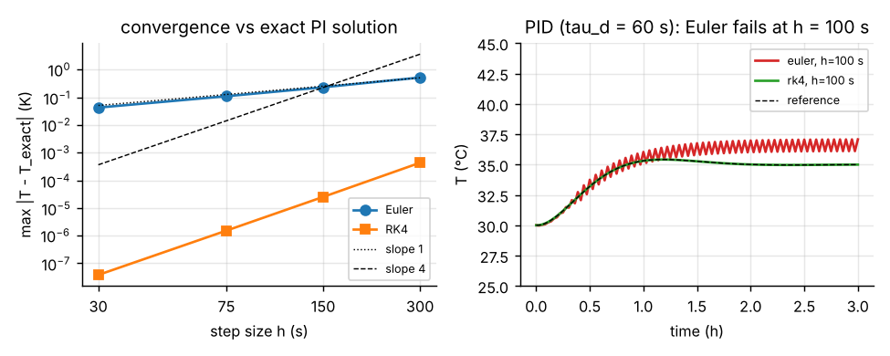
04 | NUMERICAL VALIDATION
The solver changes what the learner sees
The left plot compares error against an exact PI reference; the right shows a stiff PID case.
MAXIMUM ERROR AT H = 300 S
PID RUN AT H = 100 S
Euler 0.523 K
Euler oscillates
RK4: 0.000433 K
RK4 stays close to the reference
SMART BROODER | PROJECT 14
05

Slide 6
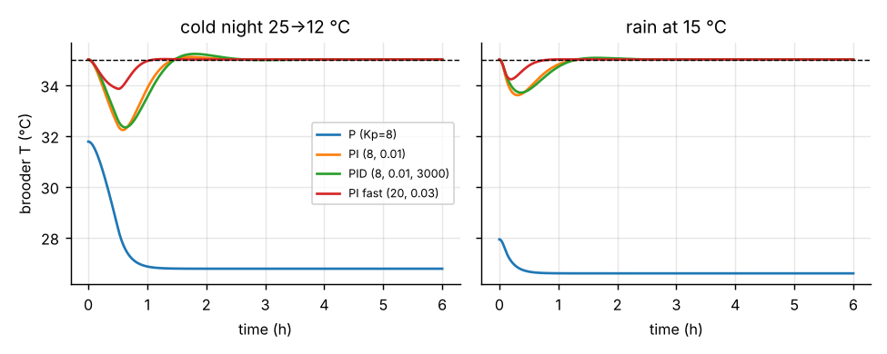
05 | RESULTS
Control choice changes recovery
Cold night: ambient drops from 25 °C to 12 °C. Results use RK4 with h = 2 s.
WHAT THE PLOTS SHOW
P-only control cannot remove the steady load.
Integral action removes steady error when power is sufficient.
The derivative term adds little here and can amplify noise in real sensors.
P-ONLY STEADY ERROR
PI RESPONSE
FASTER PI
8.23 K
2.77 K peak
1.16 K peak
cold-night case
70 min recovery
45 min recovery
A controller cannot compensate for a heater that is too small or insulation that is too weak.
SMART BROODER | PROJECT 14
06

Slide 7
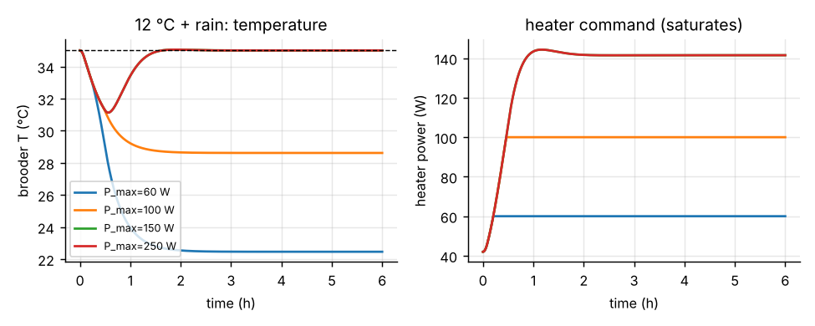
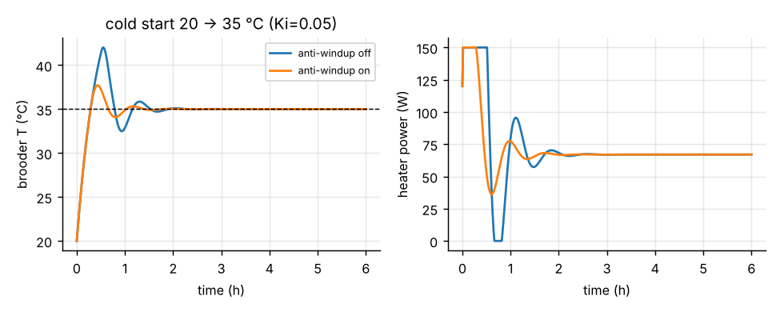
06 | PRACTICAL LIMITS
Capacity, insulation and anti-windup matter
Tuning helps—but it cannot overcome an impossible heat balance.
HEATER CAPACITY
INTEGRAL WINDUP
At 12 °C with rain, about 141.5 W is needed. A 60 W or 100 W heater cannot hold 35 °C; 150 W can.
With Ki = 0.05, anti-windup cuts start-up overshoot from 7.01 K to 2.70 K and settling from 85 to 56 min.
More insulation (R = 0.4 K/W) reduces required power to 49.5 W and gives 16 minutes of grace after heater failure.
SMART BROODER | PROJECT 14
07

Slide 8
07 | SOFTWARE ARCHITECTURE
One simulation core, two ways to explore it
The web app and Pygame interface use the same Python model and numerical solvers.
BROWSER UI
FLASK APP
MODEL CORE
SQLITE
landing.html
auth.html
index.html
routes
validation
CSRF + sessions
model.py
solvers.py
metrics.py
accounts
saved parameters
results + series
WEB API
POST /api/simulate • GET /api/runs • load or delete a run by ID
PYGAME
Desktop GUI for live experiments; shares brooder/model.py and brooder/solvers.py.
The web app computes the run on the server, then the browser plays back the returned numerical states.
SMART BROODER | PROJECT 14
08

Slide 9
08 | PEOPLE AND SAFETY
Designed to be approachable—and clear about limits
The interface explains the simulation without suggesting that it controls real equipment.
EASY START
ACCESSIBLE HELP
Quick setup for first runs; advanced controls can stay closed.
Meet Pip keeps text available; speech plays only when requested.
PERSISTENT THEME
ACCOUNT PRIVACY
Light/dark choice is saved in the browser and reused on account pages.
Hashed passwords, CSRF checks and per-user saved-run queries.
Real brooder photo • ELTORO.VET • CC0
Educational model only: simplified physics, no live sensors, no hardware control.
SMART BROODER | PROJECT 14
09

Slide 10
09 | PRESENTING THE PROJECT
A short demo tells the whole story
Show the user experience first, then connect it back to the model and experiments.
DEMO FLOW
TAKEAWAYS
1
Launch
Run `py -3 -m webapp.app` or press F5 in VS Code.
PI control removes steady-state error when heater capacity is sufficient.
2
Set up
Create an account and keep the recommended Quick setup values.
Capacity and insulation define the physical limit; tuning cannot defeat saturation.
3
Observe
Run the simulation; watch temperature, heater power and the plots.
RK4 is much more reliable than coarse Euler steps for this stiff PID example.
4
Challenge it
Try a cold night or rain, then compare a saved run.
Questions?
SMART BROODER | PROJECT 14
10

