Slide 1
Predicting CMS Hospital Star Ratings with Patient Response Data
Ian Vogt

Slide 2

Defining the topic and dataset
CMS Hospital Star Rating system first introduced in 2016 and provides consumers with a simple overall rating to better inform medical patients about where they should receive their care.
Ratings are public, so hospitals should be motivated to rate well and drive patient demand.
Data procured on HCAHPS: Patients' Perspectives of Care Survey responses across 2016-2020.
Data Source: https://www.kaggle.com/datasets/abrambeyer/us-hospital-customer-satisfaction-20162020
Notes:
The HCAHPS survey is administered to a random sample of adult patients across medical conditions between 48 hours and six weeks after discharge

Slide 3
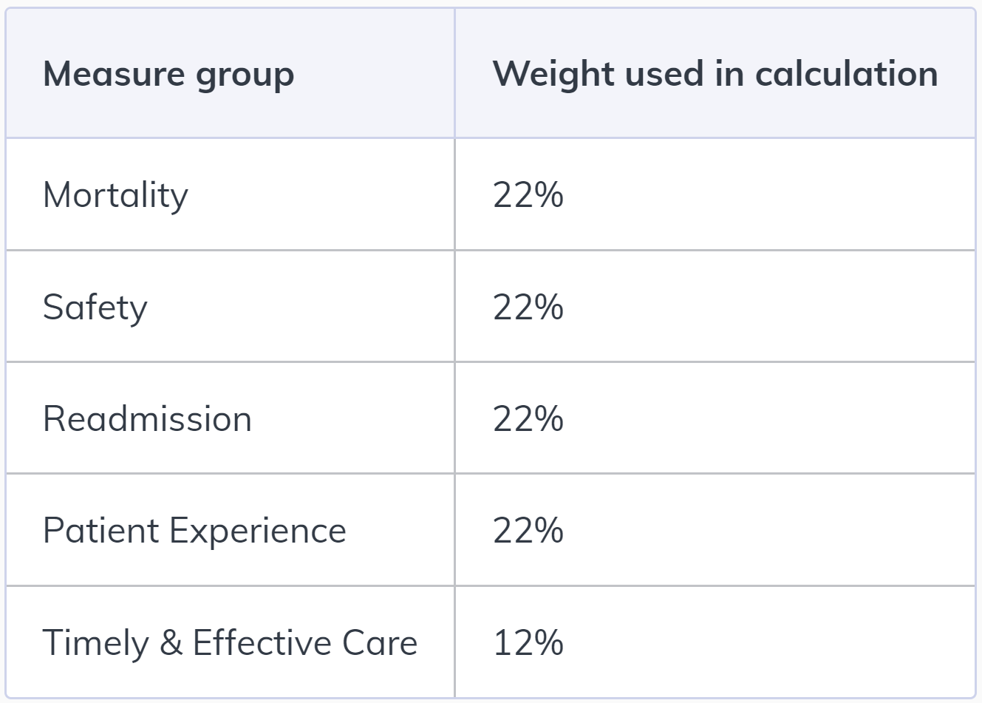
Defining the problem and solution
Question: Are CMS Star Ratings generally representative of the patient experience, and if so what aspects are most important?
Solution: Develop an interpretable model using the HCAHPS patient response data to predict CMS Hospital Star Ratings
Goal: Make inferences on which aspects of the patient experience are most important regarding obtaining a good hospital rating
HCAHPS Survey Example: https://www.anesthesiallc.com/images/eAlertsSource/HCAHPS-Survey-Questions.pdf
How CMS Hospital Star Rating measure groups are weighted. https://data.cms.gov/provider-data/topics/hospitals/overall-hospital-quality-star-rating/

Slide 4

Topic inspiration and previous research
Predicting Hospital Overall Quality Star Ratings in the USA (2021) tried to infer an interpretable model that could predict CMS Hospital Star Ratings based on the most important performance measures.
CMS Star Rating system was previously criticized for instability of the CMS loading coefficients derived from a latent variable modeling approach. It was seen that most of the CMS loading coefficients aligned with the paper’s model, but with the exception of performance measures in the patient experience and timeliness of care domains.
Kurian, Nisha, Jyotsna Maid, Sharoni Mitra, Lance Rhyne, Michael Korvink, and Laura H. Gunn. 2021. "Predicting Hospital Overall Quality Star Ratings in the USA" Healthcare 9, no. 4: 486.
Bilimoria, Karl Y., and Cynthia Barnard. "The new CMS hospital quality star ratings: the stars are not aligned." Jama 316, no. 17 (2016): 1761-1762.
Adelman, Daniel. "An efficient frontier approach to scoring and ranking hospital performance." Operations Research 68, no. 3 (2020): 762-792.
Notes:
The goal of the 1st paper was to make the CMS hospital star rating system easier to understand for hospitals from the perspective of trying to improve the hospital rating, as well as to allow patients and providers to infer on what CMS hospital star ratings would be for hospitals that were not eligible to be rated due of lack of reporting.
From the hospital perspective, the latent variable modeling approach CMS uses does not leave the hospital with interpretable results. Ordinal logistic regression reduced the double counting of information embedded when considering highly correlated performance measures. Hospitals can focus their efforts on model-identified key measures and assess, through odds ratios, the expected changes in ratings upon improvements in those performance measures.

Slide 5
Taking a different approach + honing in on the patient experience
The original CMS Hospital Star Rating prediction study used ordinal logistic regression to maximize interpretability of performance measure effect on star ratings. The paper model incorporated 6 of the 10 patient survey response measurements.
I tested linear regression, ordinal logistic regression, and ensemble logistic regression approaches to maximize predictive accuracy among methodologies that would allow explanatory inference among predictors.
I utilized Relative Weights Analysis and Shapley Values to establish importance among highly collinear predictors.

Slide 6
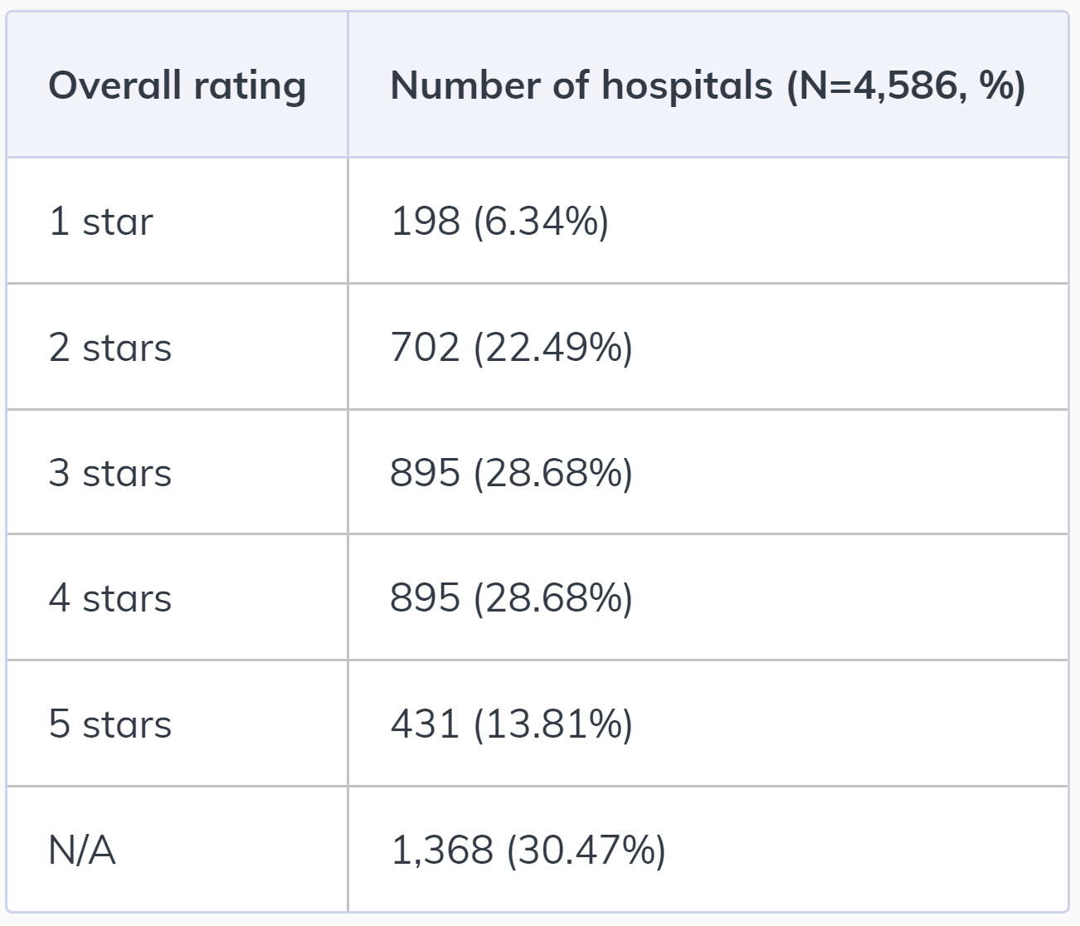
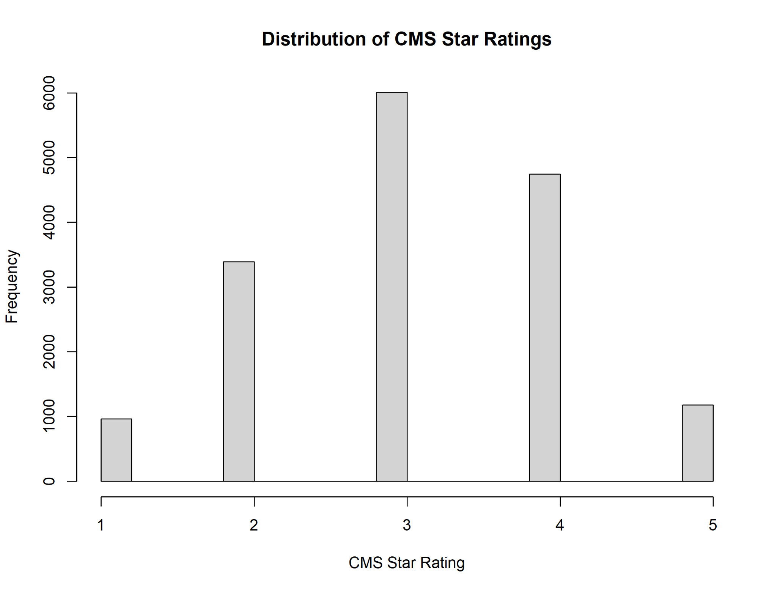
Distribution of CMS Star Ratings
Distribution of 16,280 CMS Star Ratings across 2016-2020. https://data.cms.gov/provider-data/topics/hospitals/overall-hospital-quality-star-rating/
Distribution of updated CMS Star Ratings released in July 2022. https://data.cms.gov/provider-data/topics/hospitals/overall-hospital-quality-star-rating/

Slide 7
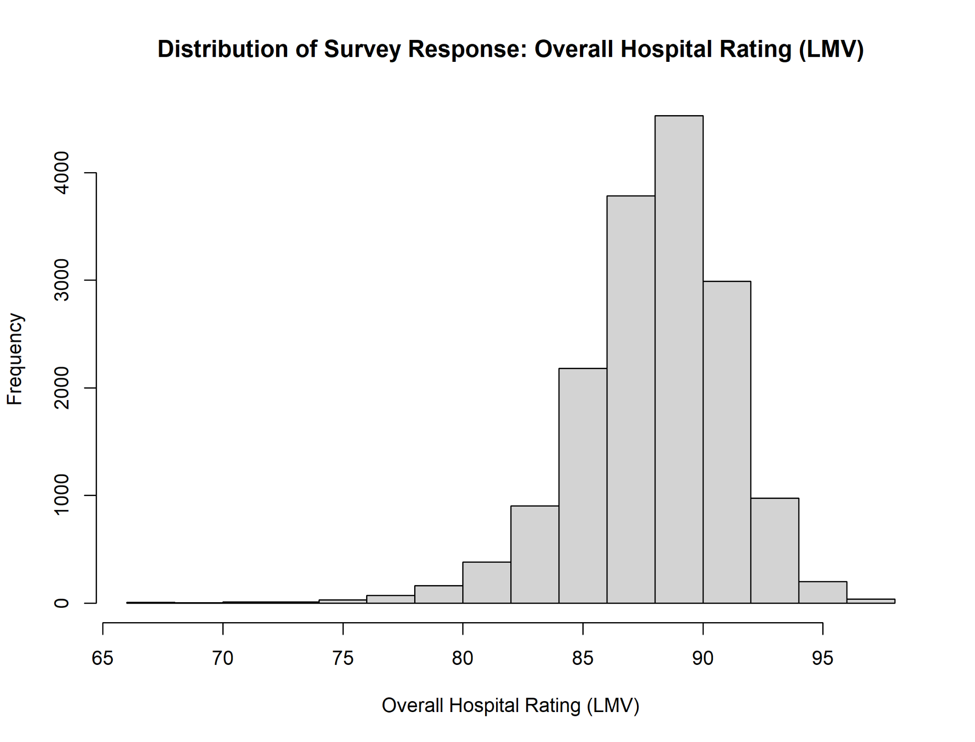
Defining the predictors - star ratings vs. linear scoring
CMS takes all survey responses and constructs HCAHPS Star Ratings (1-5) for each measurement group. The star ratings are scored linearly, adjusted, rescaled, averaged across quarters, and rounded to produce a 0-100 linear-scaled score (Linear Score or Linear Mean Value).
Data flow: Survey response → Star rating → Linear score
Details on Linear Scoring: https://hcahpsonline.org/globalassets/hcahps/star-ratings/tech-notes/april_2023_star-ratings_tech_notes.pdf

Slide 8
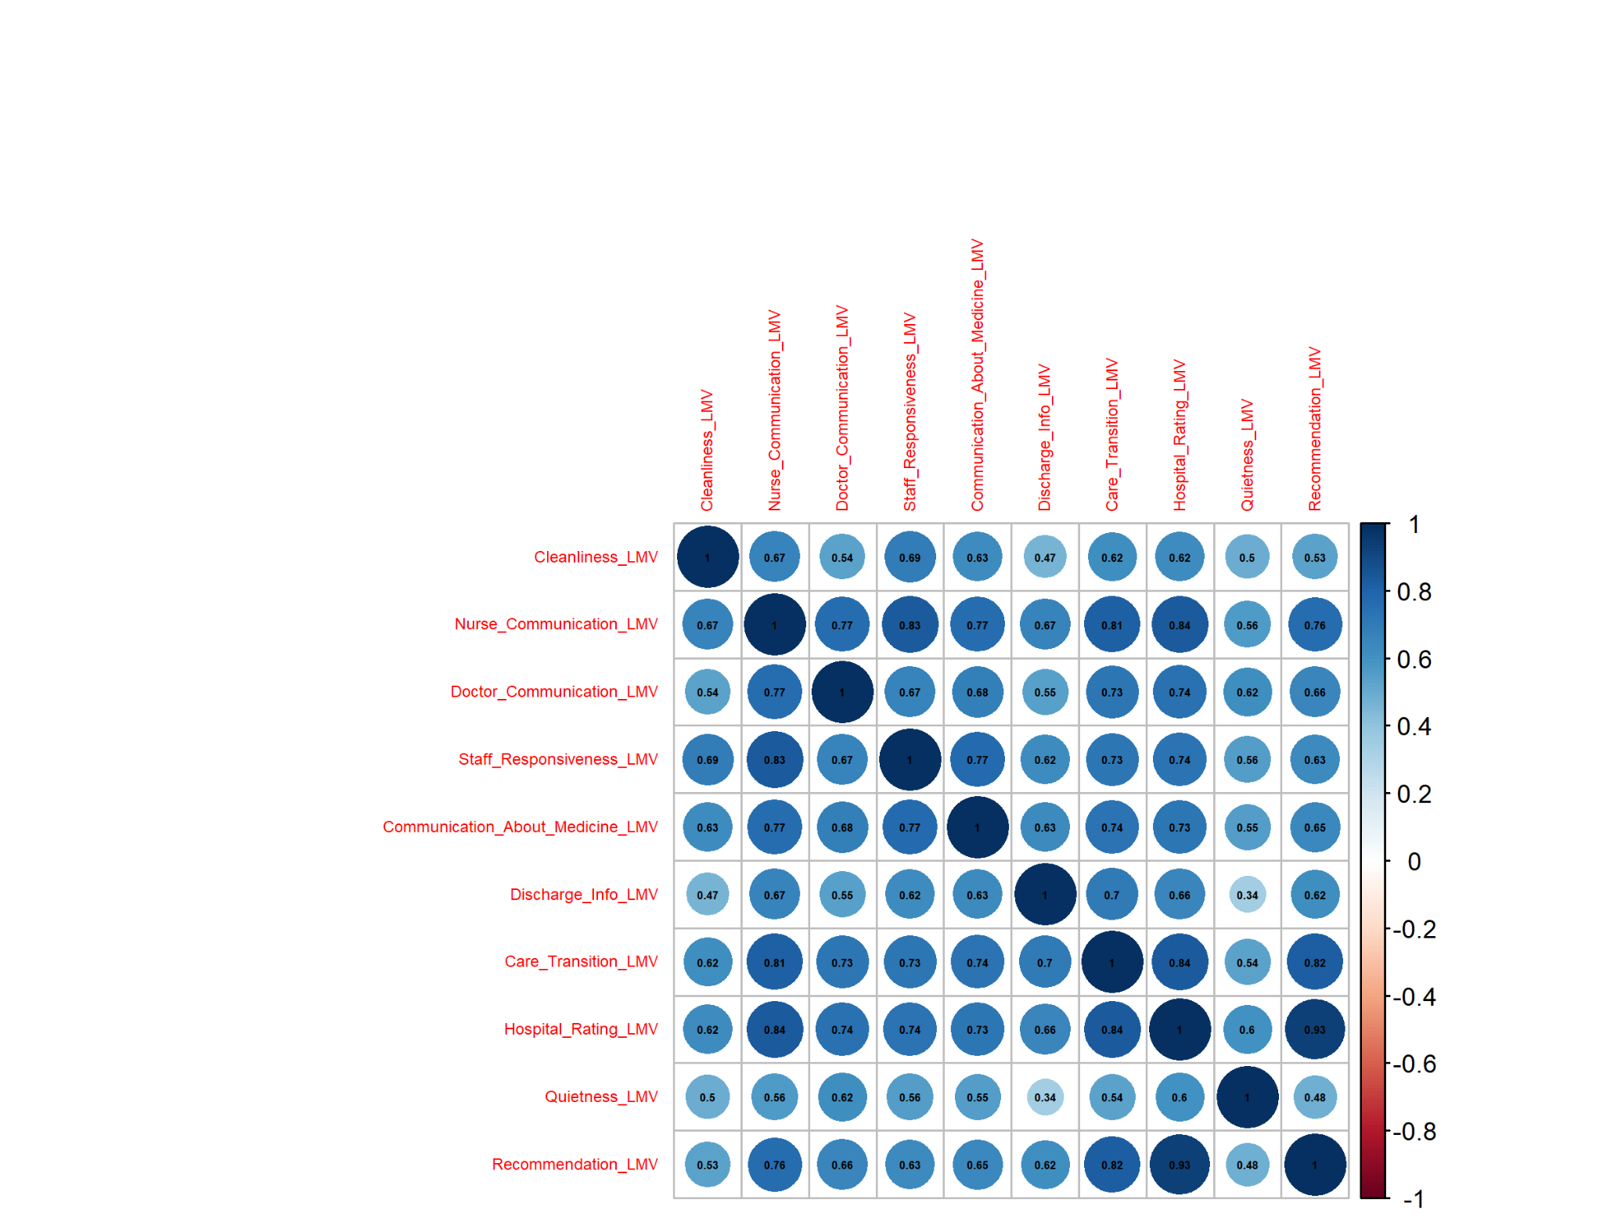
Addressing collinearity in the survey data
Going with survey response linear scores leaves us with 10 possible predictors.
Hospital Rating and Recommendation LMVs are highly correlated (93%). I chose to drop both because I feel they do not highlight any specific aspect of the patient experience.

Slide 9
What does RWA and Shapley say about feature importance?
Predictor | Rescaled Relative Weight | Rescaled Standardized Shapley Value
Cleanliness | 12.16 | 10.91
Nurse Communication | 14.61 | 16.25
Doctor Communication | 10.11 | 9.86
Staff Responsiveness | 13.70 | 14.27
Communication About Medicine | 10.39 | 10.71
Discharge Information | 13.26 | 11.65
Care Transition | 18.76 | 20.24
Quietness | 7.01 | 6.09
Relative Weight Analysis and Shapley Values are taken to infer on relative importance of the eight remaining covariates.
Both techniques identify Care Transition as the most important features, followed by Nurse Communication and Staff Responsiveness. Quietness is clearly the least important feature.

Slide 10
Model fitting and selection
Forward selection and backwards elimination algorithms used to further trim the models and address collinearity in the features.
Out-of-sample testing accuracy scores showed ensemble logistic approach could improve upon ordinal logistic approach:
Linear Regression: 0.4738 | 95% CI : (0.4597, 0.4879)
Ordinal Logistic Regression: 0.4771 | 95% CI : (0.463, 0.4912)
Ensemble Logistic Regression: 0.484 | 95% CI : (0.4699, 0.4982)

Slide 11
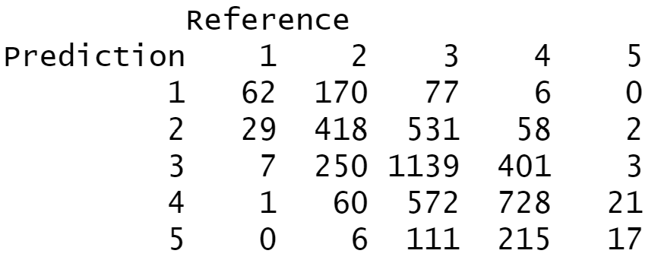
Applying ensemble to logistic regression
Predictions are formed from 4 models:
Model to predict probability a hospital is rated at least 5-stars
Model to predict probability a hospital is rated at least 4-stars
Model to predict probability a hospital is rated at least 3-stars
Model to predict probability a hospital is rated at least 2-stars

Slide 12
Interpreting model results, identifying the impact
Significance and impact of covariates varied across the 4 logistic models.
Interpretation is less straightforward, but can suggestions can be tailored to hospitals in specific rating groups looking to be bumped into the next group.
Example: Quietness score was significant in predicting the hospitals to be at least 2-star, 3-star, or 4-star rated, but not in the 5-star group.
Example: Care transition was highly significant in explaining whether or not hospitals were rated at least 4-stars or 5-stars, but less important for defining hospitals rated at least 3-stars and not significant at all in defining hospitals rated at least 2-stars. A 1-unit increase in care transition linear mean score is associated with a 1.48 times statistically significant increase in the odds of a hospital being rated 5-stars.

Slide 13
Limitations and future scope of this project
Limitation: High collinearity among communication-based survey response questions made it difficult to establish these variable associations with CMS Star Ratings.
Limitation: CMS has changed the distribution of star ratings over time. Updating data to include 2021, 2022 information.
Extension: Taking a time-series approach and modeling the effect of each survey response question over the years to see how CMS has changed question importance regarding star ratings.
Extension: Applying ensemble logistic approach to the data with more hospital performance measures to improve predictive accuracy.

Slide 14
THANK YOU!
Any questions?

Slide 15
References
Data Source: https://www.kaggle.com/datasets/abrambeyer/us-hospital-customer-satisfaction-20162020
Kurian, Nisha, Jyotsna Maid, Sharoni Mitra, Lance Rhyne, Michael Korvink, and Laura H. Gunn. 2021. "Predicting Hospital Overall Quality Star Ratings in the USA" Healthcare 9, no. 4: 486.
Bilimoria, Karl Y., and Cynthia Barnard. "The new CMS hospital quality star ratings: the stars are not aligned." Jama 316, no. 17 (2016): 1761-1762.
Adelman, Daniel. "An efficient frontier approach to scoring and ranking hospital performance." Operations Research 68, no. 3 (2020): 762-792.
Code, data, and slides pushed to https://github.com/ianmvogt/CMS-Hospital-Star-Rating-Prediction/

Slide 16
Appendix - Construction of Covariates
HCAHPS Survey Data Example (Southeast Alabama Medical Center, 2016):
65% of patients reported their room/bathroom was always clean
12% of patients reported their room/bathroom was sometimes or never clean
23% of patients reported their room/bathroom was usually clean
Cleanliness Patient Survey Star Rating: 2
Cleanliness Linear Mean Value: 84

Slide 17
Appendix - Construction of Covariates
HCAHPS Survey Data Example (Mercy Hospital Medical Center, 2018):
81% of patients reported they were given information about what to do for recovery at home
19% of patients reported they were NOT given information about what to do for recovery at home
Cleanliness Patient Survey Star Rating: 2
Cleanliness Linear Mean Value: 81

Slide 18
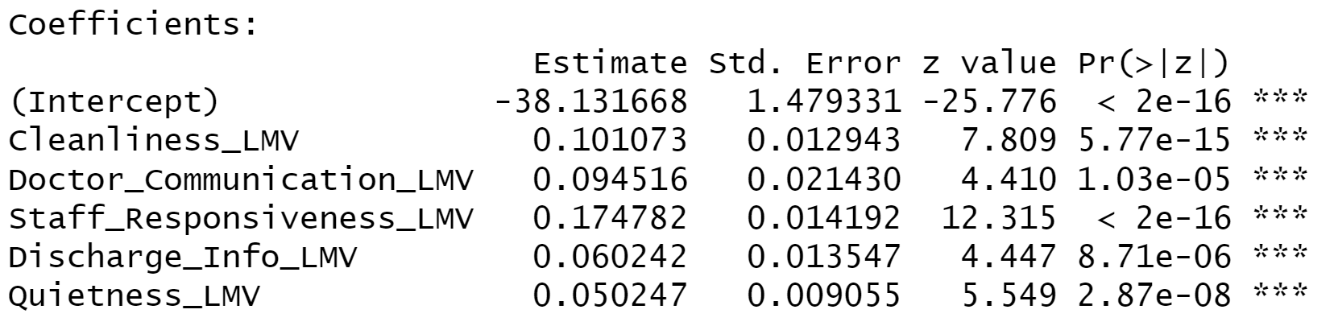
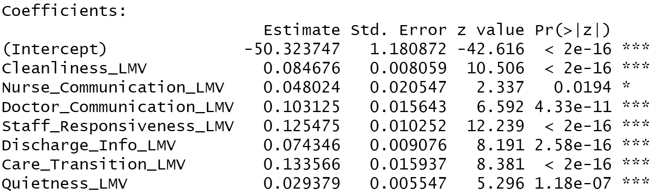
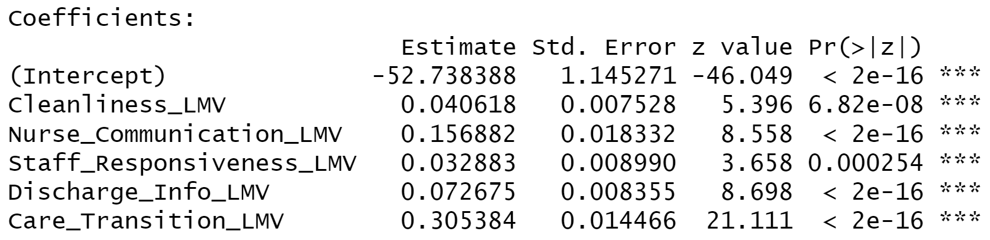
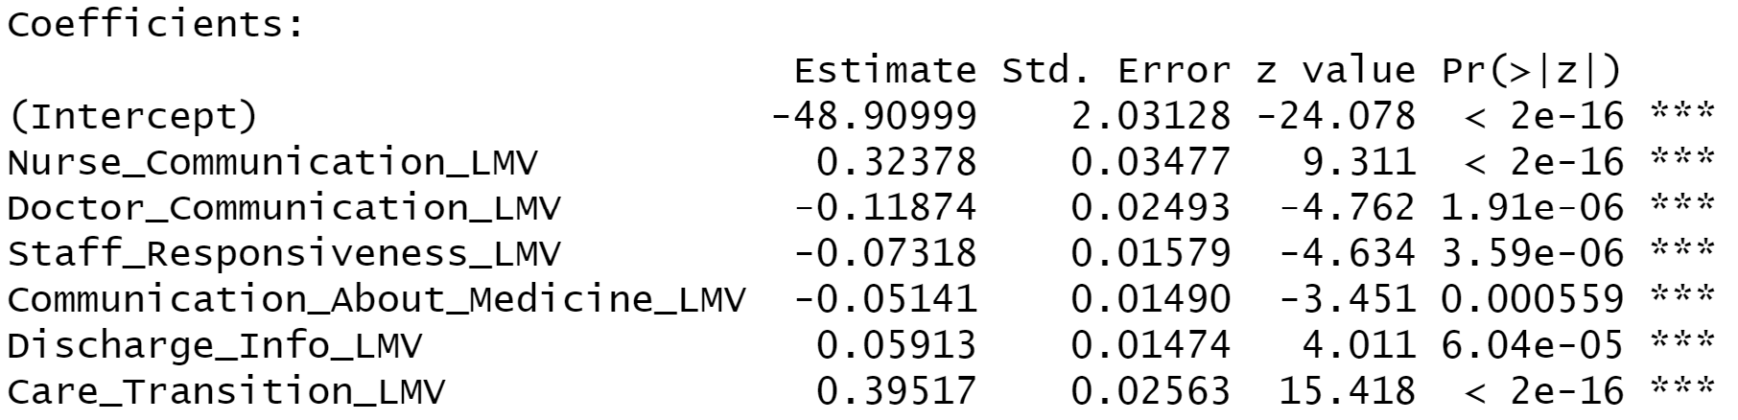
Appendix - Logistic Regression Coefficients
Logistic regression for hospitals rated > 2-stars:
Logistic regression for hospitals rated > 3-stars:
Logistic regression for hospitals rated > 4-stars:
Logistic regression for hospitals rated 5-stars:

