Slide 1

News Feeder
Multiple sources of news brought to you at a single location
Aron Bardsley, Ian Mckay, Michael Boge and Shiwei Zhang

Slide 2
What Is News Feeder?
News Feeder is a news aggregator service
Retrieves content from multiple online sources
Displays in a customisable news sheet format.
Provides:
  Single location
  Regularly updating content
  Additional parsed content

Slide 3




Architecture
Front End
Back End
Downloader Application
API Web Service
Shared Database Library
News Feeder Database

Slide 4
Team
Ian Mckay
  Team Leader
  Front End Developer
  Website Design/Implementation
Shiwei Zhang
  Back End Developer
  System Integration
Michael Boge
  Database Design
  Shared Library Developer
  Algorithm Designer
Aron Hardy-Bardsley
  Downloader Application Developer
  Web Service Developer
  Priority Queue Developer (for Back End)
ALL
Documentation for respective sections
Assistance with the two major sections (Front End and Back End)

Slide 5
Competitors
Google Reader
  Interfaces with other Google services
Bloglines
Newsgator
  Windows only
Differences
  Only retrieve RSS information, no Patch and Match equivalent
  Don’t allow for customisable layouts

Slide 6
Software Development Method
Combination of the throw-away prototype and iterative development models
Initially started as a throw-away prototype
The prototyping phases were:
  Phase 1 – Developing the front end and back end, not integrating them
    Crawling RSS feeds
    Login/Registration
    Sheet Management
    Database Connections
  Phase 2 – Developing all sub-systems and then integrating
    Queue Management
    Feed Parsing
    Administration Service
    Layouts
    Downloader Application
    Shared Database Library
Final development involved iteratively developing each section and integrating together as each iteration ended

Slide 7
System Architecture
The system uses the repository architecture
  Central database holding all information used by the other sub-systems
  Prevents data duplication
  Each sub-system can be developed without interfering with the others
  Beneficial for maintenance
The system also uses the 3-tier architecture to a degree, namely:
  Client –UI in the browser and the downloader application
  Servers –Back end
  Database – Where all content is stored

Slide 8
Front-End System
Built using PHP, Smarty, jQuery, Windows Azure Search API and Memcache technologies
Developed concurrently between a live site and the lab machines
Secure Sockets Layer implemented
Full mobile device compatibility

Slide 9
Special Features of the Front-End
Ability to add, remove, drag “widgets” of your choice in edit mode
Support for multiple content sources such as weather widgets
Ability to search for news feeds using a search term
Sheets exportable to PDF and RSS

Slide 10
Roadblocks for the Front-End
Complete removal of the Google Weather API without warning
Removal of Bing Search API
Limitations of multiple concurrent AJAX requests

Slide 11
Back-End System
Written in C++ for better performance
Daemon Process
  Logging System
Modularized System running in parallel
  AdminService
    System control via Front-End
  Crawler
    Crawl RSS/Atom feeds
  Statistics
    Periodically update statistics information

Slide 12
Special Features of Back-End
Scheduling System
  Priority Queue
Automatic feed type detection
  RSS
  Atom
Patch and Match
  Matching phase
  Patching phase
    Image extraction
    Geographical location extraction

Slide 13
Roadblocks for the Back-End
Memory leak in libxml
  Replaced with RapidXml
HTML is not a valid XML
  Replaced with htmlcxx
    Poorly documented
    Reverse engineering required
Link error with libmysqlconn
  Linking order matters
    Link at last

Slide 14
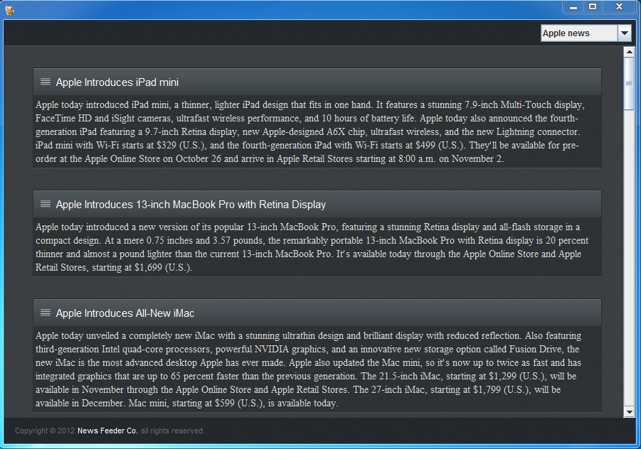
Downloader Application
Portable
Offline Use
Auto Sync

Slide 15
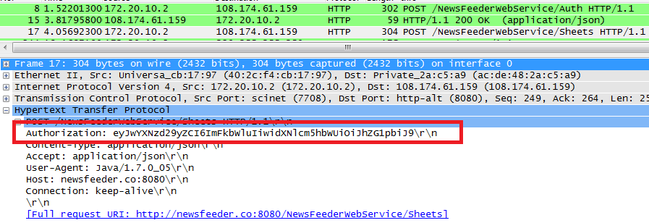
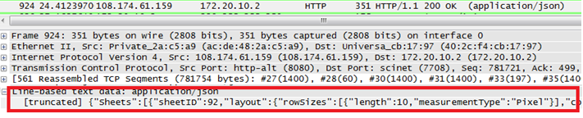
API Web Service
Request
Response
Restful
API
JSON

Slide 16
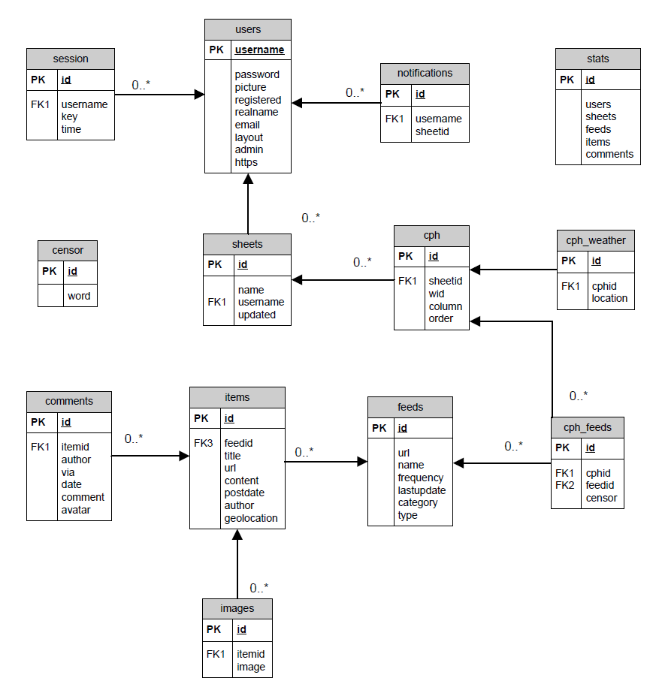
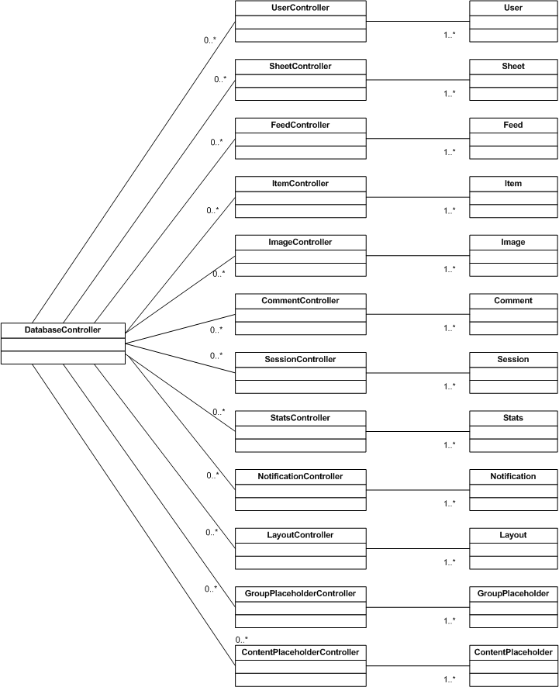
Database and Shared Library

Slide 17
Shared Library
C++ library used by other sub-systems
Architecture
  Model View Controller Architecture
SWIG (Simplified Interface and Wrapper Generator)
  Any common language can use the library
  Compiles a C++ library into interface/wrapper classes for a different language
  Thoroughly tested before implementation
Roadblocks
  MySQL API, C vs C++

Slide 18
The Database
MySQL
  Free
  Integrates easily with PHP
  Experience working with it
Rather complex schema
Database development relatively consistent
  Only really needing to add additional tables
  Change due to customisable layouts

Slide 19
Marketing Strategy
News Feeder is marketed as a SERVICE not a product
Originally, was a subscription based service
Subscribed users provided with:
  Additional Sheets/Feeds
  Access to the Downloader Application
  Higher priority in crawls
  Better stripping of ad’s
During prototype it was suggested we choose a different model

Slide 20
Marketing - Public API
Make the Web Service a public API for access to Newsfeeder content
  Pay for access
  Web Service is easily integrated with
  Shared Library provides many extra methods not currently used

Slide 21

QUESTIONS?

