Slide 1
ANG TEKSTONG PERSUWEYSIB AY NAAGLALAHAD NG ISANG OPINYONG KAILANGANG MAPANINDIGAN AT MAIPAGTANGGOL SA TULONG NG MGA PATNUBAY AT TOTOONG DATOS UPANG MAKUMBINSI ANG MGA MAMBABASA NA PUMANIG SA MANUNULAT.
ANO ANG ISANG TEKSTONG PERSUWEYSIB

Slide 2
ANG TEKSTONG PERSUWEYSIB AY NAAGLALAHAD NG ISANG OPINYONG KAILANGANG MAPANINDIGAN AT MAIPAGTANGGOL SA TULONG NG MGA PATNUBAY AT TOTOONG DATOS UPANG MAKUMBINSI ANG MGA MAMBABASA NA PUMANIG SA MANUNULAT.
Nakamal sa isang tekstong persweysiv ang mga tunay na mga datos at impormasyon tungkol sa mambabasapaksa para mas ma kumbinsi at mahikayat ng husto ang. Kadalasan natin ito makikita sa mga talumpati ng pulitiko.

Slide 3
Nakamal sa isang tekstong persweysiv ang mga tunay na mga datos at impormasyon tungkol sa mambabasapaksa para mas ma kumbinsi at mahikayat ng husto ang. Kadalasan natin ito makikita sa mga talumpati ng pulitiko.
ANG TEKSTONG PERSUWEYSIB AY NAAGLALAHAD NG ISANG OPINYONG KAILANGANG MAPANINDIGAN AT MAIPAGTANGGOL SA TULONG NG MGA PATNUBAY AT TOTOONG DATOS UPANG MAKUMBINSI ANG MGA MAMBABASA NA PUMANIG SA MANUNULAT.
•Ang layunin ng tekstong persuweysiv ay ang manghikayat o mangumbinsi sa babasa ng teksto. Taglay nito ang personal na opinyon ng may akda. Nakaasa sa argumentatibong tipo ng pagpapahayag ang tekstong persuweysib, ngunit sa halip na magpakita lamang ng mga argumento, layon nitong sumang-ayon ang mambabasa at mapakilos ito tungo sa isang layunin.

Slide 4
•Ang layunin ng tekstong persuweysiv ay ang manghikayat o mangumbinsi sa babasa ng teksto. Taglay nito ang personal na opinyon ng may akda. Nakaasa sa argumentatibong tipo ng pagpapahayag ang tekstong persuweysib, ngunit sa halip na magpakita lamang ng mga argumento, layon nitong sumang-ayon ang mambabasa at mapakilos ito tungo sa isang layunin.
HALIMBAWA:
HALIMBAWA NG TEKSTONG PERSWEYSIV,ISKRIP SA PATALASTAS,PROPAGANDA SA ELEKSYON,PLIERS NG PRODUKTO,BROCHURES NA NANGHIHIKAYAT,NETWORKING

Slide 5
•Ang layunin ng tekstong persuweysiv ay ang manghikayat o mangumbinsi sa babasa ng teksto. Taglay nito ang personal na opinyon ng may akda. Nakaasa sa argumentatibong tipo ng pagpapahayag ang tekstong persuweysib, ngunit sa halip na magpakita lamang ng mga argumento, layon nitong sumang-ayon ang mambabasa at mapakilos ito tungo sa isang layunin.
HALIMBAWA:
HALIMBAWA NG TEKSTONG PERSWEYSIV,ISKRIP SA PATALASTAS,PROPAGANDA SA ELEKSYON,PLIERS NG PRODUKTO,BROCHURES NA NANGHIHIKAYAT,NETWORKING
ANO ANG PINAKAPABORITO MONG
TV COMMERCIAL SAKASALUKUYAN?

Slide 6
ANO ANG PINAKAPABORITO MONG
TV COMMERCIAL SAKASALUKUYAN?
HALIMBAWA:
HALIMBAWA NG TEKSTONG PERSWEYSIV,ISKRIP SA PATALASTAS,PROPAGANDA SA ELEKSYON,PLIERS NG PRODUKTO,BROCHURES NA NANGHIHIKAYAT,NETWORKING
Ano naman ang PROPAGANDA?

Slide 7
“Ang propaganda ay isang uri ng patalastas,[1] kabatiran, o komunikasyon na may layuning maimpluwensiyahan ang asal ng isang pamayanan papunta sa isang layunin o posisyon. Ginagamitan ito ng masistema o maparaang pagkakalat o pagpapalaganap ng mga paniniwala o kaya ng doktrina.[2] Halimbawa nito ang mga babasahin nagtataguyod o nagtatangkilik ng isang paniniwala.”
Ano naman ang PROPAGANDA?
ANO ANG PINAKAPABORITO MONG
TV COMMERCIAL SAKASALUKUYAN?

Slide 8
“Ang propaganda ay isang uri ng patalastas,[1] kabatiran, o komunikasyon na may layuning maimpluwensiyahan ang asal ng isang pamayanan papunta sa isang layunin o posisyon. Ginagamitan ito ng masistema o maparaang pagkakalat o pagpapalaganap ng mga paniniwala o kaya ng doktrina.[2] Halimbawa nito ang mga babasahin nagtataguyod o nagtatangkilik ng isang paniniwala.”

Slide 9
•IBA’T IBANG URI NG MGA PROPAGANDA DEVICE
•NAME CALLING
•GLITTERING GENERALITIES
•TRANSFER
•TESTIMONIAL
•PLAIN FOLKS
•CARD STACKING
•BANDWAGON
•LAYUNIN NA MANGHIKAYAT O MANGUMBINSI SA BABASA NG TEKSTO.
•ISINUSULAT UPANG MABAGO ANG TAKBO NG PAG- IISIP NG MAMBABASA AT MAKUMBINSI ITO SA PUNTO NG MANUNULAT AT HINDI SA IBA, SIYA ANG TAMA.

Slide 10
ELEMENTO NG TEKSTONG PERSWESIB

Slide 11
MALALIM NA PANANALIKSIK
•Alam ng isang manunulat ang pasikot sikot ng isyung tatalakayin sa pamamagitan ng pananaliksik tungkol
KAALAMAN SA MGA POSIBLENG PANINIWALA NG MGA MAMBABASA
•Kailangang mulat at maalam ang manunulat sa iba’t ibang laganap na persepyon at paniniwala tungkol sa isyu at simulant ang argumento mula sa paniniwalang ito.
MALALIM NA PAGKAUNAWA SA DALAWANG PANIG SA ISYU
•Upang epektibong masagot ang laganap na paniniwala ng mga mambabasa.

Slide 12
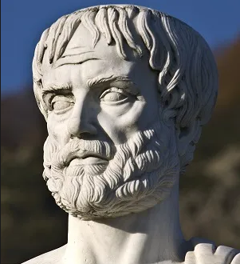
MALALIM NA PANANALIKSIK
•Alam ng isang manunulat ang pasikot sikot ng isyung tatalakayin sa pamamagitan ng pananaliksik tungkol
KAALAMAN SA MGA POSIBLENG PANINIWALA NG MGA MAMBABASA
•Kailangang mulat at maalam ang manunulat sa iba’t ibang laganap na persepyon at paniniwala tungkol sa isyu at simulant ang argumento mula sa paniniwalang ito.
MALALIM NA PAGKAUNAWA SA DALAWANG PANIG SA ISYU
•Upang epektibong masagot ang laganap na paniniwala ng mga mambabasa.
~AT AYON KAY ARISTOTLE MAY TATLONG URI NANG PERSUWEYSIB

Slide 13
Ang Pathos ay tumutukoy sa mga damdamin at damdamin. Nagbibigay-daan ito sa mga marketer o advertiser na umapela sa mga damdamin at paniniwala ng mga tao.
Halimbawa: Ang isang bag ng chips ay maaaring pagsama-samahin ang buong pamilya
•PATHOS
•ETHOS
Ang Ethos ay tumutukoy sa awtoridad at kredibilidad.Itinatampok nito ang kredibilidad at pagiging mapagkakatiwalaan ng iyong argumento na makakatulong saiyong hikayatin ang iyong audience nabilhin ang iyong produkto o serbisyo.
Halimbawa: Bilang isang tatlongbeses na Olympic gold medalist, masisiguroko sa iyo na ang inuming itong enerhiya ay magpapahusay saiyong fitness at stamina.
Ang pagbibigay-diin sa pagigingOlympic gold medalist aynagpapakita ng kredibilidad ngtagapagsalita.
~AT AYON KAY ARISTOTLE MAY TATLONG URI NANG PERSUWEYSIB

Slide 14
Ang Pathos ay tumutukoy sa mga damdamin at damdamin. Nagbibigay-daan ito sa mga marketer o advertiser na umapela sa mga damdamin at paniniwala ng mga tao.
Halimbawa: Ang isang bag ng chips ay maaaring pagsama-samahin ang buong pamilya
Ang Ethos ay tumutukoy sa awtoridad at kredibilidad.Itinatampok nito ang kredibilidad at pagiging mapagkakatiwalaan ng iyong argumento na makakatulong saiyong hikayatin ang iyong audience nabilhin ang iyong produkto o serbisyo.
Halimbawa: Bilang isang tatlongbeses na Olympic gold medalist, masisiguroko sa iyo na ang inuming itong enerhiya ay magpapahusay saiyong fitness at stamina.
Ang pagbibigay-diin sa pagigingOlympic gold medalist aynagpapakita ng kredibilidad ngtagapagsalita.
•ETHOS
•PATHOS

Slide 15
•Logo
Ang Pathos ay tumutukoy sa mga damdamin at damdamin. Nagbibigay-daan ito sa mga marketer o advertiser na umapela sa mga damdamin at paniniwala ng mga tao.
Halimbawa: Ang isang bag ng chips ay maaaring pagsama-samahin ang buong pamilya
•PATHOS
ANG LOGO AY ISANG APELA SA LOHIKA.ANG IYONG MADLA AY MAAARING MAHIKAYAT KUNG MAAARI KANG MAGPAKITANG ISANG MAKATOTOHANANG ARGUMENTO NA BATAY SA KATWIRAN.
HALIMBAWA: ANG MATIBAY,POCKET-SIZE, CAMERA NA ITO AY PERPEKTO PARA SA MGA ADVENTURER ON THE GO.
MAAARI MONG GAMITIN ANG MGAISTATISTIKA, SUKATAN NG PAGGANAP,NAKARAANG EBIDENSYA, AT UTILITY NG PRODUKTO UPANG MAKAGAWA NG NAKAKAHIMOK NAKASO SA IYONG ADVERTISEMENT.

Slide 16
seize the day!!!!!

Slide 17
Contents of this template
Here’s what you’ll find in this Slidesgo template:
A slide structure based on a thesis defense, which you can easily adapt to your needs. For more info on how to edit the template, please visit Slidesgo School or read our FAQs.
To view this template with the correct fonts in ppt format, download and install on your computer the fonts that we have used. You can learn how to download and install fonts here.
An assortment of pictures and illustrations that are suitable for use in the presentation can be found in the alternative resources slide.
A thanks slide, which you must keep so that proper credits for our design are given.
A resources slide, where you’ll find links to all the elements used in the template.
Instructions for use.
Final slides with:
The fonts and colors used in the template.
A selection of illustrations. You can also customize and animate them as you wish with the online editor. Visit Storyset to find more.
More infographic resources, whose size and color can be edited.
Sets of customizable icons of the following themes: general, business, avatar, creative process, education, help & support, medical, nature, performing arts, SEO & marketing, and teamwork.
You can delete this slide when you’re done editing the presentation

Slide 18
Table of contents
01.
02.
Presentation
Methodology
03.
04.
05.
Results
Conclusions
Bibliography
>
<
You can describe the topic of the section here
You can describe the topic of the section here
>
<
<
You can describe the topic of the section here
You can describe the topic of the section here
You can describe the topic of the section here
<

Slide 19
02
Methodology
You can enter a subtitle here if you need it

Slide 20
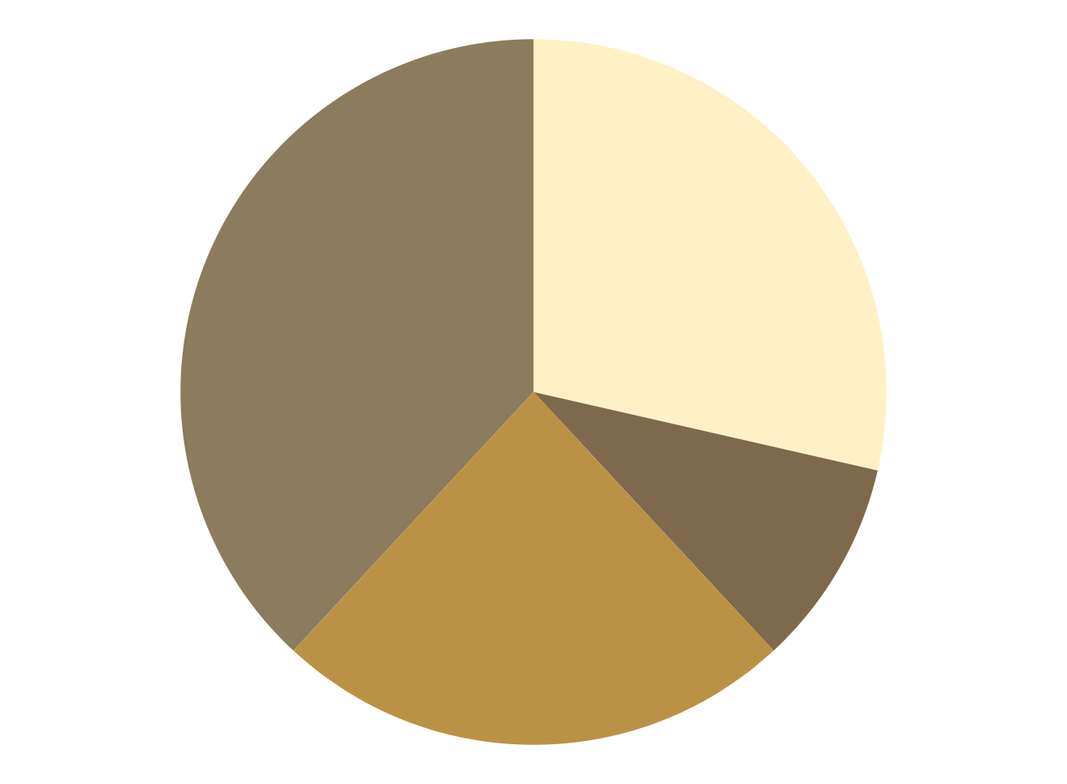
Methodology
Research
Analysis
Venus has a beautiful name, but it’s terribly hot
Jupiter is the biggest planet in the Solar System
Data Study
Comparison
Despite being red, Mars is actually a cold place
Saturn is the only planet with rings
To modify this graph, click on it, follow the link, change the data and paste the new graph here

Slide 21
Methodology
Research
Process
Jupiter is the biggest planet
Mercury is the smallest planet
Methodology
Idea
Income
Earth is the third planet from the Sun and the only one that harbors life in the Solar System. This is where we all live
Despite being red, Mars is cold
Venus has a nice name, but it’s hot
Aspiration
Goal
Saturn is a gas giant and has rings
Neptune is far away from Earth

Slide 22
Study objectives
Mercury
Venus
Mars
Mercury is the closest planet to the Sun and the smallest of them all
Venus has a beautiful name and is the second planet from the Sun
Despite being red, Mars is actually a cold place full of iron oxide dust

Slide 23
Study objectives
Research
Analysis
01
02
Jupiter is the biggest planet in the entire Solar System
Mercury is the smallest planet of them all
Data study
Comparison
03
04
Despite being red, Mars is actually a cold place
Venus is the second planet from the Sun. It’s really hot there

Slide 24
Study objectives
Despite being red, Mars is actually a cold place
Venus
01
Venus is the second planet from the Sun. It's hot there
Neptune is the farthest planet from the Sun
Saturn is a gas giant and has several rings
Mercury
02
Mercury is the smallest planet of them all
The Sun is at the center of our System
Earth is the third planet from the Sun
Ceres is located in the main asteroid belt
Jupiter
03
Jupiter is the biggest planet in the Solar System
Pluto is now considered a dwarf planet

Slide 25
Hypothesis
Mercury
Neptune
Mercury is the closest planet to the Sun and also the smallest one in the Solar System
It’s the farthest planet from the Sun and the fourth-largest in the entire Solar System

Slide 26
Hypothesis
Theory 1
Theory 2
Despite being red, Mars is cold. It's full of iron oxide dust, which gives the planet its reddish cast
Venus is the second planet from the Sun. It's hot there. It’s terribly hot, even hotter than Mercury
Jupiter
40%
Saturn
60%
Jupiter is a gas giant and the biggest planet
Saturn is a gas giant and has several rings
20%
80%
60%
40%
Mercury
Neptune
Venus
Mars
Mercury is the smallest planet
Neptune is far away from Earth
Venus is the second planet from the Sun
Mars is actually a cold place

Slide 27
Theories
Theory 1
Theory 2
Theory 3
Mercury is the closest planet to the Sun and the smallest one in the Solar System
Venus has a beautiful name and is the second planet from the Sun
Despite being red, Mars is a cold place, not hot. The planet is full of iron oxide dust

Slide 28
This IS A MAP
Venus
Venus is the second planet from the Sun
Mercury
Mercury is the smallest planet
Earth
Earth is the only planet with life

Slide 29
Global vision
Jupiter
Mercury
Is a gas giant and the biggest planet of them all
Mercury is the smallest planet of them all
Mars
Venus
Despite being red, Mars is actually a cold place
Venus is the second planet from the Sun. It’s hot there

Slide 30
Literature Review
Theory 01
Theory 02
Mercury is the closest planet to the Sun and the smallest of them all
Despite being red, Mars is actually a cold place full of iron oxide dust

Slide 31
Literature review
Theory 02
Venus has a beautiful name and is the second planet from the Sun. It’s hot and has a poisonous atmosphere
Theory 01
Mercury is the closest planet to the Sun and the smallest one in the Solar System—it’s only a bit larger than the Moon

Slide 32
Objectives
Mercury
It’s the smallest planet of them all
Mars
Jupiter
Venus
Mars is actually a very cold place
Jupiter is the biggest planet of them all
Venus has extremely high temperatures
Saturn
Neptune
The Sun
Earth
Pluto
Ceres

Slide 33
Invested time
40%
20%
25%
15%
Jupiter
Mercury
Mars
Venus
Jupiter is the biggest planet in the entire Solar System
Mercury is the smallest planet of them all
Despite being red, Mars is actually a cold place
Venus is the second planet from the Sun. It's hot there

Slide 34
Primary objectives
Venus
Saturn
Jupiter
Mars
1
4
Jupiter is the biggest planet of them all
Neptune is very far away from Earth
Venus is the second planet from the Sun
Despite being red, Mars is a cold place
2
3

Slide 35
Secondary objectives
Mercury
Venus
Mars
Saturn
Earth
Jupiter
Mercury is the closest planet to the Sun
Venus has a beautiful name and high temperatures
Despite being red, Mars is actually a cold place
Saturn is a gas giant and has several rings
Earth is the third planet from the Sun
Jupiter is a gas giant and the biggest planet

Slide 36


Slide 37
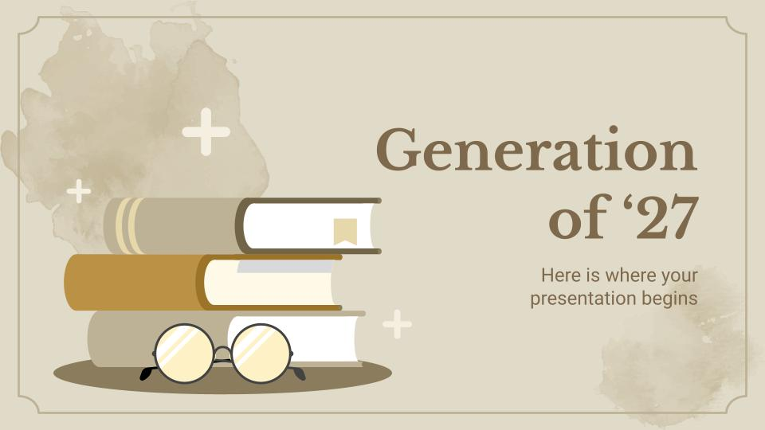
Your work
You can replace the image on the screen with your own work. Just delete this one, add yours and center it properly

Slide 38

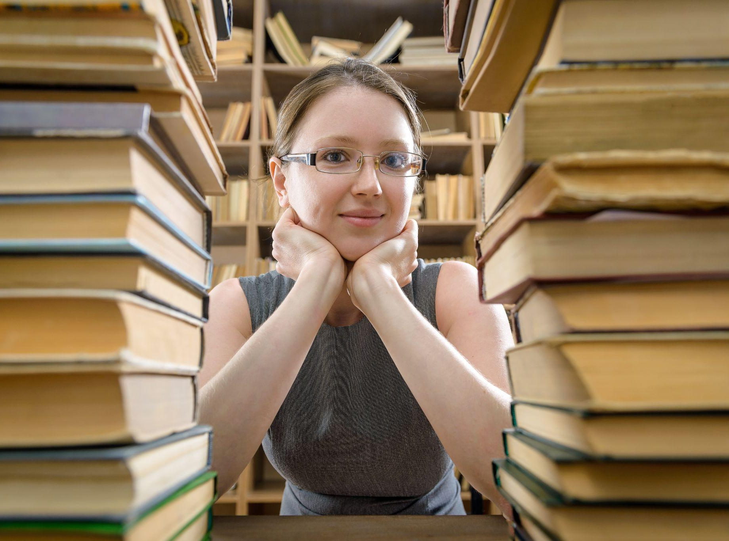
Multimedia
If you want, you can insert your multimedia content here

Slide 39
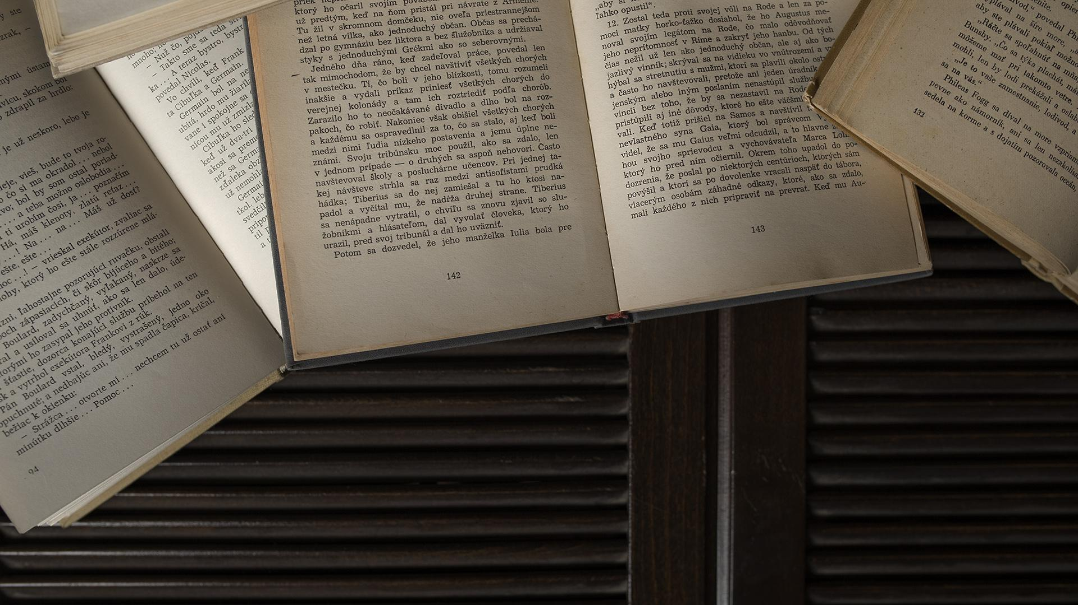
A picture is worth a thousand words

Slide 40
Study program
Checklist
Status | Description | Status | Description
03/04 | Mercury is the smallest planet of them all | 04/03 | Jupiter is the biggest planet in the Solar System
03/07 | Venus has a beautiful name and is the second from the Sun | 04/09 | Neptune is the farthest planet from the Sun
03/10 | Despite being red, Mars is actually a cold place | 04/11 | The Sun is the star at the center of the Solar System
03/21 | Saturn is a gas giant and has several rings | 04/15 | Earth is the third planet from the Sun and where we all live

Slide 41
Schedule
1st phase
2nd phase
1st week
Mo
Tu
We
Th
Fr
Sa
Su
2nd week
Mo
Tu
We
Th
Fr
Sa
Su
3rd phase
4th phase

Slide 42
Schedule
February
March
April
Jupiter is a gas giant and the biggest planet in the Solar System
Venus has a beautiful name, but also very high temperatures
Despite being red, Mars is actually a cold place. It’s full of iron oxide dust
1
2
3

Slide 43
Schedule
May
June
It’s the closest planet to the Sun and the smallest in the Solar System
Despite being red, Mars is actually a cold place. It’s full of iron oxide dust
Investigation completed
4
5

Slide 44
Schedule
 | 1st week | 2nd week | 3rd week | 4ht week | 5th week
Research
Analysis
Data study
Comparaison

Slide 45
1,927
Big numbers catch your audience's attention

Slide 46
Table
 | Test 1 | Test 2 | Test 3 | Test 4
Indicator 1
Indicator 2
Indicator 3
Indicator 4

Slide 47
Comparation
 | Goals | Result
1st phase | Mercury is the closest planet to the Sun | Venus is the second planet from the Sun
2nd phase | Mars is actually a very cold place | Jupiter is the biggest planet of them all
3rd phase | Saturn is composed of hydrogen and helium | Neptune is the farthest planet from the Sun
4th phase | Saturn is a gas giant and has several rings | Despite being red, Mars is a cold place

Slide 48
Timeline
Mercury
Mars
Mercury is the closest planet to the Sun
Now
Mars is actually a very cold place
Venus
1927
2027
Venus is the second planet from the Sun

Slide 49
Study timeline
“Mercury is closest planet to the Sun and the smallest”
“Despite being red, Mars is actually a very cold place”
1st week
2nd week
3rd week
4th week
Finish
“Venus is the second planet from the Sun and is terribly hot”
“Neptune is the farthest-known planet from the Sun”
“Earth is the only planet known to harbor life. We all live here”

Slide 50

A picture always reinforces the concept
Images reveal large amounts of data, so remember: Use an image instead of a long text

Slide 51
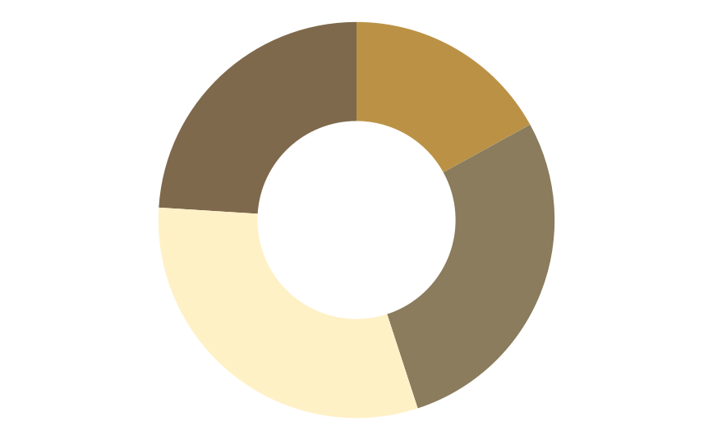
Important percentages
24%
17%
Phase 4
Phase 1
Mercury is small
Jupiter is big
31%
28%
Phase 3
Phase 2
Follow the link in the graph to modify its data and then paste the new one here. For more info, click here
Venus is hot
Saturn has rings

Slide 52
Important percentages
20%
35%
60%
50%
Jupiter
Mercury
Venus
Mars
Jupiter is the biggest planet in the entire Solar System
Mercury is the smallest planet in the Solar System
Venus is the second planet from the Sun. It's hot there
Despite being red, Mars is actually a very cold place

Slide 53
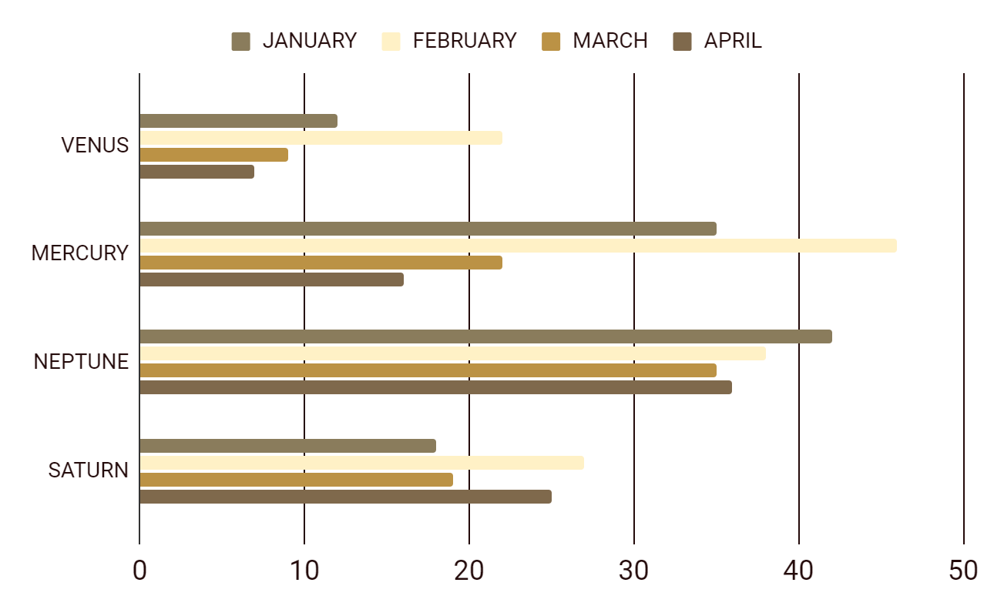
Results analysis
To modify this graph, click on it, follow the link, change the data and paste the new graph here

Slide 54
Investigation results
Venus
Mars
Venus is the second planet from the Sun
Despite being red, Mars is a very cold place
40%
70%
Mercury
Neptune
Mercury is the smallest planet of them all
Neptune is the farthest planet from the Sun
10%
30%
Jupiter
Saturn
Jupiter is the biggest planet in the Solar System
Saturn is a gas giant and has several rings
50%
60%

Slide 55
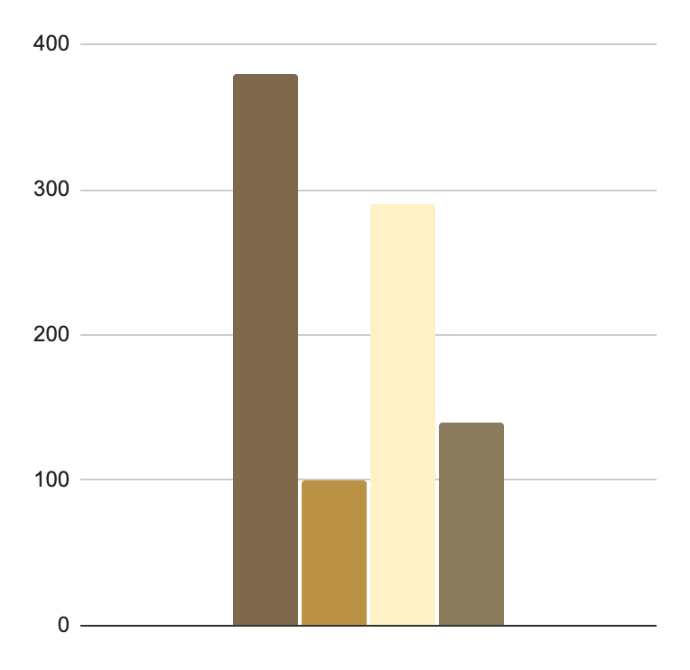
Research results
380
290
Jupiter
Mercury
Jupiter is the biggest planet in the entire Solar System
Mercury is the smallest planet of them all
100
140
Mars
Venus
Follow the link in the graph to modify its data and then paste the new one here. For more info, click here
Despite being red, Mars is actually a cold place
Venus is the second planet from the Sun. It’s hot there

Slide 56
Results analysis
Mercury
Jupiter
Venus
Mercury is the smallest planet of them all
Is the biggest planet in the Solar System
Venus is the second planet from the Sun
20%
50%
75%
Despite being red, Mars is actually a cold place
Neptune is the farthest planet from the Sun
Saturn is a gas giant and has several rings

Slide 57
Conclusions
01
You can enter a subtitle here if you need it

Slide 58
Conclusions
Conclusion A
Conclusion C
Conclusion B
Conclusion D
You can talk about the conclusions here
You can talk about the conclusions here
You can talk about the conclusions here
You can talk about the conclusions here

Slide 59
Public conclusions
Jupiter
40%
Jupiter is the biggest planet of them all
Mars
60%
Despite being red, Mars is actually a cold place
Venus
20%
Venus is the second planet from the Sun
Mercury
75%
Mercury is the smallest planet of them all

Slide 60
Conclusions
1
Mercury
Mercury is the closest planet to the Sun and the smallest one in the Solar System—it’s only a bit larger than the Moon
Venus
2
Venus has a beautiful name and is the second planet from the Sun. It’s terribly hot—even hotter than Mercury—and its atmosphere is extremely poisonous

Slide 61
Conclusion in numbers
200K
175K
Venus is the second planet from the Sun. It's hot there
Saturn is a gas giant and has several rings
Result analysis
Earth is the third planet from the Sun and the only one that harbors life in the Solar System
40K
135K
Jupiter is the biggest planet in the Solar System
Mercury is the smallest planet of them all

Slide 62
Numbers speak for themselves
333,000
24h 37m 23s
Earths is the Sun’s mass
is Jupiter’s rotation period

Slide 63
05
Bibliography
You can enter a subtitle here if you need it

Slide 64
Bibliographic references
AUTHOR (YEAR): Title of the publication. Publisher
AUTHOR (YEAR): Title of the publication. Publisher
AUTHOR (YEAR): Title of the publication. Publisher
AUTHOR (YEAR): Title of the publication. Publisher
AUTHOR (YEAR): Title of the publication. Publisher
AUTHOR (YEAR): Title of the publication. Publisher

Slide 65
Bibliographic references
Author | Tittle
Neptune | Neptune is the farthest planet from the Sun
Mercury | Mercury is the smallest planet of them all
Mars | Despite being red, Mars is actually a cold place
Saturn | Saturn is a gas giant and has several rings
The Sun | The Sun is the star at the center of our System
Notes
Venus has as a beautiful name and is the second planet from the Sun. It’s terribly hot and its atmosphere is extremely poisonous. It’s the second-brightest natural object in the night sky after the Moon

Slide 66
Thanks
Do you have any questions?
youremail@freepik.com
+91 620 421 838
yourcompany.com
Please keep this slide for attribution

Slide 67
Literature Icon Pack

Slide 68
Alternative resources
Vectors
Hand drawn international literacy day
International literacy day with stack of books
International literacy day draw
Photos
Bunch of old books
Pile of books on blue background
Smoke over antique notebook and ink pen

Slide 69
Premium alternative resources
Here’s an assortment of alternative resources whose style fits the one of this template
Hand drawn flat design literature illustration
Hand drawn flat design shakespeare illustration

Slide 70
Premium alternative infographics
A
%
B
%
C
%
D
%

Slide 71
Premium alternative infographics

Slide 72
Premium alternative infographics

Slide 73
Resources
Vectors
Glasses with books for literacy day
International literacy day with lots of books
International literacy day celebration
Photos
Glasses on old books in library
Old books on library table
Ink pen on opened old notebook

Slide 74
Premium resources
Did you like the resources on this template? Get them for free at our other websites:
Vectors
Hand drawn flat design literature illustration
Hand drawn literature illustration
Hand drawn poetry illustration
Hand drawn literature illustration
Hand drawn flat design poetry illustration
Hand drawn literature illustration
Photos
The girl in glasses among the old books in the library
Top view opened books on table
Icons Pack
Literature

