Slide 1
STBIO_AI Workflow Architecture
Template-based compact view
Agents pipeline + Orchestrator + Crosscheckers + CLI + Skills

Slide 2
Agenda
Topic
Topic
Topic
Topic
Topic
Topic
Topic
Topic

Slide 3
Main Steps (Stage 0 to Stage 6)

Slide 4
Main Steps (Stage 0 to Stage 6)
Stage 0: Ontology baseline and Gate 0
Stage 1: Requirements extraction + taxonomy + strict RAG/evidence checks and Gate 1
Stage 2: Specs formalization and Gate 2
Stage 2a: Micro-architecture synthesis + crosscheck (Decision: go) + gate
Stage 3: SRS generation + crosschecks + Stage 3 gate (System Req Spec – Mixed signal)
Stage 4: ARS generation + crosschecks + Stage 4 gate (Analog Req Spec)
Stage 5: DRS generation + crosschecks + Stage 5 gate (Digital Req Spec)
Stage 6: Cross-project architecture comparison (standalone after Stage 5)
Fail-fast rule: unresolved hard checks stop the pipeline before the next stage

Slide 5
Compact Workflow Diagram
Skill Layer
(Chronicle/Project Rules)
CLI
workflow_cli.py
Orchestrator
run_stage*_gate.py
Stage 0
Ontology Agent
Stage 1
Req Agent
Stage 2/2a
Specs+
MicroArc
Stage 3
SRS Agent
Stage 4
ARS Agent
Stage 5
DRS Agent
Stage 6
Compare Agent
Crosscheckers + Validators
(run_*_crosscheck_agent.py + validate_stage*_gate.py)
Artifacts + Reports
(stage_*_result.md, specs, traces)
Flow:
Skills and CLI guide the orchestrator, which executes stage agents;
crosscheckers and validators gate progress before artifacts are accepted.

Slide 6
Executive Architecture View
User Interaction
Chat + Task Requests
Skill Layer
Rules + Prompt Patterns
CLI Layer
workflow_cli.py
Orchestrator Core
run_stage*_gate.py + gate loop control
Agents Pipeline
Stage 0 -> 1 -> 2 -> 2a -> 3 -> 4 -> 5 -> 6
Crosscheckers + Validators
quality gates before accept
Business Outputs: Specs, Traceability, Stage Reports, Comparison Pack

Slide 7
Workflow GUI Description
GUI area | Description
Workflow Diagram | Displays Stage 0 to Stage 6 flow; the active stage is highlighted during a run and the diagram can scroll horizontally.
CLI Runs | Runs deterministic workflow commands and shows live process output, return codes, and stop-at-stage behavior.
Requirement List | Shows extracted requirement records with horizontal scrolling for long statements and source evidence.
Live Chat Console | Accepts normal questions and local workflow commands;
AI backend | OpenAI is the default selection. Auto priority is OpenAI, Azure, then Local; the masked API-key field supports session setup.
Local commands | /help, /run, /status, /validate, /taxonomy, /analyze log, /stop, and /clear run locally without an LLM.
Read-only analysis | /analyze log and pasted error messages can be analyzed without allowing code fixes.
The GUI is an operator console: local commands remain available without AI credentials, while normal questions use the selected AI backend.

Slide 8
workflow_cli.py Command Map
Command | When to use
python scripts/workflow_cli.py --help | Show command reference and options
python scripts/workflow_cli.py status | Inspect stage map and current runner status
python scripts/workflow_cli.py run --from-stage 0 --to-stage 5 | Run core pipeline in order
python scripts/workflow_cli.py run --stage 2 | Execute a single stage quickly
python scripts/workflow_cli.py retry --stage 3 --max-loops 2 | Bounded recovery for failed stages
python scripts/workflow_cli.py validate --all | Validate all gates; stop on missing evidence or hard-check failures
python scripts/workflow_cli.py arch-compare --project-to-compare <project_name> | Run Stage 6 architecture comparison
Tip: for predictable runs, use --max-loops-per-stage 1 in normal mode and retry only failing stages.

Slide 9
Python steps Execution Shortlist
python scripts/run_stage0_gate0.py
python scripts/run_stage1_requirements_gate1.py
python scripts/run_stage1_specs_gate2.py
python scripts/run_stage2_micro_arc_gate.py
python scripts/run_stage3_srs_gate.py
python scripts/run_stage4_ars_gate.py
python scripts/run_stage5_drs_gate.py
python scripts/workflow_cli.py arch-compare --project-to-compare <project_name>

Slide 10
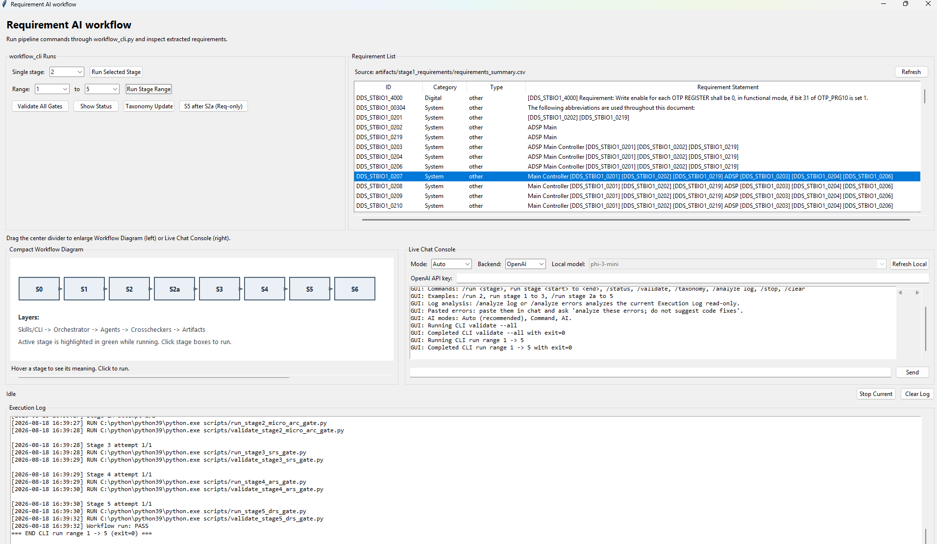
Requirements AI Workflow GUI

Slide 11
Find out more at www.st.com

Slide 12

For further support in creating a PowerPoint presentation, including graphic assets, formatting tools and additional information on the ST brand
you can visit the ST Brand Portal
https://brandportal.st.com

